Slide 1
Mathematics
NQF Level 4

Slide 2
Functions and algebra
Topic 2

Slide 3
Sketch and interpret information for the inverse graphs of functions
Module 4

Slide 4
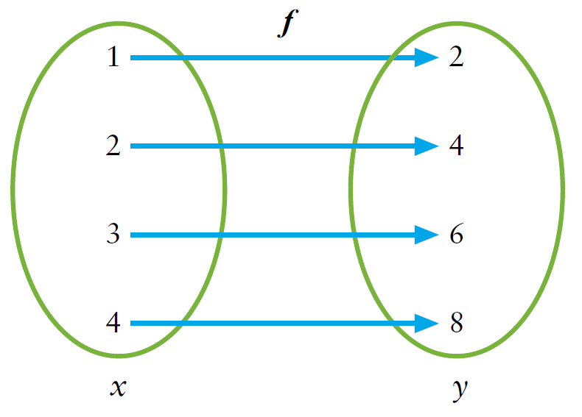
‘One-to-one’ functions
Figure 4.1: Mapping diagram for y = 2x
Here, y is a one-to-one function because each x-value maps to only one y-value.
Unit 4.1

Slide 5
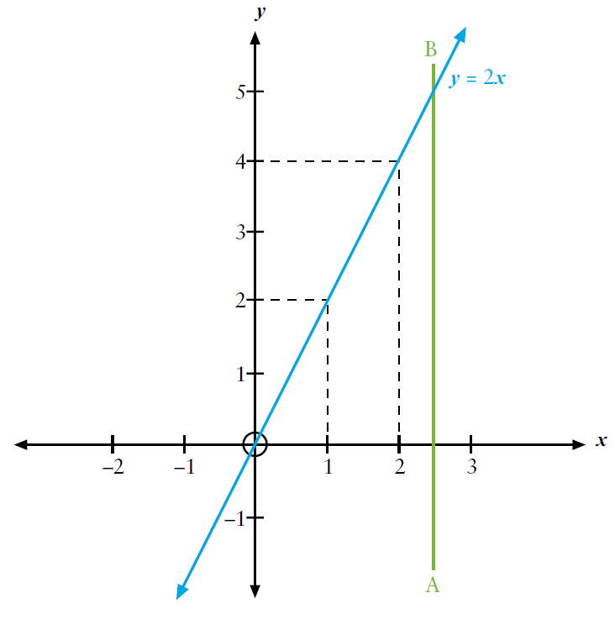
‘One-to-one’ functions
AB represents any vertical line. AB will not intersect the graph more than once, which means it is a one-to-one function.
This is an important method to distinguish between a function and a relation.
Figure 4.2: Graph of y = 2x
Unit 4.1

Slide 6
A relation but not a function
Figure 4.3: Mapping diagram for
Here, y is a relation of x, not a function, because for every x-value there are two y-values.
Unit 4.1

Slide 7
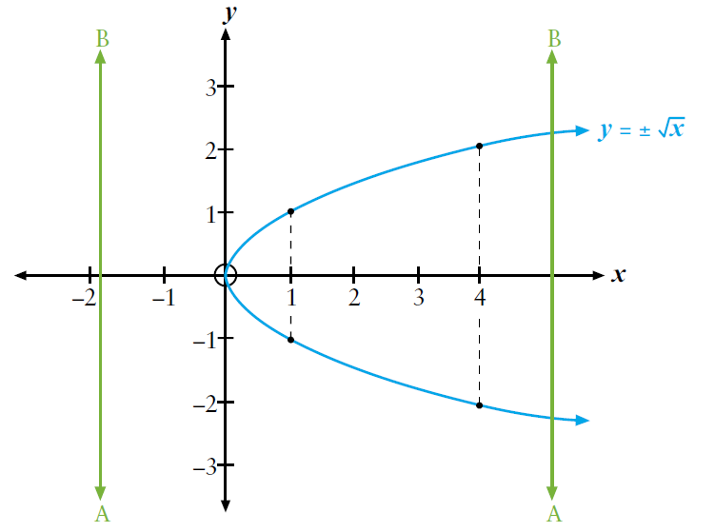
A relation but not a function
If y is a relation of x, but not a function, any vertical line AB will intersect the graph more than once.
Figure 4.4: Graph of
Unit 4.1

Slide 8
Learning activity 4.3

Slide 9
2. The graphs below represent inverse functions. For each one:
a) Determine the equations of the function and the inverse function in each case.
b) Sketch the graphs of the function and its inverse on the same set of axes in each case.
2.4
VIDEO
Click above to play this video.

Slide 10
Module 4

Slide 11
1) Find the inverse of each equation, and sketch the graph and its inverse on the same system of axes.
1.1)
INVERSE

Slide 12
1.1) Continued

Slide 13
1.1) Continued

Slide 14
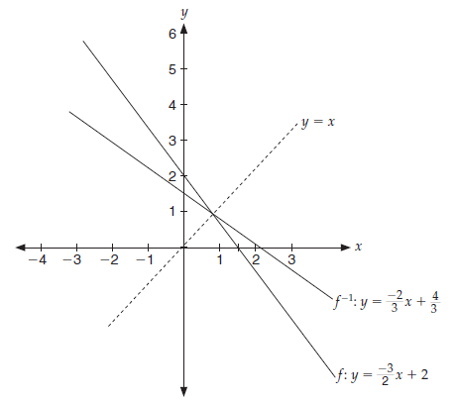
1.1) Continued
Figure 4.20: Question 1a)

Slide 15
1. Find the inverse of each equation, and sketch the graph and its inverse on the same system of axes.
1.2) y = −2x²
INVERSE
Note: f⁻¹ is not a function but a relation

Slide 16
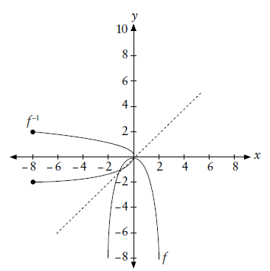
1.2) Continued
Figure 4.21: Question 1.2)

Slide 17
1. Find the inverse of each equation, and sketch the graph and its inverse on the same system of axes.
1.3) y = 4^{x}
INVERSE

Slide 18
1) Find the inverse of each equation, and sketch the graph and its inverse on the same system of axes.
1.3) y = 4^{x} (Continued)

Slide 19
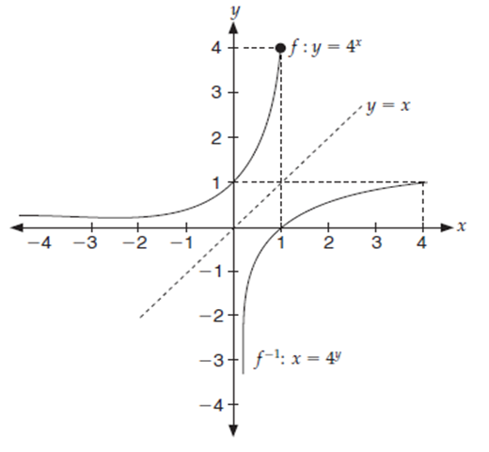
1.3) Continued
Figure 4.22: Question 1.3

Slide 20
2) The following graph (2.1) represents the inverse function f⁻¹. a) Determine the equations of f⁻¹ and f. b) Sketch the graphs of f⁻¹ and f on the same axes. c) Determine the domain and range

Slide 21
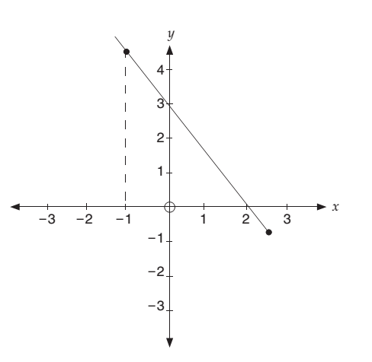
2.1)
Figure 4.34: Question 2.1)

Slide 22
2.1) Continued
2.1a)
INVERSE

Slide 23
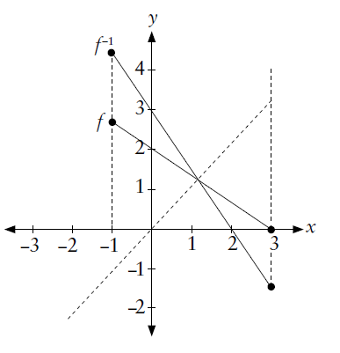
2.1) Continued
2.1b)
Figure 4.23: Question 2.1 b)

Slide 24
2.1) Continued
2.1c)
$f^{−1} − Domain:−1≤x≤3$
$$Range: −1.5≤y≤4.5$$
$$f −Domain:−1≤x≤3$$
$Range: 0≤y≤2.5$

Slide 25
2) The following graph (2.2) represents the inverse function f⁻¹. a) Determine the equations of f⁻¹ and f. b) Sketch the graphs of f⁻¹ and f on the same axes. c) Determine the domain and range

Slide 26
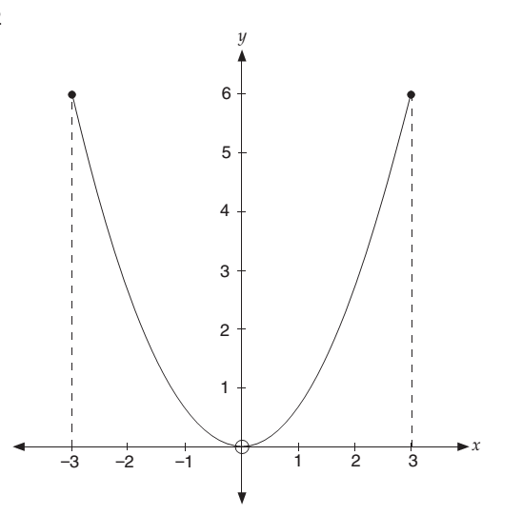
2.2)
Figure 4.35 : Question 2.2)

Slide 27
2.2) Continued
2.2a)
Point (3; 6) occurs on the graph
INVERSE

Slide 28
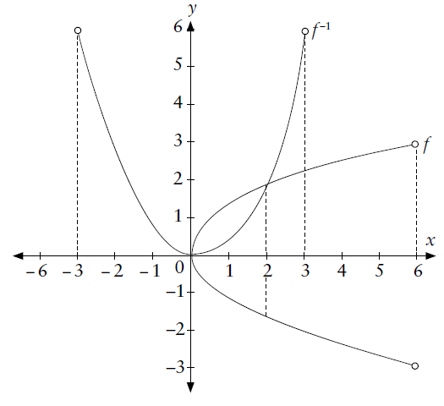
2.2) Continued
2.2b)
Figure 4.24: Question 2.2b)

Slide 29
2.2) Continued
2.2c)
$f^{−1} − Domain:−3≤x≤3$
$$Range: 0≤y≤6$$
$$f −Domain:0≤x≤6$$
$Range: −3≤y≤3$

Slide 30
2) The following graph (2.3) represents the inverse function f⁻¹. a) Determine the equations of f⁻¹ and f. b) Sketch the graphs of f⁻¹ and f on the same axes. c) Determine the domain and range

Slide 31
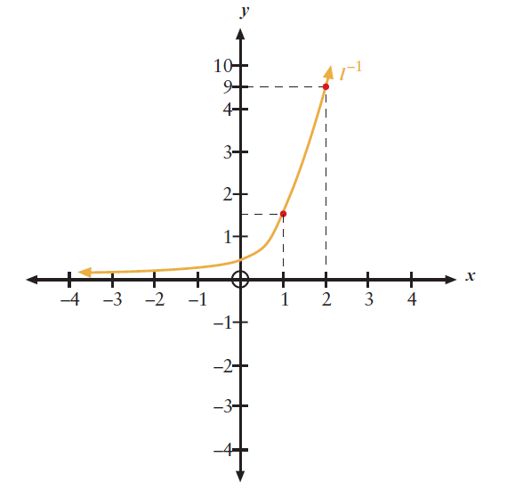
2.3)
Figure 4.36 : Question 2.3)

Slide 32
2.3) Continued
2.3a)
Point (2;16) occurs on the graph
INVERSE
If y = 2 ⇒ x = 16

Slide 33
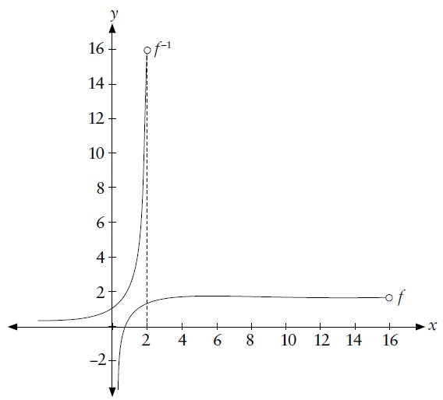
2.3) continued
2.3b)
Figure 4.25: Question 2.3b)

Slide 34
2.3) Continued
2.3c)
$f^{−1} − Domain:−\text{Ꚙ}≤x≤2$
$Range: 0≤y≤16$
$f −Domain:0≤x≤16$
$Range: −\text{Ꚙ}≤y≤2$

Slide 35
3.Determine whether the following functions have a maximum or minimum turning point.
3.1 y = 3x²
a = 3
∴ a > 0
∴ minimum turning point
3.2 y = −3x²
a = −3
∴ a < 0
∴ maximum turning point

Slide 36
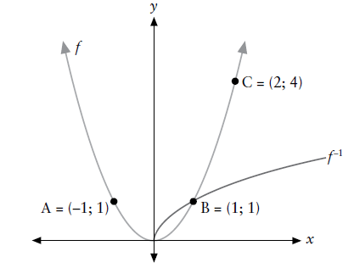
4) Given
4.1) Draw a sketch showing at least 3 points on the graph.
Figure 4.26: Question 4.1

Slide 37
4) Given
4.2) Determine $f^{−1}(x)$ if is restricted to the domain {$x:x≥0$}
INVERSE
We select the positive square root solution only because of the domain restriction
4.3) Sketch the graph of $f^{−1}(x)$ on the same set of axes.
[See graph above for solution]

Slide 38
4.4) Determine algebraically the coordinates of the points of intersection of $f(x)$ and $f^{−1}(x)$.
Substitute into $f(x)$
or

Slide 39
4.5) I$s f^{−1}(x)$ a function or a non-function?
Give a reason.
A function.
Any line drawn parallel to the y-axis cuts the graph once.
4.6) Write down the domain of $f^{−1}\left(x\right).$

