Slide 1
Mathematics
NQF Level 4

Slide 2
Data handling and probability models
Topic 4

Slide 3
Represent, analyse and interpret data using various techniques
Module 11

Slide 4
Module 11

Slide 5
2. Give examples of:
a) Qualitative variables
Male/female; eye colour (blue or brown)
b) Quantitative variables
The IQ of students; size of families
c) Discrete variables
1; 3; 5; 10
d) Continuous variables
1,21; 16,45
Summative assessment – Module 11

Slide 6
3. What type of data results from rolling a dice?
Discrete
4. What type of data is collected when a person is weighed?
Continuous
Summative assessment – Module 11

Slide 7
5. What factors must be considered when deciding on a sample size?
The bigger the sample the more accurate the results will be.
The bigger the population, the smaller the sample may be.
Quantitative research needs bigger samples.
Qualitative research needs smaller samples.
Summative assessment – Module 11

Slide 8
5. What factors must be considered when deciding on a sample size? (Continued)
At least 30 items are needed when statistical techniques are going to be used.
Heterogeneous populations need bigger samples.
If you expect small differences, you need a big sample size.
Summative assessment – Module 11

Slide 9
5. What factors must be considered when deciding on a sample size? (Continued)
At least 30 items are needed when statistical techniques are going to be used.
Heterogeneous populations need bigger samples.
If you expect small differences, you need a big sample size.
Summative assessment – Module 11

Slide 10
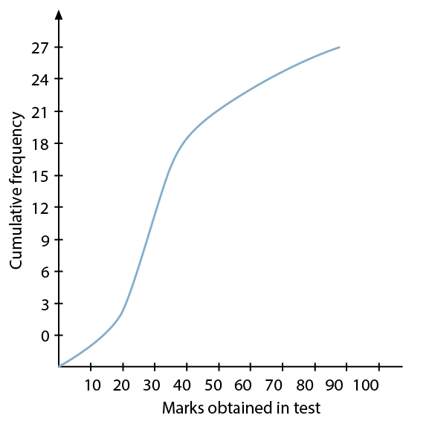
6. The ogive in Figure 11.12 was drawn from data obtained from the marks students scored in a test.
Figure 11.12
Summative assessment – Module 11

Slide 11
6a. How many students were in the class?
27
6b. How many students got less than 20%?
2
6c. How many students got more than 40%?
18
Summative assessment – Module 11

Slide 12
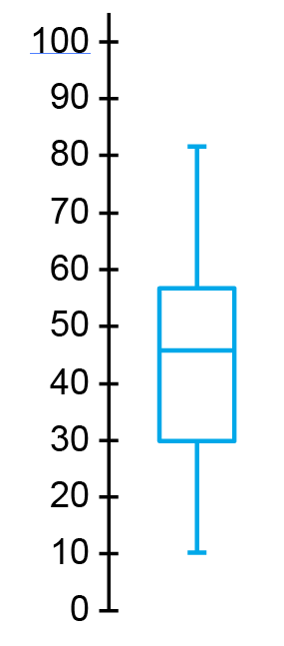
7. The box-and-whisker diagram in Figure 11.13 was drawn to show a class’s test marks.
From the diagram determine:
7a. The mean
45%
7b. The lowest mark obtained
10%
Figure 11.13
Summative assessment – Module 11

Slide 13
7c. How many students got between 10% and 30% if there were 32 students in the class?
Summative assessment – Module 11

