Slide 1
Mathematical Literacy
NQF 4

Slide 2
Understanding interest
Module 9

Slide 3
Overview
9.1 Simple versus compound interest
9.2 Interest rates and the economy

Slide 4
Simple versus compound interest
Unit 9.1
Interest is payable in two ways:
1
When you borrow money from a financial institution, you pay interest on the amount borrowed.
2
When you invest money with a financial institution, you earn interest on the amount invested.

Slide 5
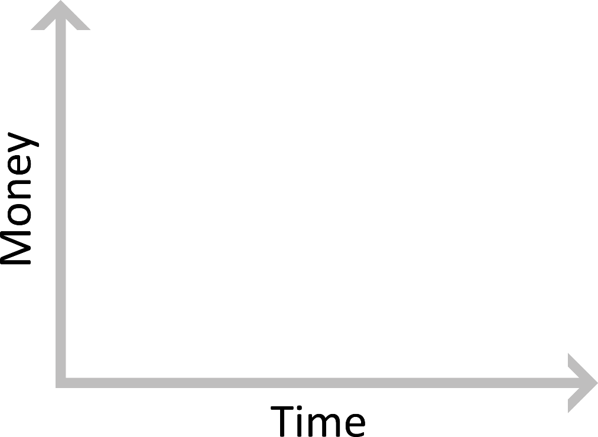
Simple versus compound interest
Unit 9.1
Simple interest
Compound interest
is calculated using the original (principal) amount only.
is calculated on the principal amount plus all previous interest earned.

Slide 6
Example 9.1 page 184
Unit 9.1
Jo lends R2 000 to Mel.
She charges him 6,25% simple interest per year.
If he borrows the money for two years, how much would he pay Jo in total?
If he pays back the money after 4 months, how much would he pay Jo in total?
How much would he have paid in interest if Jo charged him 6,25% compound interest?

Slide 7
Example 9.1 page 184
Unit 9.1
Interest paid for 1 year: 6,25% of R2 000 = R125
Interest paid for 2 years: R125 × 2 = R250
Total paid to Jo after 2 years: R2 000 + R250 = R2 250
2. Mel would pay 4 months’ worth of interest.
This means he would pay of a year’s interest.
Interest paid for 4 months:
× (6,25% of R2 000)
= × R125 = R41,67
He would pay Jo R2 041,67

Slide 8
Example 9.1 page 184
Unit 9.1
For compound interest, the principal sum changes every time interest is added.
Interest paid for first year: 6,25% of R2 000 = R125
The interest is added to the principal of R2 000.
Principal amount for the second year = R2 125
Interest paid for second year:
6,25% of R2 125 = R132,81
The value of the loan after two years with interest compounded annually is:
R2 000 + R125 + R132,81 = R2 257,81.

Slide 9
Exercise 9.1
Unit 9.1
Complete Exercise 9.1 on page 187 of your Student’s Book

Slide 10
Interest rates and the economy
Unit 9.2
How do interest rates affect our economy?
The Reserve Bank determines the repo rate. This is the interest rate at which the Reserve Bank lends money to ordinary banks.
When the repo rate increases, banks increase their interest rates.
Private individuals are affected when the interest rate goes up.
RESERVE BANK
of
SOUTH
AFRICA
ORDINARY
BANKS
ORGANISATIONS
lends money to
lends money to
PRIVATE INDIVIDUALS
BUSINESSES

Slide 11
Example 9.4 page 189
Unit 9.2
Sipho is a pensioner who lives off the interest on his investment.
He has R560 000 in his investment. The bank reduces its interest rate on investments from 9,8% per year to 9,25% per year.
Interest is calculated on a daily balance.
How will the drop in interest rate affect Sipho’s income? Explain.
Use a spreadsheet to compare Sipho’s income in a 30-day month at the old and new interest rates.

Slide 12
Example 9.4 page 189 continued …
Unit 9.2
His income will be reduced because he will earn less interest.
Students should realise that they need to add the previous day’s interest to the previous principal sum for every calculation.

Slide 13
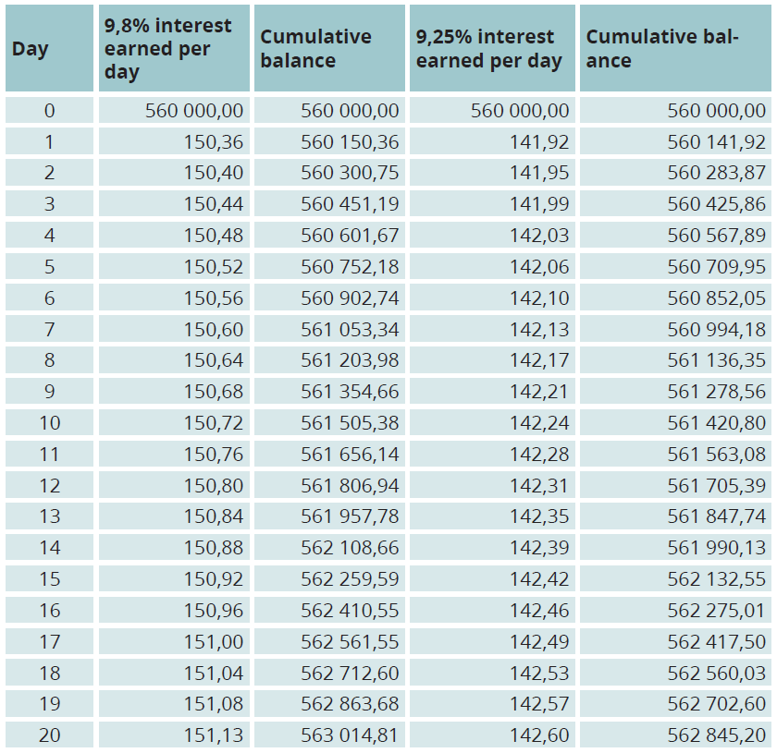
Example 9.4 page 189 continued …
Unit 9.2

Slide 14
How interest affects a housing loan
Unit 9.2
Most people need to borrow money from the bank to buy a house. A loan for a property is called a mortgage bond.
Financial institutions gain income from charging interest on home loans.
Financial institutions charge compound interest on home loans.
The bigger the loan (principal sum), the more interest you pay. As the loan reduces, the interest amount also reduces.
You can reduce the loan amount faster if you pay extra every month with your monthly instalment. The extra payment goes towards paying off the loan, not towards interest.

Slide 15
Study this graph below
Unit 9.2
The blue graph shows the bond payment. The straight line indicates that payments were made regularly (every month).

Slide 16
Study this graph below
Unit 9.2
The green graph shows the interest payment. Initially, almost the whole payment goes towards the interest charged. As the balance outstanding decreases, the interest also decreases.

Slide 17
Study this graph below
Unit 9.2
The black graph shows the amount outstanding on the bond. For the first year and a bit, the amount remains almost the same. This is because almost the whole payment goes to interest.

Slide 18
Exercise 9.2
Unit 9.2
Complete Exercise 9.2 on page 192 of your Student’s Book

Slide 19
Exercise 9.2 page 192
Unit 9.2

Slide 20
Module assessment
Module 9
Complete Module assessment on page 195 of your Student’s Book

