Slide 1
Mathematical Literacy
NQF 4

Slide 2
Taxation
Module 8

Slide 3
Overview
8.1 Value-added Tax (VAT)
8.2 Information and calculations on a payslip
8.2 Understanding personal income tax

Slide 4
Value-added Tax (VAT)
Unit 8.1
VAT
Value Added Tax
is the tax charged when we purchase goods and services.
When we do business transactions, we pay 14% VAT on most goods and services.
Every month those businesses (also called vendors) pay the VAT to the South African Revenue Service (SARS).
In other words, businesses collect VAT on behalf of SARS.

Slide 5
VAT-inclusive and VAT-exclusive
Unit 8.1
Most prices are advertised as being VAT-inclusive meaning that the VAT payable is part of the advertised price.
The price can also be shown excluding VAT and the VAT value would be added to the advertised price.
VAT included
+ VAT

Slide 6
Calculating VAT on VAT–exclusive prices
Unit 8.1
How is this done?
A plumber gives a customer a quote for R1 845,00. The price does not include VAT. To calculate the VAT:
14% × R1 845 = R258,30 The total cost that the customer will pay
= R1 845 + R258,30
= R2 103,30
Formula
Inclusive VAT is 14% of the item price

Slide 7
Example 8.1 page 177
Unit 8.1
A tour operator charges a group of tourists R2 465,00 (VAT exclusive) for a trip. Calculate the cost the tourists would actually pay for the trip.
Mr Marotse gives his client an invoice for R987,65. Calculate the VAT amount Mr Marotse would pay to SARS.
VAT = 14% of R2 465 = R345,10
Actual cost = R2 465,00 + R345,10
= R2 810,10
2. $\frac{14}{114}$ × R987,65 = R138,27

Slide 8
Exercise 8.1
Unit 8.1
Complete Exercise 8.1 on page 177 of your Student’s Book

Slide 9
Information and calculations on a payslip
Unit 8.2
The payslip includes important information and it is the employee’s responsibility to check that all the details are correct.
The payslip includes:
1
Gross earnings
2
Deductions: Pay As You Earn (PAYE) tax
3
Unemployment Insurance Fund (UIF) contributions
4
other deductions e.g. pension and medical aid contributions

Slide 10
Understanding UIF
Unit 8.2
The purpose of UIF is to provide support to workers when they cannot earn an income.
The benefits covered by UIF are:
1
Unemployment benefits
2
Illness benefits
3
Maternity benefits
4
Adoption benefits
5
Death benefits

Slide 11
How employees benefit from UIF
Unit 8.2
“An employee is entitled to
1 day’s pay for every
6 days worked to a
maximum of 238 days.”
If you are no longer employed, you go to the Department of Labour offices with your identity documents and banking details. You must sign in every 4 weeks. After 6 - 8 weeks you will receive a pay-out every 4 weeks, until your benefit expires.

Slide 12
Payment into UIF
Unit 8.2
“The employer deducts 1% entitled to
If 1% is greater than R148,72 then the maximum i.e. R148,72 is deducted.
The employer pays an equal amount of 1% of each employee’s basic salary into the fund. This means that the employer pays 2% of the basic salary or the maximum amount of R297,44 into the fund.
of each employee’s
basic salary for UIF

Slide 13
Example 8.2 page 178
Unit 8.2
Eric earns R12 500.
Calculate the UIF portion his employer will deduct from his salary.
How much will his employer pay over to SARS? Explain.
1% × R12 500 = R125,00
R250,00. His employer must also pay R125,00 to SARS.

Slide 14
Exercise 8.2
Unit 8.2
Complete Exercise 8.2 on page 178 of your Student’s Book

Slide 15
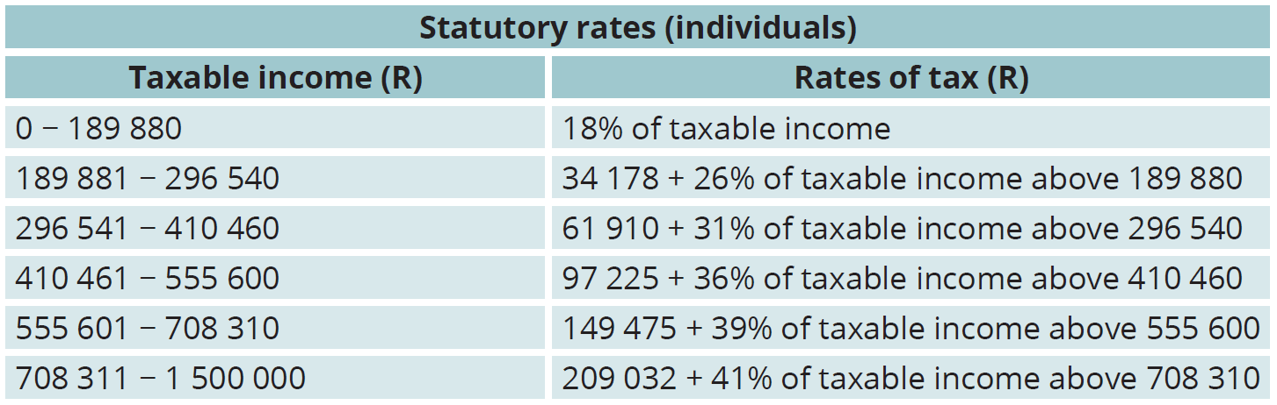
Understanding personal income tax
Unit 8.3
Income tax is an important source of revenue for the government.
Income tax is the tax that employees pay on their earnings.
Every year during the budget speech, the Minister of Finance announces the new tax rates for the financial year.
These rates are issued in a tax table.

Slide 16
How to calculate a person’s monthly tax deduction
Unit 8.3
1
Determine the gross annual salary.
2
Determine allowable deductions.
Subtract the allowable deductions from gross annual salary. What remains is the taxable salary.
Pension maximum of 7,5% of basic income
Retirement annuities (with limits)
Other exceptions.
3
4
Determine the tax bracket.
5
Calculate the annual tax according to the tax bracket.

Slide 17
How to calculate a person’s monthly tax deduction
Unit 8.3
6
Subtract any rebate that is applicable.
7
Subtract medical aid credits (according to rates). This gives the annual tax amount payable.
8
Divide the calculated tax by 12 to get the monthly tax payable.

Slide 18
Example 8.3 page 180
Unit 8.3
Refiloe earns R425 600 per year. Her pension contribution is R5 627,08 per month and her medical aid contribution is R1 876,45 per month.
Her husband and two children are her dependents.
Calculate the amount that can be deducted from Refiloe’s gross income for pension contributions.
Calculate her monthly tax payable. Refer to the tax table for 2017 to 2018.
When Refiloe completes her tax return at the end of the tax year, she can claim a rebate on her medical aid contributions. Calculate the rebate amount.

Slide 19
Example 8.3 page 180 continued …
Unit 8.3
Refiloe started a new job on 01 November 2017. Her salary increased to R585 740 per annum.
Calculate her annual income for the year 1 March 2017 to 28 February 2018.
Calculate her taxable income.
How does the increase affect Refiloe’s tax? Explain fully.

Slide 20
Example 8.3 page 180 continued …
Unit 8.3
Annual pension contribution:
= 5 627,08 × 12
= R67 524,96
Maximum pension rebate:
= 27,5% of R365 000
= R100 375
Refiloe may deduct her total pension contribution because it is less than the maximum.

Slide 21
Example 8.3 page 180 continued …
Unit 8.3
Taxable income = gross income – pension rebate = R425 600 – 67 524,96 = R358 075,04
Tax bracket: 296 541 - 410 460
Annual tax payable
= 61 910 + 31% of taxable income above 296 540
= 61 910 + 31% × (358 075,04 – 296 540)
= 61 910 + (31% × 61 535,04)
= 61 910 + 19 075,86
= R80 985,86

Slide 22
Example 8.3 page 180 continued …
Unit 8.3
Deduct primary rebate:
80 985,86 – 13 635
= R67 350,86
Monthly tax payable:
= 67 350,86 ÷ 12
= R5 612,57

Slide 23
Example 8.3 page 180 continued …
Unit 8.3
Refiloe has her husband and two children on her medical aid. She may claim R303 per month for herself (main member) and her husband (first additional member). She may also claim R240 per month for each of her two children.
(R303 × 2) + (R204 × 2) = R1 014 per month.
She may claim R1 014 × 12 = R12 168 per year as a tax deduction when she submits her tax return at the end of the tax year.

Slide 24
Example 8.3 page 180 continued …
Unit 8.3
Refiloe’s monthly income before the increase = 425 600 ÷ 12
= R35 466,67
She earned this monthly income for 8 months from 01 March to 31 October 2017.
Her new monthly income
= R585 740 ÷ 12
= R48 811,67
She earned this monthly income for 4 months from 01 November 2017 to 28 February 2018.

Slide 25
Example 8.3 page 180 continued …
Unit 8.3
Her annual income
= (35 466,67 × 8) + (48 811,67 × 4)
= 283 733,36 + 195 246,68
= R478 980,04
Taxable income = gross income – pension rebate
= 478 980,04 – 67 524,96
= R411 455,08

Slide 26
Example 8.3 page 180 continued …
Unit 8.3
Refiloe’s monthly income before the increase = 425 600 ÷ 12
= R35 466,67
She earned this monthly income for 8 months from 01 March to 31 October 2017.
Her new monthly income
= R585 740 ÷ 12
= R48 811,67
She earned this monthly income for 4 months from 01 November 2017 to 28 February 2018.

Slide 27
Example 8.3 page 180 continued …
Unit 8.3
Refiloe falls into a new tax bracket and her tax will increase. Tax bracket: 410 461 – 555 600
Annual tax payable
= 97 225 + 36% of taxable income above 410 460
= 97 225 + 36% × (411 455,08 – 410 460)
= 97 225 + (36% × 995,08)
= 97 225 + 358,23
= R97 583,23
Deduct primary rebate:
97 583,23 – 13 635 = R83 948,23.
Her annual tax increases from R67 350,86 to
R83 948,23. This is an increase of 24,6%

Slide 28
Exercise 8.3
Unit 8.3
Complete Exercise 8.3 on page 182 of your Student’s Book

Slide 29
Module assessment
Module 8
Complete Module assessment on page 183 of your Student’s Book

