Slide 1
Mathematical Literacy
NQF 4

Slide 2
Financial documents and processes
Module 7

Slide 3
Overview
7.1 Financial documents for business: income and expenditure
7.2 Cash flow, budgets and financial statements
7.3 Income, costs and the break-even point
7.4 Inflation

Slide 4
Financial documents for business: income and expenditure
Unit 7.1

Slide 5
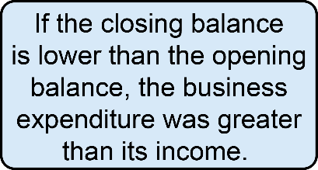
Bank Statements
Unit 7.1
Bank statements
The financial documents like invoices and receipts are used to check that the income and expenditure is correctly reflected on the bank statements.
Bank statements provide a record of all income and expenditure for a given period.
”

Slide 6
Exercise 7.1
Unit 7.1
Complete Exercise 7.1 on page 155 of your Student’s Book

Slide 7
Cash flow, budgets and financial statements
Unit 7.2
A business uses a budget, income and expenditure statement and a balance sheet to manage its finances:
Business Budget:
A document used to plan expected income and expenditure
Income/expenditure statement:
A document to measure financial performance for a specific time period
Balance sheet:
A document that shows business assets, business liabilities and owners’ equity.

Slide 8
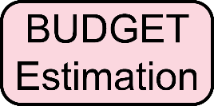
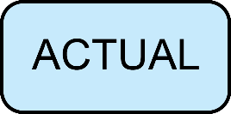
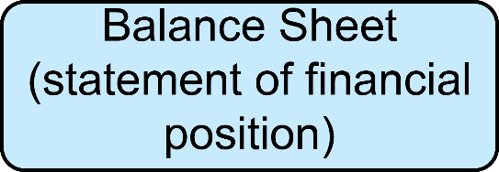
Cash flow, budgets and financial statements
Unit 7.2

Slide 9
Example 7.4 page 157
Unit 7.2
StyleGirlz Hair Studio is a busy hairdresser in a shopping mall.
The company makes their income from sales (selling hair products and equipment) and services (hair cuts, styling, coloring)
They own hairdressing equipment (e.g. hairdryers, basins, scissors)
They owe R72 320 on the company vehicle.
There are 15 employees. Some of them earn commission.
The variable expenses are commissions, staff training, repairs to equipment, purchase of consumable goods, telecommunications accounts, municipal accounts and taxes
The fixed expenses include insurance fees, salaries and rental.

Slide 10
Example 7.4 page 157
Unit 7.2
This is the budget for one month, for StyleGirlz:
The budget is an important document. It ensures that the business makes informed financial decisions.
Budget: March 2018
 | March 2017 Actual | March 2018 Estimate
Expenditure
Rental | R11 200,00 | R12 350,00
Municipality account | R2 755,00 | R3 200,00
Telecommunications bill | R943,00 | R1 100,00
Salaries | R38 750,00 | R45 420,00
Staff training | R0,00 | R2 200,00
Hair products | R4 870,00 | R5 230,00
Equipment repair | R0,00 | R850,00
SARS | R12 800,00 | R18 600,00
Insurance premium | R490,00 | R550,00
Total expenditure | R71 808,00 | R89 500,00
Income
Services | R86 570,00 | R92 000,00
Product sales | R13 255,00 | R16 000,00
Total income | R99 825,00 | R108 000,00

Slide 11
Example 7.4 page 157
Unit 7.2
The accountant considers last year’s actual income and expenditure when estimating the current year’s income and expenditure.
Other factors affect the budget. These include the economic situation of the country and whether there is a special event that could affect the business.

Slide 12
Example 7.4 page 157
Unit 7.2
Answer the questions in your team, then compare your answers with the solutions given.
a) The budget includes the actual amounts for the same period last year. Explain how this is useful.
b) Calculate the estimated percentage increase in income for the period. Give your answer to one decimal place.
c) Does the total expenditure increase by the same percentage? Show your calculations to support your answer.

Slide 13
Completing a table of values by using the formula or a description
Unit 7.2
The previous year’s information is a guide for estimating this year’s figures.
$\frac{108 000 −99 825}{99 825}$ × 100 = 8,2%
Percentage increase
= $\frac{89 500 −71 808}{71 808}$ × 100 = 24,6%
The total expenditure increases by a greater percentage than the total income.

Slide 14
Budgets, actuals and variance
Unit 7.2
Budget
The estimated values of a company’s income and expenditure.
”
Variance
The difference between the estimated values in a budget statement and the actual values found in the income and expenditure statement.
”

Slide 15
Example 7.5 page 161
Unit 7.2

Slide 16
Exercise 7.2
Unit 7.2
Complete Exercise 7.2 on page 163 of your Student’s Book

Slide 17
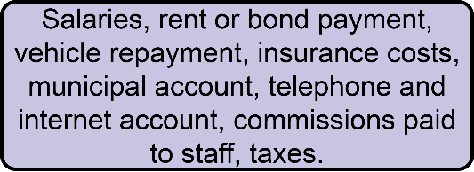
Income, costs and break-even point
Unit 7.3
The aim of any business is to make a profit.

Slide 18
Link between cost of sales and business expenditure
Unit 7.3
The aim of any business is to make a profit.
“
The income must be greater than the expenses (costs).
”
Some business costs are fixed.
Some operational costs are variable, but they can be estimated quite accurately e.g. municipal bills and telecommunications costs.
For accounting purposes, operational costs are regarded as fixed costs.
The cost of sales increases when sales or services increase.

Slide 19
Break-even point
Unit 7.3
The break-even point is also the point where the income and expenditure are equal.
Units sold after the break-even point has been reached are profit for the business.
Break-even point
This is the value where all costs are covered by the income but no profit is made.
”

Slide 20
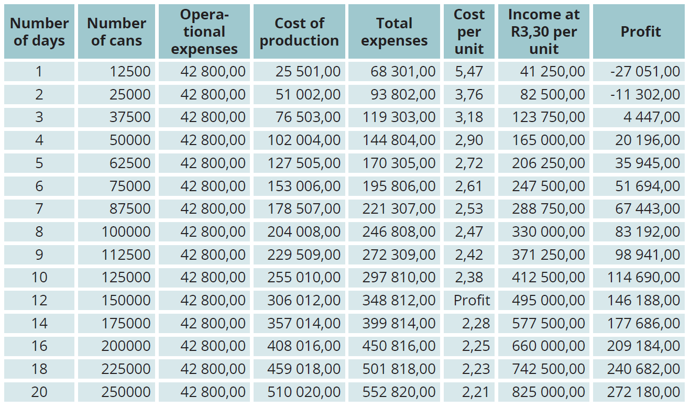
Break-even point continued …
Unit 7.3
Study the information in the spreadsheet.

Slide 21
Break-even point continued …
Unit 7.3
Refer to the spreadsheet:
No matter how many days of the month the factory is in operation, the operational costs stay the same.
Cost of production:
Cost of ingredients & metal for the cans + cost of running the machinery.
Cost of producing 12 500 cans per day over a period of 2 days:
Operational costs + cost of ingredients & metal + cost of running
machinery
= R42 800 + [2 × (12 500 × R1,29)] + (2 × R9 376)
= R42 800 + R32 250 + R18 752
= R93 802

Slide 22
Break-even point continued …
Unit 7.3
Cost of producing 1 can when 12 500 cans are produced per day over a period of 2 days:
= R93 802 ÷ (2 × 12 500) = R93 802 ÷ 25 000 = R3,76
Income for selling 25 000 cans @ R3,30 each
= 25 000 × R3,30 = R82 500
Profit = income – expenses
= R82 500 – R93 802 = − R11 302

Slide 23
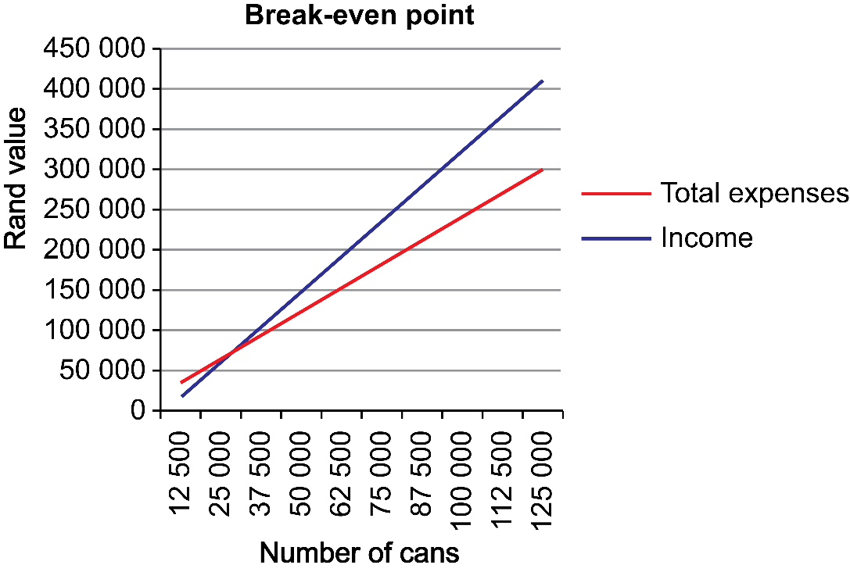
Break-even point continued …
Unit 7.3
The business runs at a loss if they only produce 25 000 units in the month.
The break-even point is reached between 25 000 and 37 500 units (on the third day). It is easier to estimate the break-even point on a graph.
Expense = Income

Slide 24
Break-even point continued …
Unit 7.3
Production is measured in units per day.
The spreadsheet and the graph show that by the end of Day 2, the business is still running at a loss.
By the end of Day 3 the business is running at a profit.
This means that the break-even point is reached on Day 3. The spreadsheet shows that the business has to sell more than 35 000 cans before it makes a profit. In fact, the business has to sell 35288 units before it makes a profit.
If the selling price is increased, the break-even point will be reached sooner.
The business can increase the selling price only if the market will accept the higher price.

Slide 25
Exercise 7.3
Unit 7.3
Complete Exercise 7.3 on page 169 of your Student’s Book

Slide 26
Inflation
Unit 7.4
Inflation
As prices increase, we are able to buy less with the same amount of money. This means that our buying power decreases.
Inflation is measured as a percentage.
In March 2017 the rate of inflation was 6,13%. So if a manufacturer needs to buy a product annually, they must budget for 6,13% more than they paid in March 2016.
Inflation refers to the gradual increase in the price of goods and services over time.
”

Slide 27
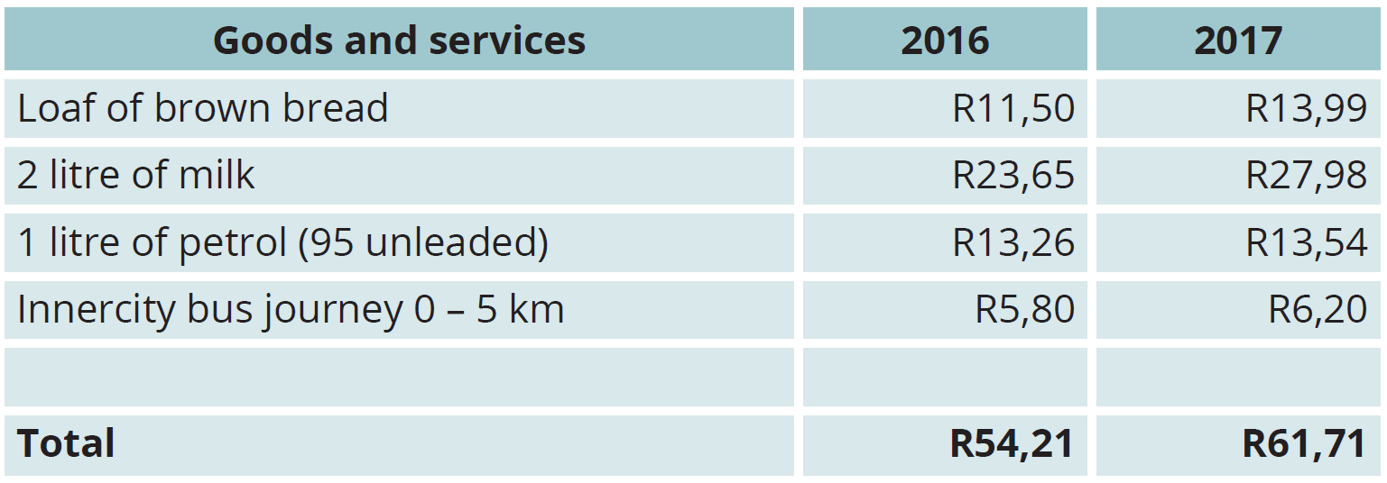
Calculating Inflation
Unit 7.4
The following example uses only some of the goods and services:
Calculating inflation: $\frac{61,71 −54,21}{54,21}$ × 100 = 13,8%
The rate of inflation on these four products is 13,8%

Slide 28
Example 7.7 page 171
Unit 7.4
StyleGirlz Hair Salon spent R465 000 on salaries in 2017. They give their staff an inflation-linked increase of 6% in 2018. Calculate how much they would budget for salaries in 2018.
R465 000 + (6% of R465 000)
= R465 000 + R27 900
= R492 900
They would spend R492 900 on salaries.

Slide 29
Exercise 7.4
Unit 7.4
Complete Exercise 7.4 on page 171 of your Student’s Book

Slide 30
Module assessment
Module 7
Complete Module assessment on page 173 of your Student’s Book

