Slide 1
Mathematical Literacy
NQF 4

Slide 2
Use representations to investigate problems and illustrative solutions
Module 5

Slide 3
Overview
5.1 Investigating various packaging arrangements
5.2 Determine the number and placement of furniture in a venue considering free space for movement
5.3 Building 3D scale models of objects from 2D plans

Slide 4
Investigating various packaging arrangements
Unit 5.1

Slide 5
Investigating various packaging arrangements
Unit 5.1
Investigate packaging problems by making models of the objects to find the best solution.
Practical Investigation 1
Choose one of the tasks listed on the next slides.
You need to:
make a model to investigate the solution (a scale model or a life size model)
present your solution by presenting your model and a written conclusion
show that you have tried at least three different ways of solving the problem and draw scale diagrams of your proposed solutions
do calculations to support your reasoning.

Slide 6
Investigating various packaging arrangements
Unit 5.1
Practical Investigation 1 (continued)
Task 1
A shopkeeper has a freezer, in which the products are packed into baskets. She needs to fit as many ice-cream containers into one basket as possible.
The freezer baskets are 42 cm wide, 16 cm deep and 48 cm long.
The ice cream containers are 2 ℓ containers of a few different shapes.
Investigate different shapes of ice cream containers and find the maximum amount that can be put into each freezer basket.

Slide 7
Investigating various packaging arrangements
Unit 5.1
Practical Investigation 1 (continued)
Task 2
Design plastic containers for ice cream sprinkles.
Design and sketch containers in the shape of a triangular prism, a rectangular prism and a circular cylinder. Label them with their dimensions.
Each must fit on a shelf space that is 12 cm tall, 6 cm wide and 6 cm deep.
Explain which container will hold the most sprinkles for the given shelf space.
Which container design would save money by using less plastic? Explain your reasoning.

Slide 8
Investigating various packaging arrangements
Unit 5.1
Practical Investigation 1 (continued)
Task 3
A new company wants to market stock cubes in an innovative way. They are thinking of making the cubes into triangular prisms or cones, rather than the traditional cube-shape with a side of 15 mm. They face two problems:
There must be the same amount of stock in each cube.
They must be able to fit the cubes into a rectangular box which will take up the least amount of shelf space.
Design a stock cube shape and size that meets all the requirements.

Slide 9
Investigating various packaging arrangements
Unit 5.1
Practical Investigation 1: Assessment
You will be assessed on:
the construction of your model
your written solution and diagrams
your calculations
your conclusion and recommendation.
Criterion | Yes | No | Comment
Does the student:
Show at least three different ways of packing boxes?
Draw clear diagrams to show the different ways of packing?
Select the correct formulae to do calculations?
Calculate correctly, giving the correct units?
Draw a reasonable conclusion, with an explanation?

Slide 10
Practical investigation 1
Unit 5.1
Complete Practical investigation 1 on page 120 of your Student’s Book

Slide 11
Determine the number and placement of furniture in a venue considering free space for movement
Unit 5.2
In this unit you need to design floor plans and show how all the necessary objects can be placed in an area to achieve the best use of the space.
A practical way to work with a floor plan is to make cut-outs of objects such as furniture and other objects to exactly the same scale as the floor plan.
You can then arrange these in the space and move them around until you come up with an arrangement you like.

Slide 12
Determine the number and placement of furniture in a venue considering free space for movement
Unit 5.2
Practical Investigation 2
Task 1
Design a childcare centre for 30 children of ages 3 to 5.
The centre has a rectangular floor area of 20 m × 10 m.
There should be:
places for each child to put their belongings
tables with chairs for children to play and eat at
an indoor play area with toys
a story area with enough space for all the children to sit around the reader.

Slide 13
Determine the number and placement of furniture in a venue considering free space for movement
Unit 5.2
Practical Investigation 2
Task 2
Design a small grocery store which serves a village.
It has an area of 7 m × 5 m.
It has enough space for people to move in the aisles.
There is a cashier’s area.

Slide 14
Determine the number and placement of furniture in a venue considering free space for movement
Unit 5.2
Practical Investigation 2
It has shelves for:
fresh dairy products, meat, fruit and vegetables in a refrigerated area
bread
tinned foods, tea and coffee
sweets and cooldrinks
newspapers and magazines
cleaning products
a few stationery supplies

Slide 15
Determine the number and placement of furniture in a venue considering free space for movement
Unit 5.2
Practical Investigation 2: Assessment
You will be assessed on:
your room plan drawn to scale
the arrangement of furniture in your venue, showing ways of making sure that there is enough activity space and space to move around
whether your plan has all of the required facilities
your presentation to the rest of the class
your critique of other group’s presentations.

Slide 16
Practical investigation 2
Unit 5.2
Complete Practical investigation 2 on page 122 of your Student’s Book

Slide 17
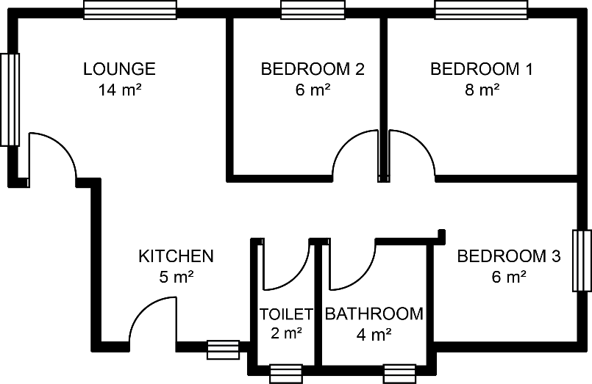
Building 3D scale models of objects from 2D plans
Unit 5.3
Practical Investigation 3
Make a model of an RDP house.
Here is a floor plan, with the area of each room given.
Draw an accurate scale drawing of this plan, which you will use as a base for your model.
Draw accurate elevations of the floor plan, to show the views of the house.

Slide 18
Building 3D scale models of objects from 2D plans
Unit 5.3
Practical Investigation 3
The walls and roof must be to the standard size.
Paste the scale drawing onto base board and build the model according to your floor plans.

Slide 19
Building 3D scale models of objects from 2D plans
Unit 5.3
Practical Investigation 3: Assessment
You will be assessed using the following checklist:
Criterion | Yes | No | Comment
Is the flat plan drawn to scale accurately, and keeps the areas of the rooms correct?
Is the scale chosen suitable for the size of model?
Are the elevations drawn accurately and to standard sizes of actual buildings?
Is the correct scale used to construct the walls and roof of the building?
Are the measurements taken correctly?

Slide 20
Practical investigation 3
Unit 5.3
Complete Practical investigation on page 122 of your Student’s Book

Slide 21
Module assessment
Module 5
Complete Module assessment on page 123 of your Student’s Book

