Slide 1
Mathematical Literacy
NQF 4

Slide 2
Representing and interpreting data
Module 14

Slide 3
Overview
14.1 Measures of central tendency and spread
14.2 Representing data using graphs; reading and interpreting data
14.3 Identifying trends and drawing conclusions

Slide 4
Measures of central tendency and spread
Unit 14.1
In daily life, we use the word average to mean somewhere in the middle.
For example, Jane has an average height, a student has an average Maths ability.
In Mathematics, we use the averages of a data set to help us summarise, represent and interpret the data.
We use three different measures of the average of data, called the measures of central tendency of the data.
The three measures of central tendency are called the mean, the median and the mode.

Slide 5
Measures of central tendency and spread
Unit 14.1
These three measures of central tendency each describe a different aspect of the data. Depending on the data set, the values found can be very different, or very similar.
Mean
Median
Mode
The mean is the total sum of all the values divided by the number of values
The median is the middle value when the data is arranged in ascending order.
The mode is the value in the data that occurs most often.

Slide 6
Advantages and disadvantages of median
Unit 14.1
Median
Advantages | Disadvantages
The median gives the middle value of a data set, i.e. half of the data is above and half below this number. We can use the median with the range to get a better picture of the top half and the bottom half of the data. | The median is not affected by very high or very low values (outliers), as it is based on the positions of the numbers in the ordered data set. The median does not tell us about how the values are spread in each half of the data. If the median and the mean are very different, then the data is not evenly spread around the middle value.

Slide 7
Advantages and disadvantages of the mode
Unit 14.1
Mode
Advantages | Disadvantages
The mode is useful to know which data value occurs most often. The mode is often used when data consists of categories such as favourite foods, colours of cars. There can be more than one mode. We do not calculate the mode. We count to see which numbers occur most often. A visual representation of the mode is useful. For example, on a bar chart, the mode is the highest bar. | If another data value occurs nearly as often as the mode, it does not affect the value of the mode. The mode does not give us any information about the rest of the data set. Not all data sets have a mode.

Slide 8
Range – a measure of spread
Unit 14.1
The range is a measure of how spread out the data set is.
The range of a set of data is the difference between the highest and the lowest values in the data set.
Formula
Range =
highest – lowest score

Slide 9
Example 14.6 page 285
Unit 14.1
The monthly salaries of employees at two financial institutions, one in Cradock in the Eastern Cape and the other in Durban in KwaZulu Natal, are recorded.
Calculate the range of the monthly salaries earned at the Cradock financial institution.
Write down the median monthly salary earned at the Cradock financial institution.
Cradock | 4 100 4 320 4 500 4 650 4 650 4 650 5 500 5 650 7 350
Durban | 5 400 5 525 5 980 6 250 6 250 6 250 6 300 7 800 8 200 8 950

Slide 10
Example 14.6 page 285
Unit 14.1
Write down the median and mode for the monthly salaries earned at the Durban financial institution.
Calculate the average (mean) monthly salary earned at the Durban financial institution.
Cradock | 4 100 4 320 4 500 4 650 4 650 4 650 5 500 5 650 7 350
Durban | 5 400 5 525 5 980 6 250 6 250 6 250 6 300 7 800 8 200 8 950

Slide 11
Example 14.6 page 285
Unit 14.1
Range = R7 350 – R4 100 = R3 250
Median = R4 650
Median = R6 250; Mode = R6 250
Average (mean)
= $\frac{\text{5400 + 5525 + 5980 + 6250 + 6250 + 6250 + 6300 + 7800 + 8200 + 8950}}{\text{10}}$
= $\frac{\text{66 905}}{\text{10}}$
= 6 690,50
The average salary of employees in Durban is R6 690,50.

Slide 12
Activity 14.1
Unit 14.1
Complete Exercise 14.1 on page 286 of your Student’s Book

Slide 13
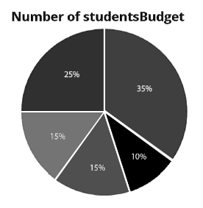
Representing data using graphs; reading and interpreting data
Unit 14.2
Graphs are drawn to give a visual representation of the data and the type of graph is determined by the type of data.
Different types of graphs
A pie graph represents data as portions of a whole pie, usually as a percentage of the whole (100%). A pie chart compares the sizes of parts well, but it does not show the actual quantities of data being represented.
3
4

Slide 14
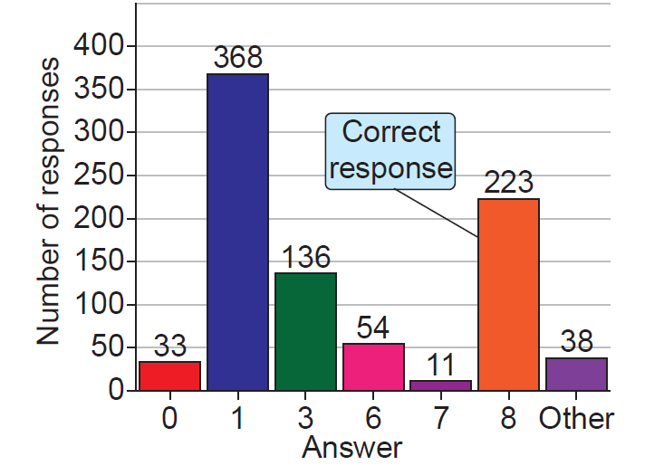
Representing data using graphs; reading and interpreting data
Unit 14.2
Graphs are drawn to give a visual representation of the data and the type of graph is determined by the type of data.
Different types of graphs
Bar graphs are useful for representing categories of discrete data measured in numbered intervals or as percentages.

Slide 15
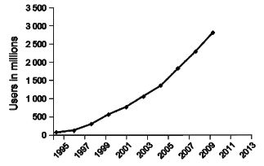
Representing data using graphs; reading and interpreting data
Unit 14.2
Graphs are drawn to give a visual representation of the data and the type of graph is determined by the type of data.
Different types of graphs
Line graphs can be used in the same way as bar graphs, but they are more useful for showing trends or changes over time.

Slide 16
Pie charts and bar graphs
Unit 14.2
Pie charts
Bar graphs
Pie charts show a whole divided into parts. They show how the parts relate to one another and how the parts relate to a whole.
They give us a visual impression of the relative proportion between parts, but they do not give the actual quantities.
Bar graphs show the amounts or quantities involved, but do not show the relationship between individual amounts and the whole as effectively as pie charts.
Bar charts allow us to compare the quantities of different categories, for example the sales of different items.

Slide 17
Example 14.9 page 290
Unit 14.2
Elizabeth is an office manager. One of her duties is to draw up a budget for the office and present it to the board of directors for approval. She has to budget for the following items:
She uses this information to draw up a pie chart for her presentation to the board of directors.
Office equipment | 10%
Stationery | 25%
Repairs | 15%
Salaries | 50%
Stationery

Slide 18
Example 14.9 page 290
Unit 14.2
Her office equipment budget is R26 000. What is her budget amount for:
Repairs
Stationery
Salaries
How much money is she planning to spend in total?
If the board of directors asks her to reduce her spending by 10%:
How much will she be able to spend in total?
How will the pie chart change?

Slide 19
Example 14.9 page 290
Unit 14.2
R26 000
R52 000
R104 00
R208 000
R187 200
The pies chart will not change. The percentages of Elizabeth’s pie chart will stay the same.

Slide 20
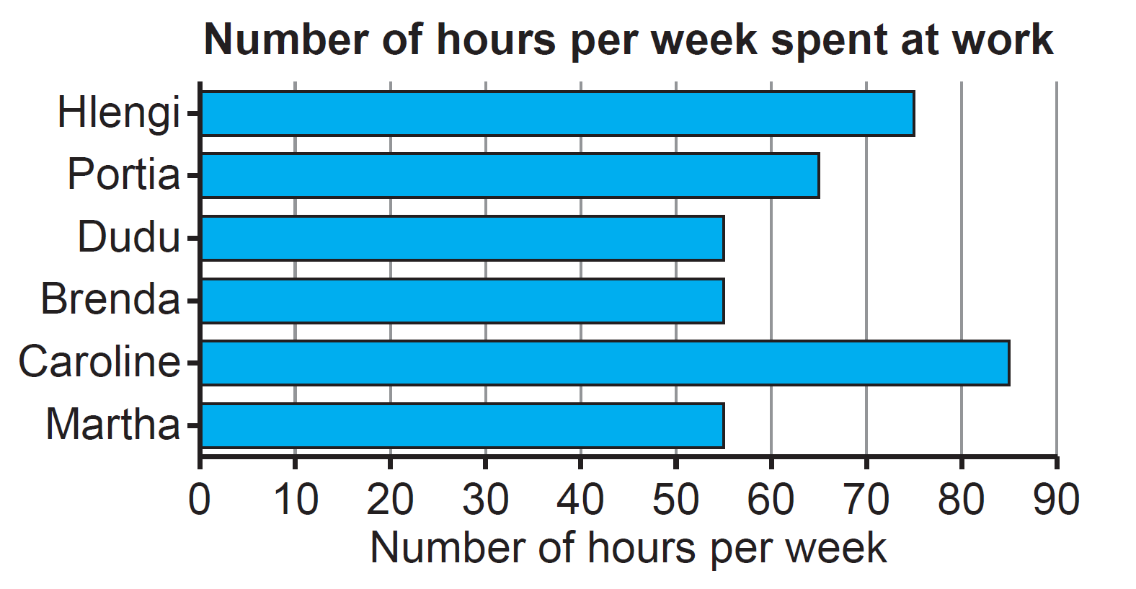
Example 14.11 page 292
Unit 14.2
A clerical company is aware that six of their employees are working more than the required 40 hours every week. Hlengi makes a horizontal bar graph to show them how many hours they are each working per week.

Slide 21
Example 14.11 page 292
Unit 14.2
What does each axis on this graph represent?
How many overtime hours does Caroline work per week?
Calculate the total number of overtime hours worked by the six employees.
If the rates for overtime work are R45 per hour, how much is the overtime work costing the company per week?

Slide 22
Example 14.11 page 292
Unit 14.2
The horizontal axis represents the number of hours that employees work per week. The vertical axis represents the six individual employees.
Caroline works 35 overtime hours per week.
90 hours of overtime.
90 × R45 = R4 050

Slide 23
Compound or double bar graphs
Unit 14.2
Definition
A double bar graph is used to compare two things for each category. For example, we could use a double bar graph to compare the differences between sales for the same month in two different years.
”

Slide 24
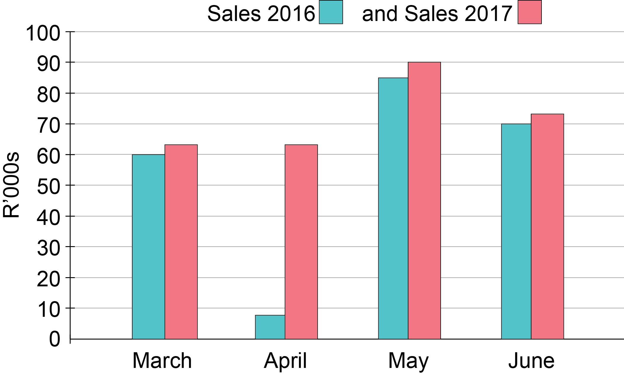
Compound or double bar graphs
Unit 14.2
In this double bar graph, sales are given in thousands of rand on the vertical axis.

Slide 25
Compound or double bar graphs
Unit 14.2
The horizontal axis shows sales for March to June for two different years, 2016 and 2017.

Slide 26
Compound or double bar graphs
Unit 14.2
This graph can be used to show a recovery in April sales from
2016 to 2017.

Slide 27
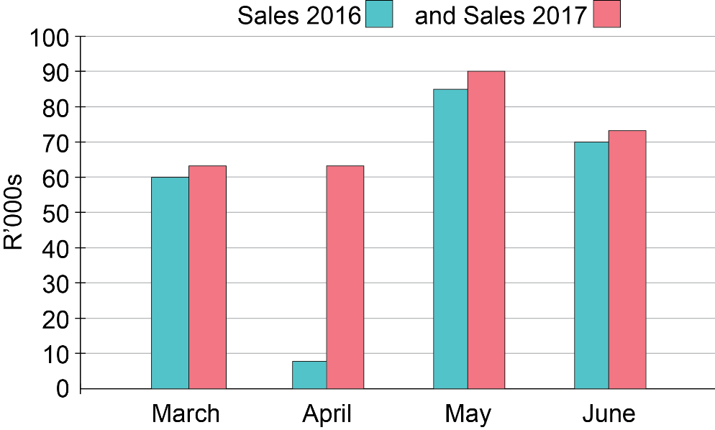
Compound or double bar graphs
Unit 14.2
Note:
Representing data in this way is useful for many industries because sales are strongly related to the time of year; so comparing information from month to month is more useful than just looking at information from year to year.

Slide 28
Compound or double bar graphs
Unit 14.2
Note:
When there are more than two bars in each category, we call it a compound bar graph. A compound bar graph allows you to compare many sets of data for each category, as well as the differences between the categories themselves.

Slide 29
Vertical and horizontal stacked bar graphs
Unit 14.2
Stacked Bar Graphs
Stacked bar graphs represent two or more sets of data in each bar. Different colours are used to compare the data within each bar. This allows for comparison and groupings.
”

Slide 30
Example 14.13 page 293
Unit 14.2
A rugby club has three teams which play matches in each season. The performances of the different teams for 2010–2013 are given in the table.

Slide 31
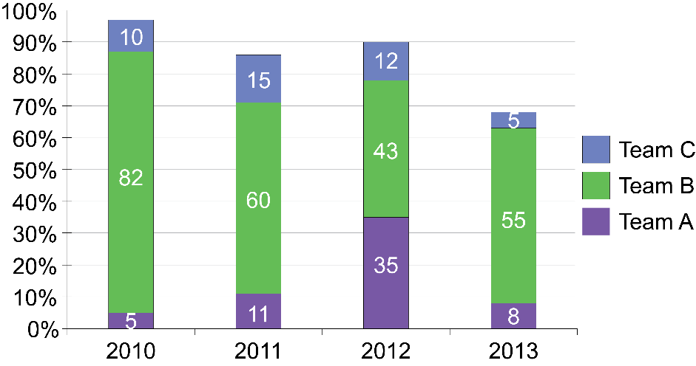
Example 14.13 page 293
Unit 14.2
This information is shown on a vertical stacked bar graph.
Which team scored the most points over the four years?
In which year did Team A score the most points?
How many points did Team C score in the four years?

Slide 32
Example 14.13 page 293
Unit 14.2
Team B scored the most points in the four years. They scored a total of 240 points.
In 2012 Team A scored the most points for their team.
Total points scored by Team C: 10 + 15 + 12 + 5 = 42

Slide 33
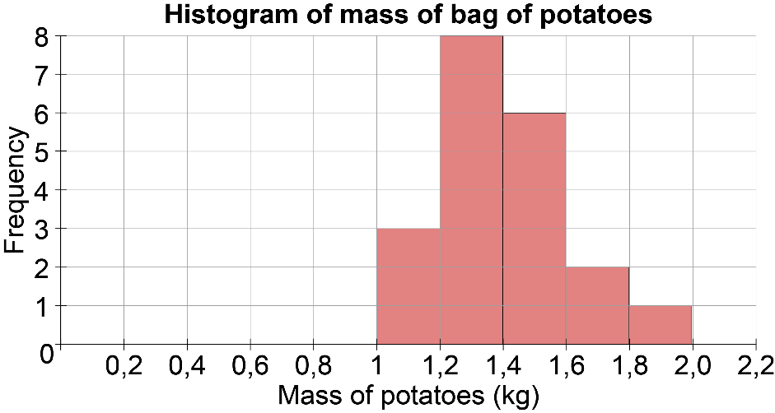
Histograms
Unit 14.2
Histograms
Histograms are graphs used to represent grouped and continuous data. They show the frequency and the distribution (spread) of the data.
The horizontal axis of a histogram has a continuous scale.
The vertical axis shows the frequency, or number of times the data is listed.
There are no gaps between the bars of a histogram.

Slide 34
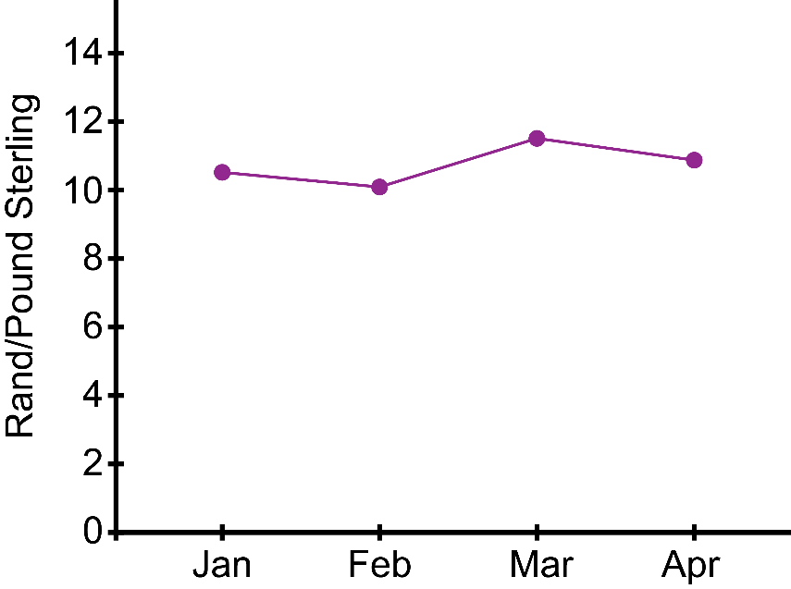
Line and broken-line graphs
Unit 14.2
Broken-line graphs
Broken-line graphs show trends or changes in quantities over a certain time period. The points show when the measurements were taken but dotted to show the trend from one reading to the next.

Slide 35
Exercise 14.2
Unit 14.2
Complete Exercise 14.2 on page 296 of your Student’s Book

Slide 36
Identifying trends and drawing conclusions
Unit 14.3
If an inappropriate kind of graph is used, this can affect the reader’s interpretation of a graph.
e.g. if a pie chart is used when actual quantities are more important than the relative proportions, then this can distort the interpretation.
Also check that the data plotted really does mean what the writer claims it does.

Slide 37
Identifying trends and drawing conclusions
Unit 14.3
Changing the scale of the axis
1
Changing the scale of the vertical axis on bar graphs and line graphs changes the apparent differences between the points or bars.
2
The larger the spaces between each number on the vertical axis, the bigger the apparent difference between the different bars will be.
3
If the spaces between the numbers on the axis are smaller, the differences appear smaller, as the bars or points appear to be closer in height.

Slide 38
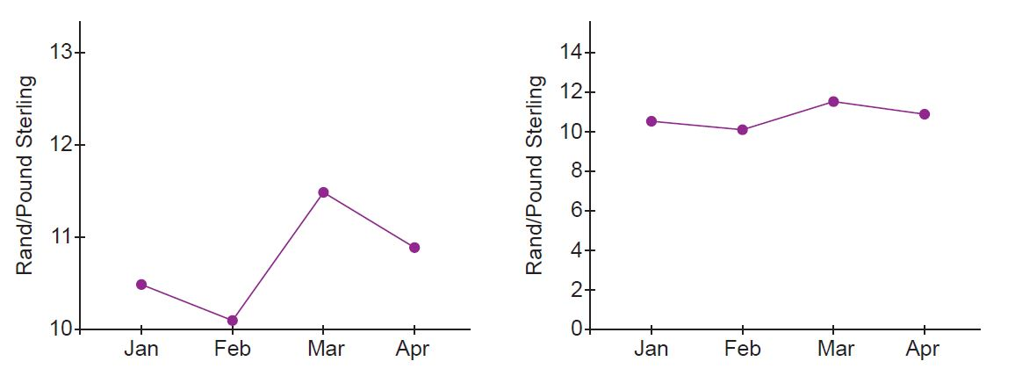
Example 14.16 page 299
Unit 14.3
These two broken-line graphs show exactly the same data: they are graphs of the exchange rate for the rand against the pound sterling over a few months. Currency fluctuation (change) is an issue which people may want to emphasise in some situations and downplay in other situations.

Slide 39
Example 14.16 page 299
Unit 14.3
In the first graph, the vertical axis does not begin at zero and the numbered intervals are further apart, increasing in R1 per pound.
This makes it look as if the exchange rate fluctuations are large.
In the second graph, the vertical axis begins at zero and the numbered intervals are closer together, increasing in R2 per pound.

Slide 40
Example 14.16 page 299
Unit 14.3
As we would not expect the rand/pound exchange rate to reach values near zero, the second graph is probably not realistic.
Economists are more likely to take the view that the first graph is more accurate, as small changes in the value of our currency have a large effect on our economy.
Note that it is not necessarily wrong to change the scale on the axes. For example, graphs showing stock exchange fluctuations rarely show the zero value on the graph and stock brokers are taught to interpret the graphs in that form.
Sometimes small changes in data values have important effects and in these cases, it may be valid to change the scale to show these. As in the example above, it is not always wrong to omit the zero value on an axis.

Slide 41
Using pictures and 3-dimensional representations
Unit 14.3
Data in a graph can be misleading at first glance. Study the graph carefully before making any conclusions.
The size of the elements can affect the way a person interprets the information. If an object or bar is drawn with a greater area, the viewer sees a larger difference between the objects.
Three-dimensional pie charts in the newspaper may be misleading.

Slide 42
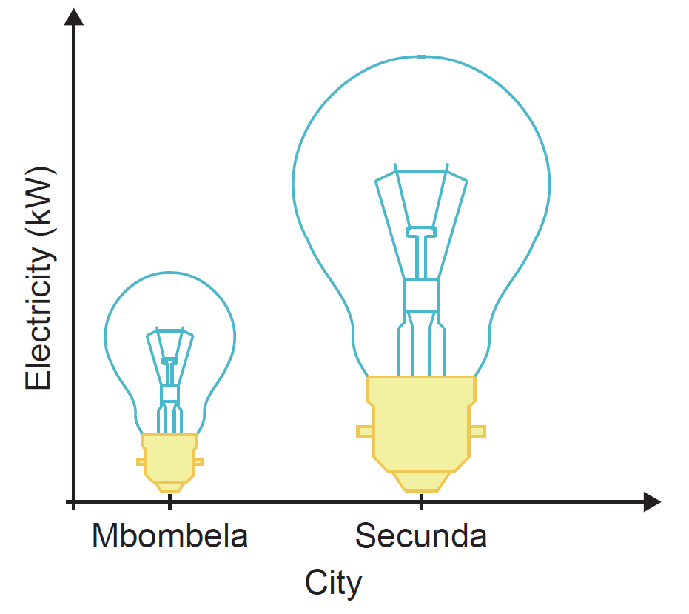
Using pictures and 3-dimensional representations
Unit 14.3
This graph shows an enlarged light bulb (wider as well as taller), so the viewer might interpret the graph as Secunda using much more electricity than Mbombela, when the difference is in fact not that large.

Slide 43
Exercise 14.3
Unit 14.3
Complete Exercise 14.3 on page 301 of your Student’s Book

Slide 44
VIDEO: Application in the Workplace

Slide 45
Module assessment
Module 14
Complete Module assessment on page 303 of your Student’s Book

