Slide 1
Mathematical Literacy
NQF 4

Slide 2
Collecting and organising data
Module 13

Slide 3
Overview
13.1 Research and collecting data
13.2 Data collection
13.3 Developing questionnaires
13.4 Data collection instruments
13.5 Using tally tables to sort data
13.6 Grouping data using intervals

Slide 4
Research and collecting data
Unit 13.1
Data is collected by individuals, organisations and governments usually because they need specific information.
Data collection is used to study and record information, to make decisions about important issues and to pass information on to relevant people or communities.
Whatever the specific reason, data is always collected to provide information.
Data is used by:
Governments
Weather Reports
Businesses
Economic forecasts, etc

Slide 5
How data is used by different groups
Unit 13.1
Everyone – from students to pensioners – uses some form of data at some time during their lives. The data may be used to complete an essay, a major project or simply to satisfy curiosity.
Data about drug abuse by young people can focus on campaigns to prevent drug use.
Data about social media can be used by business to watch the latest trends in marketing.
Provincial and national governments use data to inform their decisions about the needs of the people they serve.

Slide 6
How data is used by different groups
Unit 13.1
Data about social development can result in decisions about building new hospitals, schools and clinics.
Data about economic development can measure the impact of investment in the country.
Data about the local economy can be used to inform building of new offices, factories and warehouses.

Slide 7
Exercise 13.1
Unit 13.1
Complete Exercise 13.1 on page 251 of your Student’s Book

Slide 8
Revision of data and concepts
Unit 13.1
Range:
The range (or spread) of data refers to the difference between the smallest and the largest value in the data sample.

Slide 9
Revision of data and concepts
Unit 13.1
Research Question:
A research question may be simple or complex. You need to determine what question it is that you want answered.

Slide 10
Revision of data and concepts
Unit 13.1
Population:
The population includes all the people or things that you want to collect data about.

Slide 11
Revision of data and concepts
Unit 13.1
Target Population:
A target population is a group that a researcher hopes to understand by collecting and analysing data about that group

Slide 12
Example 13.5 page 253
Unit 13.1
Sebenza TVET college conducts a census in their school about how sexual harassment. They want to know whether any student has experienced sexual harassment from a fellow student or from a lecturer.
Who is their target population?
Who do they need information from?
Write two simple research questions that require a yes/no/maybe answer.
Would you recommend that this census should be answered with the students’ names, or anonymously? Explain.

Slide 13
Example 13.5 page 253
Unit 13.1
All students at the college.
They need information from the students, but they may want to include information from lecturers and parents as well.
Here are examples of questions that are appropriate:
Have you experienced sexual harassment on campus?
Do you know someone who has been sexually harassed?
Have you heard about someone who has been sexually harassed?
Do you know anyone on campus who has sexually harassed others?

Slide 14
Example 13.5 page 253
Unit 13.1
This census should be kept anonymous to avoid embarrassment.
However, it should advise anyone who has been sexually harassed where to go for help, and anyone who knows someone who has harassed others to notify campus authorities.

Slide 15
Data collection instruments
Unit 13.1
SURVEY
A survey is a process of collecting data from a sample of the population that we are interested in. A survey can focus on getting opinions or on getting facts from respondents.

Slide 16
Data collection instruments
Unit 13.1
QUESTIONNAIRE
A questionnaire uses a set of questions and provides spaces for respondents to write their responses. This instrument is good for getting information from a variety of people. Questionnaires are also appropriate for getting information from people that are spread over a wide area and are not easy to contact face to face.

Slide 17
Data collection instruments
Unit 13.1
INTERVIEW
An interview involves asking people a set of questions face to face. That is, you talk to the participants directly and they tell you their answers. Interviews are appropriate for a small number of participants and for short and long responses. Interviews are also appropriate when all participants can be contacted easily.

Slide 18
Data collection instruments
Unit 13.1
OBSERVATION
Observation involves simply observing a trend (also known as a phenomenon). The researcher simply observes, watches and records information. There is no discussion with participants. Observation is appropriate for collecting information where there is no need for any communication.

Slide 19
Explaining some important concepts
Unit 13.1

Slide 20
Example 13.14 page 258
Unit 13.1
Samantha is part of a team of researchers at Muizenberg beach collecting data about why more sharks are venturing closer to shore.
However, she has a strong belief that chumming is a big reason for sharks coming closer to shore.
Explain why she might not be objective when conducting this survey.
Samantha has her own strong belief on the subject. This makes it difficult for her to be objective. Study the sources of income for the two months of December and January.

Slide 21
Example 13.15 page 259
Unit 13.1
Refer to this questionnaire:
Dear Customer,
The Squeeza Family Restaurant is dedicated to improving customer satisfaction. This survey will be helpful to enhance our services and meet your needs. Your response will be used only for survey purposes. Attached is a gift voucher that can be used in the next month as a token of our goodwill. In case you have any questions regarding the survey, please call 123-456-7890. Thank you very much for your time and suggestions.

Slide 22
Example 13.15 page 259
Unit 13.1
 | Strongly agree | Agree | Neutral | Disagree | Strongly disagree
1. The restaurant is accessibly located.
2. The restaurant hours are convenient for my family needs.
3. The advertised dish was in stock.
4. A good selection of dishes was present.
5. The meals sold are good value for money.
6. The restaurant has the lowest prices in the area.
7. Meals sold are of the highest quality.
8. Restaurant atmosphere and decor are appealing.
9. Do you agree that naughty children should not be allowed in a restaurant?
10. I agree that MSG is harmful and should be avoided.
11. What could we do to make your restaurant dining experience better?

Slide 23
Example 13.15 page 259
Unit 13.1
Identify anything in the explanation to the customer that would influence their answers.
For each question, decide if it is biased or subjective.
If it is biased, change the wording to make an unbiased question.

Slide 24
Example 13.15 page 259
Unit 13.1
The attached gift voucher will influence customers to say positive things about the restaurant.
Questions 1–5 and 8 are positive statements about the restaurant, but respondents can disagree in their choice of answer category.
Question 6 and 7 assume that respondents would know about prices in the area and what makes for highest quality. They are not direct questions about their own experience of the restaurant and will be answered by ‘hearsay’, or a general feeling of like or dislike of the restaurant.

Slide 25
Example 13.15 page 259
Unit 13.1
Question 9 is biased. It puts the opinion into the respondent’s head that naughty children should not be allowed in the restaurant.
Question 10 is biased. It tries to influence the respondent to be opposed to MSGs.
Question 9 can ask if children should be allowed in the restaurant. Customers who want ‘naughty’ children to be kept out of the restaurant can comment on this in Question 11. Question 10 can ask if the restaurant should avoid putting MSGs in the food.

Slide 26
Data collection
Unit 13.2
Definition
Data collection describes a process of obtaining specific information about a certain trend or phenomenon taking place.
”
The collected data (tallies, lists of answers, lists of measurements) is called raw data.
In order to gain insight into the data, we need to find ways to summarise, organise and represent it before we can analyse it.

Slide 27
Data collection
Unit 13.2
The process of data collection needs to be ordered and systematic. To start, check that you:
Have a clear objective for your research.
Know what data you need, why you need it and how you will use it.
Identify specific data procedures that are appropriate to the context within which the data is being collected.

Slide 28
Data collection process
Unit 13.2
1.
Identify data needs
What kind of data?
How it will be used?
Identify data that is easy to find.

Slide 29
Data collection process
Unit 13.2
2.
Identify data categories
What data types or categories will you organise data into?
Use simple categories.
These categories will become the framework for your questionnaire.

Slide 30
Data collection process
Unit 13.2
3.
Design and test data collection instruments
Choose an appropriate data collection instrument.
Examples: questionnaires, interviews, observations, surveys.
Decide what you want the instrument to measure e.g. status, progress, problems, attributes .

Slide 31
Data collection process
Unit 13.2
4.
Processing and storage
Store data in records or a database.
Data is ready for processing and analysing.

Slide 32
Exercise 13.3
Unit 13.2
Complete Exercise 13.3 on page 261 of your Student’s Book

Slide 33
Developing questionnaires
Unit 13.3
Designing a questionnaire
A questionnaire is a data collection instrument.
It should include specific questions that will enable the collection of each category of data that you wish to collect.
It could also include tables that respondents can complete.

Slide 34
Tips for designing a questionnaire
Unit 13.3
The questions should be clear and unambiguous with simple layout.
The questions must be written in clear, simple language, not be too long and be in logical order. Avoid offensive questions.
Clear instructions how to complete each section and explain difficult terms.
Prompts for additional information, such as ‘Please specify’ or ’Others’, may be added.

Slide 35
Tips for designing a questionnaire
Unit 13.3
Allow anonymity to increase the number of people participating.
Avoid sensitive information that would make people not to participate or respond.
Explain the purpose the questionnaire to respondents

Slide 36
Exercise 13.4
Unit 13.3
Complete Exercise 13.4 on page 266 of your Student’s Book

Slide 37
Data collection methods
Unit 13.4
Observations | Interviews | Conducting surveys
Observe, watch and record information. There is no discussion with participants. | Ask people a set of questions face to face. | Use observations and interviews to gather information. Distinguish between descriptive surveys and analytic surveys.

Slide 38
Observations
Unit 13.4
Definition
Observation involves simply watching participants in the situation that you are investigating and then recording the information. It does not involve discussion with participants.
”

Slide 39
Observations
Unit 13.4
Direct observation requires the observer to remain anonymous and unnoticed so that the behaviour of participants is not influenced by the presence of the observer (as far as possible). For example, observing young children interacting in the playground.
Participant observation includes the observer in the event, culture or activity taking place. For example, in a health of human service programme, the observer can participate in the activities being observed.
Observation can also be done by conducting tests or using specific observation tools (for example, a checklist of criteria to rate participants).

Slide 40
Example 13.23 page 268
Unit 13.4
At Vuyelwa College in the Northern Cape, Thandeka was conducting a survey about how many students visited the library during the exam times.
What method of observation should she use? Explain.
Who is the target population of Thandeka’s research?
Which considerations should Thandeka bear in mind when setting up and carrying out her observations?

Slide 41
Example 13.23 page 268
Unit 13.4
Direct observation. Thandeka will be the observer and she will remain anonymous and generally unnoticed.
The target population are the students at Vuyelwa College visiting the library during exam times.
Thandeka should consider the student’s behaviour, her own attitudes, the conditions and the effects of some of the behaviour of students and staff at the library.

Slide 42
Interviews
Unit 13.4
Here are some questions you should ask yourself before conducting interviews:
?
Are you targeting the right target population?
Is the target population accessible?
Are you able to adjust or amend your interview in the time required?

Slide 43
Interviews
Unit 13.4
A successful interview is preceded by:
Learn as much as possible about the target population that you will be interviewing.
Do some research about the target population that you will be interviewing. Contact the appropriate person(s) and request an interview.
Explain the purpose and intention of the interview as well as use of the results.
Cover all issues of confidentiality and permission of participants.

Slide 44
Interviews
Unit 13.4
Establishing trust can be the most difficult part of an interview. Here are some steps to help you do this:
Treat everyone with equal respect.
Don’t assume you know more than anyone else.
Share what you do know freely.
Discuss the outcomes you want and how the interview will achieve this.
Follow through on whatever you say you will do. Don’t make promises you cannot keep.

Slide 45
Example 13.25 page 269
Unit 13.4
Pumla is given a project to investigate human rights violations in her community or a community close to her. She decides to draw up a set of questions that she will use during her interviews. She also decides that she will visit a mall close to where she lives and interview some people visiting the mall.
Look at some of the questions she has written down and state whether you think she would receive proper feedback during her interviews.
Do you know what human rights violations are?
Human right violations are bad. Do you agree or disagree?
Have you ever been a victim of a human rights violation?

Slide 46
Example 13.25 page 269
Unit 13.4
Human Rights violations encompass so many aspects and some people may not even be aware that their human rights are violated.
The Constitution entrenches the rights of all human beings in South Africa, so she should start out explaining this and highlight the human rights to make people aware of them.
The nature of these types of questions could also be very sensitive, so it would not be a good idea to interview people in a mall.

Slide 47
Exercise 13.5
Unit 13.4
Complete Exercise 13.5 on page 273 of your Student’s Book

Slide 48
Using tally tables to sort data
Unit 13.5
We can organise data in many ways:
Organising Data
Category
Event
Place
Individual
Group
Time of obser-vation
Using tally tables
Grouping data using intervals
Using a combi-nation of methods

Slide 49
Exercise 13.6
Unit 13.5
Complete Exercise 13.6 on page 275 of your Student’s Book

Slide 50
Grouping data using intervals
Unit 13.6
When working with a large range of data we can group the data. Grouping data makes the data more manageable.
How is this done?
Choose equal sized groups within the number range, making class intervals.
Decide how large each class interval should be.
The data range determines the size of the class intervals.
If intervals are too wide, too much data falls into the same class interval.
If intervals too small, there are too many intervals with not enough data to fill them!

Slide 51
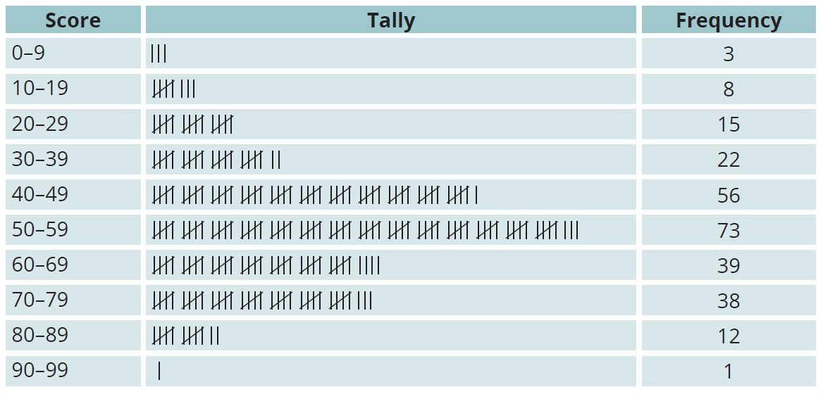
Example 13.31 page 276
Unit 13.6
Malik is the HR Manager at Britannica Boating Company.
The company runs a training course for company employees who complete a competency test out of 100 at the end.
Malik uses a grouped frequency table to record the results. The scores are grouped into the classes 0–9, 10–19, 20–29, etc.

Slide 52
Example 13.31 page 276
Unit 13.6
Complete the frequency column to be able to answer these questions.
How many employees scored between 30 and 39?
What is the score class in which most employees fall?
Which score class contains the smallest number of employees?

Slide 53
Example 13.31 page 276
Unit 13.6
22
50–59
90–99

Slide 54
Continuous and discrete data
Unit 13.6
Continuous data
Discrete data
is not restricted to whole numbers and can be any value in a continuous range.
can be counted because it only takes on whole number values.
For example:
mass, height and time are ongoing and measured in a continuous way.
For example:
the number of students in a class is discrete because there will not be half a student or quarter of a student in the class!

Slide 55
Exercise 13.7
Unit 13.6
Complete Exercise 13.7 on page 278 of your Student’s Book

Slide 56
Module assessment
Module 13
Complete Module assessment on page 280 of your Student’s Book

