Slide 1
Mathematical Literacy
NQF 4

Slide 2
Tables, graphs and formulae in the workplace
Module 12

Slide 3
Overview
12.1 Reading values off graphs
12.2 Plotting graphs of linear relationships
12.3 Graph of inverse proportion functions
12.4 The graph of constant ratio patterns
12.5 Using formulae to determine values of variables using substitution

Slide 4
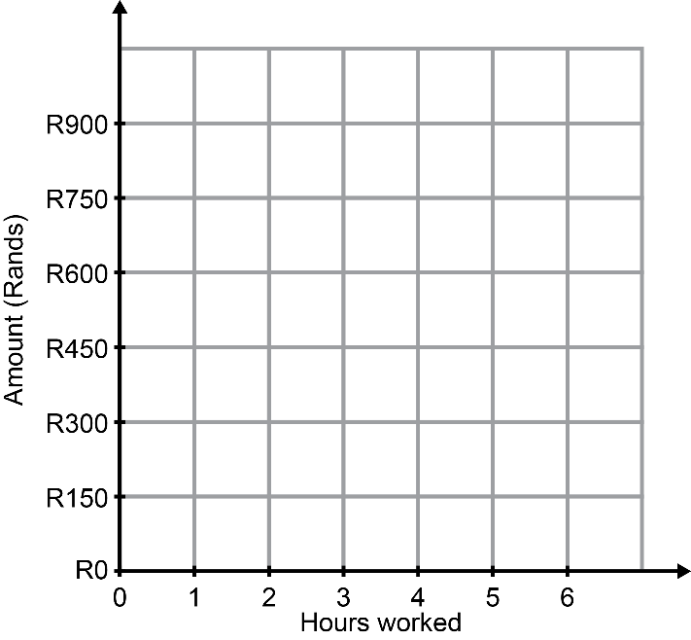
Reading values off graphs
Unit 12.1
Completing a table of values by reading values from a graph
A graph shows a number pattern by giving the input numbers on one axis and the output numbers on the other axis.
The shape of the graph shows how the numbers change in relation to each other.
We usually put the independent variable on the horizontal axis, and the dependent variable on the vertical axis.
Dependent variable
Vertical axis
Independent variable
Horizontal axis

Slide 5
Reading numbers from a graph
Unit 12.1
Point A shows R900 for 5 hours worked.
Look at the numbers on the graph and the number of values in between each mark.
The vertical axis in this graph shows R150 between each mark.
Hold a ruler from each point vertically to read the input number on the axis at the bottom.
Hold a ruler horizontally from each point to read the output number on the axis on the left.
R150 – 0 = R150
Point B shows R450 for 2½ hours worked.

Slide 6
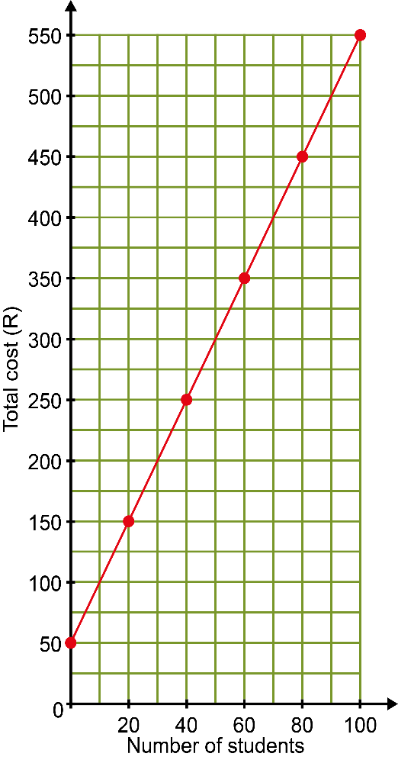
Example 12.1 page 233
Unit 12.1
Look at the graph showing the entry fee for students on a trip to the zoo.
Draw up a table of values showing the points plotted on this graph.
What is the flat fee per group of students accompanied by their lecturer? Explain how you know this.
What is the cost per student? Explain.

Slide 7
Example 12.1 page 233
Unit 12.1
Is this is a constant difference or a constant ratio pattern? Explain,
Derive a formula for this relationship. Let n be the number of students and c be the cost.
Is this relationship a direct proportion? Explain.

Slide 8
Example 12.1 page 233
Unit 12.1
Table of the pattern:
The flat fee is R50, because there is a charge of R50 for 0 students.
The cost for 20 students is R150 – R50 = R100, so the cost per student is R100 ÷ 20 = R5.
It is a constant difference or linear pattern, because the entry fee increases by R5 for each student that is added.
Number of students n | 0 | 20 | 40 | 60 | 80 | 100
Entry fee (R) | 50 | 150 | 250 | 350 | 450 | 550

Slide 9
Example 12.1 page 233
Unit 12.1
The difference between the values where n increases by 1 is R5, so the formula will contain 5n. The flat fee or constant value is R50. So the formula is c = 50 + 5n.
This is not a direct proportion, for example
40 student : 20 student is not equal to R250 : R150.

Slide 10
Exercise 12.1
Unit 12.1
Complete Exercise 12.1 on page 234 of your Student’s Book

Slide 11
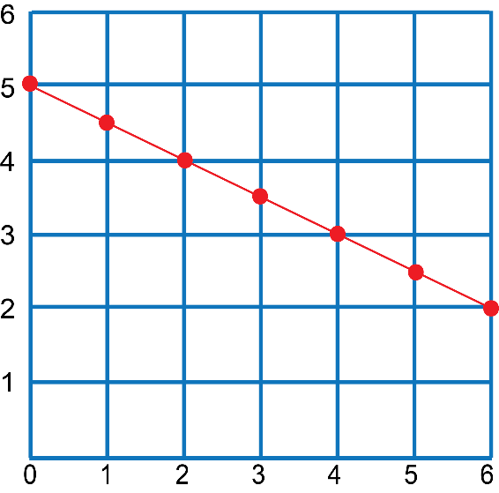
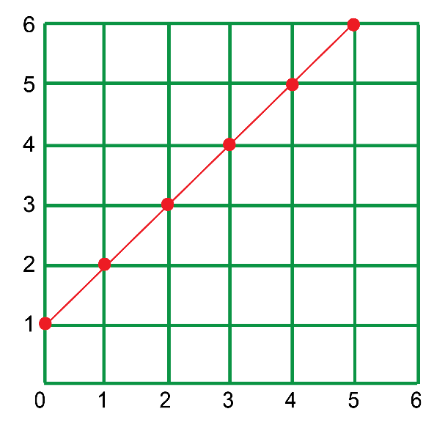
How to identify the kind of relationship in a graph
Unit 12.1
You can see what kind of graph it is by looking at the shape of the graph.
Linear graph or straight line graph
Both graphs below are not in proportion
A straight line
can be increasing or decreasing

Slide 12
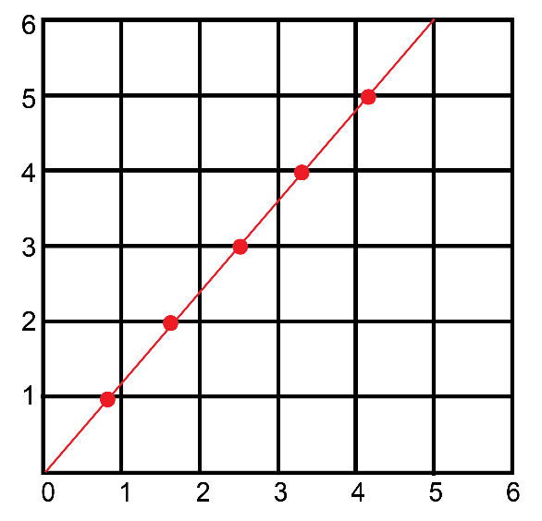
How to identify the kind of relationship in a graph
Unit 12.1
Linear graph or straight line graph
If a straight line graph starts at zero, it shows a direct proportion
A straight line
Always increasing
Both quantities increase in the same proportion.

Slide 13
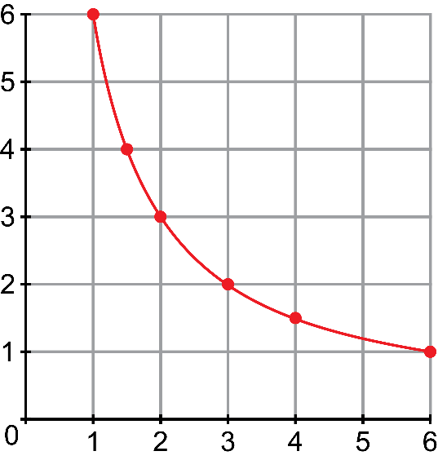
How to identify the kind of relationship in a graph
Unit 12.1
Linear graph or straight line graph
An inverse proportion
A curve
Does not touch either of the axes.
As one quantity increases, the other one decreases.

Slide 14
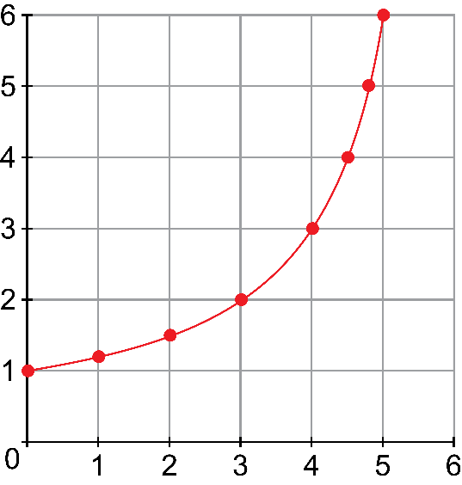
How to identify the kind of relationship in a graph
Unit 12.1
Linear graph or straight line graph
Constant ratio
A curve
An increasing graph.
Touches the vertical axis.
The vertical quantity increases
very quickly.
This is called an exponential graph.

Slide 15
Plotting graphs of linear relationships
Unit 12.2
We can use a written description of a pattern to draw up a table of values, find the formula and draw a graph of the pattern.
Choosing an appropriate scale
1
Draw axes to fill the space on the page. This makes the graph more accurate and easier to read.
2
Then use the costs per unit area or per item to calculate the total cost.
3
The highest value on your axes must be higher than the highest values of the variables, usually rounded up to a whole 10.
4
Choose intervals between the marks on your axes that will work well with the values you need to plot.

Slide 16
Plotting graphs of linear relationships
Unit 12.2
Example
To plot values such as 142, 156 and 178, choose intervals of 10 units apart from 140 to 180.
Choose to increase in multiples of 5 or 10, even when the values to plot are not multiples of 10.

Slide 17
Tips for drawing a graph
Unit 12.2
Steps for drawing a graph
Petrol (litres) | 0 | 2 | 4 | 6
Cost (R)
Cost = litres × 15
Petrol (litres) | 0 | 2 | 4 | 6
Cost (R) | 0 | 30 | 60 | 90
Draw a table of values, unless one is given.
Choose at least 4 input values and include 0, to show what the graph does at this point.
Fill in the values of the other variable, using the formula or the description.
1

Slide 18
Tips for drawing a graph
Unit 12.2
Steps for drawing graphs
Graph of cost versus petrol
Petrol (litres) | 0 | 2 | 4 | 6
Cost (R) | 0 | 30 | 60 | 90
2
Give your graph a title, usually stating the effect of one variable compared to another, e.g. “Graph of cost versus time”.

Slide 19
Tips for drawing a graph
Unit 12.2
Steps for drawing graphs
Graph of cost versus petrol
Highest value rounded off: 6
90
Petrol (litres) | 0 | 2 | 4 | 6
Cost (R) | 0 | 30 | 60 | 90
0
6
Highest value rounded off: 90
3
Choose an appropriate scale to make your graph clear and easy to read.

Slide 20
Tips for drawing a graph
Unit 12.2
Steps for drawing graphs
Graph of cost versus petrol
90
Petrol (litres) | 0 | 2 | 4 | 6
Cost (R) | 0 | 30 | 60 | 90
Cost( R)
60
30
0
2
4
6
Petrol (litres)
4
Label both the axes and write the units in which the values are measured.

Slide 21
Tips for drawing a graph
Unit 12.2
Steps for drawing graphs
Graph of cost versus petrol
90
Petrol (litres) | 0 | 2 | 4 | 6
Cost (R) | 0 | 30 | 60 | 90
Cost (R)
60
30
0
2
4
6
Petrol (litres)
5
Plot the points as ordered pairs from the table of values.
Use the horizontal axis (the x-axis) for your independent variable.
The vertical axis (y-axis) takes the dependent variable.

Slide 22
Tips for drawing a graph
Unit 12.2
Steps for drawing graphs
Graph of cost versus petrol
90
Petrol (litres) | 0 | 2 | 4 | 6
Cost (R) | 0 | 30 | 60 | 90
Cost (R)
60
30
0
2
4
6
Petrol (litres)
6
Connect the points.

Slide 23
Tips for drawing a graph
Unit 12.2
Steps for drawing graphs
Graph of cost versus petrol
90
Cost )
60
30
0
2
4
6
Petrol (litres)

Slide 24
Exercise 12.2
Unit 12.2
Complete Exercise 12.2 on page 236 of your Student’s Book

Slide 25
Example 1.4 page 238
Unit 12.2
Mbali is starting her career as a singer, but first she has to build up an audience. At her first show, the audience consisted of only 28 people. At the second show, the audience grew to 53. There were 78 people at the third show.
Draw up a table to show the pattern if it continues.
Write a formula to represent the pattern.
If this pattern continues, how long will it take until there are 303 people at her show?

Slide 26
Example 1.4 page 238
Unit 12.2
Table of the pattern:
The difference between the terms is 25, so the pattern contains 25n. The first show is 25(1) + 3 The second show is 25(2) + 3
So the formula is p = 25n + 3,
where p is the number of people and n is the show number.
Show number | 1 | 2 | 3 | 4 | 5 | 6 | 7
Number of people | 28 | 53 | 78 | 103 | 128 | 153 | 178

Slide 27
Example 1.4 page 238
Unit 12.2
c) To find this out, we need to change the formula so that n is the subject of the formula:
p = 25n + 3
25n = p – 3
n = $\frac{p − 3}{25}$
Then substitute 303 for p.
n = $\frac{303 −3}{25}$
= 300 ÷ 25
= 12 shows

Slide 28
Exercise 12.3
Unit 12.2
Complete Exercise 12.3 on page 238 of your Student’s Book

Slide 29
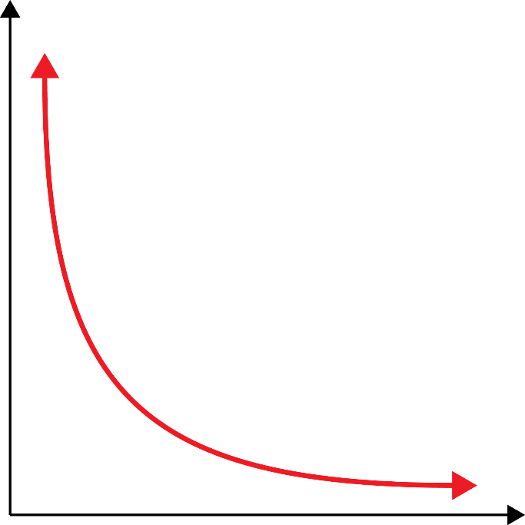
Graph of inverse proportion functions
Unit 12.3
The graph of this function is known as the hyperbola.
To plot a hyperbola, draw up a table of values and plot enough points to reveal the shape of the graph.
The graph of an inverse proportion:
is a smooth curve with the shape shown here
the curve never touches the axes.

Slide 30
Graph of inverse proportion functions
Unit 12.3
Formula
How to recognise an indirect proportion relationship
In an inverse proportion:
as one quantity decreases, the other increases
OR
as one quantity increases, the other decreases.
the product of the quantities is always the same.

Slide 31
Example 12.3 page 240
Unit 12.3
Area = 32 square units
A piece of cardboard must have a fixed area of 32 square units, but it can have different values for the length l and breadth b.
?
?

Slide 32
Example 12.3 page 240
Unit 12.3
Complete the following table of possible values for the length and breadth of the rectangle.
Draw a graph to show all the possible values of the length and breadth.
Is the graph continuous or discrete? Explain.
Why does the curve not touch the axes
Length | 1 | 2 | 4 | 8 | 16 | 32
Breadth | 32

Slide 33
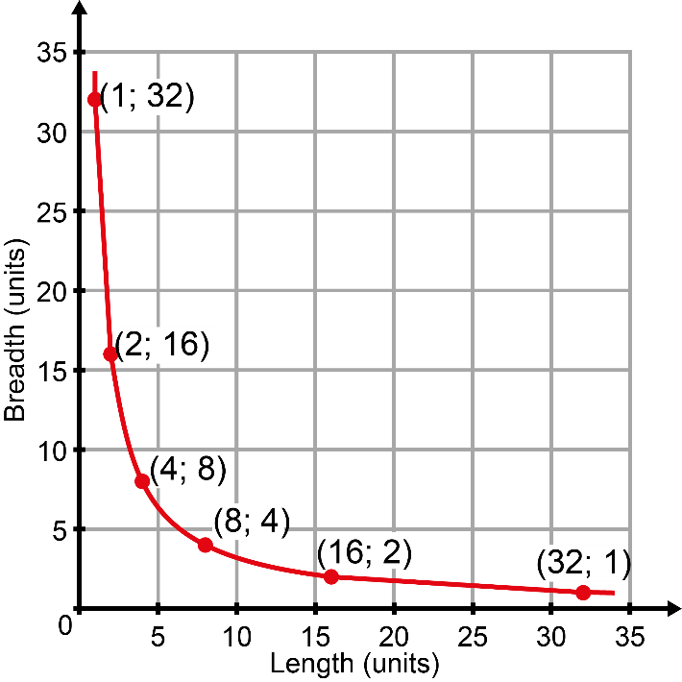
Example 1.4 page 238
Unit 12.3
Length | 1 | 2 | 4 | 8 | 16 | 32
Breadth | 32 | 16 | 8 | 4 | 2 | 1

Slide 34
Example 1.4 page 238
Unit 12.3
c) The measurement values are continuous values, so the graph is continuous.
d) Length and breadth cannot equal zero, so the graph does not touch either of the axes.

Slide 35
Exercise 12.4
Unit 12.3
Complete Exercise 12.4 on page 241 of your Student’s Book

Slide 36
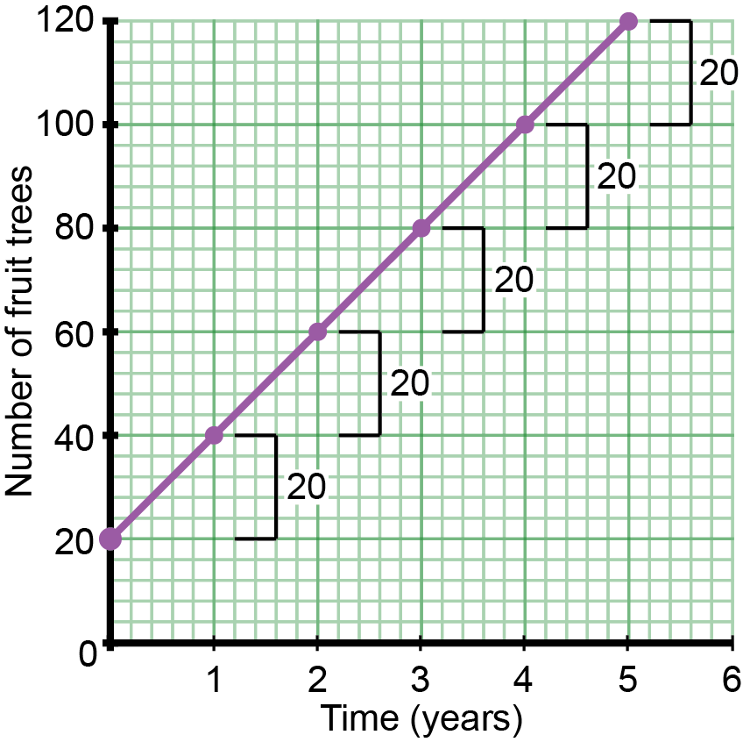
The graphs of constant rate and constant ratio
Unit 12.4
Compare constant rate (Graph A) with constant ratio (Graph B):
Graph A: Constant rate
constant rate of growth
the change is the same between each point of the graph
straight line graph
linear number pattern
constant difference is 20
Graph A: Constant rate
Year | 0 | 1 | 2 | 3 | 4 | 5
Value (R) | 20 | 40 | 60 | 80 | 100 | 120

Slide 37
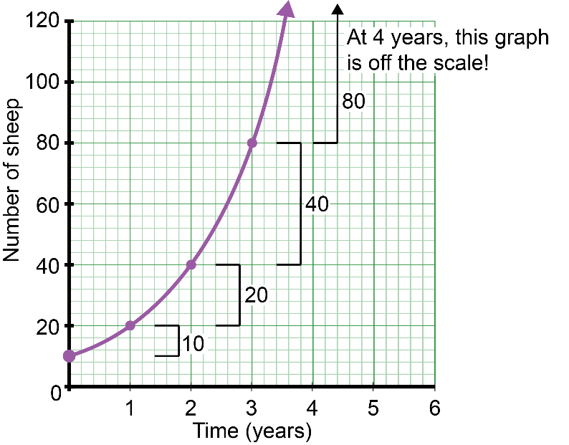
The graphs of constant rate and constant ratio
Unit 12.4
Graph B: Constant ratio
Compound growth or exponential graph.
Big differences in the number of sheep from point to point.
The constant ratio is 2.
Graph B: Constant ratio
Year | 0 | 1 | 2 | 3 | 4 | 5
Value (R) | 10 | 20 | 40 | 80 | 160 | 320
Doubling is one example of compound growth.
Compound growth is also shown if you save an amount of money and it earns compound interest.

Slide 38
Example 12.4 page 243
Unit 12.4
Celeste invests R3 000 at compound interest. The interest is added every year at 10% of the money she has in the account.
Fill in the table to show how the money grows.
The year that she starts is called year 0, because this is when she puts in the money.
Plot the graph of this relationship.
Year | 0 | 1 | 2 | 3 | 4 | 5 | 6 | 7 | 8
Amount of money (R) | 1 000 | 10% of 1 000 = 1 100

Slide 39
Example 1.4 page 238
Unit 12.4
Note: The amount will be multiplied by 10% (or 0,1) each time to get the next number in the pattern. This is a constant ratio pattern.
Year | 0 | 1 | 2 | 3 | 4
Amount of money (R) | 1 000 | 1 100 | 1 210 | 1 331 | 1 464
Year | 5 | 6 | 7 | 8
Amount of money (R) | 1 610,5 | 1 771,6 | 1 948,7 | 2 143,6

Slide 40
Example 1.4 page 238
Unit 12.3
Money (R)
Years

Slide 41
Exercise 12.5
Unit 12.4
Complete Exercise 12.5 on page 243 of your Student’s Book

Slide 42
Using formulae to determine values of variables using substitution
Unit 12.5
In formulae, letters such as x and y, or any letters, are used to represent values which are unknown. They can be used in equations or expressions to help solve problems.
The formulae we have been working with show the relationship between two variables. If we know the value of one variable in an equation, we can find the value of the other.
We can substitute the number for the letter.
Substitution
Putting a number in place of a letter in an equation.
”

Slide 43
Example 12.5 page 244
Unit 12.5
Thami needs to make a circle with an area of 40 cm². What should the radius of the circle be?
The formula for the area of a circle is A = πr². Use the value of 3,14 for π.
A = πr²
First get radius on its own on one side of the equation.
Area ÷ π = πr² ÷ π
$\frac{area}{\text{π}}$ = r²
r = $\sqrt{\frac{area}{\text{π}}}$ = $\sqrt{\frac{40}{3,14}}$
r = 3,569… = 3,57 cm
She needs to make the circle with a radius of 3,57 cm.

Slide 44
Exercise 12.6
Unit 12.5
Complete Exercise 12.6 on page 244 of your Student’s Book

Slide 45
Module assessment
Module 12
Complete Module assessment on page 246 of your Student’s Book

