Slide 1
Mathematical Literacy
NQF 4

Slide 2
Tariffs
Module 10

Slide 3
Overview
10.1 Telecommunication tariffs
10.2 Transport tariffs
10.3 Municipal tariffs
10.4 Tariffs for renting equipment of premises
10.5 Bank fees

Slide 4
Telecommunication tariffs Unit 10.1
There are tariffs for:
Different types of calls
Calls at different times
Different bundles of data
Study the individual tariffs carefully before completing questions.

Slide 5
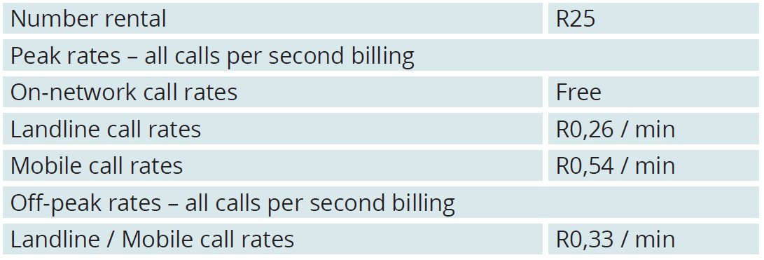
Example 10.2 page 198
Unit 10.1
Study the tariffs for a VoIP system (Voice over Internet Protocol)
Calculate the cost of rental if a business needs 40 telephones.
40 $×$ 25 number rentals = R1 000.

Slide 6
Example 10.2 page 198
Unit 10.1
The schedule below shows the calls made by 3 employees in one day. Each entry has the average seconds per call in brackets.
Calculate the total cost to the business for the calls of Employee 2.
Compare the cost of calls for Employee 1 and Employee 3.

Slide 7
Example 10.2 page 198 continued …
Unit 10.1
a) On-network calls: 10 calls × R0 = R0
Landline calls: 6 calls × 20 secs = 120 secs
120 ÷ 60 = 2 mins
2 min × R0,26 = R0,52
Mobile calls: 12 calls × 200 secs = 2 400 secs
2 400 ÷ 60 = 40 mins
40 min × R0,54 = R21,60
Total cost = R22,12

Slide 8
Example 10.2 page 198 continued …
Unit 10.1
b)
Employee 1
Employee 3
Landline calls: 14 calls × 40 secs = 560 secs; 560 ÷ 60 = 9,33 mins; 10 min × R0,26 = R2,60
On-network calls: 15 calls × R0 = R0
Mobile calls: 6 calls × 110 secs = 660 secs; 660 ÷ 60 = 11 mins; 11 min × R0,54 = R5,94
Landline calls: 2 calls × 38 secs = 76 secs; 76 ÷ 60 = 1,27 mins; 2 min × R0,26 = R0,52
Total cost = R8,54
Mobile calls: 3 calls × 84 secs = 252 secs; 252 ÷ 60 = 4,2 mins; 5 min × R0,54 = R2,70
Off-peak calls: 4 calls × 90 secs = 360 secs; 360 ÷ 60 = 6 mins; 6 min × R0,33 = R1,98
Employee 1 spends R3,34 more on calls for the day. 0
Total cost = R5,20

Slide 9
Example 10.2 page 198 continued …
Unit 10.1
In an average month, the business makes 790 on-network calls (48 secs), 530 landline calls (107 secs), 1 015 mobile calls (74 secs) and 90 off-peak calls (133 secs).
Calculate the total monthly bill for the company.
Include the 40 number rentals in your calculation.

Slide 10
Example 10.2 page 198 continued …
Unit 10.1
Business calls for the month
On-network calls: 790 calls × R0 = R0
Landline calls: 530 calls × 107 secs = 56 710 secs; 56 710 ÷ 60 = 945,17 mins; 946 min × R0,26 = R245,96
Mobile calls: 1 015 calls × 74 secs = 75 110 secs; 75 110 ÷ 60 = 1 251,83 mins; 1 252 min × R0,54 = R676,08
Off-peak calls: 90 calls × 133 secs = 11 970 secs; 11 970 ÷ 60 = 199,5 mins; 200 min × R0,33 = R66
Total cost: Rental cost + cost of calls = R1000 + R66 = R1 066

Slide 11
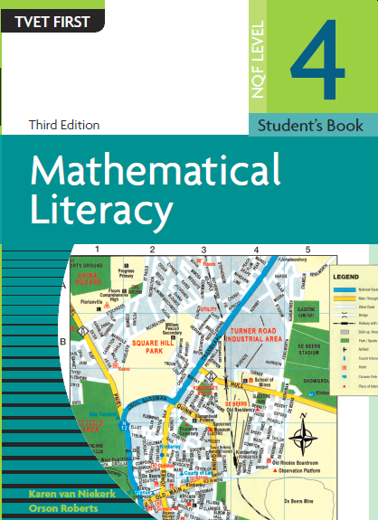
Exercise 10.1
Module 10.1
Complete Exercise 10.1 on page 192 of your Student’s Book

Slide 12
Transport tariffs Unit 10.2
There are tariffs for:
Transport of goods, depending on the size of the truck, the size of the load and the distance travelled
Toll roads
Train and bus trips
The next slide shows a map with toll roads marked around Johannesburg. Look for the gantries too.
Definition
What is a gantry?
An overhead structure where a specific fee is charged.
”

Slide 13
Transport tariffs

Slide 14
Comparing transport tariffs
There are transport tariffs that affect all people who travel to work
by public transport. We can compare the fares for different forms of transport using a graph.
How to draw a straight line graph
Step 1. Prepare the horizontal and vertical axis

Slide 15
Comparing transport tariffs
There are transport tariffs that affect all people who travel to work
by public transport. We can compare the fares for different forms of transport using a graph.
How to draw a straight line graph
720
700
Step 2. From your table, choose 2 sets of data. In the example, (1; 394) and (20; 394) are points on one graph. (1; 36) and (20; 720) are points on the other graph.
Graph 1
600
(1:394)
(20:394)
500
400
Graph 2
394
(1:36)
(20:720)
300
200
36
100
1
5
10
15
20
25

Slide 16
Comparing transport tariffs
There are transport tariffs that affect all people who travel to work
by public transport. We can compare the fares for different forms of transport using a graph
How to draw a straight line graph
720
700
Graph 1
600
(1:394)
(20:394)
Step 3. Join the points to draw the graphs
500
400
Graph 2
394
(1:36)
(20:720)
300
200
36
100
1
5
10
15
20
25

Slide 17
Comparing transport tariffs
There are transport tariffs that affect all people who travel to work
by public transport. We can compare the fares for different forms of transport using a graph
How to draw a straight line graph
700
Graph 1
600
(1:394)
(20:394)
Step 4. Label your axis
500
400
Graph 2
Cost (R)
(1:36)
(20:720)
300
200
100
5
10
15
20
25
Days

Slide 18
Example 10.5 page 204
Here is a graph of daily costs of bus fare and weekly costs of a train ticket.
Discussion
Discuss why the blue graph is higher than the red graph, for most of the days.

Slide 19
Exercise 10.2
Module 10.2
Complete Exercise 10.2 on page 206 of your Student’s Book

Slide 20
Municipal tariffs Unit 10.3
There are tariffs for residential and business services:
Refuse (solid waste) removal
Sewage disposal
Water supply
Electricity supply
Always check the service to be provided and the rate or tariff. Note whether VAT is included or not.
Be aware that municipal tariffs are often tiered.
Definition
What is a tiered tariff?
Different tariffs for different levels of water or electricity usage.
”

Slide 21
Municipal tariffs
Unit 10.3

Slide 22
Exercise 10.3
Module 10.3
Complete Exercise 10.3 on page 209 of your Student’s Book

Slide 23
Renting equipment or premises
Unit 10.4
Equipment
Are items needed for a purpose, like computers, carpet cleaners or electrical tools.
”
Premises
A building to use for a business or club.
”
Lease
A rental contract.
”
Leasing has several advantages:
Fixed costs
Maintenance plan
Replacement of old equipment
Flexible lease time periods

Slide 24
Example 10.7 page 210
Unit 10.4
A supermarket chain must replace two photocopiers. They have two options:
Purchase the machines at a cost of R40 000 each.
Lease the equipment on a 24-month agreement at a cost of R825 per month per machine. The agreement includes a full maintenance plan and training for staff.

Slide 25
Example 10.7 page 210 continued …
Unit 10.4
Calculate the cost of the lease of two machines for 24 months.
Is there an advantage to the company when leasing the machines rather than buying them? Explain.
Is there a disadvantage for the company?
What is the advantage to the company that leases the machines?

Slide 26
Example 10.7 page 210 continued …
Unit 10.4
2 machines × R825 × 24 months = R39 600
Yes. The cost of leasing the equipment for 2 years is less than the cost of one machine. If the equipment breaks, the company is protected by the maintenance plan. Technicians will fix the problem at no extra charge.
Yes. They will not own the equipment. It belongs to the company leasing the equipment. At the end of 24 months, the equipment will be removed unless the company signs a new agreement.
They can lease the same machine to a different company at the end of the lease agreement. If they maintain the equipment carefully, they can lease the equipment for many years.

Slide 27
Exercise 10.4
Module 10.4
Complete Exercise 10.4 on page 211 of your Student’s Book

Slide 28
Bank fees Unit 10.5
All banks charge fees for their services
Most fees are for depositing and withdrawing cash, especially on a business account
Always compare the fees of different banks

Slide 29
Example 10.8 page 212
Class activity
Answer the questions, using the table below:
1. How much would it cost to withdraw R5 400 from Bank A’s ATM?
2. What is the fee for depositing R23 742, 80 at Bank B’s branch?
Transaction | Bank A | Bank B
Monthly fee | R57 | R65
Cash withdrawal (own bank’s ATM) | R3,95 + R1,35 / 100 | R1,80 per R100
Cash withdrawal (another bank’s ATM) | R9,95 + R1,35 / 100 | R6,70 + R1,80 per R100
Cash withdrawal at branch | R9,95 + R1,35 / 100 | R25 + R1,80 per 100
Cash deposit (own ATM) | R3,95 + R1,35 / 100 | R1,80 per R100
Cash deposit at branch | R24,00 + 1,45 / 100 | R29 + R1,80 / 100

Slide 30
Example 10.8 page 212
Unit 10.5
The graph compares the cost of withdrawing cash at Bank A’s own ATMs and Bank B own ATMs
Estimate the coordinates of the point of intersection.
What does the point of intersection represent?
Which bank has cheaper fees for the withdrawal of R700?
Big businesses generally withdraw large sums of money. Which bank has the best option for this purpose?

Slide 31
Example 10.8 page 212
Unit 10.5
(800:15). Note, this is an estimation.
This is the point at which both banks have the same fee.
Bank B. The blue graph is below the red graph.
Bank B

Slide 32
Bank Fees
Unit 10.5

Slide 33
Exercise 10.5
Module 10.5
Complete Exercise 10.5 on page 214 of your Student’s Book

Slide 34
Module assessment
Module 10
Complete Module assessment on page 215 of your Student’s Book

