Slide 1
Mathematical Literacy
NQF 3

Slide 2
Managing your finances with confidence
Module 9

Slide 3
Overview
9.1 Financial matters relating to home-based workplaces and businesses
9.2 Sources of income for a business
9.3 Business expenditure
9.4 Budgets and income and expenditure statements
9.5 Understanding variance
9.6 Corrective measures in financial control

Slide 4
Overview continued ...
9.7 The costs of running a business
9.8 Calculating the cost of production
9.9 Calculating the selling price

Slide 5
Financial matters relating to home-based workplaces and businesses
Unit 9.1
Before starting a small business you need to understand financial control.
Here are some terms and concepts that must be known.
Budgeting – long-term, medium-term and short-term planning
Income and expenditure statements
Loans, repayments, interest rates and periods

Slide 6
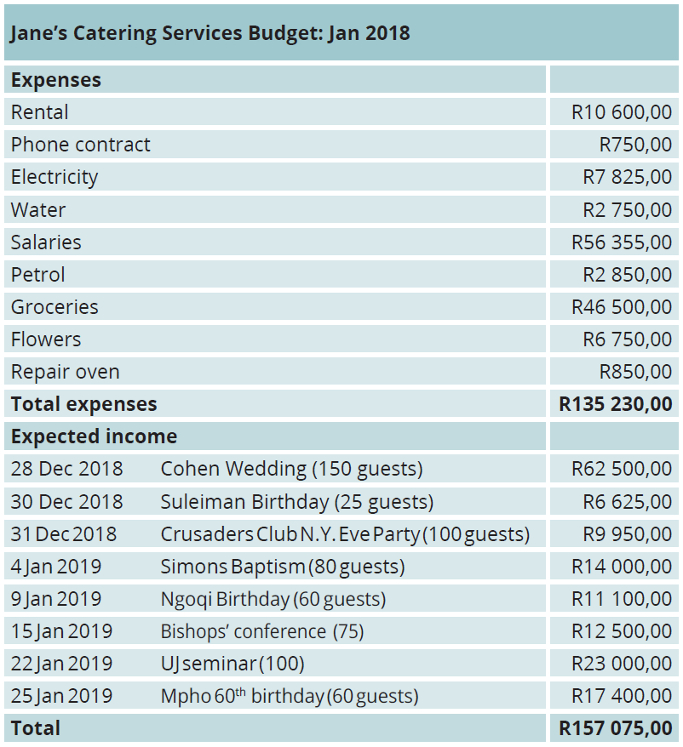
Example 9.1 page 163
Unit 9.1
Study the budget below, then answer the questions that follow.
List Jane’s fixed costs.
List her variable costs.
Explain why the repair to the oven is an occasional expense.
Explain why electricity is a variable expense.

Slide 7
Example 9.1 page 163
Unit 10.1
Rental, phone contract and salaries
Electricity, water, petrol, groceries and flowers
This is an expense that will not happen every month. It will not happen very often.
The cost of electricity depends on how much you use. Jane would not use exactly the same amount every month.

Slide 8
New terms and concepts
Unit 9.1
Cost of production
The costs to the business for producing the goods for sale.
Real cost/ total cost
All the costs are included when calculating the unit price.
Selling price
The price that the customer pays for the goods.
Break-even point
The value where the selling price and the cost price are equal. There is no profit and no loss.

Slide 9
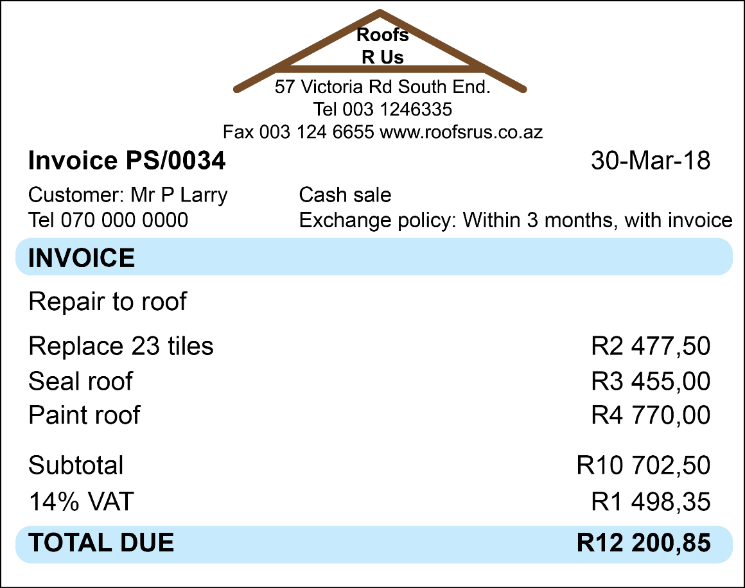
Financial documentation
Unit 9.1
Quotation

Slide 10
Financial documentation
Unit 9.1
Invoice

Slide 11
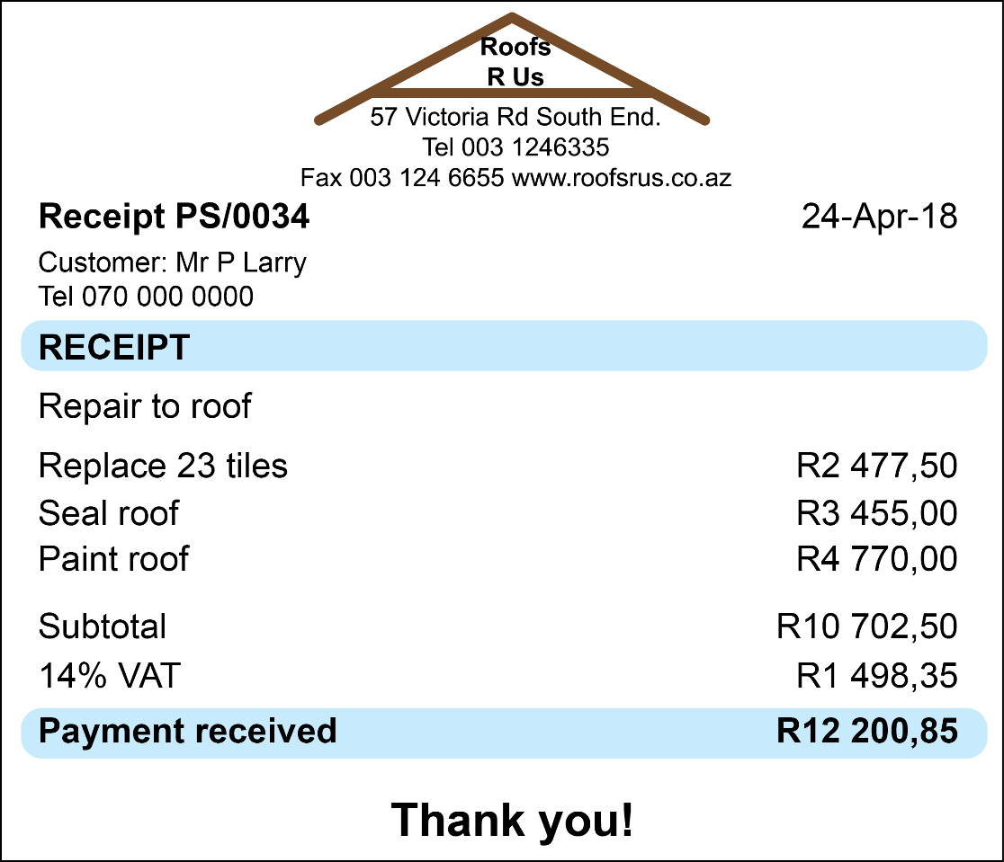
Financial documentation
Unit 9.1
Receipt

Slide 12
Example 9.2 page 166
Unit 9.1
Study the quotation, invoice and receipt in the previous slides. Then answer the questions that follow.
Explain why the date is different on each of the documents.
On the quotation, was the price VAT-inclusive or VAT-exclusive?
Why do you think a business might prefer to exclude VAT from the quoted price?
Did the customer pay for the service immediately? Give a reason for your answer.

Slide 13
Example 9.2 page 166
Unit 9.1
The quotation is given to the customer first. Once the customer accepts the quotation, the service is provided. After the service is provided, the invoice is given to the customer. The customer only pays after the invoice has been received.
VAT-exclusive.
The VAT-exclusive price is lower, and thus more attractive to the customer.
No. The invoice is dated 30 March and the receipt is dated 24 April.

Slide 14
Documentation, terms and concepts relating to employees
Unit 9.1
Payslip | All employees, even casual workers, must be given a payslip when they are paid. The payslip must clearly state gross income, nett income, tax deductions made, as well as deductions such as UIF.
Gross income | Gross income refers to your earnings before deductions. This includes salary, bonuses, commission, overtime pay and all other income.
Nett income | Your nett income refers to your income after deductions. This is also called your take-home pay.
Pay as You Earn (PAYE) | This tax is determined by your income – the more you earn, the more PAYE you pay. This tax is determined by the government every year and used by the government to run the country.

Slide 15
Documentation, terms and concepts relating to employees
Unit 9.1
Unemployment Insurance Fund (UIF) | A fund into which all employees pay 1% of their gross income. The employer also pays 1% on the employee’s behalf. The fund is used to pay unemployment benefits to people who lose their jobs.
Taxable income | This is the portion of income on which you will pay tax. Every year the Minister of Finance determines the threshold. If you earn below the threshold, you don’t pay tax. In 2017 the threshold was R75 740,00. So the first R75 740,00 that you earned was not taxable. Everything that you earned after that, was taxable income.

Slide 16
Documentation, terms and concepts relating to employees
Unit 9.1
Tax rebate | This is an amount of money deducted from your gross earnings, before tax is calculated. In 2017 this amount was R75 740,00. So your tax is calculated on a smaller amount than you actually earn. A tax rebate also refers to money paid back to the taxpayer, if you paid too much in tax.

Slide 17
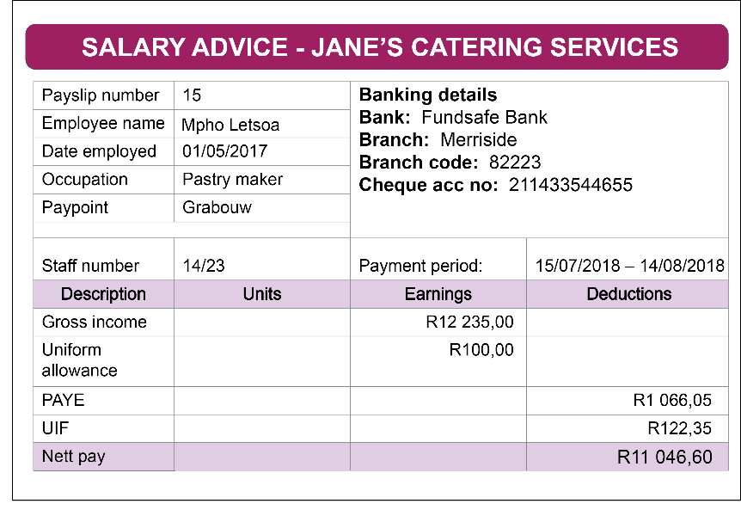
Example 9.3 page 167
Unit 9.1
Who does this payslip belong to?
What is the person’s occupation?
What is her gross monthly income?
Explain why her nett pay is less than her gross income.
How does the company pay her?

Slide 18
Example 9.3 page 167
Unit 9.1
Mpho Letsoa
She is a pastry maker
R12 235,00
Deductions are made from her gross income.
Her salary is paid into her cheque account.

Slide 19
Exercise 9.1
Unit 9.1
Complete Exercise 9.1 on page 168 of your Student’s Book

Slide 20
Sources of income for a business
Unit 9.2
Income can be received from the following sources:
Source of income | Example
Sales made or services rendered | Methu sells biscuits. The money from sales is his source of income. John fixes cars. The money from providing the service is his source of income.
Interest earned on investments We pay interest when we borrow money (from a bank), and we earn interest when we invest money (at a bank or other financial institution). | Rajen invested R20 000,00 of his business income. Every month the interest he earns on the investment is part of his income.
Rent received | Jannie rents out his garage to his neighbour. The rental he receives forms part of his income.

Slide 21
Sources of income for a business
Unit 9.2
Capital sources.
Source of income | Example
Grants from government | Through the Department of Trade and Industry Jonah received R50 000,00 towards the purchase of equipment for his panel beating business
Sponsorships from investors and loans from banks or similar institutions | To buy a Fish & Chips franchise, Tony needed R450 000,00. He raised a loan for R300 000,00 from a bank and found an investor who invested the remaining R150 000 in the business.

Slide 22
Example 9.4 page 169
Unit 9.2

Slide 23
Exercise 9.2 and 9.3
Unit 9.2
Complete Exercise 9.2 and 9.3 on page 170 and 171 of your Student’s Book

Slide 24
Business expenditure
Unit 9.3
Running a business costs money. The bigger the business the greater the expenditure.
Here are some typical business expenditures:
Running expenses – also known as operating costs. e.g. electricity, rent
Bank fees and payments – interest for loans and overdrafts and monthly banking costs.
Transport costs – cost of vehicle transport or goods
Insurance fees – insurance against loss or accidents
Skills levies – payment of levies to government for skills training.

Slide 25
Example 9.5 page 172
Unit 9.3
Jessie runs a laundry service for restaurants. She collects the tablecloths, washes and irons them, then returns them to the restaurants.
She runs 2 vans and employs 2 drivers. Each of the drivers earns R7 500 per month.
In the laundry she employs 2 permanent people to wash and iron, and also employs other workers on a casual basis when there is too much work for the 2 permanent laundry workers. The permanent laundry workers earn a basic salary of R5 500, as well as a commission of R0,85 per tablecloth that is washed and ironed.
Jessie’s running expenses are R9 340,00 per month, on average. In addition, she is paying the bank R2 320 per month on the loan for her laundry equipment.

Slide 26
Example 9.5 page 172
Unit 9.3
Jessie’s laundry workers wash and iron a total of 4 334 tablecloths for the month. Calculate the commission each worker will earn, if they washed an equal number of tablecloths.
Total commission: 4 334 × R0,85 = R3 683,90
Each worker will earn commission of:
(3 683,90 ÷ 2) = R1 841,95

Slide 27
Example 9.5 page 172
Unit 9.3
If Jessie also employed casual workers for a total of 14 hours, at a cost of R25,80 per hour, calculate Jessie’s total expenditure on salaries, wages and commission.
How much would Jessie have to pay into the Skills Development Fund?
Expenditure of salaries, wages and commission
= salary of 2 drivers + salary of 2 permanent workers + wages for casual workers + commission
= (2 × 7 500) + (2 × 5 500) + (2 × 1 841,95) + (14 × R25,80)
= 15 000 + 11 000 + 3 683,90 + 361,20
= R30 045,10
3. 1% × 30 045,10 = R300,45

Slide 28
Example 9.5 page 172
Unit 9.3
Calculate Jessie’s total expenditure for the month.
Jessie charges restaurants R11,75 per tablecloth. Was her income greater than her expenditure? Show your calculations.
Salaries, wages & commission + Skills Development Levy
+ running expenses + bank loan
= 30 045,10 + 300,45 + 9 340 + 2 320
= R42 005,55
4 334 tablecloths × R11,75 = R50 924,50.
Her expenditure was R42 005,55, so her income was
greater than her expenditure.

Slide 29
Exercise 9.4
Unit 9.3
Complete Exercise 9.4 on page 173 of your Student’s Book

Slide 30
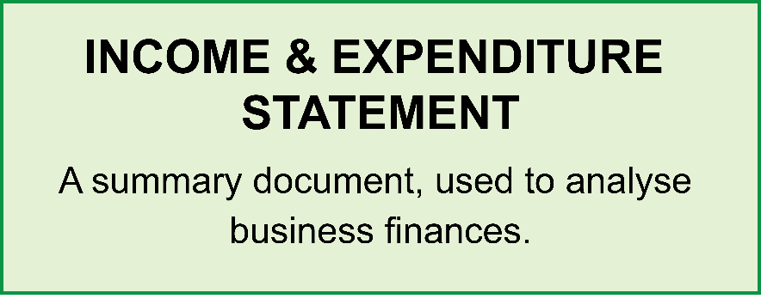
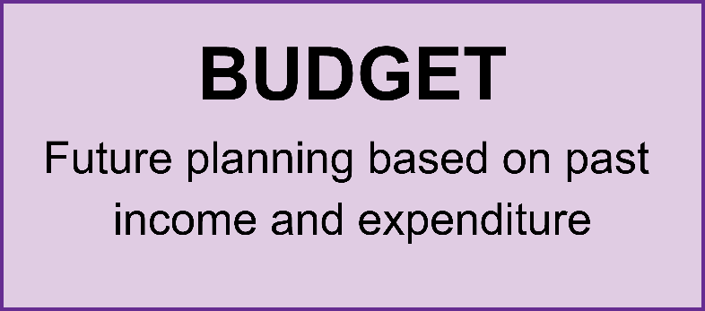
Budgets and income and expenditure statements
Unit 9.4

Slide 31
Income and expenditure statements
Unit 9.4
The statement indicates actual income and expenditure. It serves as a tool to budget for future business activities.
The statement informs the business owner about how well the business is doing and if costs need to be cut to increase profitability or not.

Slide 32
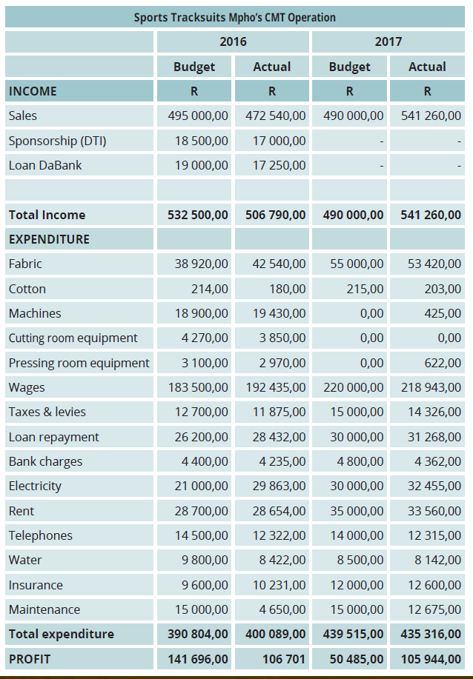
Example 9.7 page 176
Unit 9.4
Mpho runs a Cut, Make & Trim (CMT) operation. His small factory manufactures tracksuits for a larger business. The larger business sells the tracksuits to shops and sports clubs.
In 2016 Mpho obtained start-up funding for his business, as his budget shows.
By comparing his actual income and expenditure for 2016 and 2017, Mpho could see that his expenditure in 2017 was different from his expenditure in 2016.

Slide 33
Example 9.7 page 176
Unit 9.4
Mpho’s total income for 2016 was less than he budgeted for.
In 2017 his income was more than he budgeted for.
In 2016 Mpho’s income included sponsorship and a bank loan.
In 2017 his income was from sales only.
In 2016 his total expenditure was slightly more than his budget. In 2017 it was slightly less than his budget.
For both 2016 and 2017, Mpho’s income was more than his expenditure. This is a good sign, because it shows that the business made a profit.

Slide 34
Exercise 9.5
Unit 9.4
Complete Exercise 9.5 on page 177 of your Student’s Book

Slide 35
Understanding variance
Unit 9.5
Variance
Variance is the difference between the budgeted income and the actual income received.
Favourable Budget
Adverse Variance
Income > Budget
Income < Budget
When actual income is more than budget
When actual income is less than budget

Slide 36
Causes of variance
Unit 9.5
As budgets are based on previous year's figures, certain factors can affect these projections.
The factors may include the following:
1
Incorrect figures in previous year's statements.
2
Poor economic performance in the country.
3
Adverse weather, such as drought conditions.
4
Adverse socio-economic factors such as unemployment, retrenchments and less disposable income by customers.

Slide 37
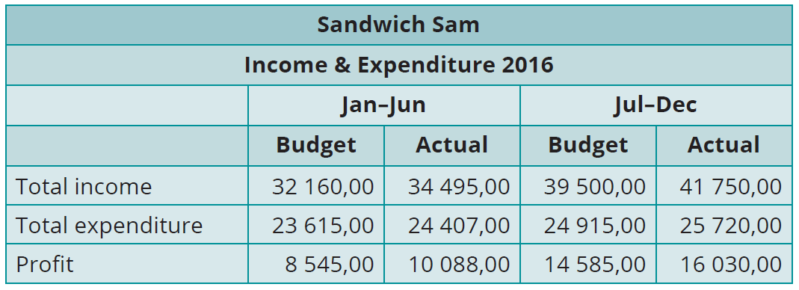
Example 9.8 page 181
Unit 9.5
In Exercise 9.5, Sam’s budgeted income for January to June 2016 was R32 160. His actual income was R34 495.
The variance between Sam’s budgeted income and his actual income is R34 495 – R32 160 = R2 335.
When the variance is very large, the business should adjust the budget for the next year. Look at Sam’s statement:

Slide 38
Example 9.8 page 181
Unit 9.5
Calculate the variances for the budgeted and actual figures for January to June.
Is the variance between budgeted and actual income greater in the first or the second half of the year? Give a reason for your answer.

Slide 39
Example 9.8 page 181
Unit 9.5
Income variance: R34 495 – R32 160 = R2 335,00
Expenditure variance: R24 407 – R23 615 = R792,00
Profit variance: R10 088 – R8 545 = R1 543,00
Variance from July to December:
= R41 750 – R39 500 = R2 250,00
(variance Jan to June) – (variance Jul to Dec)
= R2 335 – R2 250 = R85
The variance is R85 greater in the first half of the year

Slide 40
Exercise 9.6
Unit 9.5
Complete Exercise 9.6 on page 182 of your Student’s Book

Slide 41
Corrective measures in financial control
Unit 9.6
Running a business involves risks. Planning and record-keeping enable a business person to anticipate any problems and take action immediately.
Factors that put a business at risk include:
Not collecting moneys owed
Unaware of the effect of increased expenditure on profits
Spending business income on personal expenses
Incomplete financial record keeping
Not paying taxes due and SARS issuing penalties
Not paying staff, leading to labour unrest, etc.

Slide 42
Example 9.12 page 184
Unit 9.6
Janet owns a panel-beating shop. Her business was not making a good profit and she decided not to pay her insurance premiums to save on costs. Thieves stole some equipment.
Now she could not claim for her loss.

Slide 43
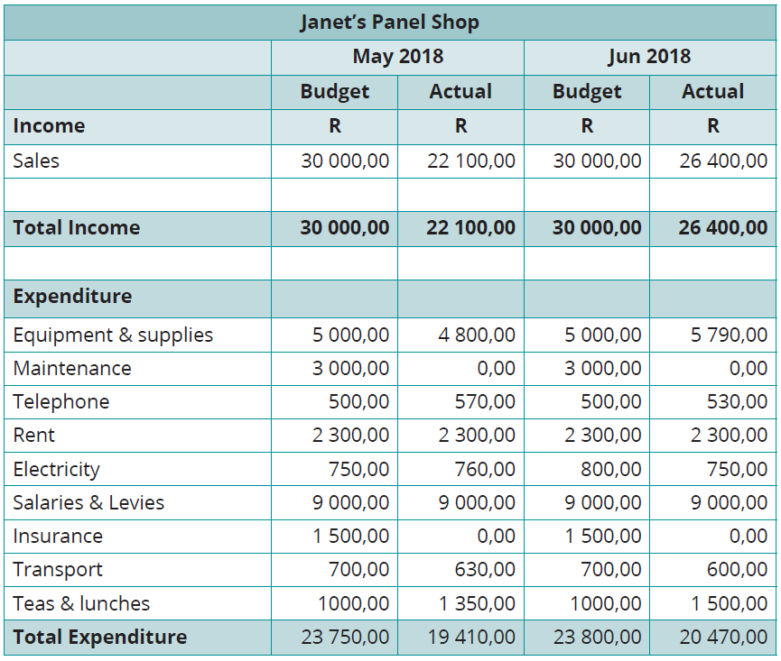
Example 9.12 page 184
Unit 9.6
Here are her statements for May and June 2018
Janet owns a panel-beating shop. Her business was not making a good profit and she decided not to pay her

Slide 44
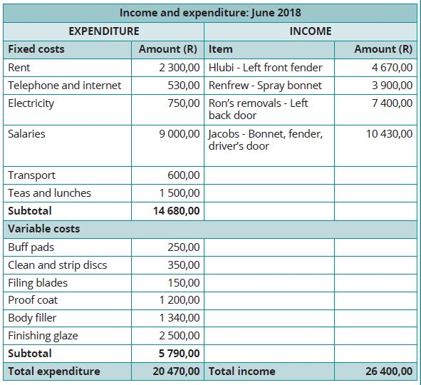
Example 9.12 page 184 continued ...
Unit 9.6

Slide 45
Example 9.12 page 184 continued ...
Unit 9.6
Calculate Janet’s profit in June 2018.
How much was her insurance premium?
Which expenditures could she cut back on in order to afford the insurance premium?
What are the implications for Janet’s business because she did not pay her insurance premiums regularly?
Can Janet save her business? Discuss.

Slide 46
Example 9.12 page 184 continued ...
Unit 9.6
R26 400 – R20 470 = R5 930
R1 500
Teas and lunches
She cannot replace the equipment and therefore cannot provide a service to customers.
She will lose income and will not be able to meet her fixed expenses.
Yes. She could take a loan to replace the equipment. She has to review her expenditure and cut down on unnecessary spending.

Slide 47
Exercise 9.7
Unit 9.5
Complete Exercise 9.7 on page 186 of your Student’s Book

Slide 48
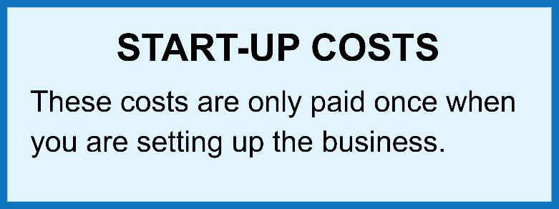
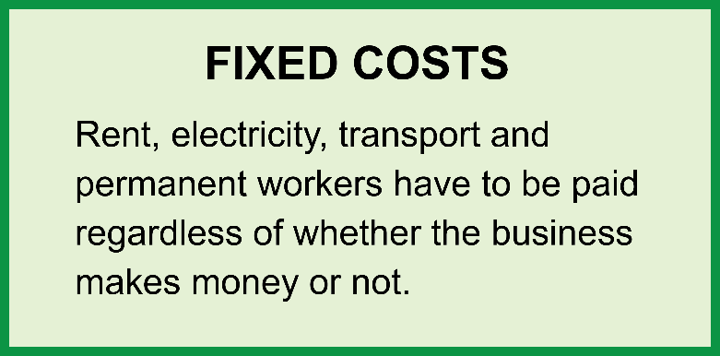
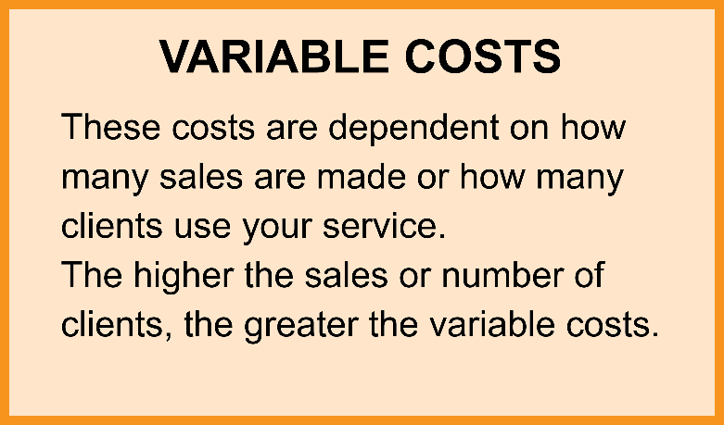
The cost of running a business
Unit 9.7
+

Slide 49
Different businesses have different costs.
Unit 9.7
Business that offers services have variable costs related to the service.
Business that makes products have variable costs related to ingredients.
Businesses that buy goods for resale have variable costs related to number of goods bought for resale.

Slide 50
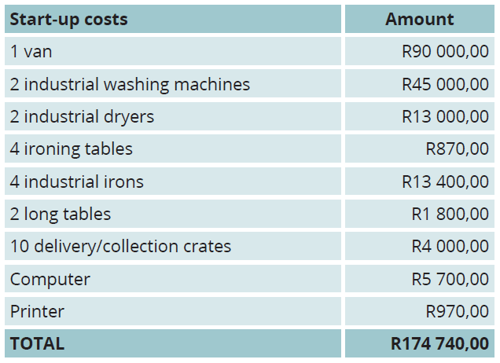
Example 9.13 page 187
Unit 9.7
Jessie collects, washes and delivers tablecloths to restaurants. For her laundry, her start-up costs were related to equipment she needed for doing the washing and ironing. She took out a loan to cover the start-up costs.
The following budget shows the start-up costs for Jessie’s laundry service:

Slide 51
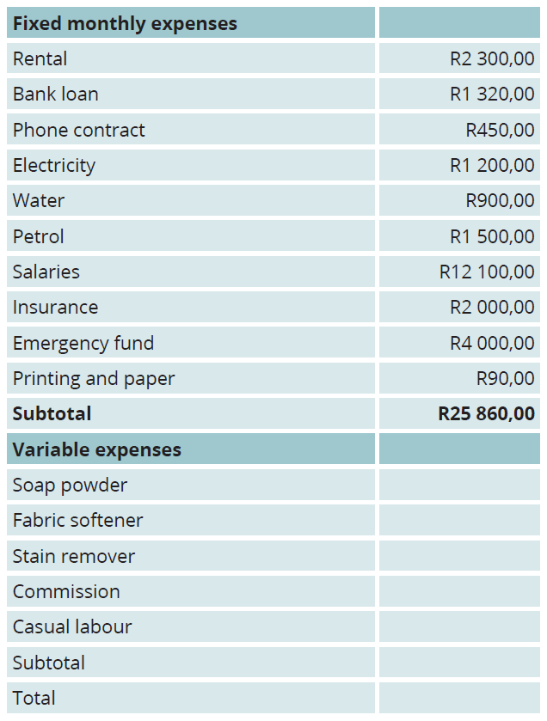
Example 9.13 page 187
Unit 9.7
Jessie uses the same template every month when she prepares her budget
Her fixed costs are already typed in. Jessie adjusts the variable costs according to the number of tablecloths she has to wash for the month.
She has to calculate the amount of soap powder, fabric softener, stain remover and commission payable based on the number of tablecloths.
Also, she only hires contract workers when her permanent employees cannot cope with the workload.

Slide 52
Exercise 9.8
Unit 9.7
Complete Exercise 9.8 on page 189 of your Student’s Book

Slide 53
Calculating the cost of production
Unit 9.8
When the cost of production or the delivery of a service is calculated, accuracy in calculations is important.
Accuracy helps you to keep business expenditure lower than business income.

Slide 54
Exercise 9.9
Unit 9.7
Complete Exercise 9.9 on page 191 of your Student’s Book

Slide 55
Calculating the selling price
Unit 9.9
Profit is the aim of any business

Slide 56
Calculating the selling price
Unit 9.9
The price of goods or a service is determined by calculating costs, but there are also other factors to consider.
Other factors to consider are:
1
Market research
2
Offering value for money
3
Comparing competitors' prices

Slide 57
Exercise 9.10
Unit 9.8
Complete Exercise 9.10 on page 192 of your Student’s Book

Slide 58
Finding the break-even point
Unit 9.9
This is the value where the income is equal to the cost
i.e. the value from which you can start to make a profit
When the business increases the selling price, the break-even point is reached sooner.
The business can only increase the selling price if they remain competitive.

Slide 59
Example 9.16 page 192
Unit 9.9
Sam sells sandwiches to workers in an industrial area. His monthly fixed expenses are R1 150. On average it costs him R5,00 to make a sandwich, and he charges customers R12,50 per sandwich.
Show that Sam will not make a profit if he only sells 100 sandwiches.
Will Sam make a profit if he sells 150 sandwiches? Show your calculations.
Will Sam make a profit if he sells 160 sandwiches? Show your calculations.
Complete the sentence: Sam should sell between ______ and ______ sandwiches before he breaks even.
Do a few calculations to find his break-even point.

Slide 60
Example 9.15 page 192
Unit 9.9
Total expenses = fixed expenses + variable expenses
= R1 150 + (R5,00 × 100) = R1 150 + R500 = R1 650,00
Income = R12,50 × 100 = R1 250,00
Profit = Income – expenses
= R1 250 – R1 650
= −R400,00
Total expenses = fixed expenses + variable expenses
= R1 150 + (R5,00 × 150) = R1 150 + R750 = R1 900,00
Income = R12,50 × 150 = R1 875,00
Profit = Income – expenses
= R1 875 – R1 900
= −R25,00
Sam will not make a profit. He will make a loss of R25,00.

Slide 61
Example 9.16 page 192
Unit 9.9
Total expenses = fixed expenses + variable expenses
= R1 150 + (R5,00 × 160) = R1 150 + R800 = R1 950,00
Income = R12,50 × 160 = R2 000,00
Profit = Income – expenses
= R2 000 – R1 950 = R50,00
Yes, he will make a profit of R50,00.
Sam should sell between 151 and 160 sandwiches before he breaks even.
e) i) Total expenses = fixed expenses + variable expenses
= R1 150 + (R5,00 × 152) = R1 150 + R760 = R1 910,00
Income = R12,50 × 152 = R1 900,00
Profit = Income – expenses
= R1 900 – R1 910 = −R10,00
He should sell more than 152 sandwiches.

Slide 62
Example 9.16 page 192
Unit 9.9
ii) Total expenses = fixed expenses + variable expenses
= R1 150 + (R5,00 × 153) = R1 150 + R765 = R1 915,00
Income = R12,50 × 153 = R1 912,50
Profit = Income – expenses
= R1 912,50 – R1 915 = −R2,50
iii) Total expenses = fixed expenses + variable expenses
= R1 150 + (R5,00 × 154) = R1 150 + R770 = R1 920,00
Income = R12,50 × 154 = R1 925,00
Profit = Income – expenses
= R1 925 – R1 920 = R5,00
When Sam sells 154 sandwiches he will break even.

Slide 63
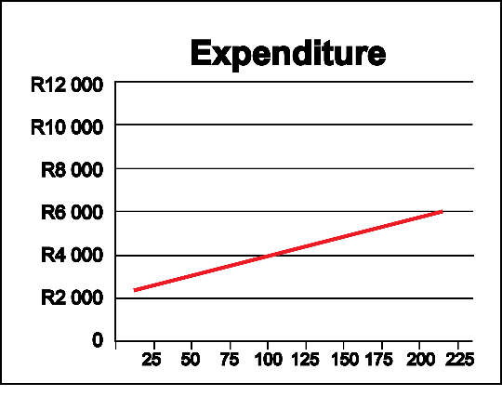
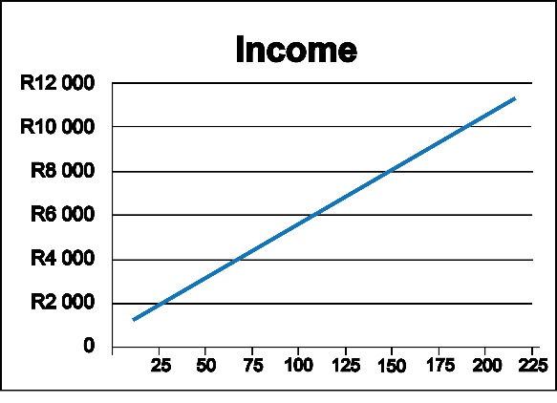
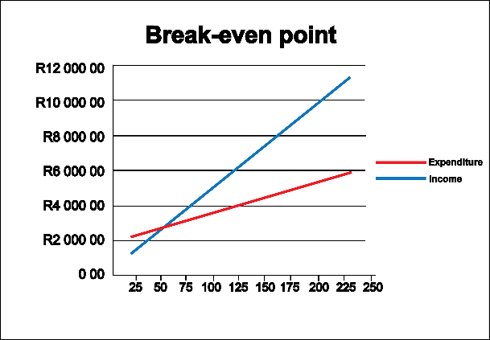
Using a graph to find the break-even point
Unit 9.9
Graphs provide a visual representation of how the costs of production and the income generated relate to each other.

Slide 64
Example 9.17 page 194
Unit 9.9
Sam sells sandwiches to workers in an industrial area. His monthly fixed expenses are R1 150.
On average it costs him R5,00 to make a sandwich, and he charges customers R12,50 per sandwich.
Sam knows that he needs to sell between 150 and 160 sandwiches before he makes a profit.

Slide 65
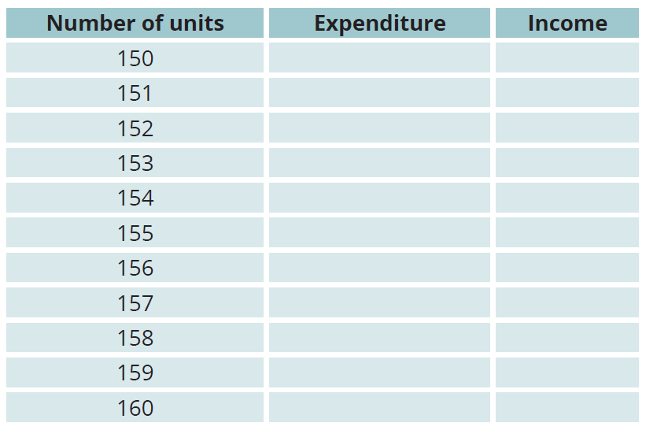
Example 9.17 page 194
Unit 9.9
1. Complete the table below.
2. On the same system of axes, use the table to plot:
his expenditure values b) his income values
Write down the co-ordinates of the point of intersection of the two graphs.
4. What does this point represent?

Slide 66
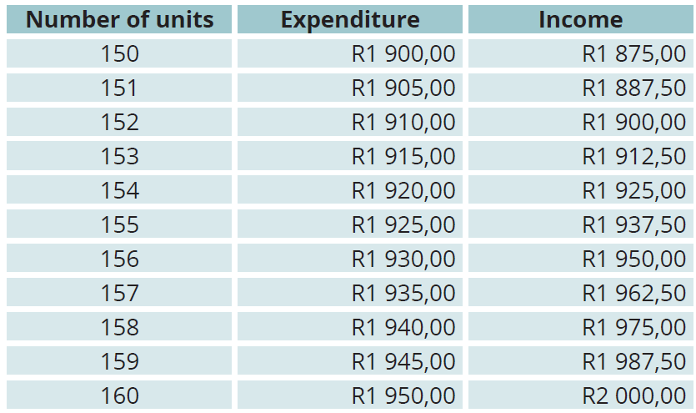
Example 9.17 page 194
Unit 9.9

Slide 67
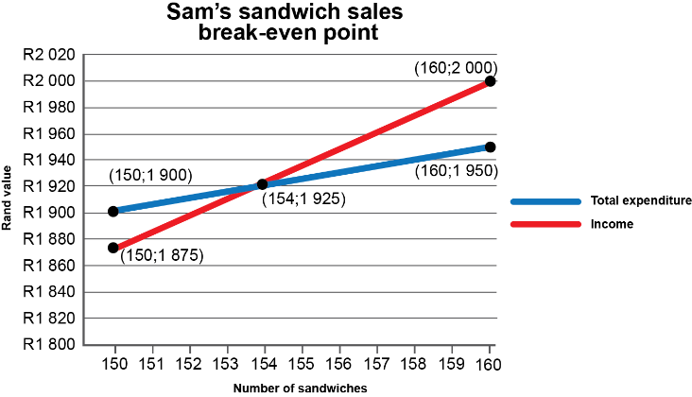
Example 9.17 page 194
Unit 9.9
(52; 1 925)
The break-even point

Slide 68
Exercise 9.11
Unit 9.8
Complete Exercise 9.11 on page 195 of your Student’s Book

Slide 69
VIDEO: Applications in the workplace

Slide 70
Module assessment
Module 9
Complete Module assessment on page 198 of your Student’s Book

