Slide 1
Mathematical Literacy
NQF 3

Slide 2
Read, interpret and use representations to make sense of and solve problems in workplace contexts
Module 7

Slide 3
Overview
7.1 Recognising representation concepts
7.2 Recognise symbols and notations used on plans
7.3 Working with scale
7.4 Using road, street and route maps
7.5 Plans to determine quantities of material needed
7.6 Interpreting instructions and assembly diagrams

Slide 4
Recognising representation concepts
Unit 7.1
Diagram
A diagram is a simplified drawing which provides information about the appearance and workings of a system or object.
Map
A map is a visual representation of an area using symbols to identify significant places.
Plans
Plans are a set of diagrams to describe a place or object, or to communicate building or production instructions.

Slide 5
Recognising representation concepts
Unit 7.1
Maps and plans are often drawn on grids that use line and block references.
The reference of a location identifies the horizontal position first and then the vertical position.

Slide 6
Example 7.1 page 117
Unit 7.1
Look at the street map and answer the questions.
Which streets cross in block A1?
Name three blocks through which the Blue River runs.
In which block do Rose Avenue and Second Street cross each other?
In which block do Third Street and Pine Avenue cross?
What feature do you see in block D4?

Slide 7
Example 7.1 page 117
Unit 7.1
3
5
Fourth Street and Rose Avenue
D1, D2 and E3
B4
D1
Luthuli Park
2
2
1
2
4

Slide 8
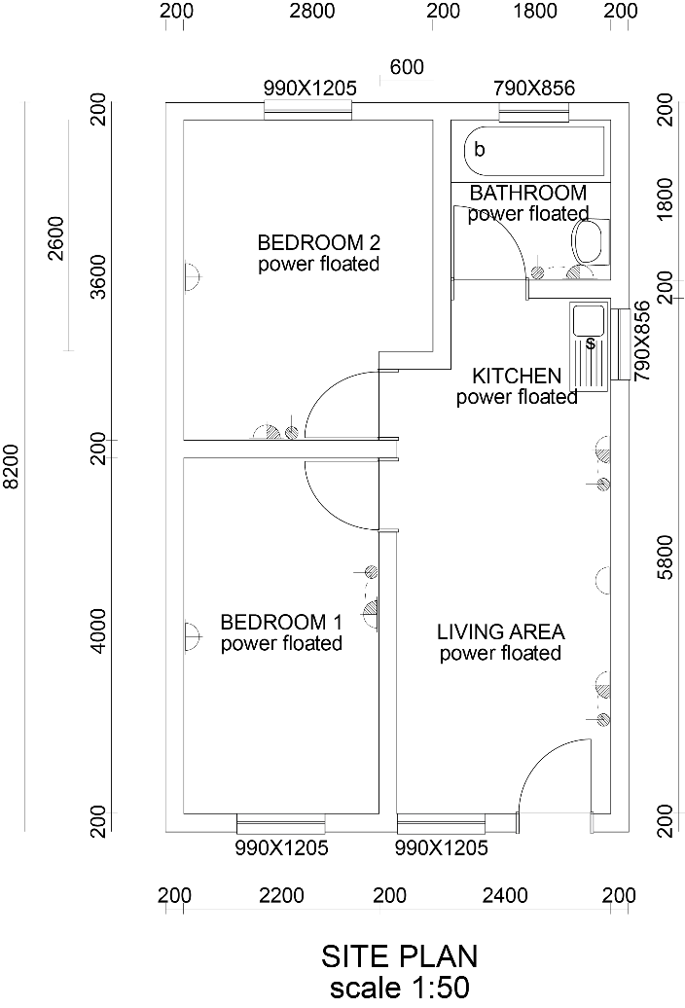
Floor plans
Unit 7.1
The floor plan of a building is drawn from the top, showing the inside plan.
This view shows how the building will be divided up.
It shows where the walls, doors, windows, toilets, kitchen, etc will be.

Slide 9
Floor plans
Unit 7.1
Floor plans are drawn to scale. So the measurements on the plan are in proportion to the actual measurements.
The scale on a floor plan for a house is usually about 1 : 50 or 1 : 100.
For 1 : 50, 1 cm on the plan represents 0,5 m.
For 1 : 100, 1 cm on the plan represents 1 m.

Slide 10
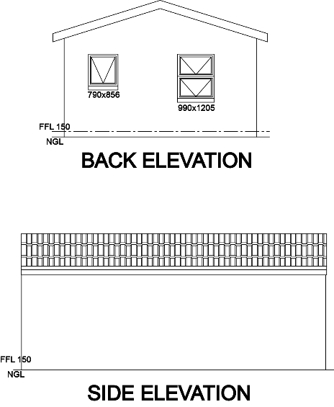
Elevations
Unit 7.1
An elevation shows the front, back or side view of a building.
Here is a building, with its elevations.

Slide 11
Scale, scale drawings and distance
Unit 7.1
Maps and plans are drawn to scale to represent distances accurately.
The distances on the map are proportional to the actual distances.
A map of the world could be on a scale of 1 : 50 000 000
Travel maps usually use scales of 1 : 125 000 or 1 : 50 000.
Street maps are usually 1 : 10 000
Floor plans for buildings often use scales of 1 : 50 or 1 : 100.

Slide 12
Giving directions
Unit 7.1
You need a starting point to direct from.
Use words like: left, right, up, down, sideways, across, north, south, east or west.
Keep the route simple, especially if the person who needs directions does not know the area.
Tell them where to turn, using a direction and a street name. Landmarks, traffic lights, names of shops are also useful.
Tell them how long or how far to go along each road, using number of blocks, landmarks and other helpful information.
Tell them which side of the street to find their destination.
Cafe
School
Current Position
Drive straight up this
road.

Slide 13
Giving directions
Unit 7.1
You need a starting point to direct from.
Use words like: left, right, up, down, sideways, across, north, south, east or west.
Keep the route simple, especially if the person who needs directions does not know the area.
Tell them where to turn, using a direction and a street name. Landmarks, traffic lights, names of shops are also useful.
Tell them how long or how far to go along each road, using number of blocks, landmarks and other helpful information.
Tell them which side of the street to find their destination.
Cafe
School
Current Position
Turn left at the first
stop sign.

Slide 14
Giving directions
Unit 7.1
You need a starting point to direct from.
Use words like: left, right, up, down, sideways, across, north, south, east or west.
Keep the route simple, especially if the person who needs directions does not know the area.
Tell them where to turn, using a direction and a street name. Landmarks, traffic lights, names of shops are also useful.
Tell them how long or how far to go along each road, using number of blocks, landmarks and other helpful information.
Tell them which side of the street to find their destination.
Cafe
School
Current Position
Turn right at the stop sign at the school.

Slide 15
Giving directions
Unit 7.1
You need a starting point to direct from.
Use words like: left, right, up, down, sideways, across, north, south, east or west.
Keep the route simple, especially if the person who needs directions does not know the area.
Tell them where to turn, using a direction and a street name. Landmarks, traffic lights, names of shops are also useful.
Tell them how long or how far to go along each road, using number of blocks, landmarks and other helpful information.
Tell them which side of the street to find their destination.
Cafe
Cafe
School
Current Position
Drive straight up the road until the café is in view.

Slide 16
Compass directions
Unit 7.1
We use the direction north as a reference point.
Maps should always show north at the top of the map with an arrow.
We use a compass to read direction.
The 8 main (cardinal) points are north (N) south (S) east (E) west (W)
The directions between these are north-east (NE); south-east (SE);
north-west (NW); south-west (SW)

Slide 17
Compass directions
Unit 7.1
Between these 8 points, we can also identify:
north-north-east (NNE) east-north-east (ENE) east-south-east (ESE) south-south-east (SSE) south-south-west (SSW) west-south-west (WSW) west-north-west (WNW) north-north-west (NNW)

Slide 18
Example 7.3 page 121
Unit 7.1

Slide 19
Example 7.3 page 121
Unit 7.1
Which ocean lies to the west and which to the east of the country?
What is the direction of Prieska from Cape Town?
What is the direction of Prieska from Port Elizabeth?
What is the direction of Umtata from Pietermaritzburg?
What is the direction of Mafikeng from Johannesburg?
What is the direction of Musina from Bloemfontein?

Slide 20
Example 7.3 page 121
Unit 7.1
Atlantic Ocean to the west. Indian Ocean to the east.
North-east
North-west
South-west
West-north-west
North-north-east

Slide 21
Exercise 7.1
Unit 7.1
Complete Exercise 7.1 on page 122 of your Student’s Book

Slide 22
Recognise symbols and notations used on plans
Unit 7.2
wall
toilet
window
single door
The arc shows the path that must be kept clear for the door to open.
sink
stove
double door The two arcs show how the doors will meet when closed and the path followed when the doors open.
double bed
chair

Slide 23
Example 7.4 page 124
Unit 7.2
Name the symbols in this floor plan.

Slide 24
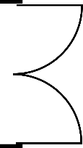
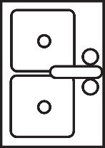
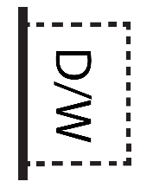
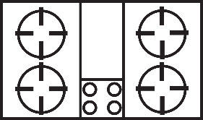
Example 7.4 page 124
Unit 7.2
Doors
Window
Sink
Dishwasher
Stove
Fridge

Slide 25
Exercise 7.2
Unit 7.2
Complete Exercise 7.2 on page 125 of your Student’s Book

Slide 26
Working with scale
Unit 7.3
Using scale to calculate actual distances
Scale is written as a ratio length in image : actual length
or as a fraction
To work out the scale, we can work out what 1 cm on the map represents.
A scale of 1 : 50 000 means that 1 cm on the map is 50 000 cm on the ground.
Convert 50 000 cm to kilometres: 50 000 cm = 500 m = 0,5 km
So 1 cm on the map represents 0,5 km on the ground.

Slide 27
Working with scale
Unit 7.3
Calculating measurements on a map from actual distances
Convert the actual measurement on the ground to centimetres.
Divide by the scale factor.
> Example 7.6 page 127 no 1
A map has a scale of 1 : 50 000.
You want to walk 4,5 km in real life.
Calculate the length of the route on the map.

Slide 28
Working with scale
Unit 7.3
> Example 7.6 page 127 no 1
Convert: 4,5 km
= 4 500 m
= 450 000 cm
Divide by the scale factor
450 000 ÷ 50 000
= 9 cm
So 4,5 km is 9 cm on the map.

Slide 29
Working with scale
Unit 7.3
Calculating the scale of a map, plan or model
1
Find the ratio between the real distance and the distance on the map.
2
Write the plan or map unit first in the ratio.
3
Convert both units to centimetres.
4
Divide by any common factors and get the first number to 1.
5
Write the ratio without units.

Slide 30
Example 7.7 page 127
Unit 7.3
If a door on a model house is 3 cm high and it is 2 m in reality, what is the scale of the model?

Slide 31
Example 7.7 page 127
Unit 7.3
Convert both measurements to cm, so 2 m = 200 cm.
3 cm : 200 cm = 1 :
Scale is 1 : 67

Slide 32
Exercise 7.3
Unit 7.3
Complete Exercise 7.3 on page 129 of your Student’s Book

Slide 33
Using road, street and route maps
Unit 7.4
Maps with different scales are needed for different purposes.
For a long distance journey, a large scale map is useful.
To find your way around a town or city, a smaller scale map is more useful.

Slide 34
Using road, street and route maps
Unit 7.4
Planning a trip using a road map (map on next slide):
This example is a trip from Kimberley to Beaufort West.
On the national map, use the bar scale to estimate the distance.
On the scale, 3 cm represents 200 km.
Kimberley to Beaufort West is about 6 cm. It is about 400 km.
The journey is roughly in a south-west direction.

Slide 35
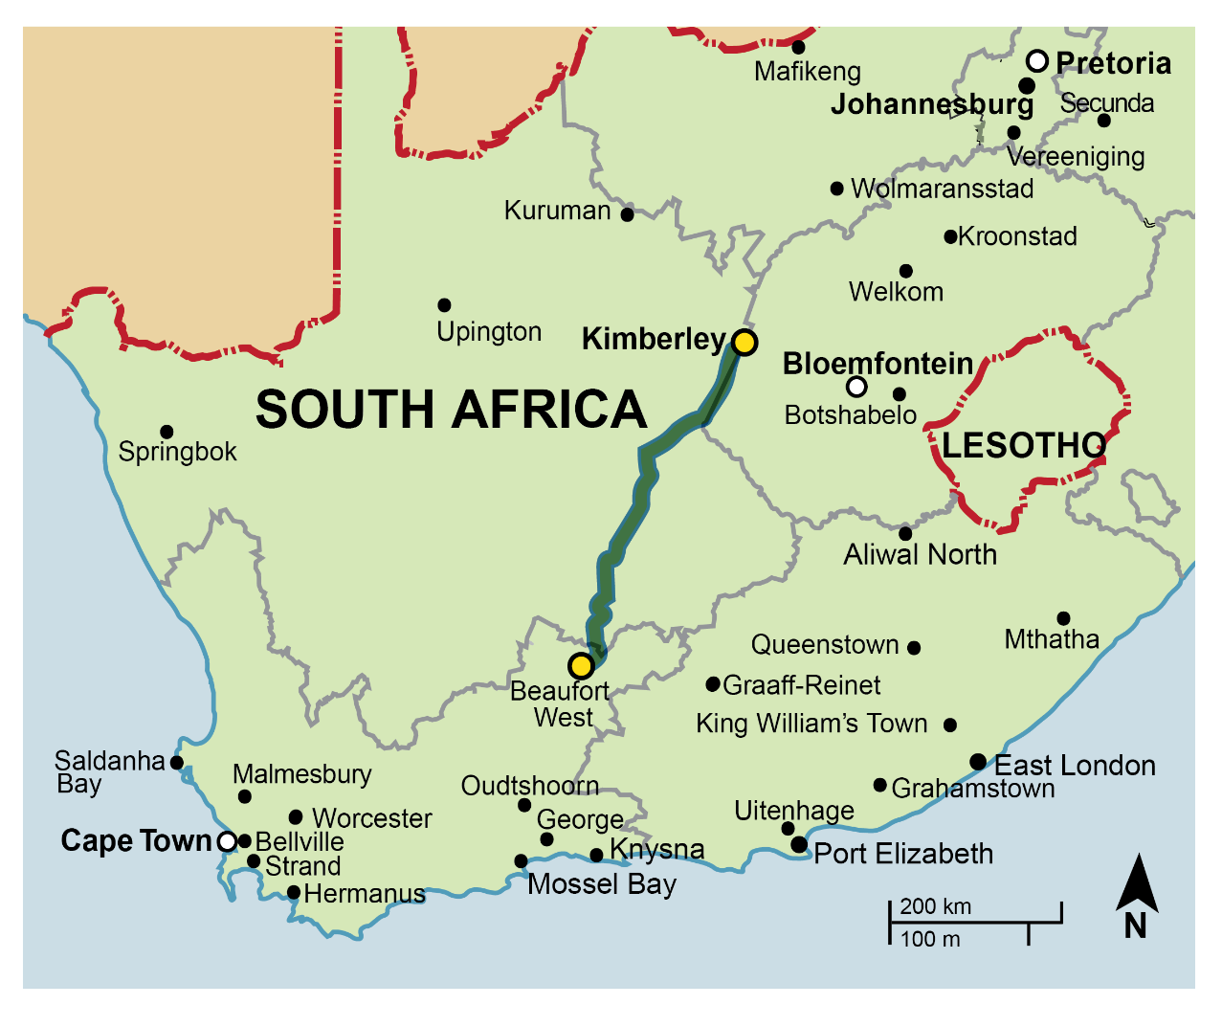
Using road, street and route maps
Unit 7.4

Slide 36
Planning a trip using a road map
Unit 7.4

Slide 37
Exercise 7.4
Unit 7.4
Complete Exercise 7.4 on page 131 of your Student’s Book

Slide 38
Exercise 7.5
Unit 7.4
Complete Exercise 7.5 on page 133 of your Student’s Book

Slide 39
Plans to determine quantities of materials needed
Unit 7.5
Builders use house plans to estimate the quantities of materials needed.
The dimensions shown on plans allow you to calculate lengths and areas.

Slide 40
Exercise 7.6
Unit 7.5
Complete Exercise 7.6 on page 136 of your Student’s Book

Slide 41
Interpreting instructions and assembly diagrams
Unit 7.6
Assembly diagrams and instructions provide step-by-step directions for putting together an object or system from its parts.
An exploded view drawing shows how the parts fit together.
The parts in the centre are usually assembled first.

Slide 42
Interpreting instructions and assembly diagrams
Unit 7.6
If you are taking something apart using the diagram, you usually remove the outside parts first.
Exploded view diagrams are often used in instruction manuals and show part identification numbers and labels.

Slide 43
Example 7.9 page 139
Unit 7.6
What kind of diagram is this? Explain.
How many parts are there altogether?
In which order would you assemble the parts? Write in a list form.
In what way are the parts labelled? How could this be useful for the consumer? What is the scale of the model?

Slide 44
Example 7.9 page 139
Unit 7.6
This is an exploded view of a kettle. Each part is shown in the position where it would be assembled.
There are 10 parts, labelled as A01 to A10.
The labels help the consumer find and identify the parts in the instruction manual, independent of the language used. You can also refer to them for ordering spare parts.
You would assemble the inner parts first and the outer parts last.

Slide 45
Exercise 7.7
Unit 7.6
Complete Exercise 7.7 on page 140 of your Student’s Book

Slide 46
Module assessment
Module 7
Complete Module assessment on page 144 of your Student’s Book

