Slide 1
Mathematical Literacy
NQF 3

Slide 2
Measurement
Module 6

Slide 3
Overview
6.1 Select and use measurement instruments correctly

Slide 4
Select and use measurement instruments correctly
Unit 6.1
Where do weather forecasters get their information?
1
Ensure that the instrument is lined up to zero correctly, or that the balance scale reads zero when empty.
2
What unit of measurement is shown on the instrument?
Some of the markings are numbered.
What is the gap between the numbered markings?
How many markings are between each numbered unit?
What are these markings equal to?
3

Slide 5
Select and use measurement instruments correctly
Unit 6.1
Where do weather forecasters get their information?
When you take a reading, your eyes must be directly in line with the place where you are taking the measurement.
This is to avoid the error of parallax - a mistake in reading a scale because the pointer does not appear to line up with the correct number when viewed from an angle instead of straight on.
4
5
Read and record all the digits you can read on the scale.
If a marking does not line up exactly with the object you are measuring, estimate the last digit of your measurement.

Slide 6
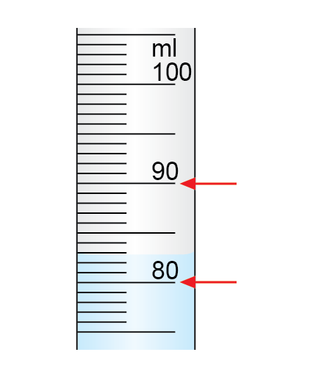
Example 6.1 page 101
Unit 6.1
What is the measurement of the liquid in this measuring cylinder?

Slide 7
Example 6.1 page 101
Unit 6.1
Step 1: Note the units on the instrument.
measuring cylinder is marked in millimetres.

Slide 8
Example 6.1 page 101
Unit 6.1
Step 2: Note what the space between the numbered unit on the scale represents.
Each numbered marking is 10 ml, and the markings in between are 1 ml each.

Slide 9
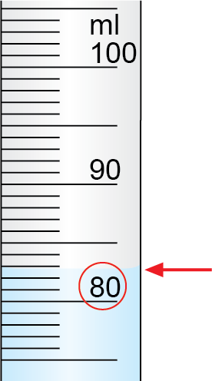
Example 6.1 page 101
Unit 6.1
Step 3: Read and record all the digits that you can on the scale.
The measurement lies in between 80 and 90 ml.
The first certain digit is 80, as the liquid level is above 80 and lower than 90.

Slide 10
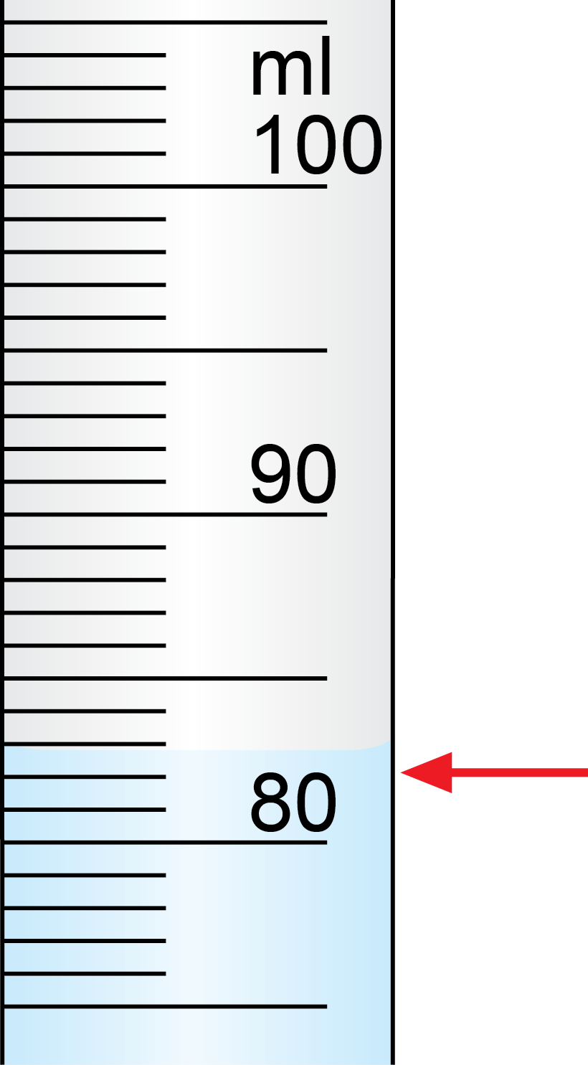
Example 6.1 page 101
Unit 6.1
Step 3: Read and record all the digits that you can on the scale.
The next digit is 2 ml, because the level of the liquid is slightly below 3

Slide 11
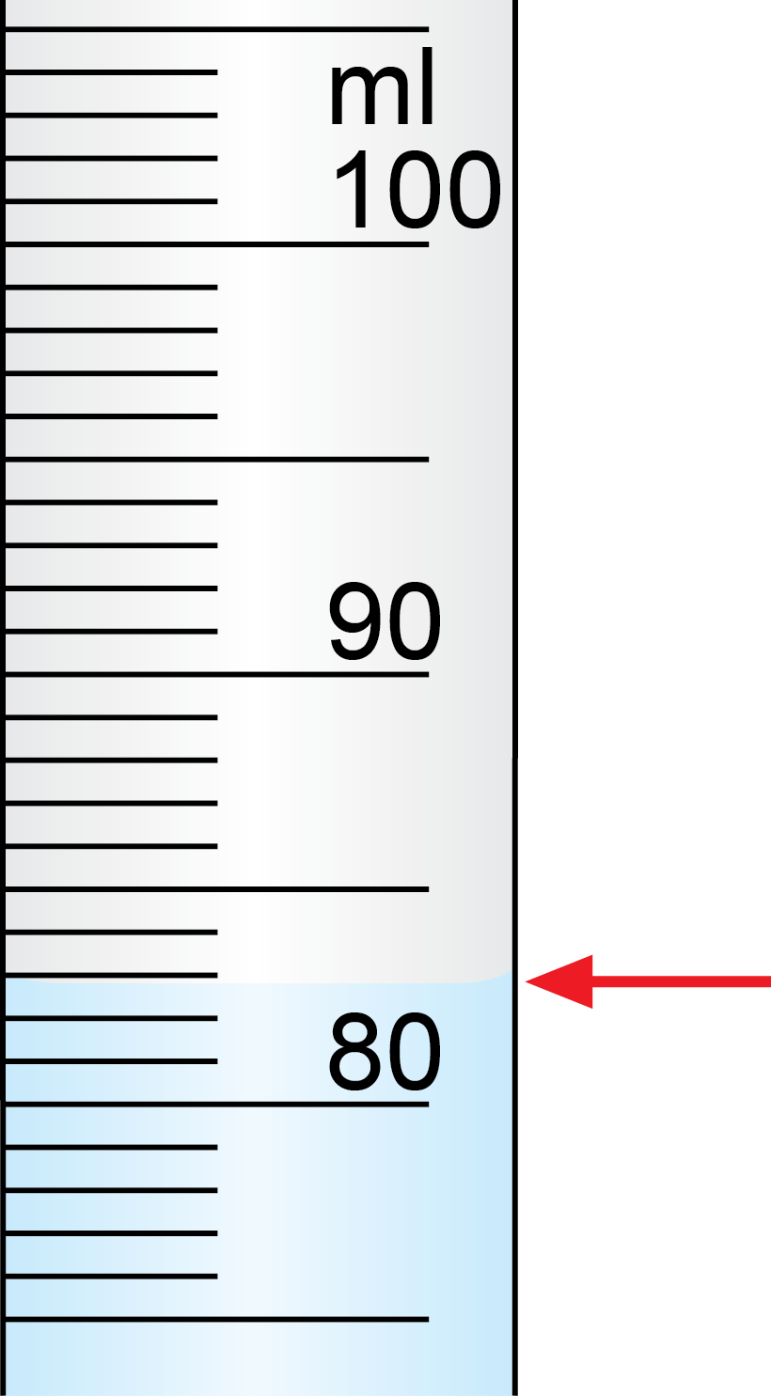
Example 6.1 page 101
Unit 6.1
Step 4: If the level does not line up exactly with a marking on the instrument, estimate the last digit.
The last digit could be 8, to show 0,8 ml more than the 2 ml line.

Slide 12
Example 6.1 page 101
Unit 6.1
Step 5: Write down the reading
Reading: 82,8 ml

Slide 13
Measuring length: rulers, measuring tapes
Unit 6.1
A standard ruler is 30 centimetres long
A metre ruler is 100 cm long
A measuring tape can be several metres long
Between each pair of cm markings, there are smaller lines that indicate millimetres.
We can use these instruments to measure accurately to 1 mm, and indicate one uncertain digit after the mm measurement (e.g. 1,6 mm)

Slide 14
Measuring length: rulers, measuring tapes
Unit 6.1
4,8 cm
To measure the length of an object:
Place the ruler or tape measure with the 0 cm line at the beginning of the object.
Mark the number at which the end of the object is in line with the centimetre reading.

Slide 15
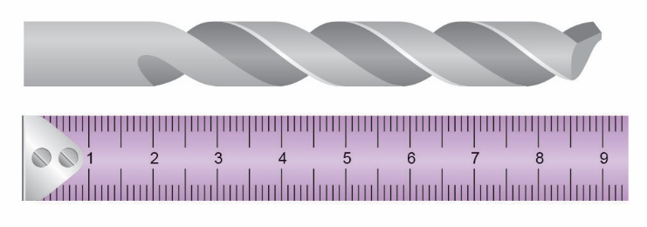
Example 6.2 page 102
Unit 6.1
Read the length of the drill bit on the tape measure.

Slide 16
Example 6.2 page 102
Unit 6.1
Step 1: Note the units on the instrument.
The tape measure is marked in centimetres.

Slide 17
Example 6.2 page 102
Unit 6.1
Step 2: Note what the space between the numbered units on the scale represent.
Numbered markings: 1 cm
Markings in between: 1 mm

Slide 18
Example 6.2 page 102
Unit 6.1
Step 3: Read and record all the digits that you can on the scale.
The drill bit is between 8 and 9 cm long.
Count the millimetre markings after 8 cm.
There are 9, so the certain digits are 8,9 cm.

Slide 19
Example 6.2 page 102
Unit 6.1
Step 4: If the level does not line up exactly with a marking on the instrument, estimate the last digit.
Very close to the 9 cm mark
Estimate to 9 (which means it is 0,09 cm more than 8,9 cm).

Slide 20
Example 6.2 page 102
Unit 6.1
Step 5: Write down the reading.
The reading is 8,99 cm

Slide 21
Measuring smaller lengths
Unit 6.1
Definition
A Vernier scale is a sliding secondary scale that measures between two marks on the main scale. It is used to measure smaller distances or angles accurately.

Slide 22
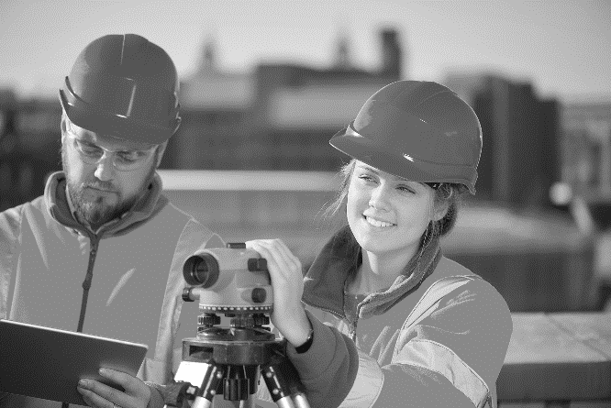
Measuring length in the workplace
Unit 6.1
Instruments that use the Vernier scale include
machinists' callipers and micrometers
sextants for navigation at sea
theodolites for land survey
scientific spectroscopes that split light into different wavelengths
telescopes
Machinist’s callipers
Micrometer
Theodolite

Slide 23
How a Vernier scale works
Unit 6.1

Slide 24
Example 6.3 page 104
Unit 6.1
Take the reading on the Vernier scale. The main scale is in mm.

Slide 25
Example 6.3 page 104
Unit 6.1
Take the main scale reading. It is between 5 and 6 mm, closer to 6.
What are the units on the Vernier scale? They are 0,1 mm
Where do the markings on both scales line up perfectly? At 8 on the Vernier scale.
Final reading: 5,8 mm

Slide 26
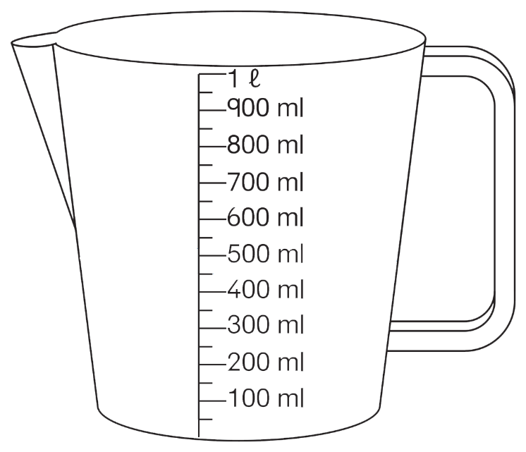
Measuring volume
Unit 6.1
Volume can be measured in containers that show scaled markings e.g. measuring jugs and cups.
This jug is marked in 50 ml intervals, so we can measure to the nearest 25ml accurately.
Remember
475ml
Remember to measure liquids at the bottom part of the curved concave surface or meniscus.

Slide 27
Measuring mass
Unit 6.1
Mass is measured in kilograms and grams using a scale.
Here is a scale that has a circular dial with a pointer.
The numbered gradations are 100 g apart and there are 5 spaces between them.
So each smaller gradation is 20 g.
The certain measurements are 600 g and 20 g.
The arrow is slightly beyond the 20 g mark.
It could be estimated as 2 g.
Reading: 622 g

Slide 28
Using a hanging scale
Unit 6.1
A hanging scale is convenient and portable.
It can be used for quick, easy measurements of the mass of luggage, fresh fish, or babies in a mobile clinic.
These scales can use a circular analogue scale or a digital readout.

Slide 29
Using a hanging scale
Unit 6.1
To use the scale correctly:
make sure the scale is set to zero when there is no object on the scale.
read the mass with the object hanging straight down. If it hangs at an angle, the reading will not be correct.

Slide 30
Using a balance scale
Unit 6.1
Some of these scales have a double or triple beam balance for greater accuracy.
Newer balance scales are digital.

Slide 31
Using a balance scale
Unit 6.1
Using a balance scale:
Set the balance to zero by pushing the sliders on the beam to the extreme left, so that the pointer is in line with zero.
Put the object on the balance platform.
Move the sliders until the pointer is at zero again. Start with the heavier weight sliders and then use the lightest one for fine tuning.
Each beam has a different scale. To read off the mass, read the position of the slider on each beam and add the masses together.

Slide 32
Example 6.5 page 106
Unit 6.1
Take the reading on this bathroom scale.

Slide 33
Example 6.5 page 106
Unit 6.1
The numbered gradations are 10 kg apart.

Slide 34
Example 6.5 page 106
Unit 6.1
The red numbers indicate values over 200 kg.

Slide 35
Example 6.5 page 106
Unit 6.1
The smaller gradations are 1 kg apart.

Slide 36
Example 6.5 page 106
Unit 6.1
The certain measurements are 115 kg and 2 kg.

Slide 37
Example 6.5 page 106
Unit 6.1
We can estimate the last digit as ¼ of a kilogram.

Slide 38
Example 6.5 page 106
Unit 6.1
The reading is 117,25 kg.

Slide 39
Measuring temperature
Unit 6.1
Thermometers measure changes in temperature by measuring the change in a liquid (e.g. ethanol)
A narrow tube with a bulb at the lower end is filled with a liquid and sealed.
A temperature scale is marked in degrees.
If it is heated, the liquid expands and rises.
If it is cooled, the liquid contracts and falls to a lower level in the tube.
Remember
Remember to take the reading from the bottom of the concave surface of the liquid.

Slide 40
Example 6.7 page 108
Unit 6.1
Take the reading on this thermometer.

Slide 41
Example 6.7 page 108
Unit 6.1
The thermometer is marked in degrees Celsius.
The numbered lines are 10°C apart.
The certain digits are 80°C and 7°C.
Estimate the last digit to be 0,5°C.
So the reading is 87,5°C.

Slide 42
Exercise 6.1
Unit 6.1
Complete Exercise 6.1 on page 108 of your Student’s Book

Slide 43
Measuring speed, distance and humidity
Unit 6.2
Speedometer
A speedometer measures the speed of a car.
Odometer
An odometer measures how far the car has travelled.

Slide 44
Measuring speed, distance and humidity
Unit 6.2
Hygrometer
A hygrometer measures humidity (the percentage of water vapour in the air).
Examples of where a hygrometer is used:
weather forecasts
maintaining humidity in a museum
outdoor sports and training
industrial areas
greenhouses
sensitive equipment e.g. cameras, musical instruments and cigars.

Slide 45
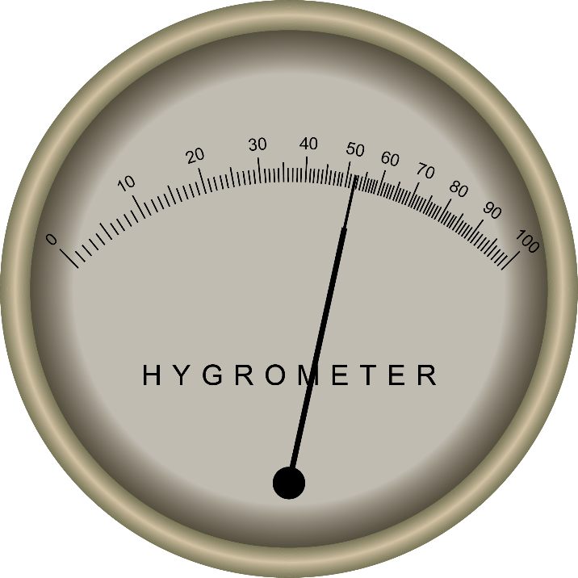
Measuring humidity
Unit 6.2
Mechanical hygrometer
This hygrometer uses the movement of a hair, which expands or contracts depending on the amount of water vapour in the air.
The hair is linked to a needle on a gauge, which shows humidity as a percentage.
The scale can be linear or non-linear, because the movement of the hair is not directly proportional to the percentage humidity.
The diagram shows a mechanical hygrometer with a non-linear scale.
The reading shows about 52,5% relative humidity.

Slide 46
Measuring humidity
Unit 6.2
Psychrometers
Psychrometers are hygrometers which use two mercury thermometers, one with a wet bulb and one with a dry bulb.
Relative humidity is calculated using a table of values.
Read the dry bulb temperature (value A).
Calculate the difference between it and the wet bulb temperature (value B).
Use the table to read off the percentage humidity where the two values meet.
Some modern hygrometers and psychrometers are digital and easier to read.

Slide 47
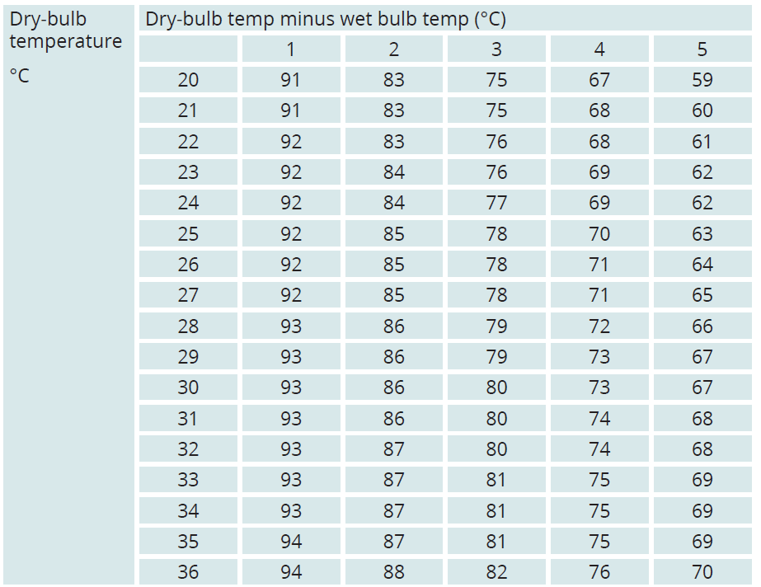
Example 6.8 page 111
Unit 6.2
What is the reading on this hygrometer? Use the part of the table shown.

Slide 48
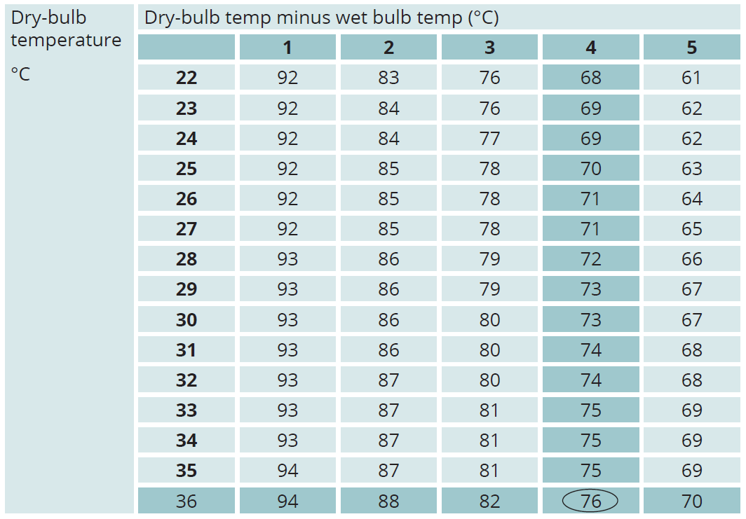
Example 6.8 page 111
Unit 6.2
The readings are 36°C (dry bulb) and 32°C (wet bulb).
Using the table, the relative humidity is 76%.
36 - 32 = 4°C

Slide 49
Exercise 6.2
Unit 6.2
Complete Exercise 6.2 on page 112 of your Student’s Book

Slide 50
Module assessment
Module 6
Complete Module assessment on page 114 of your Student’s Book

