Slide 1
Mathematical Literacy
NQF 3

Slide 2
Measurement conversions and time
Module 3

Slide 3
Overview
3.1 Perform conversions using known relationships
3.2 Convert units of measurement using given conversion factors and tables
3.3 Time notation and calculations
3.4 Solving problems involving time
3.5 Solve problems involving different time zones

Slide 4
Perform conversions using known relationships
Unit 3.1
To convert from one unit of measurement to another:
Check whether you are converting to a bigger unit or a smaller unit.
Converting to a bigger unit, your measurement will be smaller, so you will divide.
Converting to a smaller unit, your measurement will be bigger, so you will multiply.
Tip:
Memorise the conventions on the slides to follow.

Slide 5
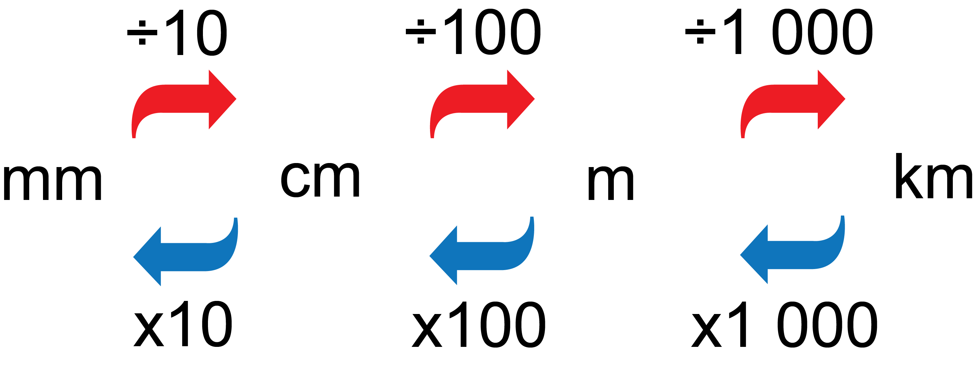
Perform conversions using known relationships
Unit 3.1
Units of length

Slide 6
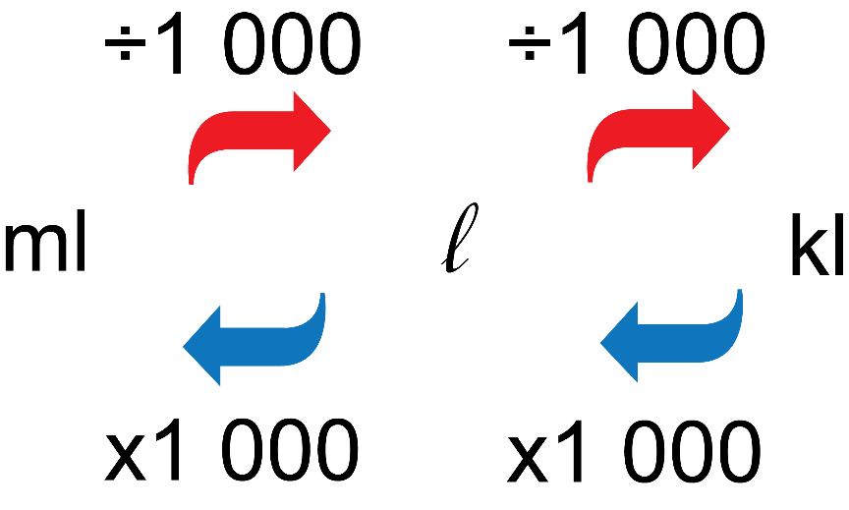
Perform conversions using known relationships
Unit 3.1
Units of volume or capacity

Slide 7
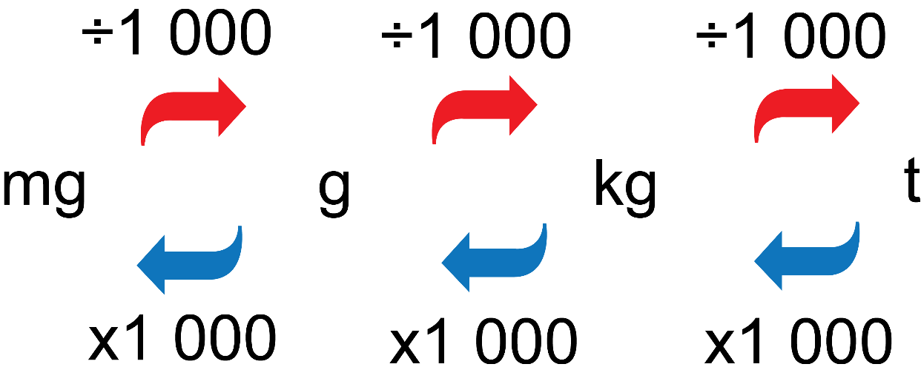
Perform conversions using known relationships
Unit 3.1
Units of mass

Slide 8
Example 3.1 page 40
Unit 3.1
Convert 762,5 kg to grams.
Convert 32,75 m to centimetres.
How much is 475 ml in litres?
There are 1 000 g in 1 kg, so multiply by 1 000.
762,5 × 1 000 = 762 500
There are 100 cm in 1 m, so multiply by 100.
32,75 × 100 = 3 275 cm
There are 0,001 litres in 1 ml, so divide by 1 000.
475 ml ÷ 1 000 = 0,475 ml

Slide 9
Exercise 3.1
Unit 3.1
Complete Exercise 3.1 on page 40 of your Student’s Book

Slide 10
Convert units of measurement using given conversion factors and tables
Unit 3.2
Cooks use some basic conversion factors when measuring ingredients.
1 teaspoon (tsp) = 5 millilitres (ml)
1 tablespoon (Tbsp) = 15 millilitres (ml)
1 cup = 250 millilitres (ml)

Slide 11
Convert units of measurement using given conversion factors and tables
Unit 3.2
Example 3.2 page 41
2 cups flour = 2 x 250 ml = 500 ml
½ tsp = ½ x 5 ml = 2,5 ml
4 tsp = 4 x 5 ml = 20 ml
2 Tbsp = 2 x 15 ml = 30 ml
¾ cup = ¾ x 250 ml = 187,5 ml

Slide 12
Metric and imperial conversions
Unit 3.2
We use the metric measurement system in South Africa.
Some countries use imperial measurements.
We can use a conversion factor to convert between the systems.

Slide 13
Metric and imperial conversions
Unit 3.2
Length
1 inch (in) | = 2,54 cm
1 foot (ft) | = 12 inches | = 30,5 cm
1 yard (yd) | = 36 inches | = 91,5 cm
1 mile (mi) | = 1 760 yards | = 1,6 km
Volume and capacity
1 fluid ounce | = 26 ml
1 pint | = 20 fluid ounces | = 590 ml
1 gallon | = 4,5 litres (Imperial) | = 3,8 litres (USA)
Mass
1 ounce (oz) | = 25 grams (g)
1 pound (lb) | = 16 ounces (oz) | = 450 grams (g)

Slide 14
Example 3.3 page 42
Unit 3.2
Wall studs need to be placed 16 inches apart on a wall frame. What is this distance in metres and in millimetres?
You need 8 oz of cream cheese for a recipe. Write this quantity in grams.
If a car takes 60 litres of fuel, what is this amount in imperial gallons?
1. 16 inches = 16 x 2,54 = 40,64 cm.
40,64 cm = 0,41 m = 406,4 mm
2. 8 oz = 8 x 25 g = 200 g
3. 60 litres ÷ 4,5 litres = 13,33 gallons

Slide 15
Solid and liquid conversions
Unit 3.2
1 g of water has a volume of 1 ml
1 kg of water has a volume of 1 litre.
Other liquids are approximately the same volume as water.
Volume of a solid is usually given in cubic units.
Volume of a liquid is usually given in ml, litres or kl.
Sometimes we need to convert between solid volume and liquid volume.
1 000 mm² = 1 ml
1 cm² = 1 ml
1 000 cm³ = 1 litre
1 m³ = 1 kl

Slide 16
Example 3.4 page 42
Unit 3.2

Slide 17
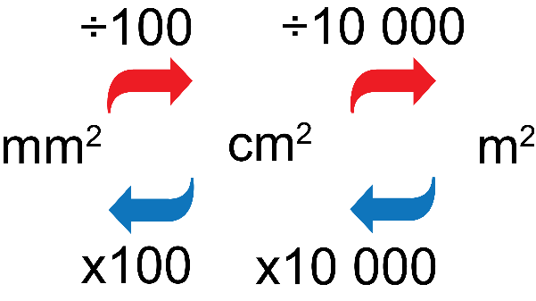
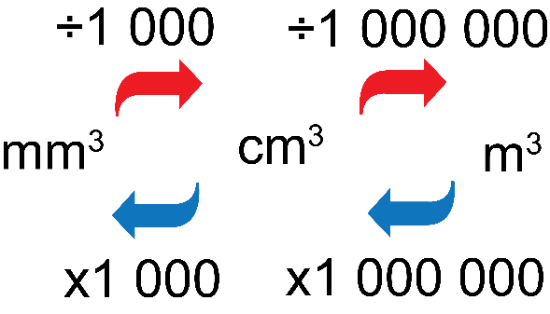
Area and volume conversions
Unit 3.2
Example 3.5 page 43
An A3 sheet of paper has the dimensions
297 mm x 410 mm.
Find the area in cm² and in m².
Write the volume 43,05 m³ in cubic centimetres.
Area
Volume

Slide 18
Area and volume conversions
Unit 3.2
First convert from mm to cm:
297 mm = 29,7 cm and 410 mm = 41 cm
Calculate the area in square centimetres:
29,7 x 41 = 1 217,7 cm²
Then convert from square centimetres
To square metres:
1 217,7 ÷ 10 000 = 0,12177 m²
43,05 m³ x 1 000 000 = 43 050 000 cm³.

Slide 19
Temperature conversions
Unit 3.2
There are two main temperature scales:
°F, the Fahrenheit scale (used in America)
°C, the Celsius scale (part of the metric system)
The boiling point of water is 100°C and 212°F.
When water freezes, it measures 0°C but 32°F.
So the difference between freezing and boiling point is 100 degrees in Celsius, but 180 degrees in Fahrenheit.
To convert, use the formulae:
°C = (°F - 32°) ÷ 1,8 (to find the temperature in degrees Celsius)
°F = (°C x 1,8) + 32 (to find the temperature in degrees Fahrenheit)

Slide 20
Example 3.6 page 44
Unit 3.2

Slide 21
Exercise 3.2
Unit 3.2
Complete Exercise 3.2 on page 44 of your Student’s Book

Slide 22
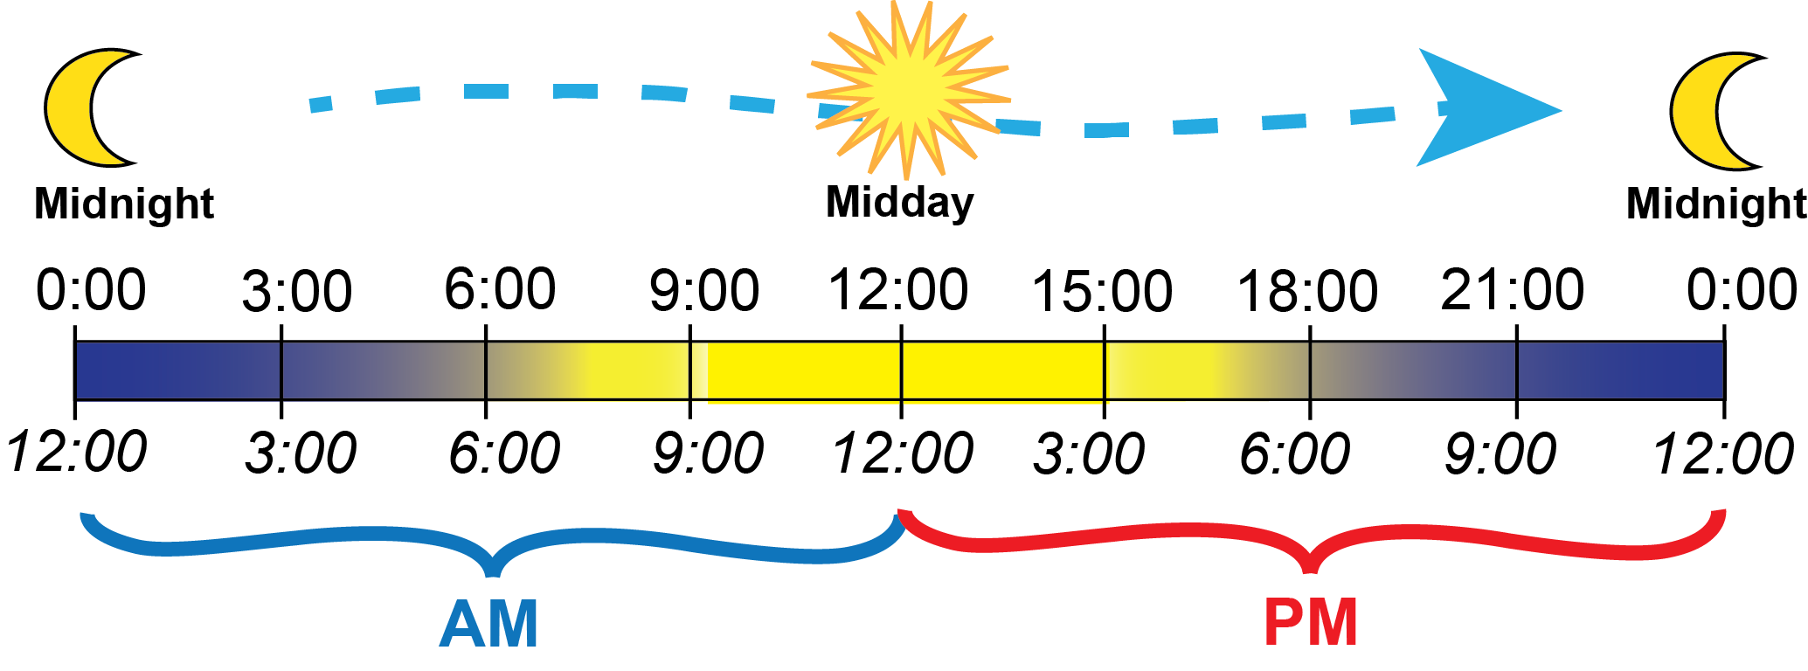
Time notation and calculations
Unit 3.3
Analogue clocks show 12 hours on their faces and represent time by the position of hands on a dial. They use a mechanical method to keep time.
Digital clocks usually show 24 hours. They use electronic methods of keeping time

Slide 23
Time notation and calculations
Unit 3.3
In a.m. and p.m. time, the 24-hour day is divided into two periods of twelve hours each:
Before noon: from 12 a.m. to 12 p.m.
After noon: from 12 p.m. to 12 a.m.
Digital time is represented by 00:00 to 23:59
The time 24:00 is the same as 00:00 (midnight).

Slide 24
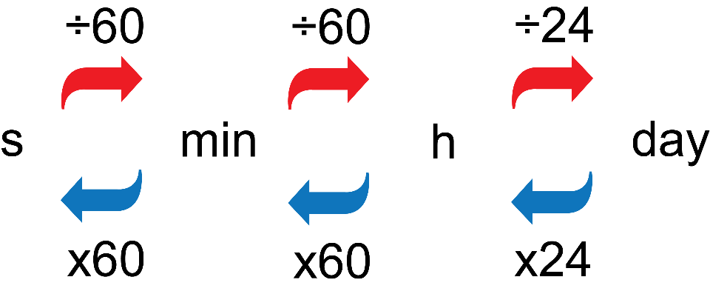
Time intervals
Unit 3.3
We calculate how long something takes to do. This is duration.
Calculators use the decimal system; time uses a base of 60, so we cannot enter times without converting them to the decimal system.
Converting between units of time
1 minute = 60 seconds
1 hour = 60 minutes
= 3 600 seconds
1 day = 24 hours
1 week = 7 days
1 year = 365¼ days

Slide 25
The calendar year
Unit 3.3
1 year = 365¼ days
The earth takes this long to move once around the sun.
Calendar years are grouped in fours.
After 3 years of 365 days, we have a “leap year” which has 366 days.
The years 2000, 2004, 2008, 2012, 2016, 2020 and 2024 are all leap years.
A year has 52 weeks and 1 day left over (or 2 in a leap year).
There are 12 months in a year.
The months have 30 or 31 days, except for February, which has 28 days (or 29 days in a leap year).

Slide 26
Example 3.7 page 465
Unit 3.3

Slide 27
Exercise 3.3
Unit 3.3
Complete Exercise 3.3 on page 47 of your Student’s Book

Slide 28
Solving problems involving time
Unit 3.3
Example 3.8 page 48
If a flight starts at 06:43 and is 3 hours and 45 min long, at what time will the aeroplane land?
OR
09:45 + 15 min + 30 min - 2 min
= 10:00 + 30 min - 2 min
= 10:28
06:43 + 3 h = 09:43
09:43 + 45 min
= 09:43 + 17 min + 28 min
= 10:00 + 28 min
= 10:28
The plane will land at 10:28

Slide 29
Exercise 3.4
Unit 3.4
Complete Exercise 3.4 on page 50 of your Student’s Book

Slide 30
Production timetables
Unit 3.4
A production timetable, or a planned schedule for completing all of the tasks for a larger job needs to:
Order the tasks correctly and plan the duration for each task.
Manage the workflow.
Identify resource and timing conflicts.
Manage the ordering of materials in time.
Allow manufacturers to estimate times for the final product.

Slide 31
Exercise 3.5
Unit 3.5
Complete Exercise 3.5 on page 52 of your Student’s Book

Slide 32
Solve problems involving different time zones
Unit 3.4
The earth rotates on its own axis and it also moves around the sun. Different parts of the earth receive sunlight at different times.
The world is divided into time zones that run from north to south.
There are 24 time zones to match the 24 hours of the day.
The time is the same everywhere within one time zone.

Slide 33
Solve problems involving different time zones
Unit 3.4
The reference point for calculating times is the line called the Coordinated Universal Time (UTC), which runs through England.
For countries to the west, we subtract hours from the UTC time.
For countries to the east, we add hours to the UTC time.
South Africa is in the time zone UTC +2, so the time is always 2 hours later than UTC.

Slide 34
Example 3.11 page 55
Unit 3.4

Slide 35
Exercise 3.6
Unit 3.6
Complete Exercise 3.6 on page 55 of your Student’s Book

Slide 36
Module assessment
Module 3
Complete Module assessment on page 57 of your Student’s Book

