Slide 1
Mathematical Literacy
NQF 3

Slide 2
Use an appropriate calculator to perform calculations and solve problems in a workplace context
Module 2

Slide 3
Overview
2.1 Recognise and practise the use of functions and characters on an appropriate calculator
2.2 Adding and subtracting integers on a calculator
2.3 Use a calculator to perform calculations on fractions
2.4 Use a calculator to perform calculations on decimals
2.5 Use a calculator to perform calculations on percentages

Slide 4
Recognise and practise the use of functions and characters on an appropriate calculator
Unit 2.1

Slide 5
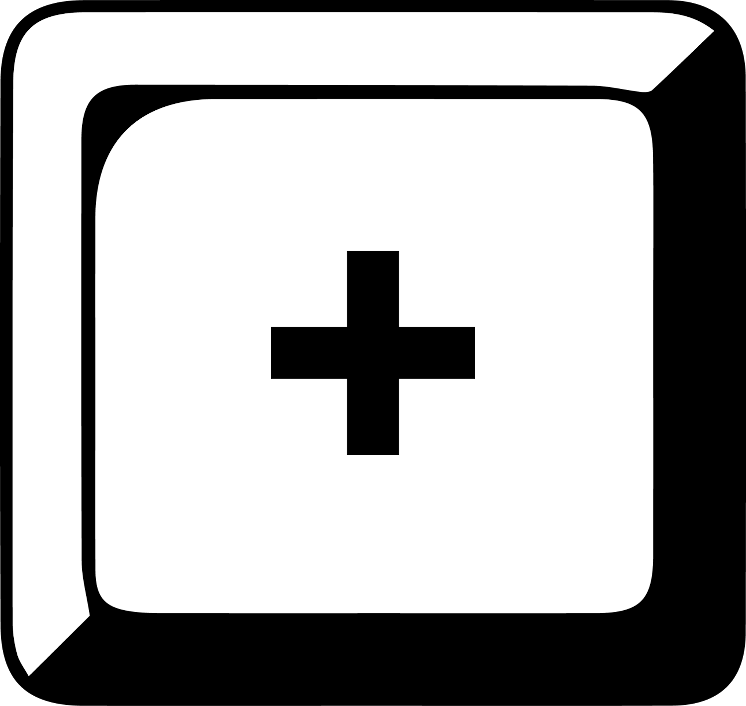
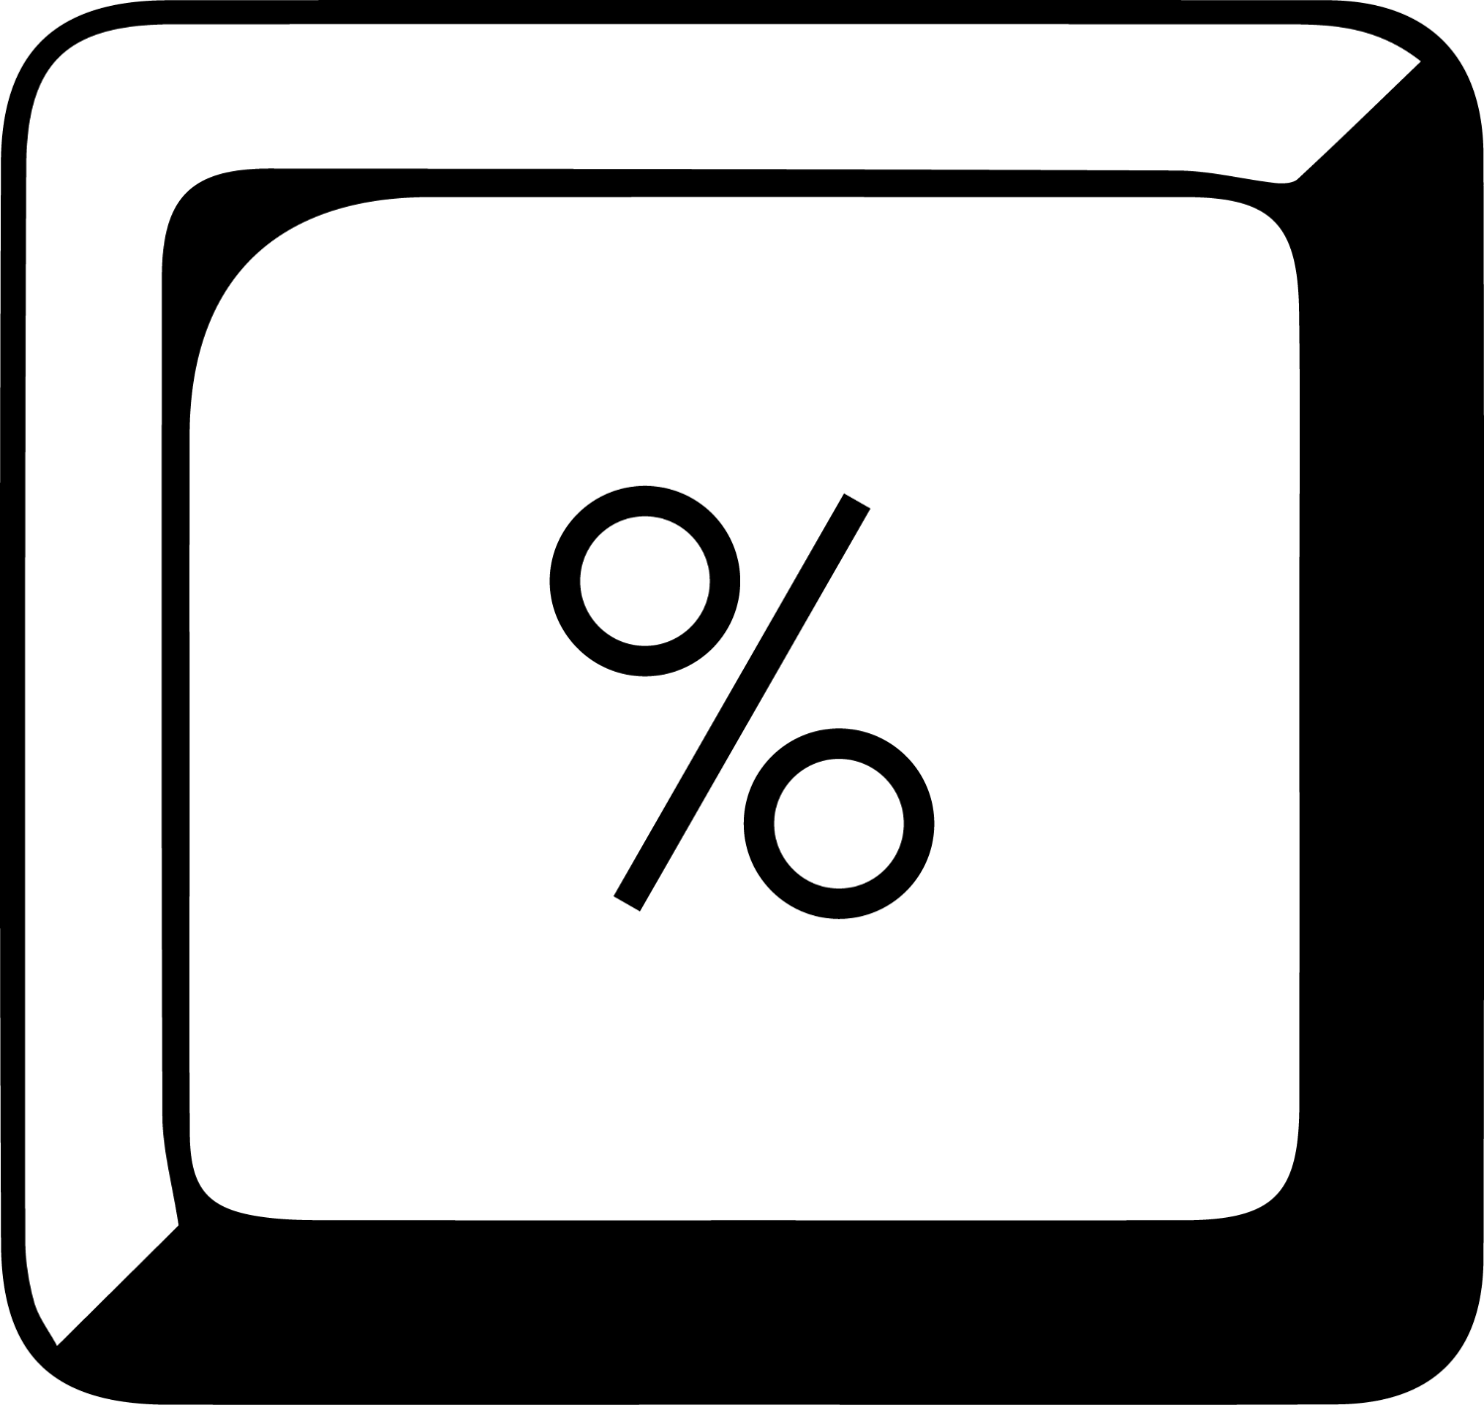
Recognise and practise the use of functions and characters on an appropriate calculator
Unit 2.1
Get to know how your calculator works. Identify and find:
the numbers (usually in the middle, with zero at the bottom).
basic maths symbols (usually on the right).
the percentage key
the square root key
the equals key

Slide 6
Recognise and practise the use of functions and characters on an appropriate calculator
Unit 2.1
Get to know how your calculator works.
To add, subtract, multiply or divide, press a number key, an operation key and another number key.
Press equals for the answer.
Basic calculators do the operations in the same order that you press the keys.
Scientific calculators follow the BODMAS order of operations.

Slide 7
Squares, square roots, cubes, cube roots
Unit 2.1
Squares
The number that is being raised to the power is called the base.
The number that the base is raised to is called the exponent.
3 squared is written 3² and means 3 × 3.
On a calculator, press the number key, followed by key.
For example, 16 gives an answer of 256 (without pressing the equals key)
3²
Exponent
Base
Power

Slide 8
Squares, square roots, cubes, cube roots
Unit 2.1
Square roots
The number that is squared is the square root.
So the square root of (4)² is 4.
On a calculator, enter the number and then
3²
$$\sqrt{9}$$

Slide 9
Raising numbers to higher powers
Unit 2.1
3 cubed is written 3³ and means 3 × 3 × 3.
On a calculator,
you can multiply the number by itself twice
or
square the number and multiply the answer by the number again
or
multiply the number by itself and press the equals key:
Press 5 × 5 =. Your answer is 25. You have worked out 5².
Press = again. The screen shows 125. You have worked out 5³.
Press = again. The screen shows 625. You have worked out 5⁴.
Press = again. The screen shows 3 125. You have worked out 5⁵.

Slide 10
The memory keys
Module 2.1
Memory keys allow you to keep a number in the memory and then recall it.
Use to add a number to the memory.
Use to subtract a number from a number already in the memory.
Press once to show the number stored,
Press MRC twice to clear the number from the memory.
The letter M appears at the top of the display to show that the display number has been stored in the memory.

Slide 11
Example 2.2 page 25

Slide 12
Clear and clear all keys
Module 2.1
Some basic calculators have a and a key.
The key (or key) clears everything on the display.
The key stands for 'clear entry' and it clears the last thing that was entered.
Decimal points and separators
Type in a decimal number e.g. 10 000,99. The calculator display often shows a decimal point, not a decimal comma.
Some calculators show markings (separators) between groups of three digits to make the display number easier to read.

Slide 13
Exercise 2.1
Unit 2.1
Complete Exercise 2.1 on page 19 of your Student’s Book

Slide 14
Adding and subtracting integers on a calculator
Module 2.2
Examples of negative numbers:
Temperatures below freezing point
Changes in position up and down
Financial calculations

Slide 15
Adding and subtracting integers on a calculator
Module 2.2
Formula
Adding a negative is the same as subtracting.
28 + (-16) = 28 - 16 = 12
Subtracting a negative is the same as adding.
54 - (-20) = 54 + 20 = 74
Changing the sign of numbers:
Some calculators have a key.
On others, you need to use the key before or after the number.

Slide 16
Example 2.3 page 21
Unit 2.2
Caleb enters the lift of a tall building at the ground floor (level 0). He goes up 5 floors, down 6 floors, down another 3 floors and up 17 floors.
He then leaves the lift. Which floor is he on?
A warehouse has stock of 267 chairs and receives an order for 500 chairs.
How many chairs are left in stock?
Use the calculation 0 + 5 - 6 - 3 + 17 = 13.
He is on the 13th floor.
267 - 500 = -223 chairs.
The warehouse needs to find 223 chairs from somewhere else.

Slide 17
Exercise 2.2
Unit 2.2
Complete Exercise 2.2 on page 22 of your Student’s Book

Slide 18
Use a calculator to perform calculations on fractions
Unit 2.3
$$\frac{7}{10}$$
Types of fractions
A fraction represents part of a whole that has been divided into equal pieces.
If you cut a board into 10 equal pieces and use 7, then you use seven tenths of the board.
The denominator of 10 shows the whole board is divided into 10 equal parts

Slide 19
Use a calculator to perform calculations on fractions
Unit 2.3
To change a mixed number to an improper fraction:
1
Multiply the whole number by the denominator of the fraction.

Slide 20
Use a calculator to perform calculations on fractions
Unit 2.3
To change a mixed number to an improper fraction:
2
Add this answer to the original numerator.

Slide 21
Use a calculator to perform calculations on fractions
Unit 2.3
To change a mixed number to an improper fraction:
3
Write the new numerator over the fraction line and the original denominator.

Slide 22
Use a calculator to perform calculations on fractions
Unit 2.3
To change a mixed number to an improper fraction:
1
Multiply the whole number by the denominator of the fraction.
2
Add this answer to the original numerator.
3
Write the new numerator over the fraction line and the original denominator.

Slide 23
Use a calculator to perform calculations on fractions
Unit 2.3
To change an improper fraction to a mixed number:
with a remainder of 2
1
Divide the numerator by the denominator.

Slide 24
Use a calculator to perform calculations on fractions
Unit 2.3
To change an improper fraction to a mixed number:
So there are 4 whole numbers with 2 thirds left over.
2
Write the whole number and the remainder, if any, as a left over fraction.

Slide 25
Use a calculator to perform calculations on fractions
Unit 2.3
To change an improper fraction to a mixed number:
1
Divide the numerator by the denominator.
2
Use the whole number answer as the whole and the remainder, if any, is the left over fraction.

Slide 26
Equivalent fractions
Unit 2.3
Equivalent fractions
Equivalent fractions are fractions with the same value, but different numbers in the numerator and denominator.
”
Formula
To make an equivalent fraction, multiply the numerator and denominator by the same number.
$$\frac{1}{3} × \frac{2}{2}= \frac{2}{6}$$

Slide 27
Equivalent fractions
Unit 2.3
Equivalent fractions
Equivalent fractions are fractions with the same value, but different numbers in the numerator and denominator.
”
Formula
$$\frac{2}{2}$$
Multiplying by is the same as multiplying by 1, so the value of the fraction has not changed.
So and are equivalent fractions.
$$\frac{1}{3}$$
$$\frac{2}{6}$$

Slide 28
Example 2.18 page 42

Slide 29
Adding and subtracting fractions
Unit 2.3
Method 1
To add and subtract fractions, you must find a common denominator first.
lowest common denominator (LCD) is 6

Slide 30
Adding and subtracting fractions
Unit 2.3
Method 2 (with a calculator)
Treat each fraction like a separate division calculation.
(1 ÷ 2) = , (2 ÷ 3) = (1 ÷ 6) = , .
Put the answers of the calculations into the calculator's memory.
Add to or subtract from the memory and press MRC to find the answer. You should get 1,333...

Slide 31
Example 2.6 page 25
Unit 2.3
Calculate
Divide first fraction and store the answer in the memory.
Divide second fraction and add answer to memory.
Divide third fraction and subtract answer from memory.
Recall answer from memory.
1 2
2 5
3 7

Slide 32
Example 2.9 page 27
Unit 2.5
A restaurant makes a fruit smoothie from
cup yoghurt
cup coconut milk,
cup apple juice
cup berry juice and
cup of crushed pineapple.
How many cups will the smoothie fill?

Slide 33
Example 2.9 page 27
Unit 2.5
Lowest common denominator of 20
Add numerators
cups
Change to mixed fraction
OR Using a calculator = 1,45 cups

Slide 34
Multiplying fractions
Unit 2.3
Example 2.7 page 26
Find
Without a calculator:
With a calculator:
13
x R65 = x 65
2 5 65
Cancel common factors in numerator and denominator
= R26
= R26

Slide 35
Dividing fractions
Unit 2.3
Example 2.8 page 27
Calculate
Without a calculator:
With a calculator:
Invert the second fraction and multiply
3 5
9 10

Slide 36
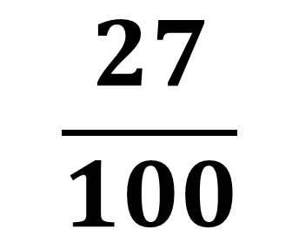
Converting fractions to decimals
Unit 2.3
27 parts out of 100 parts can be written as a:
One form can be converted to another.
$$\frac{27}{100}$$
0,27
27%
Fraction
Decimal
Percentage

Slide 37
Converting fractions to decimals
Unit 2.3
Formula
Divide the numerator by the denominator.
The whole number in a mixed number will remain a whole number in the decimal form.
$\frac{3}{5}$ = 3 ÷ 5 = 0,6
1 $\frac{6}{10}$ = 1 + (6 ÷ 10)
= 1 + 0,6
= 1,6

Slide 38
Converting fractions to percentages
Unit 2.3
Percentages are fractions where the denominator is 100.
or 0,7 which is 70%
One whole is 100%
A whole number is a multiple of 100% e.g. 3 is 300%
= 4 ÷ 5 = 0,8 = 80%
= 1 ÷ 3 = 0,33333... (round off to 0,333) = 33,3%
$$\frac{7}{10}=\frac{70}{100}$$
$$\frac{4}{5}$$
$$\frac{1}{3}$$

Slide 39
Exercise 2.3
Unit 2.3
Complete Exercise 2.3 on page 29 of your Student’s Book

Slide 40
Use a calculator to perform calculations on decimals
Unit 2.3
Decimals, like fractions, describe parts of a whole number, in units of tenths, hundredths, thousandths and so on.
The decimal comma separates the whole number from the fraction.
A decimal number has digits representing the whole number, the decimal comma and digits representing the fraction e.g. 67,05
Decimals are used to:
show amounts of money e.g. R32,95
show measurements e.g. 12,302 kg
in business, to show the value of stocks, averages and interest rates
to read measuring instruments
in calculations

Slide 41
Converting decimals and fractions
Unit 2.3
Any fraction can be expressed as a decimal by dividing the numerator by the denominator.
Recurring decimals have digits that keep repeating shown by a dot above the digit.
Formula
$$\frac{1}{2}= \frac{5}{10}=0,5$$
$$0,02= \frac{2}{100} = \frac{1}{50}$$
$$4,36= \frac{436}{100} = \frac{109}{25}$$
Divide numerator by denominator
$$4+\frac{36}{100}=4\frac{9}{25}$$
OR
$$\frac{245}{999}=0,245245=0,\dot{2}4\dot{5}$$

Slide 42
Adding and subtracting decimals
Unit 2.4
Work from left to right, adding or subtracting numbers of the same place value.
Keep the decimal comma in the correct place.
Without a calculator:
write the numbers underneath each other
insert zeros if the numbers do not have the same number of decimal places
Example:
Calculate and then check with a calculator.
8,201 + 0,97 + 1,34
 | 8 | , | 2 | 0 | 1
 | 0 | , | 9 | 7 | 0
+ | 1 | , | 3 | 4 | 0
1 | 0 | , | 5 | 1 | 1

Slide 43
Multiplying decimals
Unit 2.4
Without a calculator:
Multiply as with whole numbers, without decimal commas.
Count the number of decimal places in each number multiplied.
The answer needs that number of decimal places. Count the places from the right of the answer.
Example 2.15 page 32 no 2
A plumber charges R225,75 per hour and works for 3,5 hours. What is his fee?
To calculate 225,75 × 3,5:
22 575 × 35 = 790 125
There are three decimal places.
The fee is R790,125 Round off to R790,13

Slide 44
Multiplying and dividing decimals
Unit 2.4
When we multiply by a power of 10, we count the number of zeros and move the decimal comma the same number of places to the right.
Example 2.16 page 33
41,563 × 100 = 4 156,3
62,7903 × 1 000 = 62 790,3
1,0045 × 100 = 100,45
2 right
3 right
2 right

Slide 45
Multiplying and dividing decimals
Unit 2.4
When we divide by a power of 10, we count the number of zeros and move the decimal comma the same number of places to the left.
Example 2.17 page 33
1. 41,56 ÷ 1 000 = 0,04156
2. 81,2 ÷ 10 = 8,12
1 004,698 ÷ 100 = 10,04698
64 375,86 ÷ 23,24
= 6 437 586 ÷ 2 324
= 2 770,045611...
= 2 770,05 rounded to two decimal places.
3 left
1 left
2 left
Multiply by 100 to get rid of decimal in denominator

Slide 46
Exercise 2.4
Unit 2.4
Complete Exercise 2.4 on page 33 of your Student’s Book

Slide 47
Use a calculator to perform calculations on percentages
Unit 2.5
'Percent' means parts per 100.
If you divide a whole quantity into 100 equal parts, then one part is 1%.
The whole amount is 100%.
Example
If your business has R14 250 in cash, then R14 250 is 100% of your cash.
In decimal numbers, 100% is 1,00 or just 1.
1% = 0,01 15% = 0,15 90% = 0,9

Slide 48
Percentages
Unit 2.5
Percentages are fractions with a denominator of 100.
19% means 19 parts in every 100.
19% means or 0,19
35% of 50 can be rewritten as
0,72 can be rewritten as or 72%.

Slide 49
Example 2.18 page 35
Unit 2.5
Write 48% as a fraction in its simplest form.
Write 37,5% as a decimal fraction.
Change 0,415 to a percentage.
Change to a percentage.
Calculate 25% of 200.
Use your calculator to calculate 31% of R2,86.
Calculate 27% of R18.

Slide 50
Example 2.18 page 35 continued ...
Unit 2.5
48% =
37,5% = 37,5 ÷ 100 = 0,375
0,415 x 100 = 41,5%
25% of 200 =

Slide 51
Exercise 2.5
Unit 2.5
Complete Exercise 2.5 on page 36 of your Student’s Book

Slide 52
Module assessment
Module 2
Complete Module assessment on page 37 of your Student’s Book

