Slide 1
Mathematical Literacy
NQF 3

Slide 2
Probability
Module 18

Slide 3
Overview
18.1 What is likelihood or probability?
18.2 The probability scale
18.3 Making predictions about future events based on events of the past.
18.4 Combined events

Slide 4
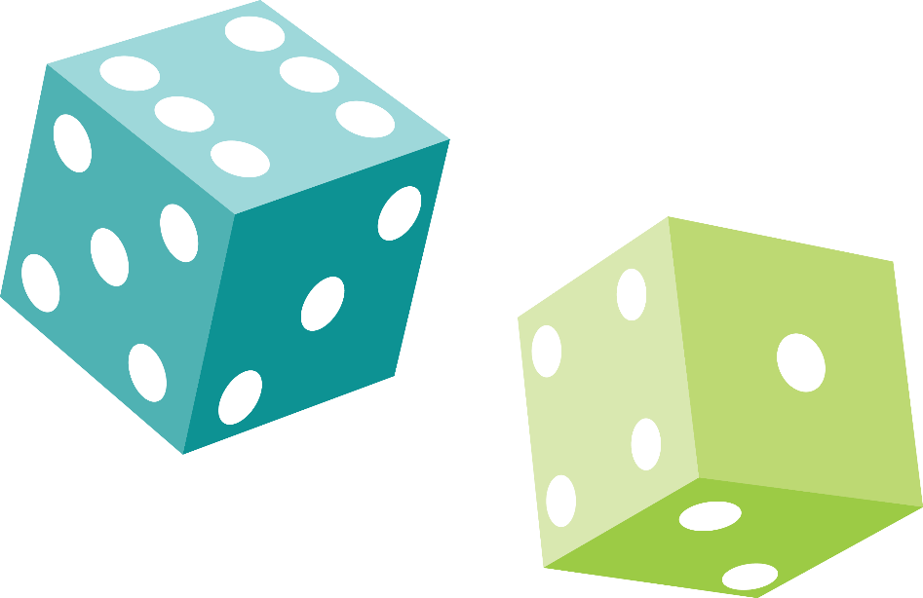
What is likelihood or probability?
Unit 18.1
In life there are certain events that we know will definitely happen, other events that might happen, but we do not know for sure and others that definitely will not happen.
Likelihood, or probability, is a way of describing the chance of something happening.

Slide 5
Exercise 18.1
Unit 18.1
Complete Exercise 18.1 on page 338 of your Student’s Book

Slide 6
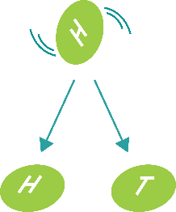
What is likelihood or probability?
Unit 18.1
We are usually interested in random things happening when we talk about probability.
Random events are events that are not planned or controlled by people or by other factors.
For example:
When you toss a coin, it lands on heads or tails. There is an equal chance that heads or tails could come up.
Every card in a well-shuffled pack has an equal chance of being drawn.
When events are random, the outcome is a matter of chance.

Slide 7
Example 18.1 page 339
Unit 18.1
You have four blue balls and one red ball on a table. If you close your eyes and take a ball off the table without looking, is it more likely that you will be holding a blue ball or a red ball?
If you spin the arrow randomly on the spinner, which colour are you most likely to land on? Which colour are you least likely to land on? Explain.

Slide 8
Example 18.1 page 339
Unit 18.1
Each ball is equally likely to be selected, but there are more blue balls than red balls. So the chances are much greater that you will pick a blue ball.
The arrow lands by chance, so it is most likely to land on the colour that covers most of the area, which is the green part.

Slide 9
Everyday examples
Unit 18.1
Probability is around us every day and in the work place.
The weather report predicts a 70% chance of rain today, so Lindi takes her raincoat to college.
A newspaper reports that Mamelodi Sundowns are favoured to win the league after their recent performances.
Kedibone buys a lottery ticket because she says, “Someone’s got to win, and it may as well be me!”
Ntsako wants to run for elections for the local municipality. He wants to know his chance of winning.
A small company needs to know their probability of success. Is the risk worth it?
A company finds that their insurance costs have gone up as their risk of accidents has increased.

Slide 10
Exercise 18.2
Unit 18.1
Complete Exercise 18.2 on page 340 of your Student’s Book

Slide 11
The probability scale
Unit 18.2

Slide 12
Exercise 18.3
Unit 18.2
Complete Exercise 18.3 on page 343 of your Student’s Book

Slide 13
Exercise 18.4
Unit 18.2
Complete Exercise 18.4 on page 346 of your Student’s Book

Slide 14
Making predictions about future events based on events of the past
Unit 18.3
The more data that we have about a situation, the more reliable the prediction can be.
Experimental probability has taught us that when we do more trials, we get closer to theoretical probability.
In business, people use probability to make decisions. Investment decisions are based on this data.
Definition
A prediction or forecast is a statement about the way things will happen in the future, often based on experience or knowledge.

Slide 15
Weather forecasting
Unit 18.3
Where do weather forecasters get their information?
1
They get the information about weather variables from weather satellites and weather balloons.
2
All the information is sent to a weather station where it is put into a computer for processing.
3
After this has been done, a weather chart is drawn and sent to all the media (television, radio and newspapers).

Slide 16
Exercise 18.5
Unit 18.3
Complete Exercise 18.5 on page 348 of your Student’s Book

Slide 17
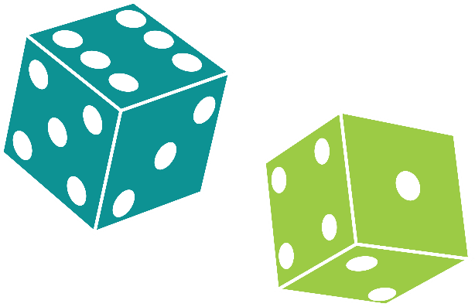
Combined Events
Unit 18.4
Examples of combined events:
flipping a coin and rolling a die at the same time
rolling a die and choosing a certain colour ball out of a bag containing many coloured balls
choosing combinations of clothing that can be worn together

Slide 18
Combined Events
Unit 18.4
Eddie has three different T-shirts: a white, a black and a red T-shirt and two pairs of jeans: black and blue. He grabs one T-shirt and one pair of jeans without looking. What are the chances that he has taken a white T-shirt and blue jeans?
There are a total of six different combinations, which are:
white T-shirt with black jeans
black T-shirt with black jeans
red T-shirt with black jeans
white T-shirt with blue jeans
black T-shirt with blue jeans
red T-shirt with blue jeans
So the probability of getting one particular combination is .
$$\frac{1}{6}$$

Slide 19
Independent events
Unit 18.4
Definition
The choosing of jeans is independent of choosing a T-shirt.
When two events are independent of each other, the probability of one event occurring does not affect the probability of the other event occurring.

Slide 20
Independent events
Unit 18.4
When you rolled a die and tossed a coin. The outcome of Heads or Tails is independent of the number rolled on the die.
The probability of getting any number on the die has no effect on the probability of getting Heads or Tails on the coin.
You could list all the possible combinations like this:
H; 1 | T; 1
H; 2 | T; 2
H; 3 | T; 3
H; 4 | T; 4
H; 5 | T; 5
H; 6 | T; 6

Slide 21
Independent events
Unit 18.4
When two events are said to be dependent, the probability of one event occurring influences the likelihood of the other event.

Slide 22
Exercise 18.6
Unit 18.3
Complete Exercise 18.5 on page 351 of your Student’s Book

Slide 23
Module assessment
Module 18
Complete Module assessment on page 352 of your Student’s Book

