Slide 1
Mathematical Literacy
NQF 3

Slide 2
Collect and organise data to answer questions in a workplace based context
Module 16

Slide 3
Overview
16.1 Key concepts related to data collection and handling
16.2 Identifying possible sources of error, bias or misinterpretation
16.3 Questions and instruments for collecting data
16.4 Classifying and organising data
16.5 Grouping data using intervals

Slide 4
Key concepts related to data collection and handling
Unit 16.1

Slide 5
Key concepts related to data collection and handling
Unit 16.1
Gathering information is an important way to help people make decisions about topics of interest.
We often see the results of data collection on television, radio or in the newspaper.
In the workplace, surveys can help decide what needs to be changed, where money should be spent, what products to purchase, what problems there might be, and so on.
We use different methods to collect data by using surveys of people
(e.g. questionnaires, opinion polls)

Slide 6
The process of data collection
Unit 16.1
Clarify the research questions and the type of data to be collected
Define the population of interest – A census or a sample
Summarise and present the results
Ask questions and tally the results
1
2
3
4

Slide 7
1. Clarify the research questions and the type of data to be collected.
Unit 16.1
What questions do you want answered?
These can be
simple questions,
Or they can be more
complex questions,
For example,
What is your favourite colour?
For example,
Which roads have the worst traffic?

Slide 8
2. Define the population of interest and choose a census or a sample
Unit 16.1
Example 16.1 page 308
In a shopping centre on a Saturday, 250 customers go to a restaurant. You want to know more about them to see what the target market for the restaurant should be.
You could interview every person there, which is a census.
You could just choose to ask every tenth person who leaves the restaurant. That is a sample.

Slide 9
2. Define the population of interest and choose a census or a sample
Unit 16.1
Example 16.1 page 308 continued…
If you use a sample, you need to choose it randomly to make sure that the data is correct.
After completing a sampling survey you can use the information to make a prediction about how the rest of the population would respond. The more people you have asked, the better your result will be.

Slide 10
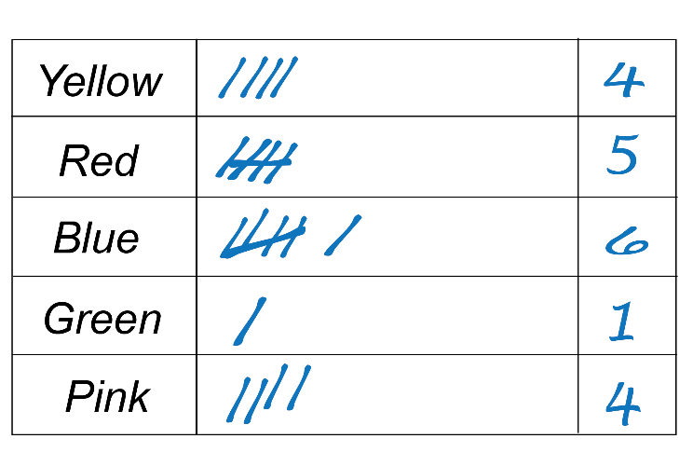
3. Ask questions and tally the results
Unit 16.1
Example 16.3 page 308
To collect information about the favourite colours of a group of people at a shopping centre, you could keep a tally of results as you ask people.
Every 5th mark crosses the previous 4 marks, so you can see groups of 5 and count up the tallies.

Slide 11
4. Summarise and present the results
Unit 16.1
Example 16.4 page 309
You have collected information about how long it has taken customers to get to a shopping centre.
You could present the information like this:
Shortest journey: 10 minutes
Average journey: 22 minutes
Longest journey: 45 minutes

Slide 12
Exercise 16.1
Unit 16.1
Complete Exercise 16.1 on page 309 of your Student’s Book

Slide 13
Identifying possible sources of error, bias or misinterpretation
Unit 16.2
Two things can go wrong when you collect data:
If questions in the survey are worded poorly or ambiguously, people's answers can be inaccurate. This results in error in your data.
You may introduce bias into the process.
Bias may be a result of:
poorly prepared questions
a sample that is not representative of a population
collecting agents with different ways of collecting the data.
Definition
Bias is information that is not truly representative of the situation you are investigating

Slide 14
Example 16.5 page 310
Unit 16.2
Thandi carried out a survey to find out how much money people living in a town spend on food each week.
She asked 100 people at the shopping centre closest to where she lives on a Tuesday morning.
Explain why Thandi’s survey might be biased and advise her on how to avoid this bias.

Slide 15
Example 16.5 page 310 continued ...
Unit 16.2
Thandi could be introducing bias by:
surveying shoppers at one shopping centre only
only asking shoppers on one week day
only asking shoppers at one time of day.
She should rather choose a variety of different places to ask people, and survey people on other days, including weekends, and at different times of the day, including after normal working hours.

Slide 16
Choosing your sample
Unit 16.2
The sample chosen from the larger group (population) must represent that group.
There are always some variables that cannot be represented. To make the sample represent the whole population as closely as possible:
choose a random sample containing all the different kinds of people representing the population from which it is drawn
choose a large enough sample to fairly represent the population

Slide 17
Exercise 16.2
Unit 16.2
Complete Exercise 16.2 on page 311 of your Student’s Book

Slide 18
Questions and instruments for collecting data
Unit 16.3
We can differentiate between two types of questions:
Closed
questions
Open-ended questions
Questions with a set number of answers to choose from.
e.g. Write down your gender: M (male) or F (female)
Questions that can be answered in any way.
e.g. How do you feel about people that litter?

Slide 19
Questions and instruments for collecting data
Unit 16.3
It is a good strategy to have a selection of closed questions, but follow up with some open-ended questions. That way you can be sure that you get the information you need.
Formula
Points to remember:
The questions must provide the information that we want.
The questions must be short and simple.
The questions must be clear and unambiguous.
The questions must mostly be closed and not open-ended.

Slide 20
Example 16.6 page 311
Unit 16.3
Your class wrote a test marked out of 50.
You want to find out how well the class felt that they did in the test.
Develop a question that you can use to find this out.

Slide 21
Example 16.6 page 311 continued ...
Unit 16.3
The term ‘how well’ is not clear. To make it clear we can use the words poor, average, good and excellent. But these words on their own are still not clear, so we must state the marks that would be considered poor, average, good and excellent.
A suitable question might be: Tick the list.
How well did you do in the test?
Description
Poor
Average
Good
Excellent

Slide 22
Example 16.6 page 311
Unit 16.3
You might also ask the students to add any comment to their answer. For example, they might want to add that in their opinion, the test was unreasonably difficult.
You could leave space for this by inserting an open-ended question such as:
‘Is there any other comment you would like to make about the test?’
Do not give them an example of a possible response or “lead” their answer in any way.

Slide 23
Instruments of data collection
Unit 16.3
Three instruments for collecting data or ways of collecting data are:
The instrument type is determined by:
info required
type of question
Observation
You simply observe, watch and record the information.
Interview
Face-to-face questions, appropriate for small numbers and short responses.
Questionnaire
You write a set of questions and provide spaces for participants to write their responses. This instrument is good for getting information from many people.

Slide 24
Exercise 16.3
Unit 16.3
Complete Exercise 16.3 on page 313 of your Student’s Book

Slide 25
Classifying and organising data
Unit 16.4
Data can be organised by using:
tallies
frequency tables
Organising data when it is collected makes it easy to find the totals.
The table shows the results of a survey:
Number of vehicles | Tally | Frequency
0 | ||| | 3
1 | |||| ||| | 8
2 | |||| |||| || | 12
3 | | | 1
4 | || | 2

Slide 26
Classifying data
Unit 16.4
Once data has been collected and organised it needs to be classified.
Numerical data is data that is measured in numbers and units.
Discrete data has exact separate values
e.g. the number of people in a room
Continuous data is data that can have any value, including fractions e.g. 12,5cm
Categorical data is data that is described, not measured in units.
e.g. a person’s gender; makes of cars; types of animals.

Slide 27
Exercise 16.4
Unit 16.4
Complete Exercise 16.4 on page 315 of your Student’s Book

Slide 28
Grouping data using intervals
Unit 16.5
When a large amount of data is collected we can group the data into class intervals.
We decide on the size of the class intervals using the range of the data and a useful number of intervals spread through the range.
We don't want too much data in the intervals, but we also don't want too many intervals to work with.
Formula
Range =
highest – lowest score

Slide 29
Example 16.8 page 316
Unit 16.5
The grouped frequency table represents the ages of 200 people in a shopping centre on a Saturday.
Age (years) | Tally | Frequency
0-9 | |||| ||| | 8
10-19 | |||| |||| || | 12
20-29 | |||| |||| |||| |||| |||| | 24
30-39 | |||| |||| |||| |||| |||| |||| |||| |||| ||| | 43
40-49 | |||| |||| |||| |||| |||| |||| |||| |||| | | 41
50-59 | |||| |||| |||| |||| |||| || | 27
60-69 | |||| |||| |||| |||| ||| | 23
70-79 | |||| |||| |||| ||| | 18
80-89 | ||| | 3
90-99 | | | 3

Slide 30
Example 16.8 page 316
Unit 16.5
Age is continuous data. So there are no gaps between the intervals.
Each class interval represents all of the possible ages up to the beginning of the next class interval.
So the interval 0–9 years represents all of the ages up to 10 years, including 9 years 6 months etc.

Slide 31
Exercise 16.5
Unit 16.5
Complete Exercise 16.5 on page 316 of your Student’s Book

Slide 32
Module assessment
Module 16
Complete Module assessment on page 319 of your Student’s Book

