Slide 1
Mathematical Literacy
NQF 3

Slide 2
Move between different representations of relationships in workplace contexts
Module 15

Slide 3
Overview
15.1 Graphs of relationships
15.2 Drawing graphs
15.3 Graphs of direct and inversely proportional relationships
15.4 Finding the independent variable by changing the formula

Slide 4
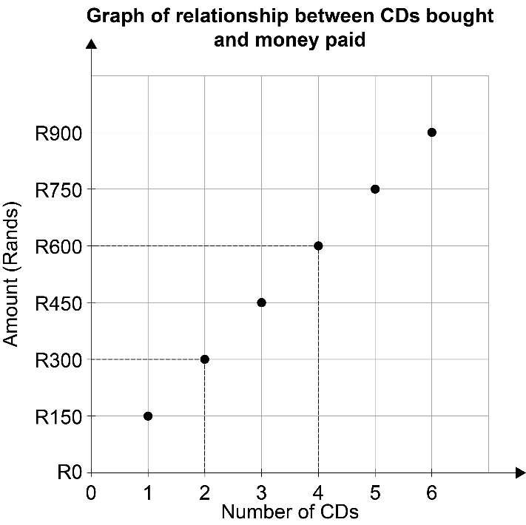
Graphs of relationships
Unit 15.1
Completing a table of values by reading values from a graph
A graph shows a number pattern by giving the input numbers on one axis and the output numbers on the other axis.
The shape of the graph shows how the numbers change in relation to each other.
We usually put the independent variable on the horizontal axis, and the dependent variable on the vertical axis.
Dependent variable
Vertical axis
Independent variable
Horizontal axis

Slide 5
Reading numbers from a graph
Unit 15.1
Point A shows R900 for 5 hours worked.
Look at the numbers on the graph and the number of values in between each mark.
The vertical axis in this graph shows R150 between each mark.
Hold a ruler from each point vertically to read the input number on the axis at the bottom.
Hold a ruler horizontally from each point to read the output number on the axis on the left.
R150 – 0 = R150
Point B shows R450 for 2½ hours worked.

Slide 6
Example 15.1 page 289
Unit 15.1

Slide 7
Completing a table of values by using the formula or a description
Unit 15.1
> Example 15.2 page 290
Kgomotso uses the formula c = 2n + 2 to decide how many cups of coffee to make, when n is the number of customers.
Use the formula to fill in the table:
Number of customers | 1 | 2 | 3 | 5 | 10
Number of cups of coffee

Slide 8
Completing a table of values by using the formula or a description
Unit 15.1
The cost of renting a car is R400 per day plus R6 per kilometre travelled.
Complete the table.
Number of km travelled | 0 | 30 | 60 | 90 | 120
Cost per day (R) | 1 | 2 | 3 | 5 | 10

Slide 9
Completing a table of values by using the formula or a description
Unit 15.1
1c = 2n + 2
Multiply number of km by 6 and add 400.
Number of customers | 1 | 2 | 3 | 5 | 10
Number of cups of coffee | 2 | 62 | 122 | 182 | 242
Number of km travelled | 0 | 30 | 60 | 90 | 120
Cost per day (R) | 400 | 580 | 760 | 940 | 1 120

Slide 10
Exercise 15.1
Unit 15.1
Complete Exercise 15.1 on page 291 of your Student’s Book

Slide 11
Dependent and independent variables in tables, equations and graphs
Unit 15.1
Independent Variable
Dependent Variable
not changed by the other variables
dependent on other values;
affected by changes in the independent variable

Slide 12
Dependent and independent variables in tables, equations and graphs
Unit 15.1
Independent Variable
Dependent Variable
Provides the input numbers
Is the set of output values

Slide 13
Dependent and independent variables in tables, equations and graphs
Unit 15.1
Independent Variable
Dependent Variable
plotted on the horizontal axis of a graph.
plotted on the vertical axis of a graph.

Slide 14
Example 15.3 page 292
Unit 15.1
1. Tshediso is analysing the cost of buying picture frames to sell at a profit. He puts the values into a table.
Which variable is dependent and which is independent? Explain.
Number of picture frames purchased | 0 | 1 | 2 | 3 | 4 | 5
Cost per day (R) | 0 | R30 | R60 | R90 | R120 | R150

Slide 15
Example 15.3 page 292 continued ...
Unit 15.1
Number of picture frames is independent. These are chosen to test the effect on the cost. The cost of the picture frames is dependent. It changes as more picture frames are bought.

Slide 16
Example 15.3 page 292 continued ...
Unit 15.1
This graph shows how money saved in a bank increases over a number of years. The graph shows compound increase.
Which variable is dependent and which is independent? Explain.

Slide 17
Example 15.3 page 292 continued ...
Unit 15.1
Number of years is independent. This varies without being affected by other values. The amount of money depends on the number of years saved, so it is the dependent variable.

Slide 18
Exercise 15.2
Unit 15.1
Complete Exercise 15.2 on page 293 of your Student’s Book

Slide 19
Drawing graphs
Unit 15.2
Steps for drawing graphs
Petrol (litres) | 0 | 2 | 4 | 6
Cost (R)
Cost = litres × 15
Petrol (litres) | 0 | 2 | 4 | 6
Cost (R) | 0 | 30 | 60 | 90
Draw a table of values, unless one is given.
Choose at least 4 input values and include 0, to show what the graph does at this point.
Fill in the values of the other variable, using the formula or the description.
1

Slide 20
Drawing graphs
Unit 15.2
Steps for drawing graphs
Graph of cost versus petrol
Petrol (litres) | 0 | 2 | 4 | 6
Cost (R) | 0 | 30 | 60 | 90
2
Give your graph a title, usually stating the effect of one variable compared to another, e.g. “Graph of cost versus time”.

Slide 21
Drawing graphs
Unit 15.2
Steps for drawing graphs
Graph of cost versus petrol
Highest value rounded off: 6
90
Petrol (litres) | 0 | 2 | 4 | 6
Cost (R) | 0 | 30 | 60 | 90
Highest value rounded off: 90
0
6
3
Choose an appropriate scale to make your graph clear and easy to read.

Slide 22
Drawing graphs
Unit 15.2
Steps for drawing graphs
Graph of cost versus petrol
90
Petrol (litres) | 0 | 2 | 4 | 6
Cost (R) | 0 | 30 | 60 | 90
60
Cost (rands)
30
0
2
4
6
Petrol (litres)
4
Label both the axes and write the units in which the values are measured.

Slide 23
Drawing graphs
Unit 15.2
Steps for drawing graphs
Graph of cost versus petrol
90
Petrol (litres) | 0 | 2 | 4 | 6
Cost (R) | 0 | 30 | 60 | 90
Cost )
60
30
0
2
4
6
Petrol (litres)
5
Plot the points as ordered pairs from the table of values.
Use the horizontal axis (the x-axis) for your independent variable.
The vertical axis (y-axis) takes the dependent variable.

Slide 24
Drawing graphs
Unit 15.2
Steps for drawing graphs
Graph of cost versus petrol
90
Petrol (litres) | 0 | 2 | 4 | 6
Cost (R) | 0 | 30 | 60 | 90
Cost )
60
30
0
2
4
6
Petrol (litres)
6
Connect the points.

Slide 25
Drawing graphs
Unit 15.2
Steps for drawing graphs
Note:
Graph of cost versus petrol
If the points form a straight line, use a ruler and draw a line through all the points.
If the points form a curved line, draw a smooth curve through all the points.
If one of the variables represents distinct items, such as number of people, then your line should be dashed or dotted.
If both variables can take values in between the points, then use a solid line.
90
Cost )
60
30
0
2
4
6
Petrol (litres)
6
Connect the points.

Slide 26
Choosing an appropriate scale
Unit 15.2
Note:
Make sure that you draw axes to fill the space on the page as far as possible. This makes the graph more accurate and easier to read.
You may have to use different scales for each axis for a graph of a real-life pattern.

Slide 27
Choosing an appropriate scale
Unit 15.2
You can use the graph paper in either direction; the longest axis does not have to be vertical.
Look at the highest values of each variable. The highest value on your axes must be higher than this, usually rounded up to a whole 10.
Example: If the highest value is 178 choose 180 or 200 for the axis.
Match the highest values to numbers of blocks on the graph paper.
Example on graph: Independent variable (7) and dependent variable (800).

Slide 28
Choosing an appropriate scale
Unit 15.2
Graph A:
The scale for Amount of money would be better increasing in 100s up to 800.

Slide 29
Choosing an appropriate scale
Unit 15.2
Graph B:
The scale for Number of hours needs to be bigger, so that 0 to 6 hours takes the whole space on the axis.

Slide 30
Choosing an appropriate scale
Unit 15.2
Graph C:
The scale has been corrected on both axes so that the graph fills the space.

Slide 31
Example 15.4 page 296
Unit 15.2

Slide 32
Drawing graphs of more than one relationship
Unit 15.2
We can compare two sets of points on the same set of axes, if both the variables represent the same kind of quantity e.g. amount of money.
> Example 15.5 page 296
Plot a graph representing the two cell phone contracts below.
Contract 1: C = 2n + 240 Contract 2: C = 2,8n + 100
Draw both these lines on the same axes using the
y-intercept point and the 200 minute point as the second point to plot for each contract.

Slide 33
Drawing graphs of more than one relationship
Unit 15.2
Now we can use the graph to answer the following questions.
a) When is contract 1 cheaper than contract 2?
b) When is contract 2 cheaper than contract 1?
c) At what point do the contracts cost the same for the same number of minutes?

Slide 34
Drawing graphs of more than one relationship
Unit 15.2
Contract 1: C = 2n + 240
Contract 2: C = 2,8n + 100
2. a) Contract 1 is cheaper above
175 minutes.
b) Contract 2 is cheaper from 0 minutes up until the intersection
point at about 175 minutes.
c) The contracts cost the same at the intersection point of about 175
minutes for R590.

Slide 35
Exercise 15.3
Unit 15.2
Complete Exercise 15.3 on page 297 of your Student’s Book

Slide 36
Graphs of direct and inversely proportional relationships
Unit 15.3
On this graph, the cost of diesel is in direct proportion to the number of litres of diesel.
The increases are in the same proportion.
Directly proportional relationships
Note:
If one variable increases with the other, it does not necessarily mean that they are directly proportional.

Slide 37
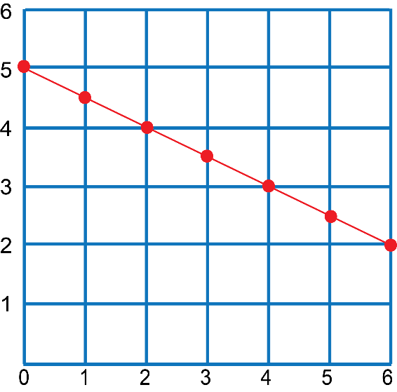
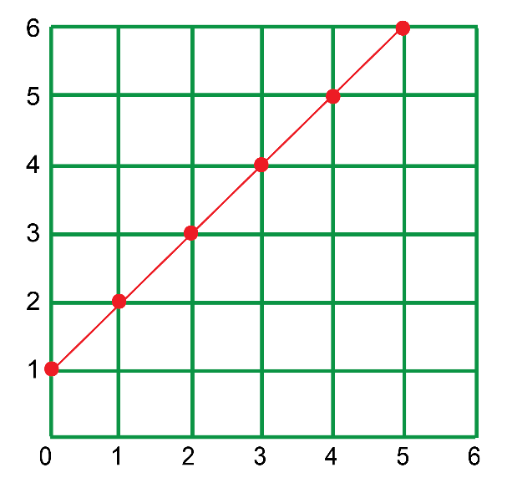
Graphs of direct and inversely proportional relationships
Unit 15.3
A linear relationship does not necessarily indicate a directly proportional relationship. If a straight line does not go through the origin, then there is no direct proportion.
These two graphs show linear relationships, but they are not directly proportional relationships.

Slide 38
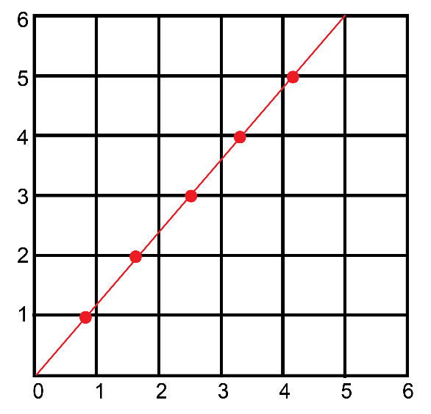
Plotting a graph of an inversely proportional relationship
Unit 15.3
A linear relationship does not necessarily indicate a directly proportional relationship. If a straight line does not go through the origin, then there is no direct proportion.
If a straight line graph starts at zero, it shows a direct proportion.

Slide 39
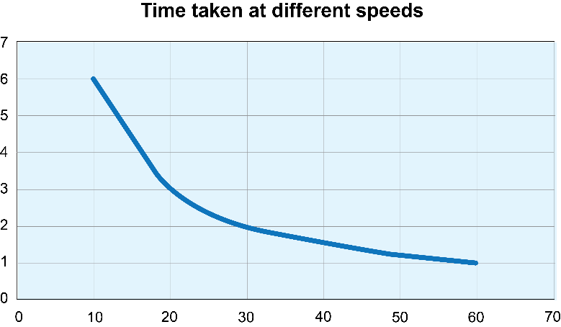
Graphs of direct and inversely proportional relationships
Unit 15.3
If two quantities are in inverse proportion, one quantity increases while the other decreases in the same proportion.
Example of speed and time:
The faster you run, the less time it takes you to complete a race.
As speed increases, the time taken decreases.
Speed and time are inversely proportional.
Inversely proportional relationships
Speed (m/s) | 10 | 20 | 30 | 40 | 50 | 60
Time (s) | 6 | 3 | 2 | 1,5 | 1,2 | 1

Slide 40
Exercise 15.4
Unit 15.3
Complete Exercise 15.4 on page 300 of your Student’s Book

Slide 41
Exercise 15.5
Unit 15.3
Complete Exercise 15.5 on page 302 of your Student’s Book

Slide 42
Finding the independent variable by changing the formula
Unit 15.4
If we have the formula for the cost of transporting children for a school trip:
cost = (35 × number of children) + 10
Or c = 35n + 10
and we know that n = 3, then we can substitute into the formula:
c = 35(3) + 10 and work out the value of c
c = 105 + 10 = 115.
If we are given the cost, and need to find out how many children were on the trip, then we need the formula with number of children on the left-hand side.

Slide 43
Finding the independent variable by changing the formula
Unit 15.4
cost = (35 × number of children) + 10
Step 1: Subtract 10 from both sides:
cost – 10 = (35 × number of children) + 10 – 10
cost – 10 = (35 × number of children)
Step 2: Divide both sides by 35:
(cost – 10) ÷ 35 = (35 × number of children) ÷ 35
(cost – 10) ÷ 35 = number of children
Step 3: Swap the left-hand and the right-hand sides:
number of children = (cost – 10) ÷ 35

Slide 44
Example 15.7 page 302
Unit 15.4
Minenhle runs a small business selling shirts for R75 each. She has fixed costs of R2 000 per month and R15 per shirt.
We have the formula c = 15n + 2 000 for her costs. If her costs are R4 250, how many T-shirts does she have to sell?
We have the formula r = 75n for the amount of money that she makes (revenue) from selling T-shirts. If she makes R10 500, how many T-shirts has she sold?

Slide 45
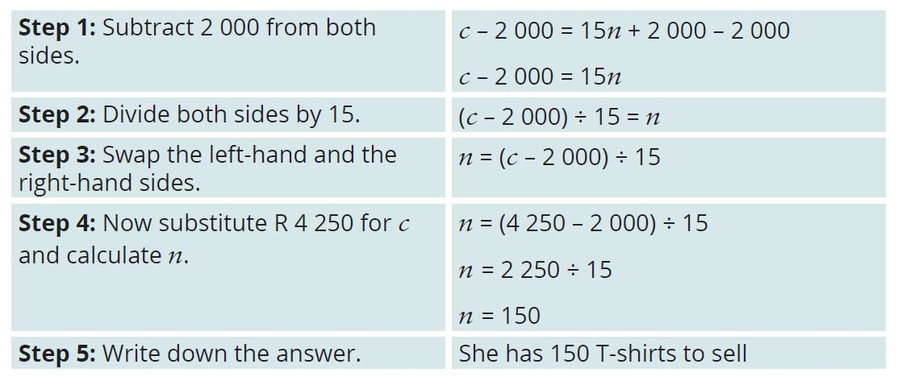
Example 15.7 page 302
Unit 15.4
1a) Change the formula c = 15n + 2 000 so that n is on the left-hand side.

Slide 46
Example 15.7 page 302
Unit 15.4
b) Change the formula r = 75n so that n is on the left-hand side.

Slide 47
Module assessment
Module 15
Complete Module assessment on page 304 of your Student’s Book

