Slide 1
Mathematical Literacy
NQF 3

Slide 2
Working with value added tax and unemployment insurance
Module 10

Slide 3
Overview
10.1 VAT-inclusive versus VAT-exclusive
10.2 Understanding the Unemployment Insurance Fund
10.3 Reading and interpreting payslips

Slide 4
VAT-inclusive versus VAT-exclusive
VAT
Unit 10.1
Value Added Tax
Value Added Tax (VAT) in South Africa is charged on most goods and services at 14%.
It is published annually by the Minister of Finance who has the power to change this rate at any time.
VAT is collected by vendors (businesses) and paid over to SARS monthly.
Some services and foodstuffs are exempt from VAT.

Slide 5
VAT-inclusive versus VAT-exclusive
Unit 10.1
Most prices advertised include VAT. The VAT payable has already been added to the price.
Some prices advertised exclude VAT and the VAT is added to the advertised price.
VAT included
+ VAT

Slide 6
Calculating VAT on VAT-exclusive prices
Unit 10.1
The price of a car is advertised as R359 950 without VAT.
We can calculate the VAT:
Add VAT to the advertised price:
14% × R359 950 = R50 393
Total cost = R359 95 + R50 393 = R410 343
Formula
VAT on advertised price = 14% of price

Slide 7
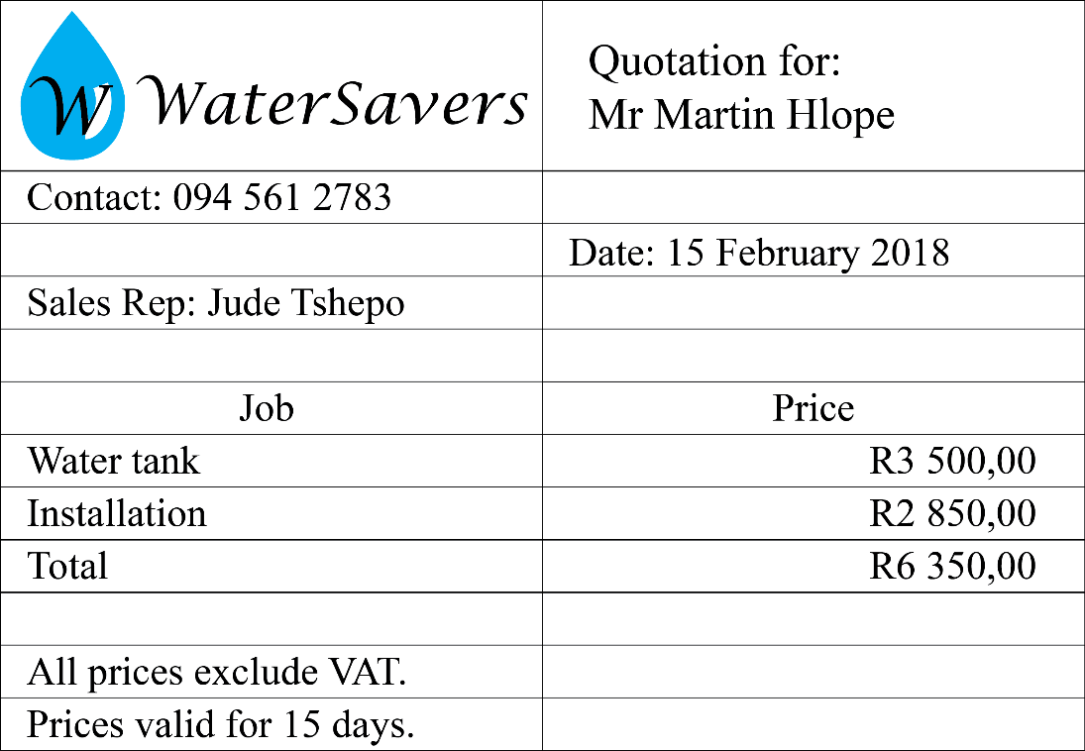
Example 10.1 page 202
Unit 10.1
Answer the questions relating to the quotation:

Slide 8
Example 10.1 page 202 continued ...
Unit 10.1
What is the price quoted to the customer for the service?
What does “All prices exclude VAT” mean?
How does it benefit Water Savers if they quote a price that excludes VAT?
a) Calculate the VAT to be charged on the service.
b) Calculate the total cost to the customer.

Slide 9
Example 10.1 page 202 continued ...
Unit 10.1
R6 350,00
It means that the cost of VAT has not been added to the price. It has to be added to the final price given to the customer if he accepts the quote.
The price looks lower than it actually is.
a) 14% of R6 350 = R889,00
b) Price of service + VAT = R6 350 + R889 = R7 239

Slide 10
Calculating VAT on VAT-exclusive prices
Unit 10.1
Determine the price before the VAT is added
Method 1
Method 2
Selling price is 100%. VAT is 14%
R420,00 is 114% of selling price
420,00 ÷ 114% = 368,42
Tax is calculated on R368,42:
14% of R368,42 = R51,58
Breakdown of total charge:
Cost of goods + VAT
= R368,42 + R51,58 = R420,00
R420,00 includes 14% VAT
(100% of the cost of the goods) + (14% VAT on that cost)
R420,00 = 114% of cost of goods
∴ Cost of goods = × 420,00
= R368,42
VAT = × 420,00 = R51,58
$$\frac{\text{100}}{\text{114}}$$
$$\frac{\text{14}}{\text{114}}$$

Slide 11
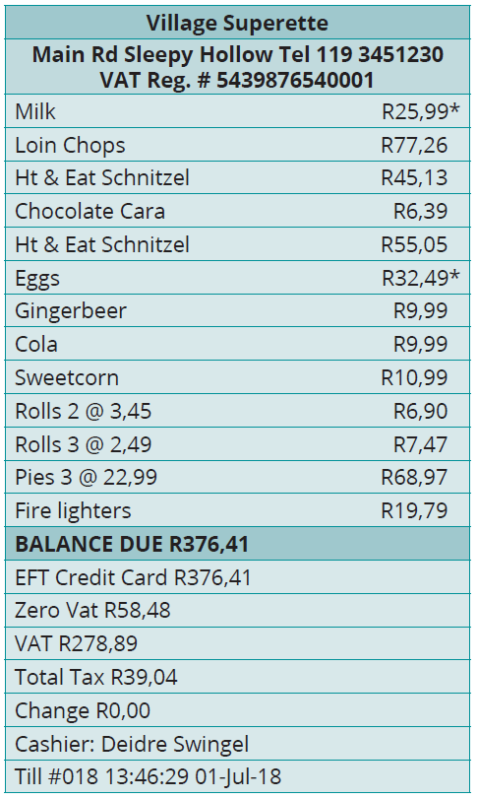
Example 10.2 page 203
Unit 10.1
Study the till slip below, then answer the questions that follow.
What did the customer pay for the goods?
a) Which items are exempt from VAT? Explain how you can identify them.
b) What is the value of the goods that are exempt from VAT? Find the information on the till slip.
The value of the goods on which VAT was calculated, is R278,89. Show the calculations for this amount.
Show that the tax has been correctly calculated.

Slide 12
Example 10.2 page 203 continued ...
Unit 10.1
R376,41
a) Milk and eggs. They are marked with an asterisk (*). b) R58,48
Total amount – VAT exempt items
= R376,41 – R58,48
= R317,93
R317,93 ÷ 1,14 = R278,89
14% of R278,89 = R39,04

Slide 13
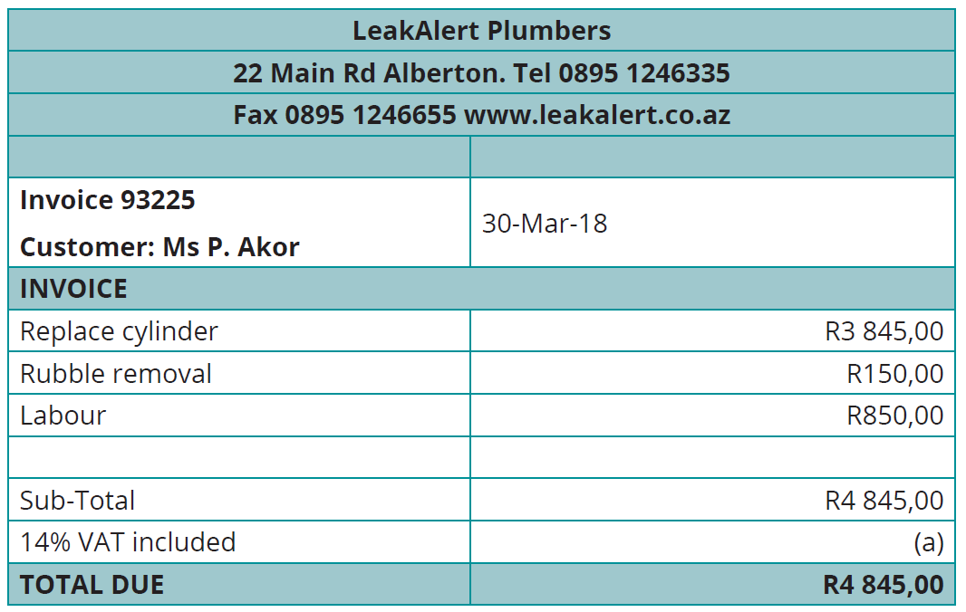
Example 10.3 page 204
Unit 10.1
Calculate the VAT amount that has been left blank on the invoice:
Give 2 reasons why a business might find it useful to show the price before VAT and the VAT amount, on an invoice.

Slide 14
Example 10.3 page 204 continued ...
Unit 10.1
× 4 845,00 = R595,00
A business would use the two amounts for business calculations:
* the price before VAT to calculate their income
* the VAT amount to calculate what to pay to SARS.
$$\frac{\text{14}}{\text{114}}$$

Slide 15
Exercise 10.1
Unit 10.1
Complete Exercise 10.1 on page 205 of your Student’s Book

Slide 16
Understanding the Unemployment Insurance Fund
Unit 10.2
UIF
2%
Unemployment Insurance Fund
The Unemployment Insurance Act states that every employer should deduct 1% of basic salary from their employees. The employer should contribute another 1% of the employee’s basic salary.
This 2% is paid into the Unemployment Insurance Fund (UIF).

Slide 17
Benefits of UIF to employees
Unit 10.2
An employee is entitled to 1 day's pay for every 6 days worked to a maximum of 238 days.
A claim can be made:
1
if the employee is retrenched
2
if the employee takes maternity leave
3
if the employee adopts a baby and takes leave
4
if the employee is terminally ill
5
if the employee dies and has dependents

Slide 18
Employers' responsibilities
Unit 10.2
The Unemployment Insurance Act is a law which states that:
“Every employer has to
register each
employee for UIF.”

Slide 19
Example 10.4 page 207
Unit 10.2
Magdaline’s payslip showed that her gross income for August 2017 was R13 345,00.
Calculate the amount her employer had to deduct for UIF payment.
Show that her employer submitted R266,90 to the fund.

Slide 20
Example 10.4 page 207 continued ...
Unit 10.2
1% × R13 345,00 = R133,45
The employer also had to contribute 1% of Magdalene’s salary towards UIF.
Employee’s contribution + employer’s contribution
= R133,45 + R133,45
= R266,90

Slide 21
Exercise 10.2
Unit 10.2
Complete Exercise 10.2 on page 207 of your Student’s Book

Slide 22
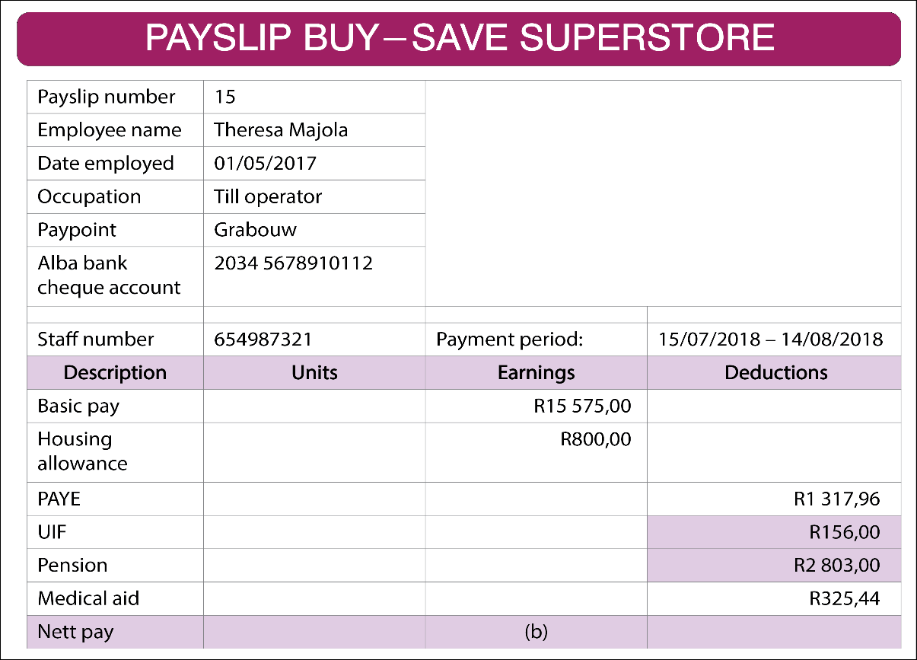
Reading and interpreting payslips
Unit 10.3
Period of payment
PAYE UIF
All deductions
Other possible deductions:
Medical aid contribution
Pension contribution
Loan repayments
Gross earnings
Nett earnings

Slide 23
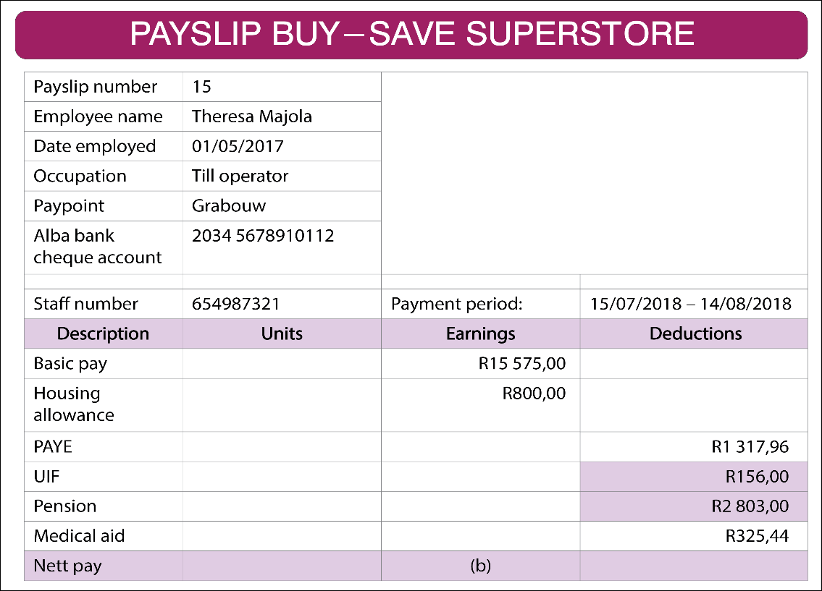
Example 10.5 page 208
Unit 10.3
The payslip below shows what Andile Sibeko earned for the month of June 2018.

Slide 24
Example 10.5 page 208 continued ...
Unit 10.3
How much did Andile earn before deductions?
Check that the UIF calculation is accurate.
Check that the total deductions are correct.
How was Andile’s nett pay calculated? Show the calculations.
How was Andile paid?

Slide 25
Example 10.5 page 208 continued ...
Unit 10.3
R7 375,00
1% × R7 375,00 = R73,75
R1 080,15 + R73,75 + R325,75 = R1 479,65
R7 375,00 – R1 479,65 = R5 895,35
The money was paid into his Ithembekile cheque account.

Slide 26
Exercise 10.3
Unit 10.3
Complete Exercise 10.3 on page 209 of your Student’s Book

Slide 27
Module assessment
Module 10
Complete Module assessment on page 210 of your Student’s Book

