Slide 1
Mathematical Literacy
NQF 2

Slide 2
Estimating and measuring
Module 5

Slide 3
Overview
5.1 Estimating length, mass, volume and temperature
5.2 Using measuring instruments accurately

Slide 4
Estimating length, mass, volume and temperature
Unit 5.1
Definition
An estimate is a measure that is close to the actual measurement.
”
If you estimate well, you can:
select the right measuring instrument and unit
look in the correct range for an answer
realise immediately when your measurement or calculation is wrong.
find a strategy to solve a problem.

Slide 5
Estimating length
Unit 5.1
To estimate a length, you need to know the lengths of some common objects.
Then compare the unknown length to something you know.
Examples:
a matchbox (about 4 cm)
your hand (about 15 cm to the
fingertips)
a ruler (30 cm)
your height (e.g. 1,7 m)
distances that you travel often

Slide 6
Estimating mass or weight
Unit 5.1
Find out the masses of some objects you can use to compare.
The size of the object does not determine its mass!
Then compare the unknown mass to something you know.
Examples:
ant (about 5 mg)
paperclip (about 1 g)
teaspoon of sugar (about 5 g)
loaf of bread (about 800 g)
large brick of margarine (500 g)

Slide 7
Estimating mass or weight
Unit 5.1
Examples:
a 5 litre container of juice (5 kg)
a brick (2,5 kg)
a refrigerator (100 kg)
a small car (1 tonne)

Slide 8
Estimating volume and capacity
Unit 5.1
Find out the volumes of some objects you can use to compare.
Then compare the unknown volume to something you know.
Examples:
teaspoon (5 ml)
1 tablespoon (15 ml)
1 cup (250 ml)
a can of cold drink (300 ml)
a bottle of milk (1 litre)
a petrol tank (60 litres)
a bath (300 litres)

Slide 9
Estimating temperature
Unit 5.1
Three important temperatures to remember:
z
Water freezes at 0°C (zero degrees Celsius)
A normal human body temperature is 37°C
Water boils at 100°C
We can use these temperatures to estimate other temperatures.
For example, a glass of cold water is much colder than body temperature, but not as cold as ice. It is between 4°C and 15°C.

Slide 10
Example 5.1 a) Unit 5.1

Slide 11
Example 5.1 c) Unit 5.1

Slide 12
Exercise 5.1
Unit 5.1
Complete Exercise 5.1 on page 89 of your Student’s Book

Slide 13
Using measurement instruments accurately
Unit 5.2
An
analogue measuring instrument
often needs you to read a scale accurately.
A
digital measuring instrument
gives a read-out of the measurement.

Slide 14
General rules for measuring
Unit 5.2
Here are some important guidelines for using scaled instruments:
Use the correct measuring instrument for the purpose. For example, don't use a ruler marked in cm if you need mm measurements.
Line up to zero, or have a reading of zero at the beginning.
Check that you know what the numbered units and the marked intervals between them represent.
Your eyes must be directly in line with the place where you are taking the measurement.
Take a reading and record the digits marked.

Slide 15
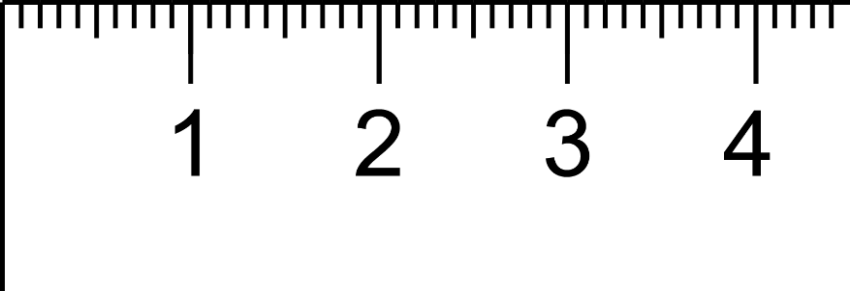
Measuring length: rulers, measuring tapes
Unit 5.2
millimetres
cm
centimetres
A standard ruler is 30 centimetres long.
A ruler usually shows millimetre markings between the centimetres.
10 mm = 1 cm

Slide 16
Measuring length: rulers, measuring tapes
Unit 5.2
100 cm = 1 m
A metre ruler is 100 cm long.
Formula
x 100
x 10
metres
centimetres
millimetres
÷100
÷ 10

Slide 17
Steps in measuring length
Unit 5.2
1
What is the unit of measurement marked on the ruler or measuring tape?
2
What unit does each marking show?
3
Align one end of the object to the zero mark.
4
Read the measurement off the instrument to the number of digits that are clear.
5
If necessary, estimate one decimal place past what you can read. Write down the reading.

Slide 18
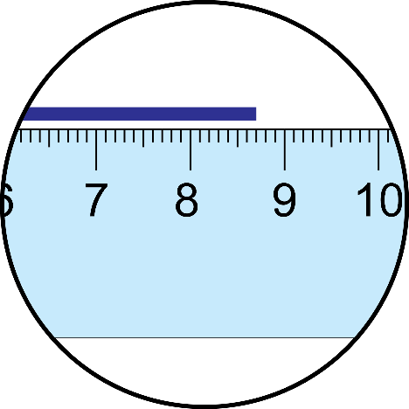
Example 5.2 b) page 91
Unit 5.2
Measure the length of the blue line to the nearest half centimetre.

Slide 19
Example 5.2 b) page 91
Unit 5.2
The unit on this ruler is centimetres. It is marked off in half centimetres (0,5 cm) and millimetres.
The zero is in line with the beginning of the blue line.
The line is a bit more than 8,5 cm long.
The line is about 2 mm beyond the 0,5 cm marking.
We can estimate the reading as 8,7 cm.

Slide 20
Exercise 5.2
Unit 5.2
Complete Exercise 5.2 on page 93 of your Student’s Book

Slide 21
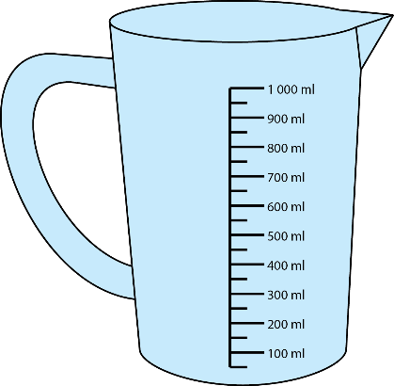
Measuring volume: measuring jugs and cups
Unit 5.2
Choose the cup or jug with the measurement you want.
Scoop or pour the ingredient or liquid in up to the level of the marking you want.
Pour some out or add some in until the measurement is exactly right.
The surface of a liquid is curved. Take your reading at the bottom of the curve.

Slide 22
Example 5.3 a) page 91
Unit 5.2
a) A chef is making a recipe that needs 875 ml of flour. How should he measure out the volume using standard measuring cups?
Measure using the full cup of 250 ml.
250 + 250 + 250 = 750 ml (3 cups)
Subtract the amount already measured from the total.
875 - 750 = 125 ml
This is half a cup.
Write down the measuring cups used: 3½ cups

Slide 23
Exercise 5.3
Unit 5.2
Complete Exercise 5.3 on page 94 of your Student’s Book

Slide 24
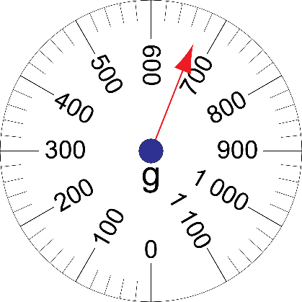
Measuring mass: scales
Unit 5.2
Mass is measured in grams or kilograms using scales.
Here, a circular scale and a linear scale both read 670 g.
Bathroom scales usually read mass in kg from 0 to 120 kg.
Kitchen scales usually read mass in grams up to 500 g or 1 000 g.

Slide 25
Measuring mass: scales
Unit 5.2
When measuring the mass of an object, remember:
1
Begin by setting the scale to zero. Turn the knob on a mechanical scale, or reset the button on a digital scale.
2
Follow the same rules we have listed so far to read the scale.
3
If the object needs to be in a container, find and record the mass of the empty container first.
4
Find the mass of the container and the object together. Then subtract the mass of the container to get the mass of the object.

Slide 26
Example 5.4 a) page 90
Unit 5.2
a) Take the mass reading on this scale at a vegetable shop.
The scale is marked in kg and g.
The numbered markings are 500 g apart and there are 100 g markings in between.
The certain measurement is 1 700 g.
The pointer looks like it is halfway between 1 700 and 1 800, so we can estimate the reading as 1 750 g.

Slide 27
Exercise 5.4
Unit 5.2
Complete Exercise 5.4 on page 96 of your Student’s Book

Slide 28
Measuring temperature
Unit 5.2
Mercury and alcohol thermometers show the temperature with a column of liquid. The liquid rises with a higher temperature because the liquid expands.
A clinical thermometer is marked from 35 degrees Celsius to 42 degrees Celsius.
It is designed to read small changes in a patient's temperature.

Slide 29
Example 5.5 a) Unit 5.2

Slide 30
Example 5.5 b) Unit 5.2

Slide 31
Exercise 5.5 & 5.6
Unit 5.2
Complete Exercise 5.5 & 5.6 on page 98 and 99 of your Student’s Book

Slide 32
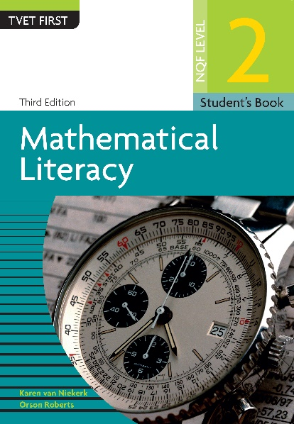
Module assessment
Module 5
Complete Module assessment on page 100 of your Student’s Book

