Slide 1
Mathematical Literacy
NQF 2

Slide 2
Solving problems using ratio, rates and percentages
Module 4

Slide 3
Overview
4.1 Ratio
4.2 Rates
4.3 Percentages

Slide 4
Ratio
Unit 4.1
Definition
Ratios show us how a quantity is divided up into parts.
The numbers are of the same type or measurement.
The parts in a ratio are each exactly the same size.
You write ratios without their units.
A ratio of 5 : 3 is not the same as a ratio of 3 : 5
A ratio is a comparison of two or more numbers.
”

Slide 5
Example 4.1 page 64
Unit 4.1
b) There are 12 female students and 16 male students in a class.
What is the ratio of males to females?
Read the question carefully. Write down the quantities. 12 females; 16 males
Write them in ratio form. Remove the units. Check the order 16 : 12
Simplify if you can. Is there a number that divides into both sides of the ratio? 16 : 12 divided by 4 4 : 3

Slide 6
Comparing ratios
Unit 4.1
Compare ratios by writing both ratios in their simplest form.
Different ratios that simplify to the same ratio are called equivalent ratios.
To find equivalent ratios, multiply or divide both quantities by the same number.
For example 100 : 600 is equivalent to 25 : 150 and 1 : 6.
100 : 600
25 : 150
÷4
÷4
÷25
÷25
25 : 150
1 : 6

Slide 7
Example 4.2 page 65 Unit 4.1

Slide 8
Exercise 4.1
Unit 4.1
Complete Exercise 4.1 on page 66 of your Student’s Book

Slide 9
Dividing quantities in a given ratio
Unit 4.1
When you divide a quantity in a certain ratio, calculate how many parts the quantity is divided into, and the amount of each part.
> Example 4.3, page 67
A survey shows that a ratio of 5 : 1 students in a college earn money by working on the weekends, or don't earn money by working on the weekends.
If there are 2 088 students in the college, how many earn money and how many do not?

Slide 10
Dividing quantities in a given ratio
Unit 4.1
1. Write down the ratio 5 : 1
Write down the quantity of the whole. 2 088
2. Write down the total number of parts. 5 + 1 = 6
3. Divide the whole by the number of parts. 2 088 ÷ 6 = 348
This is the number in each part.
Find each quantity in the ratio.
Multiply the number of parts by the amount in one part.
5 parts x 348 = 1 740 students who earn money
1 part x 348 = 348 students who do not earn money.

Slide 11
Using ratios to find unknown quantities
Unit 4.1
Ratios show a quantity is divided up or shared.
Using the ratio, you can find quantities of one amount if you know the quantity of another amount.
> Example 4.4, page 68
In a bag of red and green sweets, the ratio of red sweets to green sweets is 3 : 4.
If the bag contains 120 green sweets, how many red sweets are there?

Slide 12
Example 4.4 page 68
Unit 4.1
a) Identify the known ratio and the unknown ratio.
Use x for the unknown number in a ratio.
red : green
known ratio 3 : 4
unknown ratio x : 120
We don't know the number of red sweets if there are 120 green sweets.

Slide 13
Example 4.4 page 68
Unit 4.1
Write both ratios as fractions in the same order
Cross-multiply the fractions.
Solve for x :

Slide 14
Example 4.4 page 68
Unit 4.1
Check:
The answer should simplify to the known ratio.
Replace x with 90 in x : 120
There are 90 red sweets in the second bag
90 : 120
÷ 30
÷ 30
3 : 4

Slide 15
Scale ratios
Unit 4.1
A scale ratio on a drawing or map shows the ratio of the length on the drawing to the length in real life.
The wall in this plan is 4 cm long in the drawing.
In real life, it is 400 cm, which is 4 m.

Slide 16
Scale ratios
Unit 4.1
Solve scale problems in the same way as ratio problems.
Tip:
It is convenient to use centimetres when we work with scale plans.
We usually convert real-life measurement to metres.
100 cm = 1 m

Slide 17
Example 4.5 page 70
Unit 4.1
The wall of a room has a length of 3,5 m. How long would this be on a scale drawing if the scale ratio is 1 : 100?
The scale of a house plan is written as the ratio 1 : 75. What are the actual measurements of
i) a wall of length 3 cm on the plan
ii) a window 2 cm long on the plan
iii) a passageway 5 cm long on the plan?

Slide 18
Example 4.5 page 70
Unit 4.1
Convert all measurements to centimetres.
Identify the known ratio and the unknown ratio.
length on plan : length in real life known 1 : 100 unknown x : 350
Write both ratios as fractions in an equality, keeping the same order
Cross-multiply 100x = 350
Solve the equation for x. 100x ÷ 100 = 350 ÷ 100
x = 3,5
3,5 m is 350 cm

Slide 19
Example 4.5 page 70
Unit 4.1
Check the answer:
Therefore the length of the wall on the plan is 3,5 cm.
3,5 : 350
÷ 3,5
÷ 3,5
1 : 100

Slide 20
Example 4.5 b) page 70 Unit 4.1

Slide 21
Exercise 4.2
Unit 4.1
Complete Exercise 4.2 on page 71 of your Student’s Book

Slide 22
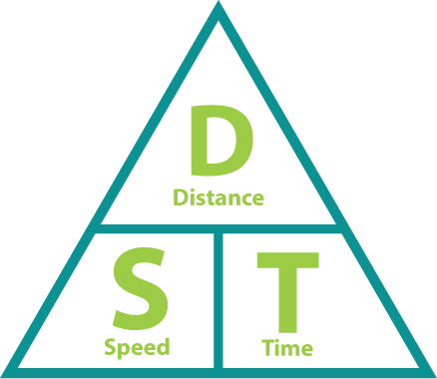
Rates
Unit 4.2
Definition
Rates tell us how one quantity changes in relation to another quantity.
Speed is the ratio of distance divided by time.
Speed = distance : time
We represent speed in units of distance per unit of time e.g. km/h
A rate is a special ratio where the two terms are in different units.
”

Slide 23
Some different kinds of rates
Unit 4.2
Conversion rates:
between units of measurement e.g. 10 mm per cm
between currencies e.g. the exchange rate for the Rand
Cost rates: e.g. the unit cost of an item per kilogram
Consumption rates: litres of petrol used per 100 km travelled
Speed: units of distance per units of time e.g. km/h or m/s

Slide 24
Example 4.6 page 73
Unit 4.2
Robert works in a warehouse packing goods for delivery. He can pack 15 crates per hour. How many hours will it take him to pack 90 crates?
b) Sara is an athlete whose normal race speed is 20 km/h. If she runs at her normal race speed for 7 km, how long will it take her in minutes?

Slide 25
Example 4.6 page 73
Unit 4.2
Identify known rate and unknown rate.
Write an equation with = between the ratios.
Cross multiply
Solve for the unknown
value.
Check your answer.
known rate: 15 crates per hour
unknown rate: 90 crates in a hours
15 × a = 1 × 90
a = 90 ÷ 15 = 6 hours
90 ÷ 6 hours = 15 crates/hour

Slide 26
Example 4.7 page 74
Unit 4.2
a) Store A sells potatoes at R21,95 per 3 kg bag and Store B at R90 for 15 kg. What is the unit price for each and which is the better buy?
Rates Store A: R21,95 per 3 kg
Store B: R90 per 15 kg
Convert to unit rates R21,95 ÷ 3 = R7,32 per kg
to the nearest cent
R90 ÷ 15 kg = R6/kg
Store B has the better buy.

Slide 27
Exercise 4.3
Unit 4.2
Complete Exercise 4.3 on page 74 of your Student’s Book

Slide 28
Percentages
Unit 4.3
Definition
Percentages are fractions with a denominator of 100
”
We write the sign % instead of using the denominator.
We usually calculate percentage using a fraction or a decimal.
For example, 25% of R150 can be written as
× 150 = 0,25 × 150 = R37,50

Slide 29
Example 4.8 a) page 77 Unit 4.3

Slide 30
Decrease or increase by a percentage
Unit 4.3
Method 1
New value = original value + % × original value (increase)
New value = original value - % × original value (decrease)
First add the percentage increase or decrease then add or subtract it from the original value.

Slide 31
Decrease or increase by a percentage
Unit 4.3
Method 2
New value = (100 + % increase) × original value
New value = (100 - % decrease) × original value
First work out the new percentage and multiply this by the original value.

Slide 32
Example 4.9 page 78
Unit 4.3
The price of a shirt costing R38 is increased by 15%. Calculate the new price.
Method 1
Find 15% of R38:
Increase R38 by R5,70
Therefore R38 + R5,70
= R43,70
Method 2
Need 115% of R38:
× 38 = 43,7

Slide 33
Using percentages to compare numbers
Unit 4.3
When you compare two fractions with different denominators, you can write them as percentages. Then you can compare them easily, since they have the same denominator of 100.
> Example 4.10 page 80
A class has 26 students and 13 of them are boys.
Express this as a percentage.
Write a fraction with the total number of students in the denominator.
Multiply by 100 and simplify. The answer is a percentage
= 50%

Slide 34
Exercise 4.5
Unit 4.3
Complete Exercise 4.5 on page 80 of your Student’s Book

Slide 35
Further applications of percentages and rates
Unit 4.3
> Example 4.11 page 81
A car park attendant is paid R42 per hour for a basic
40-hour week. Overtime is paid at time and a half.
If he works 48 hours in a week, how much does he earn?
Basic Pay: 40 × R42 = R1 680
Overtime page: 8 × 1,5 × R42 = R504
Total pay: R1 680 + R504 = R2 184

Slide 36
Exercise 4.6
Unit 4.3
Complete Exercise 4.6 on page 81 of your Student’s Book

Slide 37
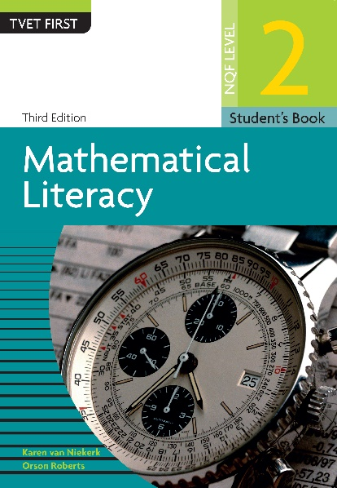
Module assessment
Module 4
Complete Module assessment on page 83 of your Student’s Book

