Slide 1
Mathematical Literacy
NQF 2

Slide 2
Measurement and time conversions
Module 3

Slide 3
Overview
3.1 Time notation
3.2 Conversions with a calculator
3.3 Time calculations

Slide 4
Time notation
Unit 3.1
Analogue time
Analogue clocks show 12 hours on their faces and represent time by the position of hands on the dial.
Digital time
Digital clocks usually show 24 hours. They use only numbers to show the time.

Slide 5
Time notation
Unit 3.1
In a.m. and p.m. time, the 24-hour day is divided into two periods of twelve hours each:
Before noon: from 12 a.m. to 12 p.m.
After noon: from 12 p.m. to 12 a.m.

Slide 6
Example 3.1 page 49
Unit 3.1
Write the following in 24-hour time.
a) 12.15 a.m. b) 3.23 a.m. c) 6.59 p.m. d) 12.23 p.m.
a) 12.00 a.m. is midnight shown as 00:00 so 12:15 a.m. is 00:15
b) 03:23
c) Add 12 hours: 18:59
d) 12:23 (just after midday)

Slide 7
Exercise 3.1
Unit 3.1
Complete Exercise 3.1 on page 49 of your Student’s Book

Slide 8
Conversions with a calculator
Unit 3.2
To convert from one unit of measurement to another:
Decide whether you are converting to a
bigger unit or a smaller unit.
÷
x
Converting to a
bigger
unit, your measurement will be smaller, so you will divide.
Converting to a
smaller
unit, your measurement will be bigger, so you will multiply.

Slide 9
Metric System
Unit 3.2
In South Africa, we use the metric system, which is a base 10 system.
To make conversions easy, we can use a table:
km | Hm | Dm | m | dm | cm | mm

Slide 10
Conversions on a calculator Unit 3.2

Slide 11
Metric System
Unit 3.2
> Example 3.2 on page 50
Convert 23 m to centimetres.
= 2 300 cm
km | Hm | Dm | m | dm | cm | mm
 |  | 2 | 3
km | Hm | Dm | m | dm | cm | mm
 |  | 2 | 3 | 0 | 0

Slide 12
Metric System
Unit 3.2
> Example 3.2 on page 50
Convert 3 450 mm to metres.
= 3,450 metres
km | Hm | Dm | m | dm | cm | mm
 |  |  | 3 | 4 | 5 | 0
km | Hm | Dm | m | dm | cm | mm
 |  |  | 3, | 4 | 5 | 0

Slide 13
Exercise 3.2 and 3.3
Unit 3.2
Complete Exercise 3.2 and Exercise 3.3 on page 50 of your Student’s Book

Slide 14
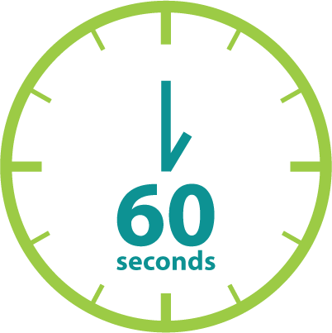
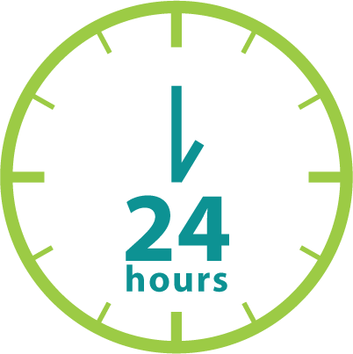
Time calculations
Unit 3.3
Time Values
in a minute
in an hour
in a day
So time conversions are not metric!
70 minutes + 60 minutes
= 130 minutes
= 2 hours 10 minutes

Slide 15
Example 3.4 page 53 Unit 3.3

Slide 16
Exercise 3.4
Unit 3.3
Complete Exercise 3.4 on page 54 of your Student’s Book

Slide 17
Time calculations
Unit 3.3
Time conversions
> Example 3.5, page 55
Convert 3 hours 40 minutes to:
i) minutes ii) seconds
b) Convert 364 days to weeks.

Slide 18
Time calculations
Unit 3.3
Time conversions
a) i) 60 minutes in an hour
(3 x 60) + 40 minutes = 220 minutes
ii) 60 seconds in a minute
220 x 60 = 13 200 seconds
b) 364 ÷ 7 = 52 weeks

Slide 19
Case Study: Planning Study Time Unit 3.3

Slide 20
Exercise 3.5
Unit 3.3
Complete Exercise 3.5 on page 56 of your Student’s Book

Slide 21
Timetables
Unit 3.3
Definition
Timetables are visual tools for planning your hours, days, weeks and months.
”

Slide 22
Timetables
Unit 3.3
Case Study: Planning study time
Tsepo writes final exams for Marketing in 2 weeks.
He needs to study for about 20 hours.
He has classes until 2 days before the exam.
He must attend classes for 4 hours per day.
He takes 2 hours to travel to college and back each day.
Tsepo works for 3 hours on Monday and Wednesday afternoons.
He practises soccer on Tuesday and Thursday evenings.
He plays soccer on a Saturday from 7.30 until 4 p.m.
He takes 15 minutes to get to and from the soccer club.
Use the timetable below to help Tsepo plan his study time.

Slide 23
Timetables
Unit 3.3
 | Monday | Tuesday | Wednesday | Thursday | Friday | Saturday | Sunday
05:00
06:00
07:00
08:00
09:00
10:00
11:00
12:00
13:00
14:00
15:00
16:00
17:00
18:00
19:00
20:00
21:00
22:00
23:00
24:00

Slide 24
Exercise 3.6
Unit 3.3
Complete Exercise 3.6 on page 60 of your Student’s Book

Slide 25
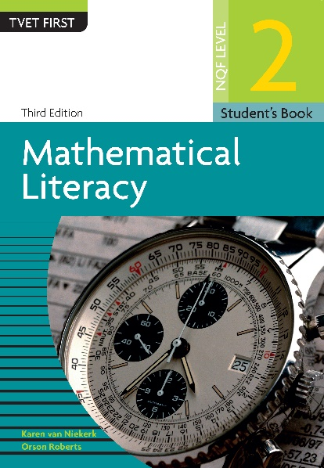
Module assessment
Module 3
Complete Module assessment on page 61 of your Student’s Book

