Slide 1
Mathematical Literacy
NQF 2

Slide 2
Calculate and solve problems
Module 2

Slide 3
Overview
2.1 Basic operations on a calculator
2.2 Calculations on fractions, decimals and percentages

Slide 4

Basic operations on a calculator
Unit 2.1
Get to know how your own calculator works.
Note:
ON or C clears
everything
Basic calculators do the operations in the order that the keys are pressed.
They don't use BODMAS
Scientific calculators use BODMAS.
change a number to negative
find the percentage of a number
find the square root of a number
operation keys + - x ÷ =
clears last entry
enter a decimal number using the decimal point

Slide 5
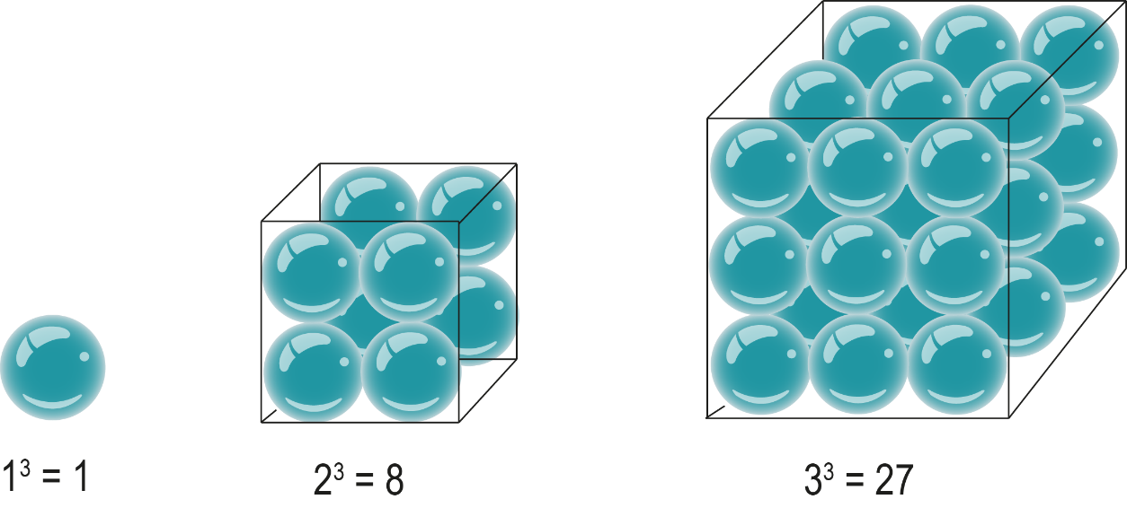
More complex operations on whole numbers
Unit 2.1
Squares and cubes:
7 squared is written 7² and means 7 x 7.
On a basic calculator, press 7 x 7 =.
7 cubed is written 7³ and means 7 x 7 x 7.

Slide 6
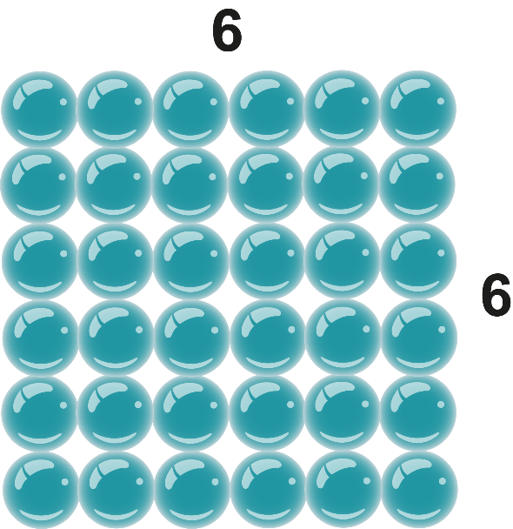
More complex operations on whole numbers
Unit 2.1
Square roots:
To find the square root of a number, we find a number multiplied by itself to get the original number.
The square root of 36 is 6, because 6 x 6 = 36.
On a calculator, enter the number and then

Slide 7



More complex operations on whole numbers
Unit 2.1
Numbers that are not perfect squares
> Example 2.4 page 29
Find the side of square with an area of 74 units.
Key sequence is 74
Display shows 8,602325...
Answer 8,60 units rounded to 2 decimal places.

Slide 8
More complex operations on whole numbers
Unit 2.1
The memory keys
Use M+ to add a number to the memory
Use M- to subtract a number from a number already in the memory.
Press MRC once to show the number stored
Press MRC twice to clear the number from the memory.

Slide 9
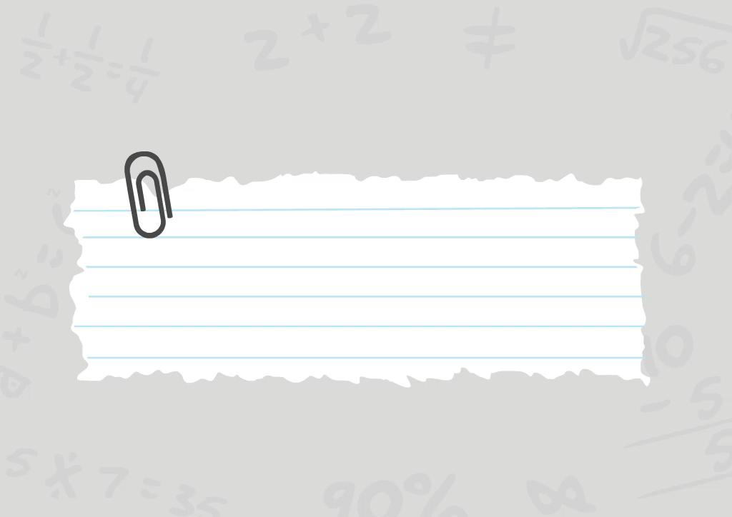

Using the memory keys
Unit 2.1

Slide 10
Example 2.5 page 30
Unit 2.1
1. Show the key sequences and then give the answers to:
  a)
  b)

Slide 11





Example 2.5 page 30
Unit 2.1
1a)
means (100 - 17) divided by 5.
Key sequence:
Display: 316,6
300
100
17
5

Slide 12

Example 2.5 page 30
Unit 2.1
1b)
Key sequence:
Display: 282
750
27 x 19
45

Slide 13
Exercise 2.3
Unit 2.1
Complete Exercise 2.3 on page 30 of your Student’s Book

Slide 14
Getting to know your scientific calculator
Unit 2.2
How to know that you are using a scientific calculator:
It looks a bit like this one here
The calculation still appears on the screen with the answer
You can use the arrow key to scroll back through the calculation.
Note:
Check all the details about scientific calculators on pages 31 and 32. Work out how to do all the things that are mentioned on these two pages.

Slide 15

Calculations on fractions, decimals and percentages
Unit 2.2
Even with a calculator, you need to know how fractions work!
Adding and subtracting fractions
Method 1
To add and subtract fractions, you must find a common denominator first
LCD is 6

Slide 16
Calculations on fractions, decimals and percentages
Unit 2.2
Even with a calculator, you need to know how fractions work!
Adding and subtracting fractions
Method 2
Treat each fraction as a separate division calculation
e.g. = 4 ÷ 5
Put the answers in the memory
Add or subtract from the memory and press

Slide 17

Multiplying fractions
Unit 2.2
> Example 2.7 page 34
Find of R65
Without a calculator:
With a calculator:
13
x R65 = x 65
2 5 65
Cancel common factors in numerator and denominator
= R26
= R26

Slide 18


Dividing fractions
Unit 2.2
> Example 2.8 page 35
Calculate
Without a calculator:
With a calculator:
Invert the second fraction and multiply out.
3 5
7 5
= 2,33

Slide 19
Working with decimals
Unit 2.2
Converting decimals to fractions:
b)
c)
Converting fractions to decimals:
= 3 ÷ 4 = 0,75 Calculator keys:
3 4

Slide 20
Exercise 2.6
Unit 2.2
Complete Exercise 2.6 on page 40 of your Student’s Book

Slide 21
Adding and subtracting decimals
Unit 2.2
Calculate 12,362 + 7,419
12,362
+ 7,419
19,781
Line up decimal commas

Slide 22
Multiplying decimals
Unit 2.2

Slide 23
Multiplying decimals
Unit 2.2
> Example 2.17 page 42
Calculate:
a) 1,2 x 2 b) 1,2 x 0,2 c) 1,2 x 0,02
We know that 12 x 2 = 24.
a) 1,2 x 2 = 2,4 1 decimal number after the comma
b) 1,2 x 0,2 = 0,24 1 + 1 decimal place results in 2 decimal places in answer
c) 1,2 x 0,02 = 0,024 1 + 2 decimal places results in 3 decimal places in answer

Slide 24
Multiplying decimals
Unit 2.2
> Example 2.18 page 42
Calculate:
41,563 x 100
→ move decimal 2 places right
41,563 x 100
= 4 156,3

Slide 25
Dividing decimals
Unit 2.2
> Example 2.19 page 42
Calculate:
41,56 ÷ 1 000
→ move decimal 3 places left
41,56 ÷ 1 000
= 0,04156

Slide 26
Exercise 2.7
Unit 2.2
Complete Exercise 2.7 on page 42 of your Student’s Book

Slide 27
Working with percentages
Unit 2.2

Slide 28
Working with percentage
Unit 2.2
Percentages are fractions with a denominator of 100.
19% means 19 parts in every 100.
19% means or 0,19
35% of 50 can be rewritten as

Slide 29
Example 2.20 page 44
Unit 2.2
a) Write 28% as a fraction in its simplest form.
b) Write 25% as a decimal fraction.
c) Change 0,4 to a percentage.
d) Change to a percentage.

Slide 30
Example 2.20 page 44
Unit 2.2
e) Calculate 25% of 200.
f) Calculate 31% of R2,86.
g) Calculate 27% of R18.

Slide 31

Example 2.20 page 44
Unit 2.2
a)
b)
c)
d)

Slide 32
Example 2.20 page 44
Unit 2.2
e) ‘Of’ means multiply so
f)
g)

Slide 33
Exercise 2.8
Unit 2.2
Complete Exercise 2.8 on page 44 of your Student’s Book

Slide 34
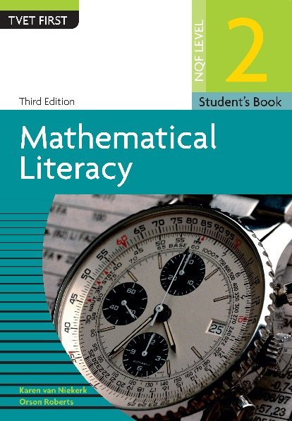
Module assessment
Module 2
Complete Module assessment on page 46 of your Student’s Book

