Slide 1
Mathematical Literacy
NQF 2

Slide 2
Collect and organise data
Module 15

Slide 3
Overview
15.1 Key concepts in data handling
15.2 Data collection tools
15.3 Organising data

Slide 4
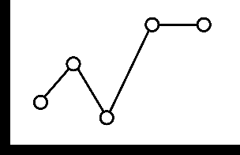
Key concepts in data handling
Unit 15.1
Definition
Planning, collecting, organising, analysing and presenting data is a process known as data handling.
”
Understanding the key concepts and terms used in this process is important.
Research questions
Populations and samples
Reliable data

Slide 5
Research questions
Unit 15.1
Description
The research question is clear, focused and specific. The primary purpose is to gather information that is precise, accurate and reliable.
”
Some questions that can help you to write a research question are:
What do I want to find out?
How will I find the information that I need?
What will I do with the information that I collect?
Who will find this information useful?
Is the question interesting and relevant?
Is the research question researchable? Consider the available time and
resources.
Is the research question measureable?
Is the research question too broad or too narrow?

Slide 6
Example 15.1 page 282
Unit 15.1
Write a clear research question.
Formula
Check what the main idea or fact is that you want to find out. Will it be possible to collect the information you need? Will the answer to the question be useful to someone?
Can you collect measureable data, and can you present it in a table or graph?
Is there a link between how much time students take to get to college and the distance from their home?

Slide 7
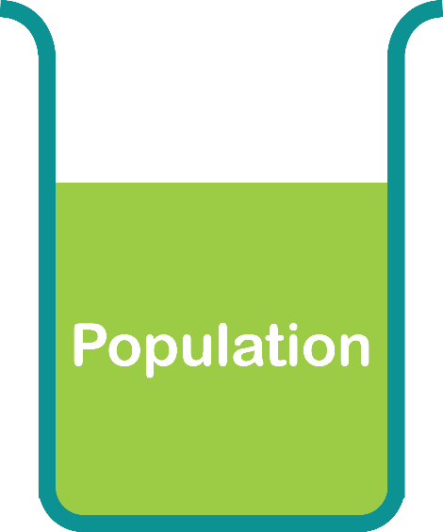
Population and samples
Unit 15.1
Population
A population is the group of individuals or units that will be studied.
”

Slide 8
Population and samples continued ...
Unit 15.1
Sample
A sample is a section of the population that is selected. The sample selected must be a fair representation of the population from which it is drawn.
”

Slide 9
Example 15.2 page 284
Unit 15.1
Class Activity
A college has 1 500 students. The population is all 1 500 students.
To find information about the population, you could interview or observe only some of the 1 500 students. This group we choose is a sample.
The sample could be all Level 2 students, or only the Level 2 Marketing students, or the 15 rugby team members or a random selection of 30 students from the college.
Decide which of these samples is appropriate.

Slide 10
Reliable data
Unit 15.1
A researcher needs data from a sample that is identified reliably and free from bias.
A reliable sample can be used to reach conclusions about the whole population.
Not all statistical information is accurate or true. Always check if the information is factual or if it is opinion.
Bias / subjectivity
Prejudice towards the method or result of research.
”

Slide 11
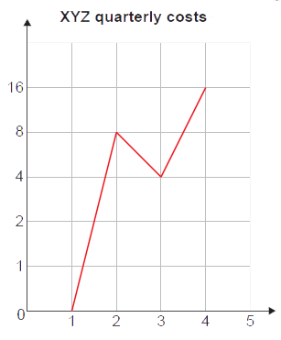
Example 15.3 page 285
Unit 15.1
Susan drew this graph. Use the graph to answer the questions.
Make a list of the problems with this graph.
Between which two intervals do you find the biggest jump?
Redraw the line graph using even steps on the
y-axis.
How does your new scale affect your answer in Question b)?

Slide 12
Example 15.3 page 285 continued ... Unit 15.1

Slide 13
Example 15.4 page 285
Unit 15.1
Comment on this statement: ‘Out of a random sample of 10 women, nine preferred Smoothie Hand Lotion.’
Comment on this statement: ‘Out of a random sample of 10 women, nine preferred Smoothie Hand Lotion to their regular brand.’
Comment on this statement: ‘Nine out of 10 women prefer Smoothie Hand Lotion.’

Slide 14
Example 15.4 page 285 continued ...
Unit 15.1
The statement does not stipulate who the 10 women are; they could be employees of the Smoothie Hand Lotion company.
The statement does not stipulate what the women prefer Smoothie Hand Lotion to. The comparison could be to something that is not in the same category, such as petroleum jelly.
According to this statement, only 10 women were sampled. Only sampling 10 women is not representative of all the women in the country.

Slide 15
Exercise 15.1
Unit 15.1
Complete Exercise 15.1 on page 286 of your Student’s Book

Slide 16
Data collection tools
Unit 15.2
There are different ways to collect data.
Data Collection Tools
Observations
Interviews
Questionnaires

Slide 17
Observations
Unit 15.2
Observation does not require any contact with participants. The method simply entails observing, studying and recording information and data that is needed for the research.
Advantage
Disadvantage
This method is best suited for research where no contact is required with participants.
Observation can be influenced by any bias or shortcomings of the observer.

Slide 18
Example 15.5 page 288 Unit 15.2

Slide 19
Interviews
Unit 15.2
Interviews can be conducted by observation or by using a questionnaire.
Interviews are suitable where there is a small number of participants and responses are expected to be short.
Interviews are useful when participants agree to face-to-face questions.
Disadvantage
Observation can be influenced by any bias or shortcomings of the observer.

Slide 20
Questionnaires
Unit 15.2
A questionnaire consists of a series of questions designed to gather information and then completed by participants.
The information can be gathered from an oral interview or a written questionnaire.
A questionnaire is the most popular research instrument.
Advantage
Disadvantage
They can be completed online and submitted immediately.
Participants are sometimes not truthful.

Slide 21
Types of questions
Unit 15.2
Closed questions
Open-ended questions
These are questions that a participant must choose from a list of options.
Questions that can be answered by the participant in their own words.

Slide 22
Example 15.6 page 288
Unit 15.2
You would like to find information about the heights of the 300 Level 2 students at your college.
Develop an instrument that you can use to collect the information.

Slide 23
Example 15.6 page 288 continued ... Unit 15.2

Slide 24
Example 15.7 page 289
Unit 15.2
Which instrument would be appropriate for collecting data for each of the following cases? Give a reason for your choice.
The weight of all the 300 Level 2 students at a college
The colours of cars that are parked in the college parking area
The opinions of all the students in your group about a proposed building development in a local area.
Develop an interview question that you could use to collect data for a) iii) above.

Slide 25
Example 15.7 page 289 continued ...
Unit 15.2
Questionnaire. The number of Level 2 students is large.
Observation. There is no need to talk to anyone. You just count the cars for each colour.
Interview or questionnaire. There are probably fewer than 25 in the group of students, so the answers can be called out and written down immediately. The students could also be given a questionnaire to answer.

Slide 26
Example 15.7 page 289 continued ...
Unit 15.2
Here is an example of a questionnaire:
Are you aware of the proposed development on Smith Street opposite the college?
Yes
No
If your answer is yes, what is your opinion on the proposed building development?
I do not have an opinion on the development.
I think it is a good development.
I am opposed to the development.

Slide 27
Exercise 15.2
Unit 15.2
Complete Exercise 15.2 on page 290 of your Student’s Book

Slide 28
Organising data
Unit 15.3
Once data has been collected, the next step is to classify it.
Identify if the data is:
numerical data that is discrete
numerical data that is continuous
categorical data
The next step is to organise the data.

Slide 29
Organising data continued ... Unit 15.3

Slide 30
Example 15.8 page 291
Unit 15.3
A Mathematical Literacy test out of 10 was written by 30 students. The results of the test are as follows:
8 9 6 10 4 8 7 7 10 9
5 6 7 8 6 7 7 4 5 8
7 6 5 6 7 4 8 9 6 7
Classify the data as numerical or categorical.
Organise the data into:
a tally table for the marks
a frequency table for the marks

Slide 31
Example 15.8 page 291 continued ...
Unit 15.3
Numerical data
Discrete data
Tally table for marks:
Tally table for marks:
Mark | Tally marks | Total
4 | ||| | 3
5 | ||| | 3
6 | |||| | | 6
7 | |||| ||| | 8
8 | |||| | 5
9 | ||| | 3
10 | || | 2
Frequency table for marks:
Mark | 4 | 5 | 6 | 7 | 8 | 9 | 10
Frequency | 3 | 3 | 6 | 8 | 5 | 3 | 2

Slide 32
Example 15.8 page 291 continued ...
Unit 15.3
The weights (to the nearest kg) of 22 students in a class are:
59 61 57 59 62 71 78 81
83 67 58 81 56 60 69
85 69 61 54 48 61
Tally the data using the intervals
40 – 49; 50 – 59; 60 – 69; 70 – 79; and 80 – 89.
Draw up a frequency table for the data.

Slide 33
Example 15.8 page 291 continued ...
Unit 15.3
Tally table:
Frequency table:
Tally table:
Mark | Tally marks
40 – 49 | ||
50 – 59 | |||| |
60 – 69 | |||| |||
70 – 79 | ||
80 – 89 | ||||
Frequency table:
Weight (kg) | 40 – 49 | 50 – 59 | 60 – 69 | 70 – 79 | 80 - 89
Frequency | 2 | 6 | 8 | 2 | 4

Slide 34
Module assessment
Module 15
Complete Module assessment on page 294 of your Student’s Book

