Slide 1
Mathematical Literacy
NQF 2

Slide 2
Patterns, tables and graphs
Module 14

Slide 3
Overview
14.1 Completing tables of values from graphs and formulae
14.2 Drawing straight line graphs

Slide 4
Completing tables of values from graphs and formulae
Unit 14.1
We can show patterns using a:
list of numbers
table of values
formula
We can also use a graph.
Graph
A graph summarises how one quantity changes if another quantity that is related to it also changes.
”

Slide 5
Completing tables of values from graphs and formulae
Unit 14.1
A point on a graph shows two
numbers, a number on the
horizontal axis and a number on
the vertical axis.
The two numbers at a point
form an ordered pair.
The point shown here is (4; 3),
4 on the horizontal axis, 3 on the
vertical axis.
The number on the horizontal axis is always written first.

Slide 6
Reading values off graphs Unit 14.1

Slide 7
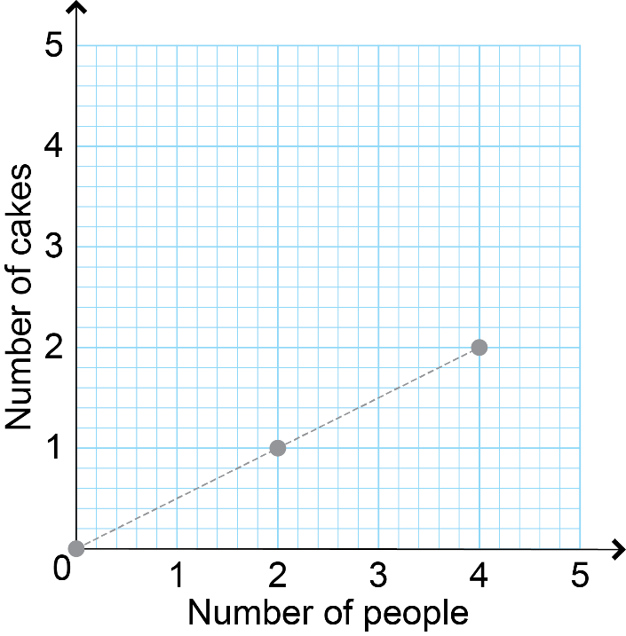
Example 14.1 page 260
Unit 14.1
A caterer supplies a certain number of cakes, depending on the number of people at an event.
The graph shows the relationship between the number of cakes and the number of people.

Slide 8
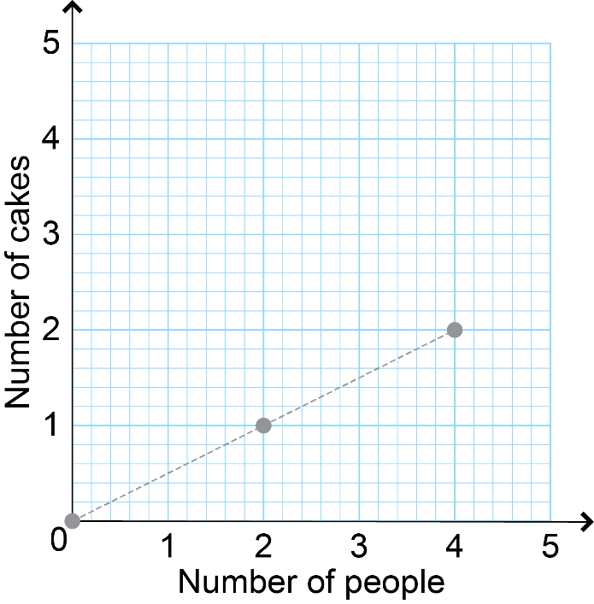
Example 14.1 page 260 continued ...
Unit 14.1
Read the values of each point off the graph.
Draw up a table of values and enter the values shown on the graph.

Slide 9
Example 14.1 page 260 continued ...
Unit 14.1
Step 1: Write the labels from the graph into the table.
Number of people
Total number of cakes
Number of people is independent. Put it in top row of table.

Slide 10
Example 14.1 page 260 continued ...
Unit 14.1
Step 1: Write the labels from the graph into the table.
Number of people
Total number of cakes
Number of cakes is dependent. Put into second row of table.

Slide 11
Example 14.1 page 260 continued ...
Unit 14.1
Step 1: Write the labels from the graph into the table.
Step 2: Write the heading of the graph.
Step 3: Read off the ordered pair for each point.
Step 4: Write the values into the table.
Number of people
Total number of cakes
Number of cakes needed for the number of people.
(0; 0) (2; 1) (2; 4)
Number of people | 0 | 1 | 2
Total number of cakes | 0 | 2 | 4

Slide 12
Using formulae to determine values of variables using substitution
Unit 14.1
In formulae, variables represent unknown values.
Variables are usually letters.
If you know the value of one unknown, you can find the other.
Substitute numbers for the variables.
If a = 35b + 10 and b = 3, then
a = 35(3) + 10
a = 105 + 10 = 115
Substitution
Substitution means putting a number in place of a letter in an equation.
”

Slide 13
Exercise 14.1
Unit 14.1
Complete Exercise 14.1 on page 262 of your Student’s Book

Slide 14
Drawing straight line graphs
Unit 14.2
To draw a graph, you need to:
use a given table of values
work out a table of values from a formula
draw a system of axes with an appropriate scale for each axis
write labels for the graph and both axes
plot the points as ordered pairs from the table of values

Slide 15
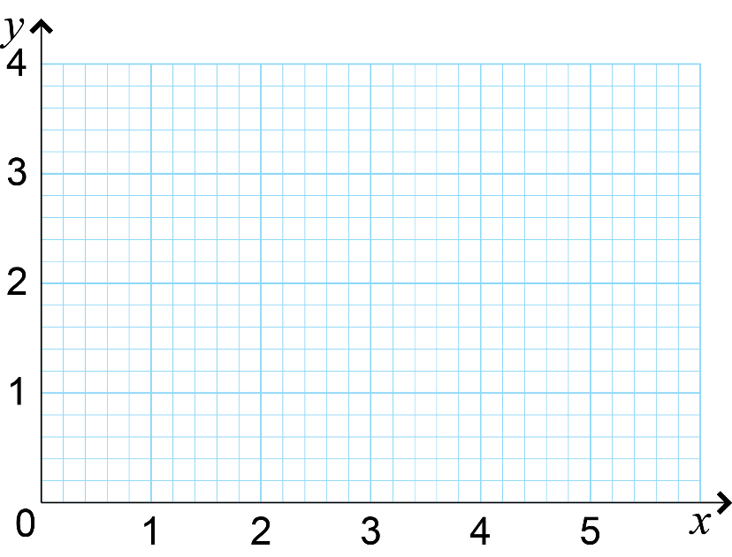
The axis of the graph
Unit 14.2
An axis is a reference line, which is numbered and labelled.
The place where the two axes cross is called the origin. It is the point (0; 0).
Use the horizontal axis, or x-axis, for your independent variable.
The vertical axis (y-axis) shows the dependent variable.
'axes' is the plural of 'axis'

Slide 16
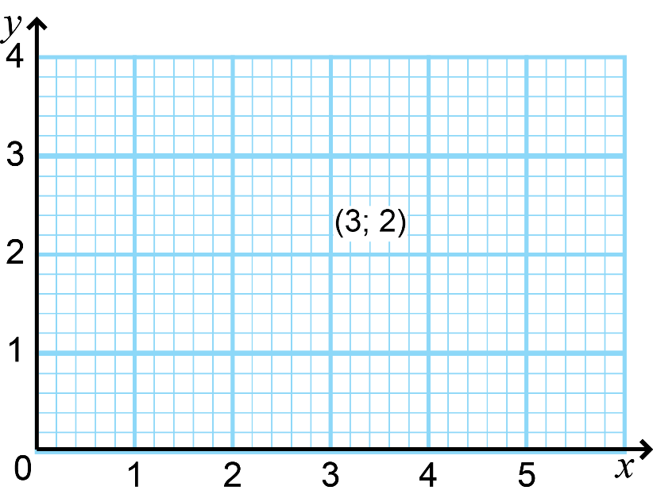
Plotting points
Unit 14.2
To plot the point representing the coordinate pair (3; 2):
1. Start at the origin (0; 0).
2. Move along the horizontal axis until you reach 3.
3. Move upwards until you are in line with 2 on the vertical axis.
4. Make a mark with your pencil at that point.

Slide 17
Exercise 14.2
Unit 14.2
Complete Exercise 14.2 on page 271 of your Student’s Book

Slide 18
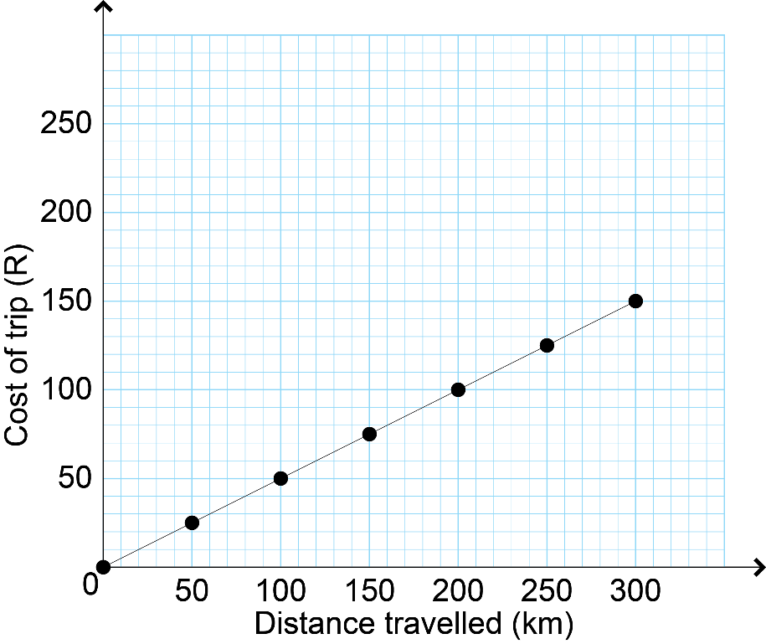
Graphs of direct proportion and inverse proportion relationships
Unit 14.3
If two quantities are directly proportional, the graph to represent the quantities will form a straight line.
In this graph, you can calculate the cost of the trip for any distance travelled by multiplying the distance by the constant of proportionality, which is ½ (half).
If you double one variable, the other will be doubled.

Slide 19
Inverse proportion
Unit 14.3
If two quantities are in inverse proportion, one quantity increases while the other decreases in the same proportion.

Slide 20
Inverse proportion
Unit 14.3
1
60 min
The more people are helping to complete a job, the shorter the time it will take. So the number of people and the time taken to complete the job can be inversely proportional to each other.

Slide 21
Inverse proportion
Unit 14.3
2
30 min
The more people are helping to complete a job, the shorter the time it will take. So the number of people and the time taken to complete the job can be inversely proportional to each other.

Slide 22
Inverse proportion
Unit 14.3
3
20 min
The more people are helping to complete a job, the shorter the time it will take. So the number of people and the time taken to complete the job can be inversely proportional to each other.

Slide 23
Inverse proportion
Unit 14.3
4
15 min
The more people are helping to complete a job, the shorter the time it will take. So the number of people and the time taken to complete the job can be inversely proportional to each other.

Slide 24
Inverse proportion
Unit 14.3
4
2×
15 min
Check if one variable halves when you double the other one.

Slide 25
Inverse proportion
Unit 14.3
2
30 min
Check if one variable halves when you double the other one.

Slide 26
Inverse proportion
Unit 14.3
1
2
3
4
×
×
×
×
60
30
20
15
= 60
= 60
= 60
= 60
If you multiply the two quantities together, their product always remains constant (the same).

Slide 27
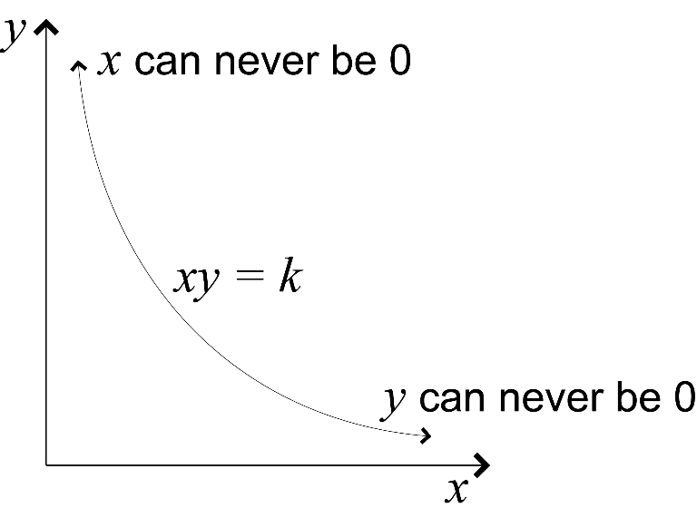
Graph for inverse proportion
Unit 14.3
A graph of two variables that are inversely proportional to each other, always has the shape called a hyperbola.
In theory, a hyperbola can also have negative values for x and y.

Slide 28
Exercise 14.3
Unit 14.2
Complete Exercise 14.3 on page 274 of your Student’s Book

Slide 29
Module assessment
Module 14
Complete Module assessment on page 276 of your Student’s Book

