Slide 1
Mathematical Literacy
NQF 2

Slide 2
Understanding and using tariff systems
Module 12

Slide 3
Overview
12.1 Tariff systems
12.2 Calculations with telephone tariffs
12.3 Calculations with transport tariffs

Slide 4
Tariff systems
Unit 12.1
Tariffs
We can identify two types of phone tariffs in South Africa:
A tariff is the cost per unit of a service usually based on time duration or volume of the service.
”
Cell phone tariffs
Landline and data deals for the home

Slide 5
Example 12.1 page 221
Unit 12.1
The following is a deal offered by a cell phone company. Answer the questions relating to it.
What would you pay per month for this contract?
List three things included in the bundle.
Explain what is meant by ‘monthly minutes’.
Explain what happens when you have used up your airtime minutes.
Monthly Fee | R129,00
SMS bundle | R100,00
Airtime minutes | R100,00
Anytime Data | R150,00
Out of bundle data (per Mb) | R0.,95
Out of bundle SMS and MMS | R0,55
Out of bundle Wifi voice calls (per minute) | R0,55

Slide 6
Example 12.1 page 221 continued ...
Unit 12.1
R129,00
Monthly SMSs, airtime minutes and anytime data.
This refers to the number of minutes you may speak on the phone every month, as part of the contract.
You will be charged at the out-of-bundle rate of R0,55 per minute.

Slide 7
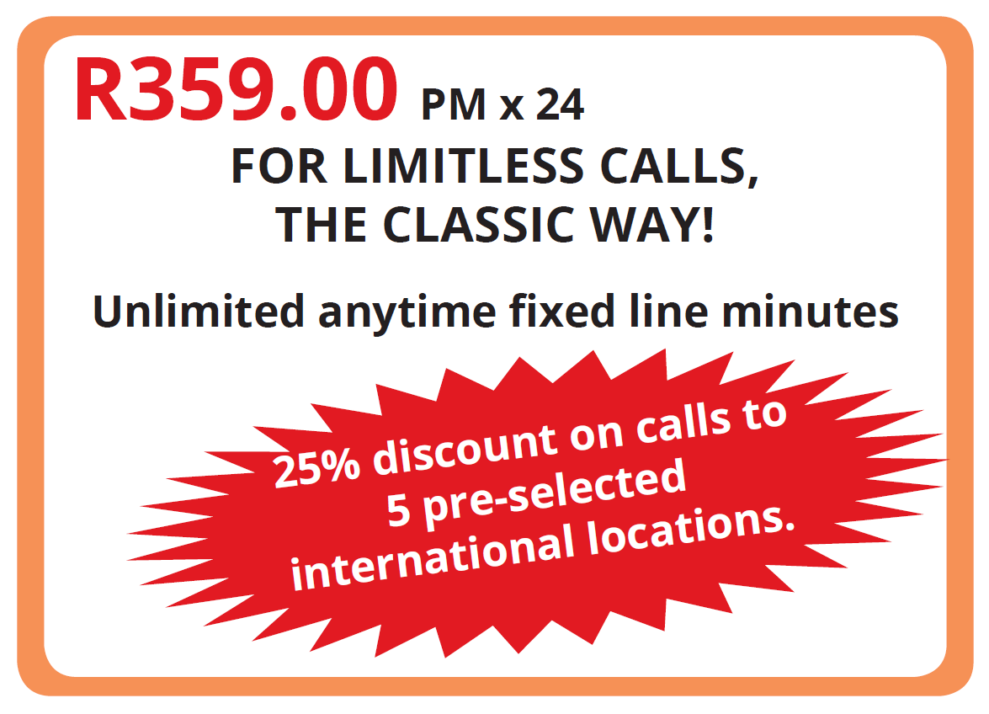
Example 12.2 page 221
Unit 12.1
This contract is a deal for a landline phone in a home:
What is the length of this contract?
What is the cost per month?
Explain what is meant by ‘unlimited fixed line minutes’.
Who would a contract like this appeal to?

Slide 8
Example 12.2 page 221 continued ...
Unit 12.1
24 months
R349,00
You may speak to someone on another landline for an unlimited amount of time.
Someone who is housebound and uses a landline a lot, e.g. a pensioner.

Slide 9
Transport tariffs
Unit 12.1
When we have many options to choose from, decision making can be difficult.
Transport systems have information that you need to filter before making an informed decision:
different routes
different timetables schedules
prices and rates charged

Slide 10
Example 12.3 page 222
Unit 12.1
Look at the timetables and answer the questions:
Johannesburg–East London (Wednesday, Friday and Sunday Service)
Station | Class available | Day | Arr. | Dep.
Johannesburg | Sleeper/Sitter | Day 1 |  | 17:30
Vereeniging | Sleeper/Sitter | Day 1 | 19:00 | 19:20
Kroonstad | Sleeper/Sitter | Day 1 | 21:42 | 21:50
Bloemfontein | Sleeper/Sitter | Day 2 | 00:32 | 00:55
Burgersdorp | Sleeper/Sitter | Day 2 | 06:17 | 06:34
Queenstown | Sleeper/Sitter | Day 2 | 08:58 | 09:12
East London | Sleeper/Sitter | Day 2 | 13:25

Slide 11
Example 12.3 page 222 continued ...
Unit 12.1
East London – Johannesburg (Wednesday, Friday and Sunday Service)
Station | Class available | Day | Arr. | Dep.
East London | Sleeper/Sitter | Day 1 |  | 09:00
Queenstown | Sleeper/Sitter | Day 1 | 13:05 | 13:26
Burgersdorp | Sleeper/Sitter | Day 1 | 16:00 | 18:28
Bloemfontein | Sleeper/Sitter | Day 1 | 21:36 | 21:56
Kroonstad | Sleeper/Sitter | Day 2 | 00:51 | 01:10
Vereeniging | Sleeper/Sitter | Day 2 | 03:20 | 03:25
Johannesburg | Sleeper/Sitter | Day 2 | 05:00

Slide 12
Example 12.3 page 222 continued ...
Unit 12.1
What transport service does this timetable refer to?
Which day does the service not operate on?
How many times does the train stop between Johannesburg and East London?
If you wanted to travel from Bloemfontein to Queenstown, what time would you board the train?
How long does the train stop at Bloemfontein station?

Slide 13
Example 12.3 page 222 continued ...
Unit 12.1
The train service between Johannesburg and East London.
On Mondays, Tuesdays, Thursdays and Saturdays
Five times
00:55
23 minutes (00:32 till 00:55)

Slide 14
Exercise 12.1
Unit 12.1
Complete Exercise 12.1 on page 223 of your Student’s Book.

Slide 15
Calculations with telephone tariffs
Unit 12.2
There are two types of cell phone services available.
Contract option
a fixed rate is paid each month for certain fixed benefits.
Prepaid option
Airtime or data is purchased for use as and when it is required.

Slide 16
Example 12.5 page 224
Unit 12.2
Jenny is looking for the cheapest option for airtime and data. She can afford to spend R150 per month. She compares three plans:
Deal 1 | Deal 2 | Deal 3
You pay R109 PM for 24 months You get R150 airtime per month You pay 40c per Mb of data, 50c per SMS and 80c per voice minute | You pay R150 month-to-month and get R200 airtime You pay R0,79 per voice minute, R0,50 per SMS and R0,99 per Mb of data | You pay R149 month-to-month You get 150 voice minutes, 300 Mb data and for every 5 SMSs you send, you get 50 SMSs

Slide 17
Example 12.5 page 224 continued ...
Unit 12.2
In an average month Jenny uses 170 Mb of data and speaks on the phone for 90 voice minutes. Will she have enough airtime if she chooses Deal 1? Show your calculations.
How does Deal 2 compare with Deal 1? Give reasons for your answer, but do not do any calculations.
Would Deal 3 be a good option for Jenny? Give a reason for your answer.
What is the difference between a 24 month contract and a month-to-month contract?
What are the advantages and disadvantages of a 24 month contract?

Slide 18
Example 12.5 page 224 continued ...
Unit 12.2
170 Mb of data @ 40c per Mb = R68,00
90 voice minutes @ 80c per voice minute = R72,00
Total airtime used: R140
She will have enough airtime.
She pays R109 and gets R150 worth of airtime.
Deal 2 is more expensive. The voice minutes and data cost more per unit.
Deal 3 is not a good option. It is more expensive than Deal 1 and Jenny does not use that much data or voice minutes.

Slide 19
Example 12.5 page 224 continued ...
Unit 12.2
When you sign up for a 24 month contract, you pay the contract amount every month for 24 months.
A month-to-month contract is valid only for one month. You can buy a new contract every month.
The advantage of a 24 month contract is that if you have a good deal, the prices stay the same for the next 24 months.
The disadvantage is that if better deals come along, or your needs change, you cannot change your contract.

Slide 20
Exercise 12.2
Unit 12.2
Complete Exercise 12.2 on page 226 of your Student’s Book

Slide 21
Calculations with transport tariffs
Unit 12.3
We all use transport on a regular basis and need to know how to work out what different types of transport will cost.
Some tariff systems are confusing, so reading tables carefully and accurately is an important skill to develop.

Slide 22
Example 12.7 page 228
Unit 12.3
Pumeza lives in Queenstown in the
Eastern Cape. She has to travel to
Pretoria for a job interview.
The interview is at 10:30 on 26 July.
She will stay with family in Pretoria and return to Queenstown on 28 July.
She considers her transport options. Should she go by plane, train or bus? Pumeza cannot afford the plane fare. She compares the fares of two bus services.

Slide 23
Example 12.7 page 228 continued ...
Unit 12.3
Bus Service A
Route: Queenstown Station-Jhb/Pta Seats: Price: R495,00
Depart: Queenstown | Arrive: Pretoria
Tue, 24 Jul 2018 20:00 | Wed, 25 Jul 2018 06:30
Route: Pta/Jhb-Queenstown Station Seats: Price: R495,00
Depart: Pretoria | Arrive: Queenstown
Tue, 27 Jul 2018 23:10 | Wed, 28 Jul 2018 09:30

Slide 24
Example 12.7 page 228 continued ...
Unit 12.3
Bus Service B:
Queenstown to Pretoria
Pretoria to Queenstown
Board | Destination | Departure Date | Depart | Arrival date | Arrive | Fare
Queenstown | Pretoria | 24 Jul 2018 | 20:15 | 25 Jul 2018 | 06:30 | R399
Board | Destination | Departure Date | Depart | Arrival date | Arrive | Fare
Pretoria | Queenstown | 27 Jul 2018 | 16:30 | 28 Jul 2018 | 03:45 | R459

Slide 25
Example 12.7 page 228 continued ...
Unit 12.3
What will a return journey cost Pumeza if she uses Bus Service A?
What time would the bus leave Queenstown?
How long will the trip take?
What will a return journey cost with Bus Service B?
What time would she return to Queenstown if she travelled home with Bus Service B?
What would you advise Pumeza to do? Give a reason for your answer.

Slide 26
Example 12.7 page 228 continued ...
Unit 12.3
R459 + R459 = R918,00
20:00
20:00 to 06:30 = 10 hours 30 minutes
R399 + R459 = R858,00
03:45
Although Bus Service B is cheaper, I would advise Pumeza to travel to Pretoria on Bus Service B and back to Queenstown on Bus Service A. If Pumeza gets a lift from Queenstown station, she can use Bus Service B for the return journey. If not, it would be dangerous to arrive at 03:45.

Slide 27
Exercise 12.3
Unit 12.3
Complete Exercise 12.3 on page 229 of your Student’s Book

Slide 28
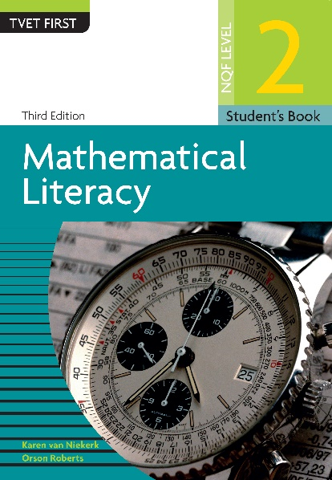
Module assessment
Module 12
Complete Module assessment on page 235 of your Student’s Book

