Slide 1
Mathematical Literacy
NQF 2

Slide 2
Reading and interpreting bank information
Module 11

Slide 3
Overview
11.1 Bank accounts for personal use
11.2 Read and interpret bank statements and fees brochures

Slide 4
Reading and interpreting bank information
Which bank?
What type of account?
Unit 11.1
Choosing a bank
Does the bank have an account type and services suited to my needs?
Does the bank have a branch close by that I can access easily?
Are there ATMs close enough for my purposes?
Are the banking charges and information about how to keep the banking fees low clearly stated?

Slide 5
Types of bank accounts
Unit 11.1
The type of account you choose is based on:
There are basically two types of transactional account available today.
Current or Cheque account and Savings account
1
The fees and charges
2
The minimum and maximum balances
3
The types of transactions available on the account type.

Slide 6
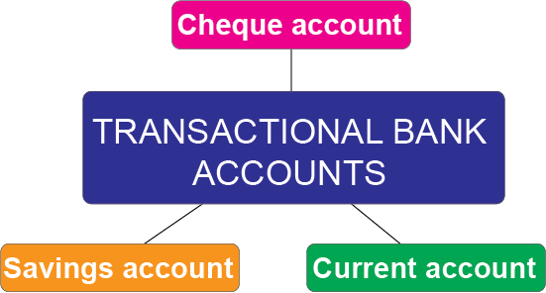
Transactional bank accounts
Unit 11.1

Slide 7
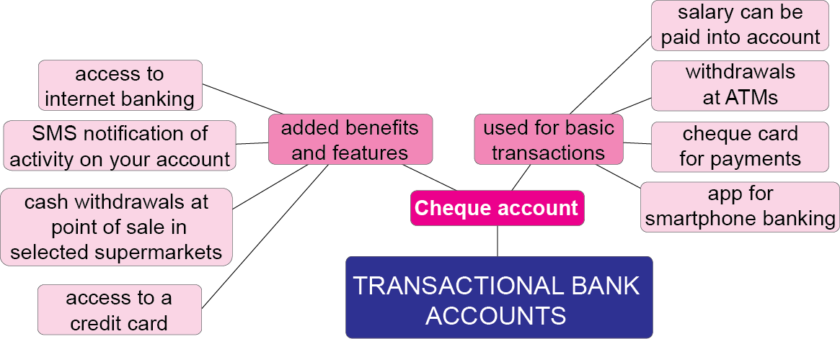
Transactional bank accounts
Unit 11.1

Slide 8
Transactional bank accounts
Unit 11.1

Slide 9
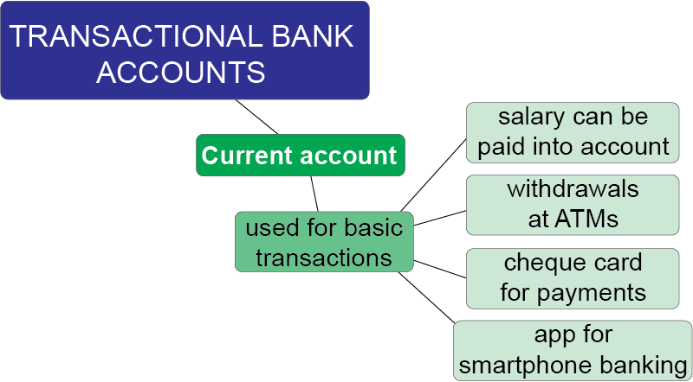
Transactional bank accounts
Unit 11.1

Slide 10
Debit card
Unit 11.1
Description
It is linked to your cheque or savings account and the amount swiped or withdrawn is deducted immediately from the account to which the card is linked.
A debit card is usually issued for any transactional account.
The cardholder can withdraw money at an ATM or at the till at most supermarkets.
”
Note:
The debit card must not be confused with a credit card. They are two different types of transaction cards.

Slide 11
Credit card account
Unit 11.1
Description
All purchases made on a credit card account become debt owed.
The interest payable is much higher than for some other forms of credit.
The amount owing is repayable over six or twelve months, which makes the account expensive to maintain.
This account is often opened as an additional benefit to a cheque account. The amount of credit granted depends on the risk profile of the account holder.
”

Slide 12
Case study
Unit 11.1
Complete Case study on page 208 of your Student’s Book

Slide 13
What you need to open a bank account
Unit 11.1
This is part of an application form for a bank account.

Slide 14
What you need to open a bank account
Unit 11.1
The Financial Intelligence Centre Act, 38 of 2001, abbreviated to “FICA” requires every person opening a bank account to provide the bank with:
a bar-coded Identity document
proof of residence
a source of primary income, e.g. salary, rental income, etc.
FICA regulations are necessary to prevent money laundering (the abuse of financial systems to hide or disguise the proceeds of crime).

Slide 15
Banking forms
Unit 11.1
Most banking today takes place via the internet and ATMs. There is not much need for bank forms.
Cheques will soon become a thing of the past. Some companies do not accept cheques anymore.
A cheque is only valid for a limited time period and once expired is referred to as being stale and no longer valid.

Slide 16
Cheques Unit 11.1

Slide 17
The deposit slip Unit 11.1

Slide 18
Example 11.1 page 212
Unit 11.1
Carl Pieterse works for Sterling Plumbers. The company has an account with SB Bank, Rosettenville Branch. The branch code is 53111 and the account number is 98445522100.
On 23 August 2017 his employer sends him to the bank to do some deposits. He deposits the following:
8 × R100 notes, 3 × R50 notes, 2 × R20 notes, 7 × R5 coins, 14 × R2 coins, 30 × 20c coins, 5 × 10c coins
A cheque for R544,60 from Pioneer Bank Clerewood branch, in the name of M. Mbabane.
A cheque for R1 744,50 from Savvy Bank in the name of P. Toerien.

Slide 19
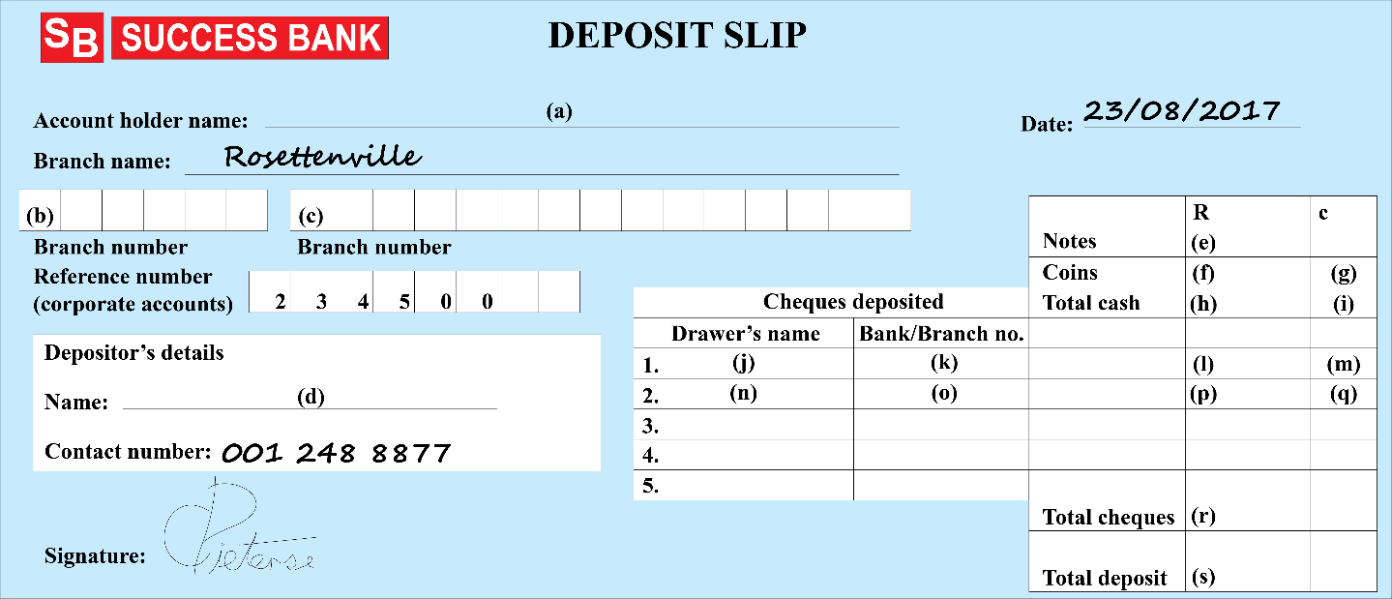
Example 11.1 page 212 continued ...
Unit 11.1
Use this information to complete the deposit slip provided. Write down what you would fill in for A–S.

Slide 20
Example 11.1 page 212 continued ...
Unit 11.1
Sterling Plumbers
53111
98445522100 D.
Pieterse
(8 × R100 notes) + (3 × R50 notes) + (2 × R20 notes)
= R800 + R150 + R40 = R990
(7 × R5 coins) + (14 × R2 coins) + (30 × 20c coins)
+ (5 × 10c coins) = R35 + R28 + R6 + R0,50
F. R69 G. 50c H. R1 059
I. 50c J. M. Mbabane K. Pioneer Bank
L. 544 M. 60c N. P. Toerien
O. Savvy Bank P. 1 744 Q. 50c
R. R2 289,10 S. R3 348,60

Slide 21
Exercise 11.1
Unit 11.1
Complete Exercise 11.1 on page 213 of your Student’s Book

Slide 22
Read and interpret bank statements and fees brochures
Unit 11.2
A bank statement is a record of all transactions on a bank account.
Internet banking and EFTs (electronic funds transfer) are recorded online, so banks only issue statements when you ask.
Most bank statements have the same format:
Transaction date
Type of transaction
Description of transaction
Credit transaction
Debit transaction
Balance on the account after each transaction.

Slide 23
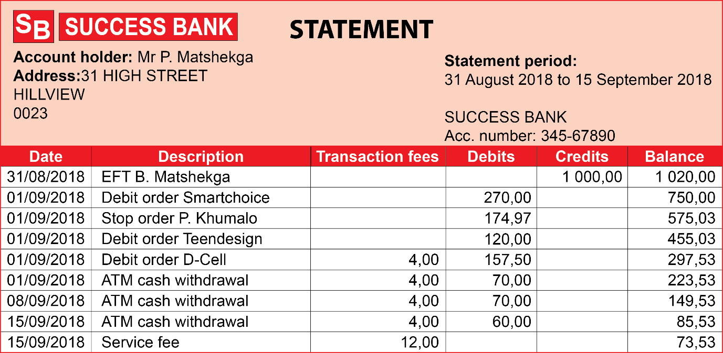
Example 11.2 page 214
Unit 11.2
Petrus printed out this bank statement from the internet.

Slide 24
Example 11.2 page 214 continued ...
Unit 11.2
At which branch does Petrus bank?
Write down the branch code he uses on transactions.
For which dates did Petrus request a statement? Name the opening and closing dates of the statement.
Explain what the debits are.
The opening balance is not given on this statement. Calculate what it would have been.
How much did Petrus pay in banking charges this month?

Slide 25
Example 11.2 page 214 continued ...
Unit 11.2
Epping Heights branch
Branch code 5643
The transactions are from 31 August 2018 to 15 September 2018.
The debits are all the amounts that were paid to other people or businesses. The account was debited each time.
R1 020 – R1 000 = R20. The opening balance would have been R20.
R28

Slide 26
Bank fees
Unit 11.2
Banks charge their clients for all services.
Some banks have a high monthly charge and do not charge for individual transactions. Other banks have a low monthly charge, but charge for individual transactions.
A good way to save is to always use your own bank’s ATM machines. All banks charge more when you use a different bank’s ATM.
Different types of bank accounts also have different charge structures.
You can use an independent online website to compare the fees of different banks.

Slide 27
Exercise 11.2
Unit 11.2
Complete Exercise 11.2 on page 215 of your Student’s Book

Slide 28
Module assessment
Module 11
Complete Module assessment on page 218 of your Student’s Book.

