Slide 1
Mathematical Literacy
NQF 2

Slide 2
Reading information in financial documents
Module 10

Slide 3
Overview
10.1 Documents for goods and services
10.2 Reading statements of accounts
10.3 Payslips
10.4 Understanding VAT

Slide 4
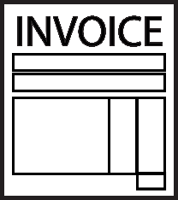
Documents for goods and services
Unit 10.1
Goods and services are delivered to people daily. In these transactions money is exchanged and as proof of this exchange, documents are issued as proof of the transaction.
These documents include the following:
receipts
till slips
invoices
credit notes

Slide 5
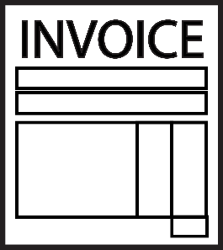
Types of invoices
Unit 10.1
cash invoice
A simple record where the buyer pays immediately for the goods or services.
till slip
A record of a purchase without the buyer's details, as payment usually happens immediately.
credit invoice
Issued to a buyer when goods are returned, or when a transaction is reversed

Slide 6
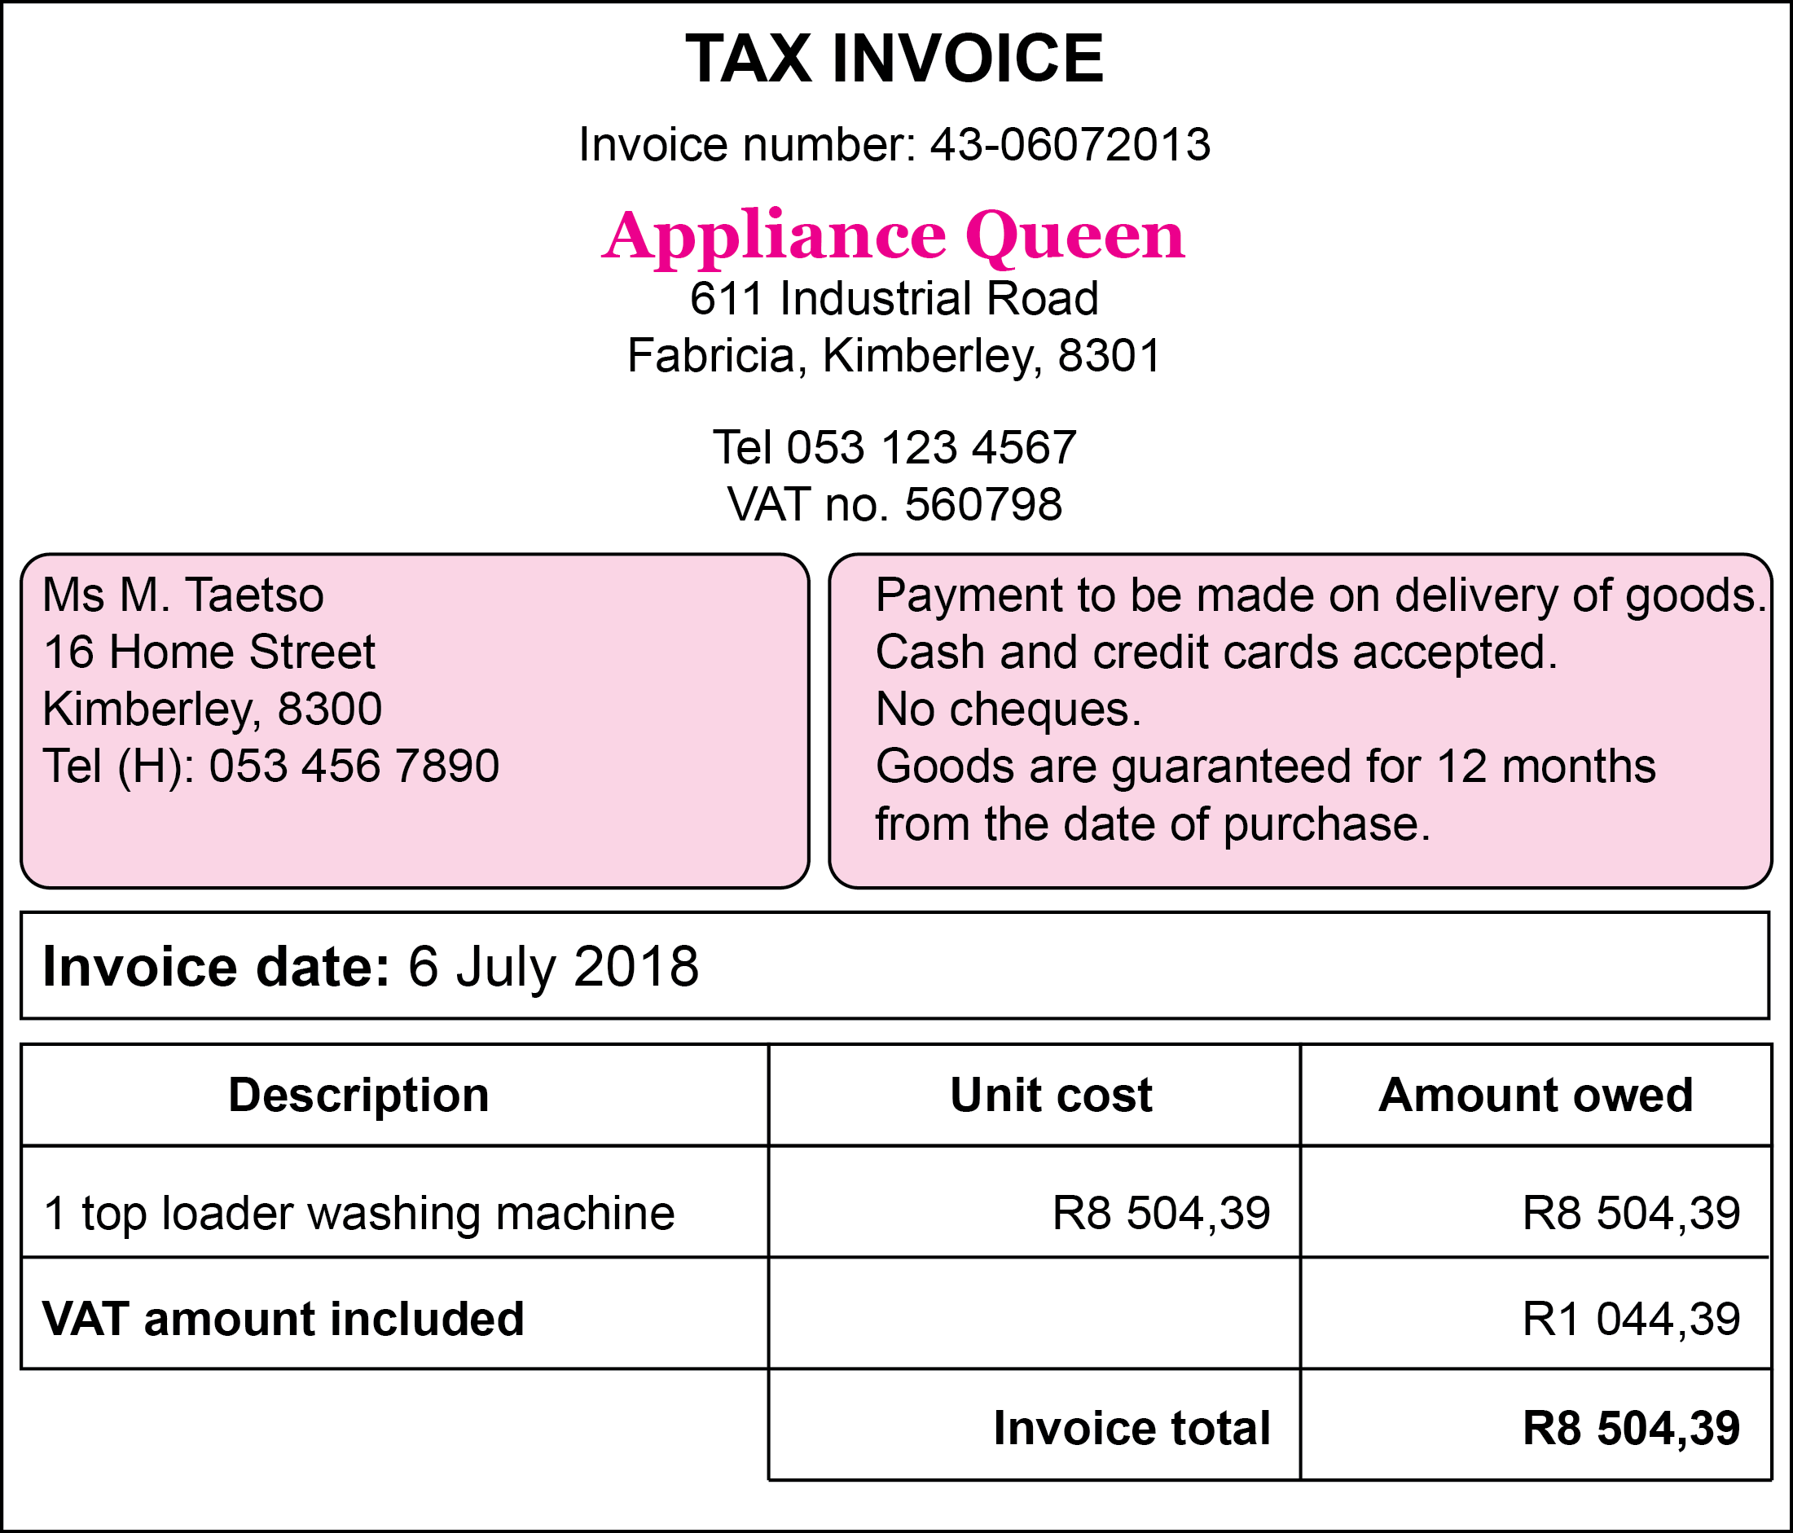
Example 10.1 page 190
Unit 10.1

Slide 7
Example 10.1 page 190 continued ...
Unit 10.1
Who is the buyer (customer)?
What did she buy?
Who is the seller?
Is the seller registered for VAT? Give a reason for your answer.
When was this purchase made?
Calculate the cost of the appliance before VAT was included.

Slide 8
Example 10.1 page 190 continued ...
Unit 10.1
Ms M. Taetso
A toploader washing machine
Appliance Queen
Yes. There is a VAT registration number (560798) on the invoice.
6 July 2018
Cost of appliance before VAT was included:
Amount owed – VAT = R8 504,39 – R1 044,39 = R7 460,90.

Slide 9
Example 10.1 f) page 190 Unit 10.1

Slide 10
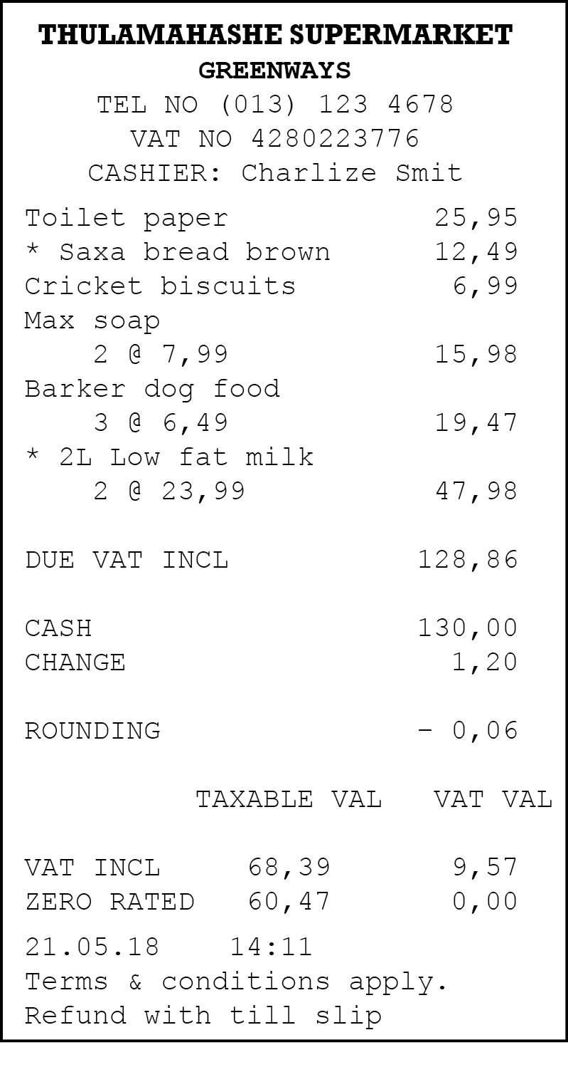
Example 10.2 page 191
Unit 10.1

Slide 11
Example 10.2 page 191 continued ...
Unit 10.1
Where and when was this purchase made?
Identify the following amounts from the slip:
i) The total cost of the purchase
ii) The amount paid by the customer and the method of payment
iii) The change paid to the customer.
iv) The VAT amount.
What does ‘ROUNDING − 0,06’ mean?
Why do you think the cashier’s name and time of purchase are included on the till slip?

Slide 12
Example 10.2 page 191 continued ...
Unit 10.1
At Thulamahashe Supermarket in Greenways on 21 May 2018.
i) R128,86 ii) R130,00 cash payment iii) R1,20 iv) R8,40
When working with cash, the lowest denomination this store deals in is 10c coins. The shop gives the customer the benefit by rounding down the amount owing to the nearest 10c. In this case, R128,86 is rounded down to R128,80.
If there is any problem with the sale, the store would know which till operator was responsible, and when the problem occurred.

Slide 13
Exercise 10.1
Unit 10.1
Complete Exercise 10.1 on page 193 of your Student’s Book

Slide 14
Reading statements of accounts
Unit 10.2
Statements
Statements of account are financial documents issued by institutions to their customers. The details of all the transactions for a specific period are listed.
These statements are often just referred to as 'accounts’.
Statements can be issued monthly, quarterly or annually.
Any breach in the conditions of the account is also stipulated on the statement, e.g. late payment, interest.

Slide 15
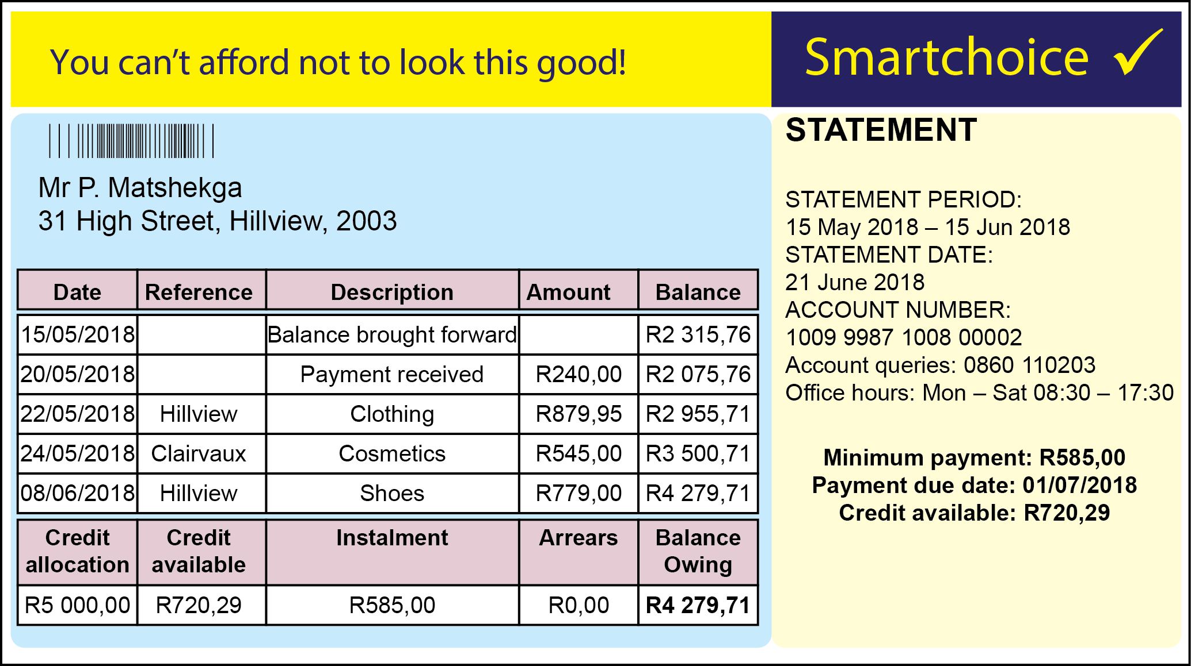
Example 10.4 page 196
Unit 10.2
Petrus has an account at Smartchoice Clothing Store. Every month he receives a statement such as this:

Slide 16
Example 10.4 page 196 continued ...
Unit 10.2
Identify the following on the statement:
the statement date
the due date and amount of the next instalment
the balance brought forward
the closing balance
b) How many purchases does Petrus make during the month?
c) What was the total amount of his purchases during this statement period?
d) His minimum payment in the previous month was R240. Explain why it has increased to R585,00.

Slide 17
Example 10.4 page 196 continued ...
Unit 10.2
e) What is the total amount of credit that Smartchoice grants him?
f) In the next statement period, Petrus makes a payment of R585,00 and another purchase of R400. If he does no further transactions in the statement period, what will his closing balance be? Show your calculations.

Slide 18
Example 10.4 page 196 continued ...
Unit 10.2
21 June 2018
The due date is 01 July 2018. The amount due is R585,00
R2 315,76
R4 279,71
Three
R879,95 + R545,00 + R779,00 = R2 203,95
His balance owing has increased.
R5 000,00
R4 279,71 – R585,00 + R400,00 = R4 094,71

Slide 19
Exercise 10.2
Unit 10.2
Complete Exercise 10.2 on page 197 of your Student’s Book

Slide 20
Payslips
Unit 10.3
Payslip
A payslip is a document issued by an employer to an employee listing all the details of the employee's income and deductions.
When the employee is paid monthly it is called a salary advice.
The following details ae included on a payslip:
Employer's details
Employee’s personal details
Employee’s tax reference number
Employee’s bank and bank account number

Slide 21
Payslips
Unit 10.3
The following important information must be on the payslip:
On some payslips/salary advices, a detailed summary is shown of the income earned and deductions up to this point in the employer's financial year.
Gross salary
This includes basic salary and any other income such as commission or overtime
Deductions
This includes Tax, UIF, Pension fund, etc.

Slide 22
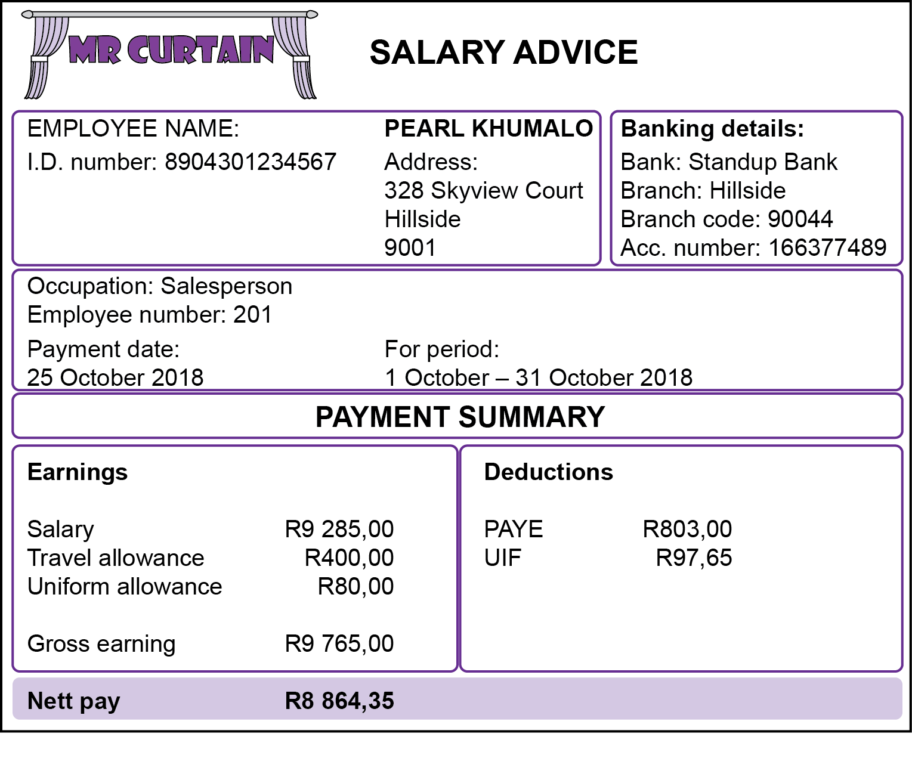
Example 10.5 page 199
Unit 10.3
Study this payslip and then answer the questions that follow.

Slide 23
Example 10.5 page 199 continued ...
Unit 10.3
Who is Pearl’s employer?
How does her employer pay her salary?
What is Pearl’s gross salary?
What tax is reflected on her salary advice slip?
Which two expenses does the employer subsidise?
Do the calculations to show that her nett pay is correctly calculated?

Slide 24
Example 10.5 page 199 continued ...
Unit 10.3
Mr Curtain
Her salary is deposited into her Standup Bank account.
R9 765,00
PAYE (Pay as you earn)
Her employer subsidises her uniform and transport costs.
R9 285,00 + (R400,00 + R80,00) – (R803,00 + R97,65) = R9 285,00 + R480,00 − R900,65 = R8 864,35

Slide 25
Example 10.5 f) page 199 Unit 10.3

Slide 26
Exercise 10.3
Unit 10.3
Complete Exercise 10.3 on page 192 of your Student’s Book

Slide 27
Understanding VAT
VAT
Unit 10.4
Facts about VAT
An indirect form of tax collection, where business owners are responsible for collecting it and paying it over to SARS.
It is calculated at a rate of 14% on all goods sold and services rendered subject to certain exemptions.
Exempt items include basic food stuff, school fees, rent, train fares etc.
Value Added Tax

Slide 28
Calculations
Module 10.4
There are basically two calculations you need to know when calculating VAT.
Calculating the price of an item with VAT when you are given the price without VAT.
+ VAT
Calculating the price of an item without VAT when you are given the price inclusive of VAT.
- VAT

Slide 29
Example 10.6 page 202
Unit 10.4
Sibusiso needs to buy a new tyre for his car. The price of a new tyre excluding VAT is R500.
Calculate the VAT that would have to be added.
How much will the total price of the tyre be?

Slide 30
Example 10.6 page 202 continued ... Unit 10.4

Slide 31
Example 10.7 page 202
Unit 10.4
Kaylee wants to buy a printer to print out her projects. The printer at Computer Supplies is marked as R990.
What is the price excluding the VAT?

Slide 32
Example 10.7 page 202 continued ... Unit 10.4

Slide 33
Exercise 10.4
Unit 10.3
Complete Exercise 10.4 on page 202 of your Student’s Book

Slide 34
Module assessment
Module 10
Complete Module assessment on page 204 of your Student’s Book

