Slide 1
Life Orientation: Life Skills
NQF 4

Slide 2
Understand & deal with depression in personal & work situations
Module 8

Slide 3
Think about it…
Is medication always the answer for a person who is severely depressed?
What role do your thoughts play in feeling depressed?
Are all suicides actually preventable?

Slide 4
Depression – its meaning, symptoms & effects
Unit 8.1

Slide 5
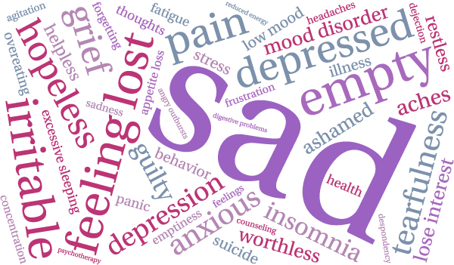
What does depression mean?
Depression = feeling generally sad (or “pressed down”).
Clinical depression = major depression:
Intense sadness
Utter hopelessness
No enthusiasm.

Slide 6
What does depression mean?
Depression may be short-term or may continue throughout a person’s life.
Bipolar = depressive disorder with extreme lows & extreme highs.
Figure 8.1: The occasional bout of sadness is normal, however, you need to approach someone to help you if it carries on for a long time and for no specific reason

Slide 7
The link between stress & depression
A stressful event may cause depression, for instance:
Divorce
Financial problems
The death of a loved one.
Other causes of depression:
An imbalance in neurotransmitters
An imbalance in hormones
Certain medication.

Slide 8
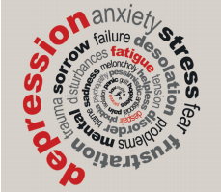
The link between stress & depression
Depression can cause physical problems, such as:
Heart attacks
Strokes
Heart disease.
Figure 8.3: The symptoms and causes of stress and depression can follow one another in a spiral or cycle

Slide 9
Symptoms of depression
Physical symptoms, for example:
Always tired
Change in appetite
Unexplained headaches or backache
Self-harm.
Figure 8.4: Depression is mainly a condition of the mind and emotions but also affects people physically

Slide 10
Symptoms of depression
Mental symptoms, for example:
Loss of interest in life
Difficulty concentrating
Avoiding other people
Thinking about death & suicide.

Slide 11
Symptoms of depression
Emotional symptoms, for example:
Anxiety
Sadness & negativity
Sensitivity to noise
Feeling hopeless & worthless.
Figure 8.5: Although most depressed people feel emotionally overwhelmed and fatigued, some may become agitated

Slide 12
Learning activity 8.1
Module 8
Test your knowledge of this section by completing Learning activity 8.1 in your Student’s Book.

Slide 13
Effects of depression on personal situations
Difficulty coping with & recovering from illness.
May abuse alcohol or drugs.
May withdraw socially.
Lack of interest in usual activities.

Slide 14
Effects of depression on work situations
Lack of energy & decision-making skills.
Poor work performance.
Lack of motivation.
Moodiness.

Slide 15
Learning activity 8.2
Module 8
Test your knowledge of this section – and answer a mental health questionnaire – by completing Learning activity 8.2 in your Student’s Book.

Slide 16
Strategies & support structures for dealing with depression
Unit 8.2

Slide 17
Strategies against depression
• Lifestyle strategies
• Thinking strategies
• Professional strategies.

Slide 18
Lifestyle strategies against depression
Make positive choices about:
• Food
• Eating habits
• Exercise
• Sleep
• Alcohol, smoking & drugs
• Stress management
• Medication.

Slide 19
Thinking strategies against depression
Try to think positively.
Face the stressors/life events that trigger depression.
Don’t isolate yourself.
Look after good relationships.
Break off negative relationships.
Learn to express your feelings & handle stress better.

Slide 20
Professional strategies against depression
See a healthcare professional for counselling or treatment.
If necessary, take prescribed medication according to prescription.
Figure 8.14: Professional counsellors and therapists are trained to keep your problems confidential and not to judge you

Slide 21
Support structures for people with depression
Offer support:
In the home
For family & friends
In support groups
In the work environment
In clinics
Through organisations & helplines.
Organisations & helplines include:
LifeLine
SADAG.

Slide 22
Click above to play this video.

Slide 23
Learning activity 8.3
Module 8
Test your knowledge of this section by completing Learning activity 8.3 in your Student’s Book.

Slide 24
Handling suicidal colleagues or friends
Unit 8.3

Slide 25
Dealing with a suicidal colleague or friend
Be aware of warning signs.
Get immediate help for the person.
Professional treatment is needed.
Encourage personal changes to make them feel better.

Slide 26
Learning activity 8.4
Module 8
Test your knowledge of this unit – and consider ways to deal with suicidal thoughts – by completing Learning activity 8.4 in your Student’s Book.

Slide 27
Click above to play this video.

Slide 28
Module 8
Test your knowledge of this module by completing Summative assessment of Module 8 in your Student’s Book.

