Slide 1
Life Orientation: Life Skills
NQF 4

Slide 2
Manage stress in order to maintain a balanced lifestyle
Module 7

Slide 3
Think about it…
Is there a difference between good stress & bad stress?
How does stress affect you?
Can you learn to cope better with bad stress?

Slide 4
Stress – symptoms, types & causes
Unit 7.1

Slide 5
What is stress?
Stress = physical, emotional and/or mental tension caused by an outside source
Stressor = cause/source of stress
People respond to stress differently
Stress response = the way people react to stressors.

Slide 6
Symptoms of stress
Stress affects you:
Physically (in your body)
Emotionally
Mentally (in your mind).
Stress affects your body & mind at the same time.

Slide 7
Physical symptoms of stress
Nervous system & glandular system:
Nerves, brain & spinal cord send messages to the glandular system
Glandular system sends hormones (e.g. adrenaline & cortisol)
Hormone levels = normal once danger is over
If a stress/threat is constant, your body becomes nervous, sleepy, achy & rundown.

Slide 8
Physical symptoms of stress
Digestive system:
Struggle to swallow
Change in appetite
Indigestion & heartburn
Nausea & vomiting.
Figure 7.2: Heartburn is a sharp or burning pain in your chest which has nothing to do with your heart but is a form of indigestion

Slide 9
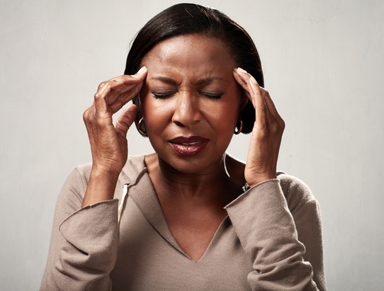
Physical symptoms of stress
Sensory system:
Skin feels strange (e.g. cold or sweaty)
Dry mouth
Senses working better or worse than normal
Strange sounds in your ears
Headaches.

Slide 10
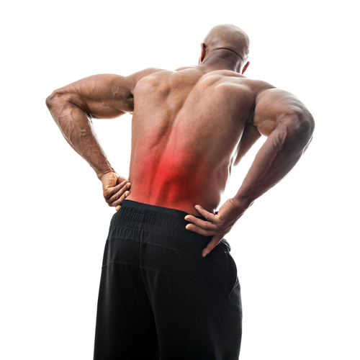
Physical symptoms of stress
Locomotor system:
Sore muscles, bones, joints & tendons
Grinding teeth
Tiredness/clumsiness
Struggling to sit still
Shaking hands or lips.

Slide 11
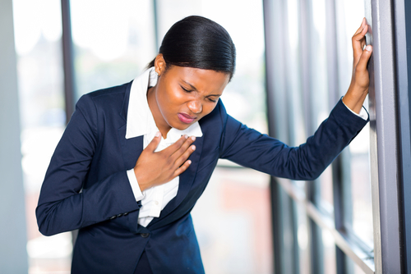
Physical symptoms of stress
Respiratory system:
Shallow or hard breaths
Shortness of breath
Struggle to breathe.
Circulatory system:
Red cheeks
Raised heartbeat and/or blood pressure
Chest pain.

Slide 12
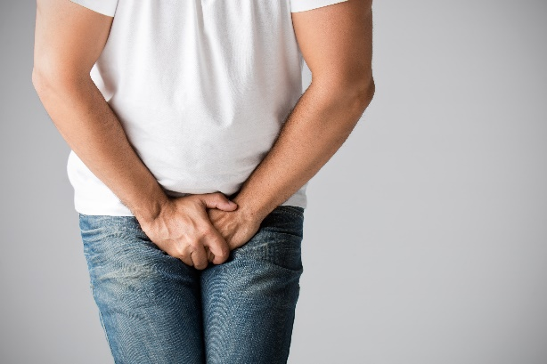
Physical symptoms of stress
Immune system:
Lower immunity
Slower healing & recovery
Rashes/itching.
Urogenital system:
Need to urinate more often
Changes to hormones
Irregular or painful periods
Lack of sexual desire and/or ability.

Slide 13
Learning activity 7.1
Module 7
Test your knowledge of this section by completing Learning activity 7.1 in your Student’s Book.

Slide 14
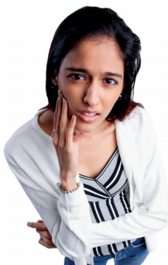
Emotional & mental symptoms of stress
Include feeling:
Angry
Confused
Depressed
Frustrated
Hopeless
Lonely
Overwhelmed
Worried.
Figure 7.6: Some people feel they need to worry and stress because that shows that they care

Slide 15
Learning activity 7.2
Module 7
Test your knowledge of this section by completing Learning activity 7.2 in your Student’s Book.

Slide 16
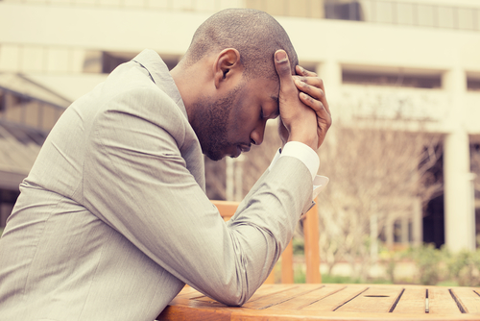
Types of stress
Good stress (eustress):
Energises
Can become harmful if not handled well.
Bad stress
Distress
Acute stress
Chronic stress.

Slide 17
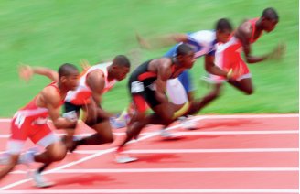
Eustress
Energises your mind.
Prepares your body to face challenges.
Must return to normal so that you can recover.
Figure 7.9: Healthy eustress in action

Slide 18
Bad stress
Distress:
Instead of feeling excited, you dread the challenge
May become more anxious
Need to deal with it & prioritise.
Acute stress:
Severe stress often caused by one intense thing.

Slide 19
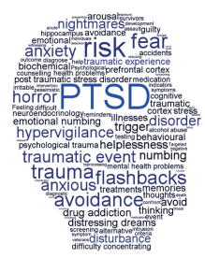
Bad stress
Chronic stress:
Prolonged distress
Lasts for months or years
May need intervention (e.g. therapy and/or medication).
Figure 7.10: Post-traumatic stress disorder (PTSD) is a form of chronic stress that follows on from repeated incidences of acute stress

Slide 20
Learning activity 7.3
Module 7
Test your knowledge of this section – and address stress you are facing currently – by completing Learning activity 7.3 in your Student’s Book.

Slide 21
General causes of stress
Refer to Table 7.1 in your Student’s Book for general causes of stress.

Slide 22
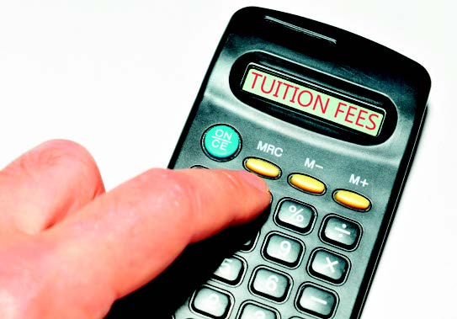
General causes of stress
You may be stressed by:
Where you live
Relationship problems
Finances/the economy
The natural environment
Health issues
Education or work problems
Difficulties at home.

Slide 23
Work-related causes of stress
Refer to Table 7.2 in your Student’s Book for work-related causes of stress.

Slide 24
Click above to play this video.

Slide 25
Learning activity 7.4
Module 7
Test your knowledge of this section – and reflect on solutions to stressful situations you have faced in the past year – by completing Learning activity 7.4 in your Student’s Book.

Slide 26
Effects of stress
Unit 7.2

Slide 27
Effects of stress on personal situations
Not being able to control your emotions
Worsened physical conditions
Becoming withdrawn
Struggling to communicate
Becoming obsessive
Relationships suffer.

Slide 28
Effects of stress on work situations
Feeling tired, sick & overworked
Struggling to concentrate
Becoming disorganised
Unable to perform at best level
Battling to make decisions
Becoming easily upset
Making mistakes
Abusing substances.

Slide 29
Click above to play this video.

Slide 30
Learning activity 7.5
Module 7
Test your knowledge of this section – and answer a stress test – by completing
Learning activity 7.5 in your Student’s Book.

Slide 31
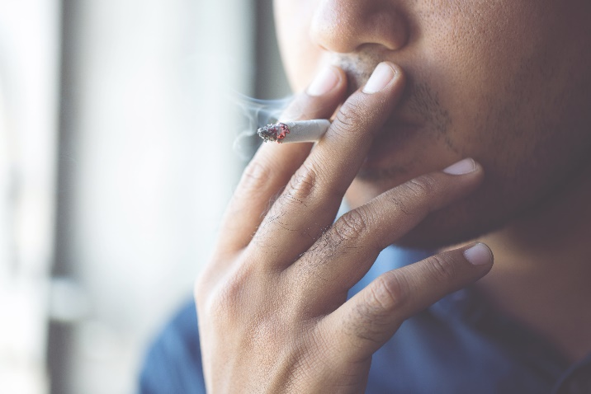
Harmful effects of using substances to alleviate stress
Examples of harmful substances:
Drugs
Cigarettes (nicotine)
Alcohol.
Bad side-effects.
They don’t do away with the problem (& usually make it worse).

Slide 32
Harmful effects of drugs
May be:
OTC (over-the-counter) medicine
Prescribed medicine
Illegal drugs.
Bad physical & mental side-effects.
Don’t remove cause of stress.
Can be addictive.

Slide 33
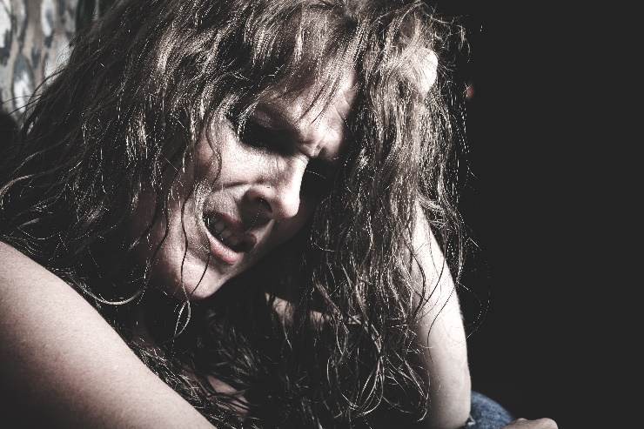
Harmful effects of smoking
Can cause side-effects, cravings & addiction.
Dagga can cause:
Anxiety
Mood swings
Paranoia.
Cigarette smoking can cause:
Lung & other cancers
Lung disease
Heart disease.

Slide 34
Harmful effects of alcohol
Can cause:
Slurred speech
Loss of coordination & balance
Accidents
Bad judgements
Blackouts.
Can lead to:
Depression
Memory loss
Damaging internal organs.

Slide 35
Click above to play this video.

Slide 36
Learning activity 7.6
Module 7
Test your knowledge of this section by completing Learning activity 7.6 in your Student’s Book.

Slide 37
Preventing & managing stress
Unit 7.3

Slide 38
Strategies for handling stress
Don’t be a worrier.
Focus on positive things.
Keep your mind light:
Don’t bad talk yourself.
Read, watch & listen to positive materials.
Surround yourself with positive people.
Find joy in beautiful things, such as nature.
Practise being thankful.
Know yourself.

Slide 39
Strategies for handling stress
Take care of your relationships.
Take care of yourself.
Relax and rest often.
Exercise regularly.
Delegate some tasks and dump others.
Start with smaller tasks.
Avoid multi-tasking.
Discuss the issue with a mature person.

Slide 40
Learning activity 7.7
Module 7
Test your knowledge of this unit – and practise ways to relieve stress – by completing Learning activity 7.7 in your Student’s Book.

Slide 41
Module 7
Test your knowledge of this module by completing Summative assessment of Module 7 in your Student’s Book.

Slide 42
Portfolio task 3
Complete Portfolio task 3A in your Student’s Book, or Portfolio task 3B or 3C from your lecturer. This is a formal assessment.

