Slide 1
Life Orientation: Life Skills
NQF 4

Slide 2
Apply advanced cognitive skills & strategies in various contexts
Module 5

Slide 3
Think about it…
What are the dangers of making decisions based on your feelings only?
Can a person develop thinking skills?
What does it mean to think logically?

Slide 4
Logical reasoning & argument skills
Unit 5.1

Slide 5
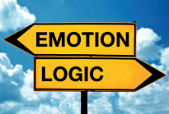
What is logic?
Logic is:
Being able to reason in a clear way
Based on reason & not emotions
Looking at all options.
Figure 5.1: Logic disregards emotions,
and emotions tend to disregard logic

Slide 6
Logical reasoning skills
Table 5.1: Three main kinds of reasoning
Reasoning | Explanation | Example
Inductive | Observe specific details and instances, and then generalise these to produce a “universal” principle that you believe will apply in similar situations. In other words, go from the specific to the general. | Dennis is a young teenager and the girls of his age in his class are taller than him. The same happened to Ronewa, Cebisile and Phahamo. Therefore, at a certain stage, young boys grow more slowly in height than girls of the same age.

Slide 7
Logical reasoning skills
Table 5.1: Three main kinds of reasoning
Reasoning | Explanation | Example
Deductive | Apply a general principle to an idea or statement that you assume to be true (an assumption), and then reach a conclusion about the idea. In other words, go from the general to the specific. | At a certain stage, boys grow more slowly in height than girls of the same age. Dennis is a young teenager, so at some stage the girls of his age in his class will be taller than him.
Abductive | If you have a general principle and a conclusion, you can formulate a possible idea to support the conclusion. In other words, go from the general and/or specific to a theoretical explanation. This type of reasoning can stimulate fascinating scientific research. | At a certain stage, girls are taller than boys of the same age. It happened to Dennis, Ronewa, Cebisile and Phahamo, who were between 11 and 14 years old, but after age 14 the boys caught up with the girls. So it has to do with puberty. It is (probably) caused by hormonal differences between boys and girls during early adolescence.

Slide 8
Learning activity 5.1
Module 5
Test your knowledge of this section by completing Learning activity 5.1 in your Student’s Book.

Slide 9
Learning activity 5.2
Module 5
Test your knowledge of this section by completing Learning activity 5.2 in your Student’s Book.

Slide 10
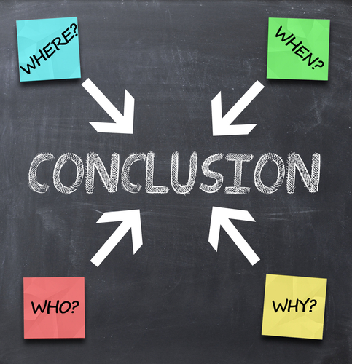
Logical argument skills
Argument = proving something.
Logical arguments are based on:
Premises
Inferences
Conclusions.

Slide 11
Premises
Premise = statement about something.
Arguments need to be based on premises.
If premises are false, the conclusion will be untrue.
Tentative premises need more investigation.

Slide 12
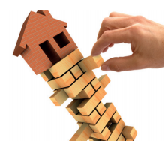
Premises
True premise = existing, proven fact.
Sometimes true premise = exceptions to so-called facts.
False premise = false information.
Figure 5.4: Having shaky or false premises in an argument
is like building a wall on a weak foundation, or a foundation that
is missing quite a few bricks – sooner or later the structure will collapse

Slide 13
Learning activity 5.3
Module 5
Test your knowledge of this section by completing Learning activity 5.3 in your Student’s Book.

Slide 14
Inferences & conclusions
Inference = deduction, assumption or gathered information.
An inference may be hidden.
Premise + inference = conclusion.
Figure 5.5: In a good logical argument the pieces (premises) fit together to lead to a valid conclusion – however, what do you do with the piece of evidence that doesn’t fit?

Slide 15
Learning activity 5.4
Module 5
Test your knowledge of this section by completing Learning activity 5.4 in your Student’s Book.

Slide 16
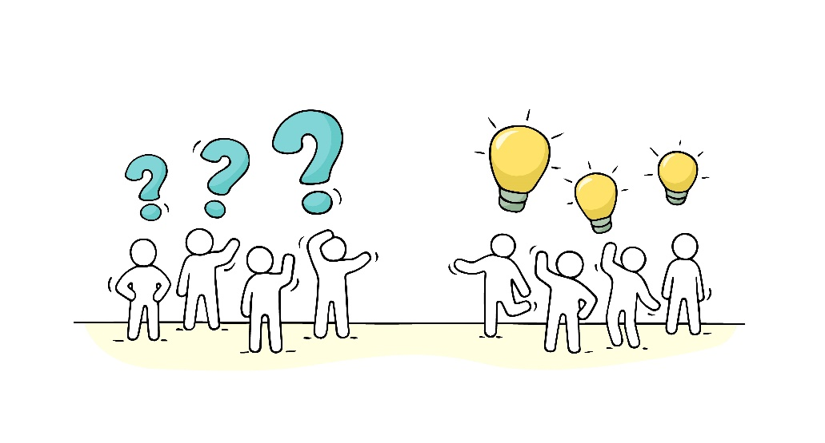
Inferences & conclusions
Most conclusions combine logical reasoning & argument skills.
Conclusions can also be:
“Both – and”
“Either/or”
“Neither/nor”.

Slide 17
Learning activity 5.5
Module 5
Test your knowledge of this section by completing Learning activity 5.5 in your Student’s Book.

Slide 18
Learning activity 5.6
Module 5
Test your knowledge of this section – and practise your logical reasoning and argument skills – by completing Learning activity 5.6 in your Student’s Book.

Slide 19
Reflective thinking – strategies & techniques
Unit 5.2

Slide 20
The concept of reflective thinking
To reflect = think seriously about something.
Reflective thinking = critical thinking:
Analyse
Assess
Evaluate
Judge.
Organise your thoughts clearly.

Slide 21
Using reflective thinking to solve problems
Define the problem.
Describe the existing situation.
Select criteria for judging solutions.
Analyse the problem more.

Slide 22
Using reflective thinking to solve problems
Make the problem as specific as possible.
Think of things you haven’t considered.
Suggest solutions.
Select the best solution.
Decide how to apply the solution.
Evaluate whether the problem will be solved well.

Slide 23
Learning activity 5.7
Module 5
Test your knowledge of this section by completing Learning activity 5.7 in your Student’s Book.

Slide 24
Reflective strategies & techniques
Verbal reflection, for example:
Talk to peers.
Interview the relevant person.
Give verbal feedback.
Describe the problem.

Slide 25
Reflective strategies & techniques
Visual reflection, such as:
Keep a diary.
Use mind maps.
Formulate SMART goals.
Make to-do lists.
Introspective reflection, for instance:
Think back.
Use good new habits.
Practise ways to reduce stress.
Keep track of progress.

Slide 26
Learning activity 5.8
Module 5
Test your knowledge of this section by completing Learning activity 5.8 in your Student’s Book.

Slide 27
Module 5
Test your knowledge of this module by completing the Summative assessment of Module 5 in your Student’s Book.

