Slide 1
Life Orientation: Life Skills
NQF 4

Slide 2
Describe parenting as an example of a challenging life situation
Module 4

Slide 3
Think about it…
‘Once a parent, always a parent’ – do you agree?
What does the way in which children are treated say about a society?
Which aspect of raising a child is the most important?

Slide 4
Children – a lifelong responsibility for both parents
Unit 4.1

Slide 5
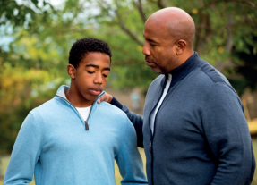
A lifelong responsibility
The type of responsibility changes as children grow, but parents are always responsible for their children.
Figure 4.2: Parenting doesn’t stop once a child reaches 16, 18 or 21; parents need to continue to offer support and guidance in different ways

Slide 6
Responsibilities of both parents: Giving
Provide food, shelter, protection
Provide care
Provide nurturing
Provide unconditional love
Figure 4.3: A parent’s love is powerful,
and yet it must help the child to grow
independent from him or her one day

Slide 7
Responsibilities of both parents: Setting standards
Children learn by observing.
Children need positive relationships.
Children need to develop good communication skills.
Children need to learn conflict resolution skills.
Children need to learn & understand good values.

Slide 8
Responsibilities of both parents: Instructing
Parents teach children:
Their language & explanations
How to treat others
About the body & how it works
The importance of hygiene
Practical skills
What morals & rules are.

Slide 9
Learning activity 4.1
Module 4
Test your knowledge of this unit – and assess your experience with your parents/as a parent – by completing Learning activity 4.1 in your Student’s Book.

Slide 10
Loving, respecting & caring for children
Unit 4.2

Slide 11
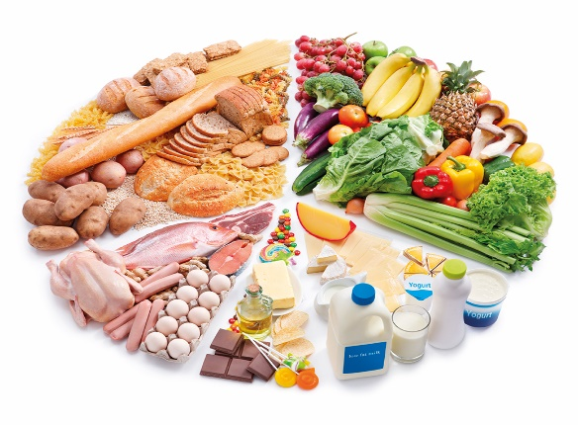
Legislation about children
Section 28 of the Constitution – children’s rights (child = up to 18 years old) include:
• Right to protection
• Right to family care
• A name & nationality
• Right to nutrition, shelter & healthcare
• No involvement in dangerous labour or war.

Slide 12
Legislation about children
Other legislation about children includes:
• The Child Care Act (1983)
• The Child Justice Act (2008)
• The Children’s Act (2005)
• The Domestic Violence Act (1998)
• The Criminal Law (Sexual Offences and Related Matters) Act (2007).

Slide 13
Showing love, respect & care
Children need love:
• Show them affection.
• Set boundaries for them
• Give them praise.
• Play games with them.

Slide 14
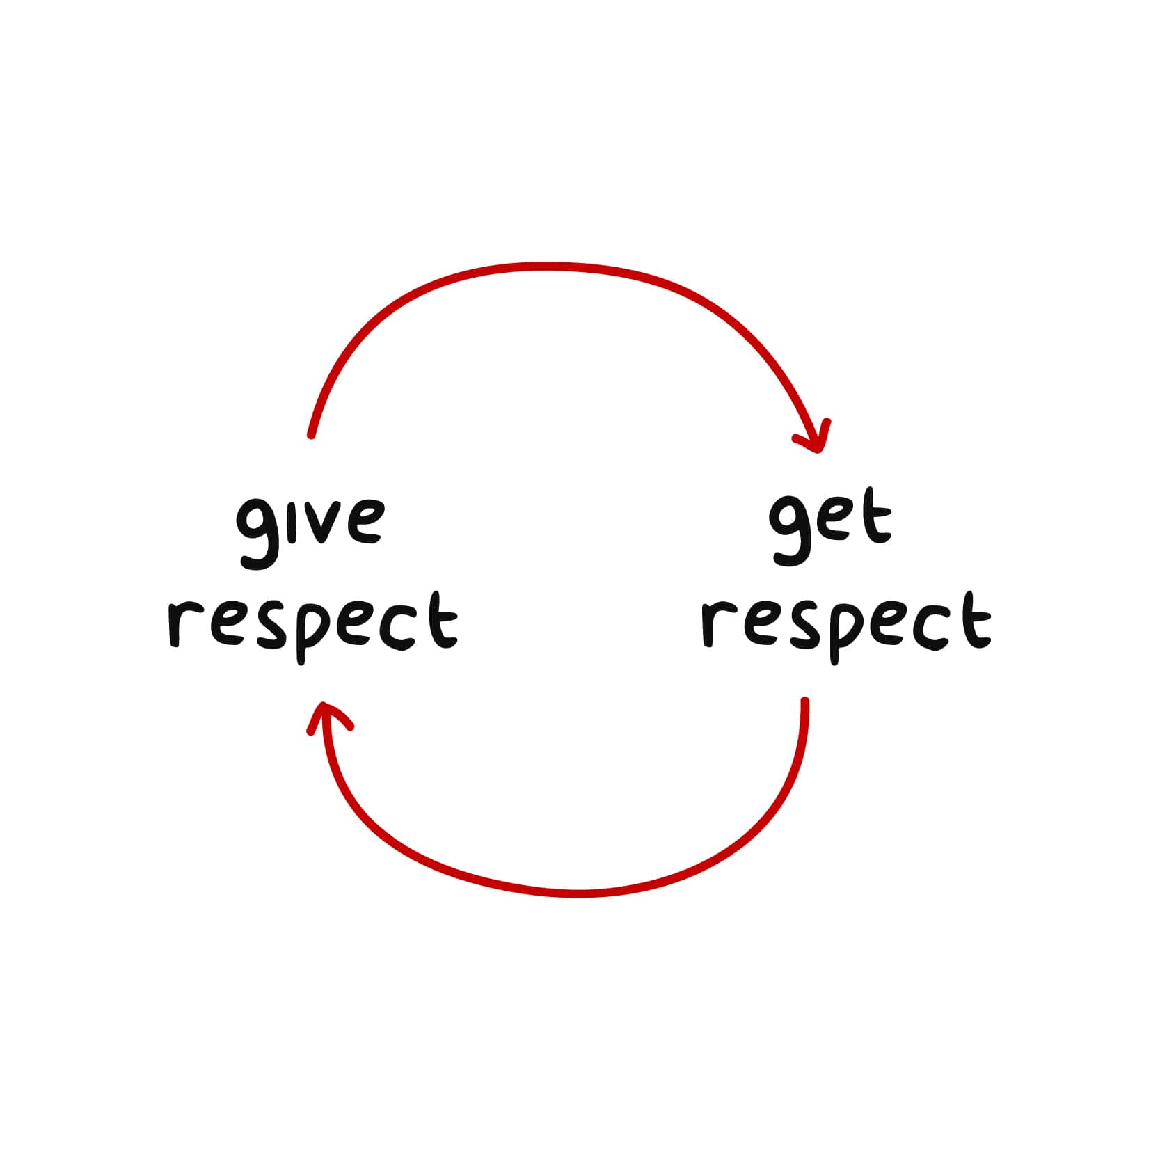
Showing love, respect & care
Children need respect:
• Be polite.
• Listen well.
• Answer questions.
• Lead by example.
• Apply discipline.
• Admit your mistakes.
• Don’t show favouritism.
• Be consistent.

Slide 15
Showing love, respect & care
Children need care.
Self-esteem
Education
Security
Good nutrition
Good hygiene
Children’s needs
Clean drinking water
Healthcare
Suitable &
clean clothing
A good
night’s rest
Healthy & safe
exercise
Unconditional love

Slide 16
Learning activity 4.2
Module 4
Test your knowledge of this section – and reflect on your childhood – by completing Learning activity 4.2 in your Student’s Book.

Slide 17
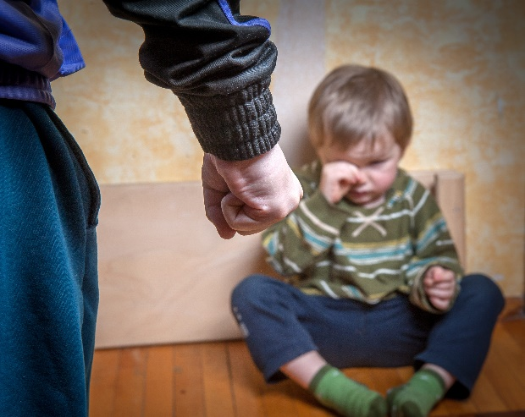
Examples of child abuse
• Not giving love
• Abusing the child verbally
• All forms of neglect
• Any form of child labour
• Any type of physical abuse, including:
Hitting
Punching
Kicking.

Slide 18
Examples of child abuse
Any form of sexual abuse including:
Molestation
Pornography
Prostitution
Rape.
All forms of kidnapping
Any type of slavery
Murder (infanticide).
Figure 4.10: Child abuse leaves wounds & scars on
people’s souls which
they carry with them
into old age

Slide 19
Who commits child abuse?
Most often someone the child knows, such as:
Parents
Other family members
Friends
Other children
Childminders
Teachers.

Slide 20
Consequences of child abuse
Refer to Table 4.1 in your Student’s Book for more information about the consequences of child abuse.

Slide 21
Learning activity 4.3
Module 4
Test your knowledge of this section – and research ways to report child abuse – by completing Learning activity 4.3 in your Student’s Book.

Slide 22
Basic parenting skills
Give enough time & affection
Make the child feel protected & safe
Manage routines well
Guide – explain & encourage.

Slide 23
Basic parenting skills
Communicate well (e.g. listen, respect & express kindly & clearly).
Interact regularly (e.g. ask questions, go to events with/for the child & play games together).
Discipline constructively (e.g. set limits, be consistent & teach self-control).
Love unconditionally.

Slide 24
Learning activity 4.4
Module 4
Test your knowledge of this section – and research good parenting skills – by completing Learning activity 4.4 in your Student’s Book.

Slide 25
Costs of having & raising a child
Unit 4.3

Slide 26
Costs of having a baby
Expenses before birth include:
Medical
Maternity clothing
Preparing for the baby (e.g. room, clothes & nappies).
Expenses for the birth include:
Medical
Baby clothing & supplies
Help with the household.

Slide 27
Costs of having a baby
Expenses during infancy include:
Medical
Baby food & formula
Nappies
Car seat
Childcare
Educational toys & books.

Slide 28
Costs of having a baby
Costs of raising a child include:
Medical
Housing
Food & clothing
Education & childcare
Transport
Sports & other activities.

Slide 29
Learning activity 4.5
Module 4
Test your knowledge of this unit – and research current childcare costs – by completing Learning activity 4.5 in your Student’s Book.

Slide 30
Postnatal depression
Unit 4.4

Slide 31
What is postnatal depression?
Postnatal = time immediately after the birth of a child.
Depression = extreme unhappiness & hopelessness.
While having baby blues (a few days of weepiness & anxiety) is normal, women who have symptoms for more than 10 days need to seek help.

Slide 32
Postnatal depression symptoms
Feeling hopeless & alone
Guilt
Exhaustion
Moodiness & frustration
Anxiety
Forgetfulness
Lacking confidence
Struggling to do normal activities.
Figure 4.19: Lack of sleep can contribute to postnatal depression

Slide 33
How postnatal depression affects mother & baby
Refer to Table 4.2 in your Student’s Book for more information about postnatal depression & its effects on both mother & child.

Slide 34
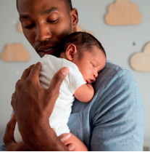
Dealing with postnatal depression
Get emotional & physical support.
Get comfort from others who have experienced it.
Join a support group.
Go for counselling.
Severe cases might need medication.
Figure 4.21: The loving support of the child’s father is vital in overcoming postnatal depression

Slide 35
Learning activity 4.6
Module 4
Test your knowledge of this unit – and find out more about postnatal depression – by completing Learning activity 4.6 in your Student’s Book.

Slide 36
Support structures for new parents
Unit 4.5

Slide 37
Types of support structures for parents
Medical: hospitals, clinics & midwives
Emotional: support groups & organisations
Social: social support & online advice
Economic: grants.

Slide 38
Learning activity 4.7
Module 4
Test your knowledge of this unit by completing Learning activity 4.7 in your Student’s Book.

Slide 39
Module 4
Test your knowledge of this module by completing the Summative assessment of Module 4 in your Student’s Book.

