Slide 1
Life Orientation: Life Skills
NQF 4

Slide 2
Explore strategies and skills for successful interviews
Module 3

Slide 3
Think about it…
How can you prepare for an interview if you don’t know what you will be asked?
During an interview, what will often speak louder than your words?
What should you do after an interview?

Slide 4
Types of job interviews
Unit 3.1

Slide 5
Specific preparation for different types of interviews
Figure 3.1: If you prepare properly for a job interview, you will feel more in control of the situation

Slide 6
Individual interview
Takes place face-to-face (at a table or over video call)
With one person.

Slide 7
Panel interview
A small group of people face you (at a table or over video call).

Slide 8
Telephonic interview
Occurs when one or more people interview you on the phone.

Slide 9
Skype/video interview
Interviewed by one/more people
Over computer, tablet or smart phone
Takes places with/without video.

Slide 10
Presentation interview
You present a PowerPoint or flipchart presentation to an individual or group.

Slide 11
Situational interview
Is behavioural/case study/ competency-based
You need to respond to a scenario.

Slide 12
Group interview
You are interviewed with other applicants in a group.

Slide 13
Informal interview
Can take place at a restaurant, social function or sports event.

Slide 14
Learning activity 3.1
Module 3
Test your knowledge of this unit by completing Learning activity 3.1 in your Student’s Book.

Slide 15
Click above to play this video.

Slide 16
Before the interview
Unit 3.2

Slide 17
Response to an invitation for an interview
Respond within two hours via email (formal letter format)
Repeat details of date & venue
Politely request to reschedule, or decline if necessary
See Examples 3.1 & 3.2 in your Student’s Book.

Slide 18
General preparation for a job interview
You will feel better if you prepare:
Your responses to questions
Personal documentation
Your appearance & clothing
Your positive attitude
Your transport & time off work or college
Any questions you have about the company.

Slide 19
General preparation for a job interview
Refer to Table 3.1 in your Student’s Book for a handy checklist that will help you prepare for a job interview.

Slide 20
Choosing clothing for an interview
Clothing must be appropriate for the job & be in line with the company’s image
Clothing should be neat, clean & fit well
Choose professional colours
See Example 3.3 in your Student’s Book for unsuitable clothing.

Slide 21
Practise your posture & gestures
Sitting & standing, for instance:
Good posture
What to do with your hands
No swaying or fidgeting.
Expression & gestures, such as:
The way you smile
Talking seriously
Making slight movements.

Slide 22
Adopt the right attitude
Shows in your eyes & body language
Influences the interviewers
Try to be:
Polite
Respectful
Alert & focused.

Slide 23
Prepare questions of your own
Shows your interest in the company/job
Shows that you’ve researched the company/position
Examples:
What are short- & long-term goals for the position?
What challenges may I face?

Slide 24
Click above to play this video.

Slide 25
Learning activity 3.2
Module 3
Test your knowledge of this unit – and prepare for an interview – by completing Learning activity 3.2 in your Student’s Book.

Slide 26
Typical interview questions & suitable answers
Unit 3.3

Slide 27
Types of interview questions
About you & your CV
Some closed questions
Some open questions
Some reflective questions
Some hypothetical questions
Some behavioural questions

Slide 28
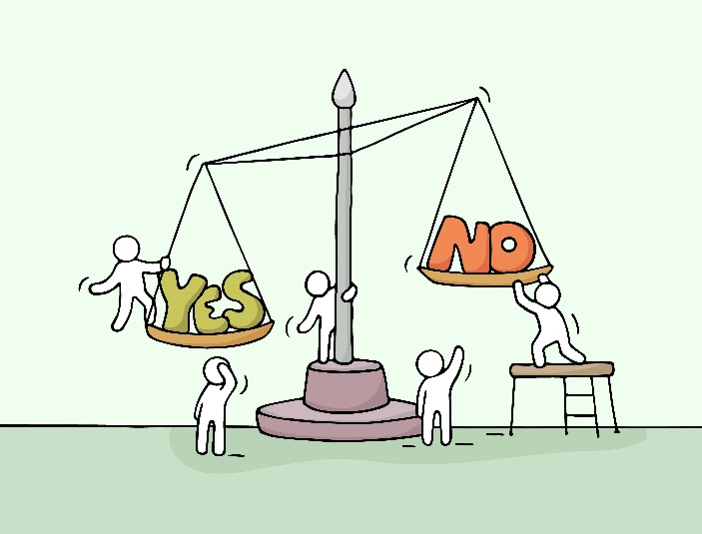
Closed questions
Answers limited (e.g. yes/no)
They require factual responses
You can give more detail, even if not asked
See examples in your Student’s Book.

Slide 29
Open questions
Need to give detailed insights, views & feelings
Take longer to answer
Refer to Table 3.2 in your Student’s Book for more information on open questions.

Slide 30
Reflective questions
Type of open-ended question
Need to think about a situation, behaviour, choice or viewpoint
May start with:
“Why …?”
“Tell me about …”
“What would happen if …”

Slide 31
Hypothetical questions
Type of open-ended question
Suggests an imaginary situation & asks how you would react
May start with:
“How would you …?”
“Imagine if …”
“What would you do if …”

Slide 32
Behavioural questions
Need to think back
Discuss how you handled past situation
Say what you would do differently.
Figure 3.15: When answering case study-type questions, use the STAR technique to describe the Situation and the Task that flowed from it, the Action you took and the Result

Slide 33
Click above to play this video.

Slide 34
Learning activity 3.3
Module 3
Test your knowledge of this unit – and prepare for an interview – by completing Learning activity 3.3 in your Student’s Book.

Slide 35
During & after the interview
Unit 3.4

Slide 36
During the interview
Ensure that you are well prepared.
Practise good interviewee behaviour & avoid bad interviewee behaviour.
Show confidence.

Slide 37
Good interviewee behaviour
Arrive on time
Introduce yourself at reception
Be led to the interview room
Turn off your phone/tablet (unless you’re using it for the interview)
Ensure you greet & introduce yourself politely to the interviewer/s
Maintain polite eye contact.

Slide 38
Good interviewee behaviour
Sit where you are asked to & maintain good posture
Accept water, tea or coffee to drink (no alcohol!)
Speak clearly & calmly
Listen before answering questions
Ensure you don’t fidget
Be sure to stay focused and show confidence.

Slide 39
Bad interviewee behaviour
Refer to Table 3.4 in your Student’s Book to see examples of bad interviewee behaviour.

Slide 40
Learning activity 3.4
Module 3
Test your knowledge of this section – and assess your interview behaviour – by completing Learning activity 3.4 in your Student’s Book.

Slide 41
After the interview
Make sure you end the interview appropriately
Send follow-up correspondence (e.g. Examples 3.5 & 3.6 in your Student’s Book)
Make a follow-up phone call
If you are shortlisted, you may go for a 2nd (or 3rd) interview
If you are notified that you didn’t get the job, learn from the experience.

Slide 42
Learning activity 3.5
Module 3
Test your knowledge of this unit by completing Learning activity 3.5 in your Student’s Book.

Slide 43
Module 3
Test your knowledge of this module by completing the Summative assessment of Module 3 in your Student’s Book.

