Slide 1
Life Orientation: Life Skills
NQF 4

Slide 2
Compile a job application toolkit
Module 2

Slide 3

Think about it…
What else can you use when looking
for a job, apart from your CV?
Is there a difference between a reference & a testimonial?
What can job-listing websites do for a jobseeker?

Slide 4
A job application toolkit
Unit 2.1

Slide 5

What is a toolkit?
A set of resources.
Include these in your toolkit to prepare to find a job:
    CV
    Job application letter or covering letter
    Application forms
    References, testimonials & certificates.

Slide 6

Your curriculum vitae (CV)
A summary of:
    Your personal details
    Your education
    Your qualifications
    Your work experience
    Your skills
    Your community & social involvement.

Slide 7
Your curriculum vitae (CV)
Format of a CV:
    Needs to be user-friendly
    Needs to include necessary content
    Should be brief
    See Example 2.1 in your Student’s Book for a CV template.

Slide 8
Your curriculum vitae (CV)
Refer to Table 2.1 in your Student’s Book for examples of personal information in a CV.

Slide 9

Your curriculum vitae (CV)
A CV also includes:
    Your qualifications & skills
    Your employment history (jobs, dates, positions & main responsibilities)
    Other noteworthy information (e.g. awards, memberships & hobbies).

Slide 10

Click above to play this video.

Slide 11
Learning activity 2.1
Module 2
Test your knowledge of these sections by completing Learning activity 2.1 in your Student’s Book.

Slide 12

Updating a CV
Update regularly (at least once a year)
Have up-to-date references & testimonials
Adapt your CV to different situations
Ensure that all content is truthful.

Slide 13
Learning activity 2.2
Module 2
Test your knowledge of this section – and create your own CV – by completing
Learning activity 2.2 in your Student’s Book.

Slide 14
Job application letter or covering letter
The first page of your application
Introduce yourself & explain why you are applying
Use full sentences & formal language; check your spelling & grammar
Type up & sign
See Box 2.1 & Example 2.4 in your Student’s Book.

Slide 15

Application forms
Some companies use a special form (see Example 2.5 in the Student’s Book).
This can be done:
    In printed form & returning
    it to the company
    By submitting an
    online form.
Keep a copy for your
records.

Slide 16
References & testimonials
Give prospective employers an idea of how others see you
References:
    Verbal recommendation
    You need permission to include them on your CV
    Supply name, job position, company name & contact details for three references.

Slide 17

References & testimonials
Testimonials:
    Formal letters from previous employees
    Attach to CV
    Need to include how they know you & how long they’ve known you
    Highlight your character & best qualities.

Slide 18
Learning activity 2.3
Module 2
Test your knowledge of this section – and practise filling in a sample job application – by completing Learning activity 2.3 in your Student’s Book.

Slide 19
Online applications
& CVs
Unit 2.2

Slide 20

The value of posting a job application online
Benefits:
    Submitted immediately
    Cannot get lost
    Consistent format & presentation for all applicants
    Saves on printing.
Figure 2.11: Online applications save time and money; however, if your application is successful, you will have to go for an interview, so choose the locations carefully

Slide 21
The value of posting a job application online
Disadvantages:
    More competition for a job
    May not allow for creativity/unique skills
    Software may be programmed to reject certain responses
    Temptation to apply for jobs in places you don’t want to move to
    Lack of personal contact.

Slide 22
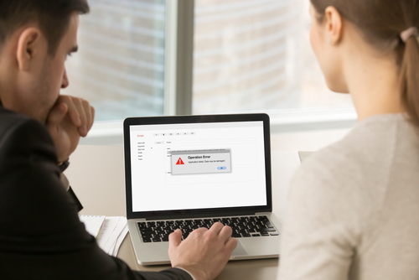
The value of posting a CV on the Internet
Benefits:
    Available for recruiters worldwide
    Employers can read your CV anytime &
    not just when looking to fill a vacancy
    Eliminates unsuitable candidates
    Saves on printing.

Slide 23

The value of posting a CV on the Internet
Disadvantages:
    Your info is online for criminals to use
    Your CV may be used in identity theft
    People may learn about your clients
    Someone might contact you for reasons
    not related to work.

Slide 24
The procedure for applying & posting online
Use job-listing websites
Register (keep your password safe)
Find suitable job ads
Upload your CV or apply
Note if you want to receive job alerts
Read articles with career advice.

Slide 25

Click above to play this video.

Slide 26
Learning activity 2.4
Module 2
Test your knowledge of this unit – and identify suitable websites for looking for a job – by completing Learning activity 2.4 in your Student’s Book.

Slide 27
Module 2
Test your knowledge of this module by completing the Summative assessment of Module 2 in your Student’s Book.

