Slide 1
Life Orientation: Life Skills
NQF 4

Slide 2
Explore ways to deal with the infringement of workers’ rights & settle labour disputes
Module 12

Slide 3
Think about it…
What is the key ingredient in a good working relationship between employers & employees?
What is the difference between dismissal & retrenchment?
Can workers strike whenever they feel it is justified?

Slide 4
Workers’ grievances & the CCMA
Unit 12.1

Slide 5
What is a grievance?
A legitimate reason for laying a formal complaint at work
It may be an infringement against rights
It is not about demands but rather about raising awareness regarding a serious issue.
Figure 12.1: Sexual harassment needs to be reported as a grievance

Slide 6
Grievance & complaints procedures
Stage 1: Direct reporting
Stage 2: Grievance investigation & meeting
Stage 3: Grievance hearing
Stage 4: External dispute resolution.
Figure 12.3: If necessary, witnesses may be present at the grievance meeting

Slide 7
Click above to play this video.

Slide 8
Learning activity 12.1
Module 12
Test your knowledge of this section by completing Learning activity 12.1 in your Student’s Book.

Slide 9
What is the CCMA?
CCMA = Commission for Conciliation Mediation and Arbitration
In existence because of the Labour Relations Act
Not linked to trade unions, businesses or political parties
Assists workers only after internal negotiations with the employer have failed.

Slide 10
Negotiation
Discussion between employer & employee(s)
Try to compromise to resolve the issue
Formal negotiations may include representation by skilled negotiator(s).

Slide 11
Conciliation & dispute resolution
Conciliation = an independent mediator calms down people involved in a dispute
Dispute = disagreement
Dispute resolution needed if grievance isn’t resolved
If all internal attempts fail, you can involve the CCMA.

Slide 12
Mediation & arbitration
Mediation = when a mediator becomes involved in a dispute, but doesn’t take sides or force a solution.
Arbitration:
If mediation & conciliation fail
Third party (e.g. CCMA) makes judgement & tells two parties what to do.

Slide 13
Litigation
Litigation = bringing a lawsuit against someone or challenging a lawsuit.
CCMA can give legal advice, but won’t get involved:
In civil lawsuits
Where the law has been broken.
Figure 12.6: The CCMA won’t become involved if the case is about someone who broke the law

Slide 14
Bargaining councils
One or more registered trade unions join bargaining councils to:
Negotiate agreements for groups of workers
Prevent & resolve labour disputes.
May inspect the workplace & investigate complaints.
If they cannot resolve a dispute, they may appoint an arbitrator or go to the CCMA.

Slide 15
Workplace forums
Employer & employees make joint decisions about work issues
A trade union applies to the CCMA to start a workplace forum
A workplace forum:
Can’t negotiate wages or industrial action
Promotes interests of all employees.

Slide 16
The CCMA’s conciliation procedure
Step 1: Refer the case to the CCMA.
Step 2: Attend the conciliation hearing.
Step 3: Participate in the hearing.
Step 4: Reach a settlement agreement.
Step 5: Uphold the agreement, or proceed to a further stage.
Step 6: Request arbitration.

Slide 17
The CCMA’s conciliation procedure
Refer to Table 12.1 in your Student’s Book to see criteria for referring a case to the CCMA.

Slide 18
Learning activity 12.2
Module 12
Test your knowledge of this section by completing Learning activity 12.2 in your Student’s Book.

Slide 19
Disputes handled by the Department of Labour
All pay-related complaints, such as:
Working overtime without pay
Being paid less than agreed
Not being paid for leave days.

Slide 20
Disputes handled by the Department of Labour
To lodge a labour complaint:
Complete the form at one of the department’s offices.
An inspector visits your workplace.
A compliance order is issued if your employer is found guilty.
If your employer won’t pay, the case will go to the Labour Court.

Slide 21
Disputes handled by the CCMA
Issues about the employment relationship, for instance:
Unfair dismissal
Working conditions
Discrimination
Changes in the workplace
Retrenchment
Sexual harassment.

Slide 22
Learning activity 12.3
Module 12
Test your knowledge of this section by completing Learning activity 12.3 in your Student’s Book.

Slide 23
Unfair dismissal & retrenchment
Unit 12.2

Slide 24
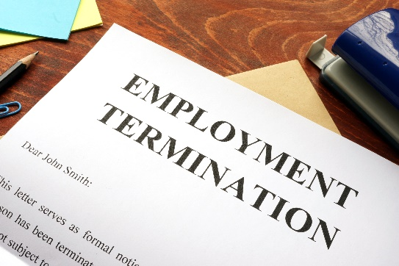
Fair dismissal
Dismissal is considered fair if:
There is serious employee misconduct (e.g. theft).
The employee performs poorly or isn’t able to work (e.g. prolonged illness).
The employer’s operational requirements change (e.g. restructuring).

Slide 25
Unfair dismissal
According to Chapter 8 of the Labour Relations Act, unfair dismissal includes:
Where process isn’t followed properly
Discrimination
Infringement of workers’ rights.

Slide 26
Procedure to follow for unfair dismissal
Stage 1: Referral (to relevant council or the CCMA)
Stage 2: Conciliation
Stage 3: Arbitration (judgement by third party) or adjudication (legal decision).

Slide 27
Procedure to follow for unfair dismissal
Stage 4: Remedy
If dismissal is unfair:
You may be reinstated or re-employed by the employer.
You may be paid compensation.

Slide 28
Procedure to follow for unfair dismissal
Refer to Table 12.2 in your Student’s Book to see types of unresolved unfair dismissal disputes that can be referred for arbitration or adjudication.

Slide 29
Click above to play this video.

Slide 30
Learning activity 12.4
Module 12
Test your knowledge of this section by completing Learning activity 12.4 in your Student’s Book.

Slide 31
Retrenchment
Retrenchment = cut back on staff.
An employer may retrench legally if the needs of the business have changed.
Retrenchment may occur if there are changes to the:
Economy
Technology
Structure.

Slide 32
Procedure to follow if you are retrenched
Ensure that your dismissal is fair.
If you think your dismissal is unfair, consult a workplace forum, trade union or labour lawyer.
If your retrenchment is unfair, you can lodge a complaint with the CCMA.
You must receive severance pay.

Slide 33
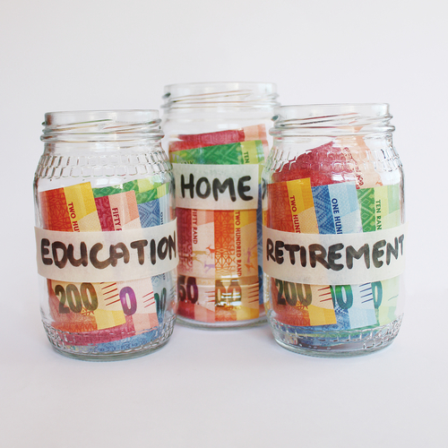
Coping with retrenchment
Uphold your self-esteem.
Stay positive.
Reassess your skills base.
Stay humble.
Keep a check on your finances.

Slide 34
Learning activity 12.5
Module 12
Test your knowledge of this section – and think of ways to use your skills – by completing Learning activity 12.5 in your Student’s Book.

Slide 35
Strike action & unions
Unit 12.3

Slide 36
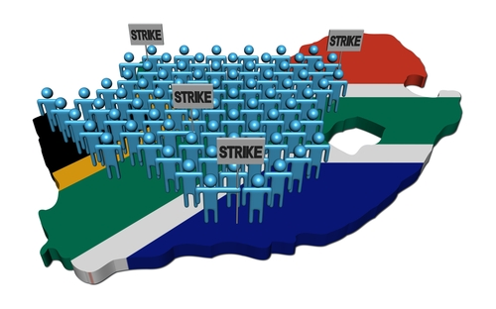
Strike action
SA Constitution allows for legal strikes & trade unions
Strike = workers organise & refuse to work to protest something (e.g. wages)
Usually organised by trade unions
In certain circumstances, employers can lock workers out.

Slide 37
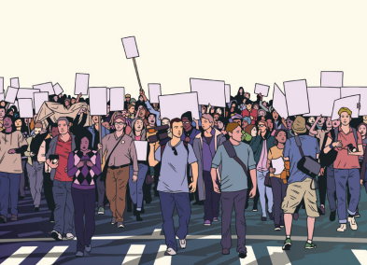
Correct procedure for strike action
Ensure that strike or lockout is legal
Ensure workers know what to expect
Give notice of strike action.
Figure 12.18: The Constitution allows peaceful, non-violent protest action. Section 17 states: “Everyone has the right, peacefully and unarmed, to assemble, to demonstrate, to picket and to present petitions”

Slide 38
Correct procedure for strike action
Prescribed procedures don’t apply if:
The employer locks out employees staging an illegal strike.
Workers strike in response to an illegal lockout.
An employer changed workers’ working conditions without consulting them.
Detailed records must be kept.
Workers can strike in support of a legal strike by another group of employees.

Slide 39
Learning activity 12.6
Module 12
Test your knowledge of this section – and find out more about secondary strikes – by completing Learning activity 12.6 in your Student’s Book.

Slide 40
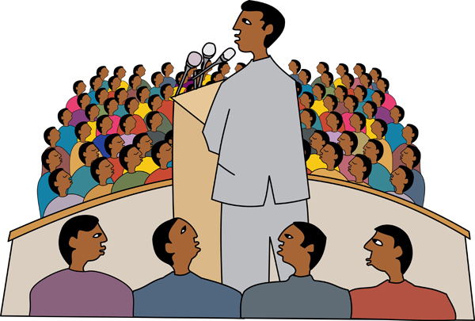
Benefits of belonging to a union
Union can raise concerns with employers.
Unions can represent you in grievance meetings & disciplinary hearings.
You have help protecting your rights.

Slide 41
Benefits of belonging to a union
Unions can monitor whether an employer obeys labour law.
Unions can enter into collective agreements.
Unions can form a bargaining council with the employer’s organisation.

Slide 42
Click above to play this video.

Slide 43
Learning activity 12.7
Module 12
Test your knowledge of this unit – and find out more about the trade union for your profession – by completing Learning activity 12.7 in your Student’s Book.

Slide 44
Module 12
Test your knowledge of this module by completing the Summative assessment of Module 12 in your Student’s Book.

