Slide 1
Life Orientation: Life Skills
NQF 4

Slide 2
Describe workers’ rights & responsibilities
Module 11

Slide 3

Think about it…
Is working just about making money?
How can jobs be provided for the 600 000 to 800 000 matriculants each year after they have completed their further studies?
Duty, or responsibility, is the other side of rights. Do you agree?

Slide 4
The value of work
Unit 11.1

Slide 5
Recognising the value of work
Refer to Table 11.1 in your Student’s Book for reasons why working is valuable & a wise way to spend your time.

Slide 6
Learning activity 11.1
Module 11
Test your knowledge of this unit – and reflect on your intended career – by completing Learning activity 11.1 in your Student’s Book.

Slide 7
Bringing value to your work
Get into action.
Be diligent:
    Pay attention to detail and errors.
    Be energetic and positive.
    Focus, and work thoroughly.
    Finish what you have started.
Work from the heart.
Manage your time well.
Appreciate your work.

Slide 8
Learning activity 11.2
Module 11
Test your knowledge of this section by applying it to Case study 11.1 and completing Learning activity 11.2 in your Student’s Book.

Slide 9
Job contracts
Unit 11.2

Slide 10

What is a job contract?
Legal, binding written agreement between employee & employer.
Gives terms & conditions of employment, including:
    Duties
    Salary
    Benefits.

Slide 11
The importance of a job contract
Confidence
Direction
Trust
What a job
contract gives
Focus
Protection
Guidelines
Legitimacy
Justice
Figure 11.4: Benefits of having a job contract

Slide 12

Basic items a job contract should cover
Personal details
Work details
Restrictive clauses
Closure (signed by both parties)
See Example 11.2 in your Student’s Book.

Slide 13
Basic items a job contract should cover
Refer to Table 11.3 in your Student’s Book for examples of job-related details in an employment contract.

Slide 14

Click above to play this video.

Slide 15
Learning activity 11.3
Module 11
Test your knowledge of this unit – and create an employment contract for your intended occupation – by completing Learning activity 11.3 in your Student’s Book.

Slide 16
Workers’ rights
& responsibilities
Unit 11.3

Slide 17

What are rights?
Right = a freedom or entitlement.
Every right comes with responsibilities.
Basic workers’ rights need to be upheld by employers.

Slide 18

Rights, responsibilities
& labour legislation
Bill of Rights = foundation of all labour legislation.
Includes rights about:
    Equality before the law (Section 9)
    Ban on forced labour (Section 13)
    Fair labour practices & joining trade unions voluntarily (Section 23).

Slide 19

Rights, responsibilities
& labour legislation
Trade unions help employees to:
    Negotiate with employers
    Plan legal, protected strikes
    Know the labour laws
    Assist employees in grievance discussions.

Slide 20
Rights, responsibilities
& labour legislation
Acts focusing on labour:
    Basic Conditions of Employment Act (BCEA)
    Compensation for Occupational Injuries and Diseases Act (COIDA)
    Employment Equity Act (EEA)
    Employment Services Act (ESA).

Slide 21
Rights, responsibilities
& labour legislation
Other acts focusing on labour:
    Labour Relations Act (LRA)
    Occupational Health and Safety Act (OHSA)
    Skills Development Act (SDA)
    Skills Development Levies Act (SDLA)
    Unemployment Insurance Act (UIA)
    Unemployment Insurance Contributions Act (UICA).

Slide 22
Rights, responsibilities
& labour legislation
Refer to Table 11.4 in your Student’s Book to find out more about the main pieces of South African labour legislation.

Slide 23
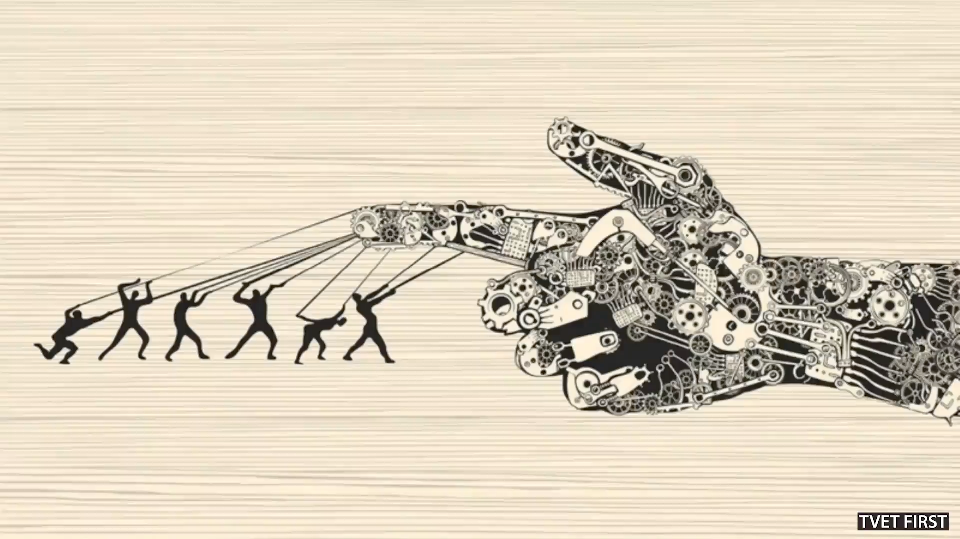
Click above to play this video.

Slide 24
Learning activity 11.4
Module 11
Test your knowledge of this section by completing Learning activity 11.4 in your Student’s Book.

Slide 25
Module 11
Test your knowledge of this module by completing the Summative assessment of Module 11 in your Student’s Book.

