Slide 1
Life Orientation: Life Skills
NQF 4

Slide 2
Advocate road safety measures
Module 10

Slide 3
Think about it…
Why are the numbers of road accidents not decreasing significantly?
How many of these accidents could have been prevented?
It has been said: “Drunk driving is not an accident; it is a choice.” Do you agree?

Slide 4
Traffic accidents – effects, causes & prevention
Unit 10.1

Slide 5
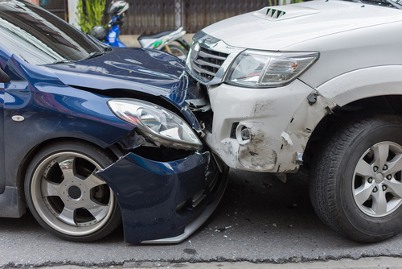
What is a traffic accident?
Accident = unexpected event.
Involves a mode of transport (e.g. bicycle, car, or people on foot).
Causes damages to vehicle, people and/or goods.

Slide 6
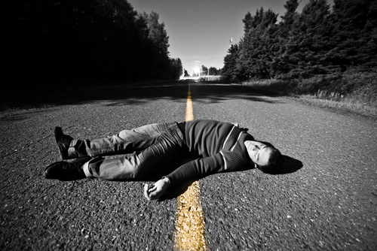
Effects of traffic accidents on individuals
Medical care & costs
Loss of work time
Need for support & counselling
Financial difficulties
Pain and/or disability
Death.

Slide 7
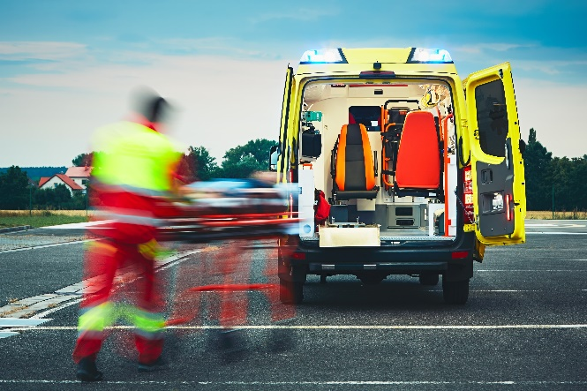
Effects of traffic accidents on the community
Loss of lives
Loss of breadwinners/financial income
Need for ongoing support
Pressure on medical facilities.

Slide 8
Effects of traffic accidents on work productivity
Loss of skilled workers
Emotional trauma may cause poor concentration & performance
Physical pain and/or disability may affect work
Depression
Need time off for medical care.

Slide 9
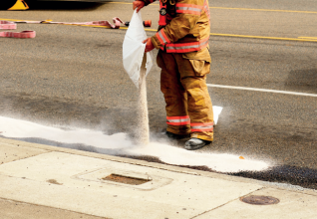
Road safety – a national priority
Every year in SA:
Approx. 11 000 people die in road accidents
Accidents cost approx. R307 billion.
Figure 10.4: Accident scenes involving fuel or chemical spills need to be cleaned up and made safer for other road users; such measures cost money

Slide 10
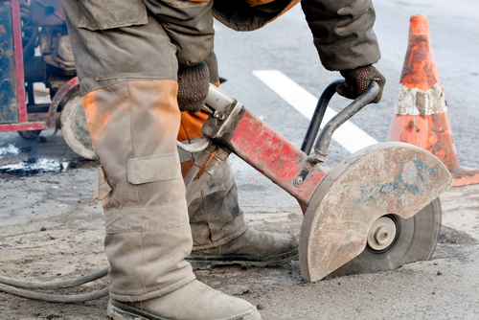
Road safety – a national priority
Government has to supply:
Emergency response & facilities (including medical staff)
Road safety officials
Road safety programmes
Law enforcement
Legal services
Road repairs
Road accident fund & disability grants.

Slide 11
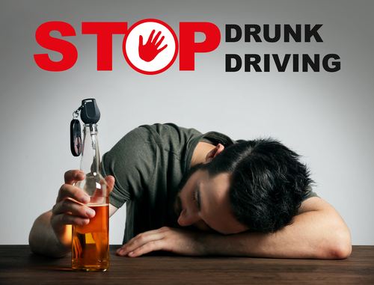
Road safety – a national priority
National road safety initiatives include:
Road Traffic Management Corporation (including National Traffic Police)
Arrive Alive South Africa
South Africans Against Drunk Driving
Road Accident Fund.

Slide 12
Learning activity 10.1
Module 10
Test your knowledge of this section – and interview a road accident survivor – by completing Learning activity 10.1 in your Student’s Book.

Slide 13
Driver-related causes of traffic accidents
Refer to Table 10.1 in your Student’s Book for information about the main causes of driver-related traffic accidents.

Slide 14
Learning activity 10.2
Module 10
Test your knowledge of this section by completing Learning activity 10.2 in your Student’s Book.

Slide 15
Passenger-related causes of accidents
Refer to Table 10.2 in your Student’s Book for information about the main causes of passenger-related traffic accidents.

Slide 16
Other road user-related causes of accidents
Refer to Table 10.3 in your Student’s Book for information about the main types of other road users causing traffic accidents.

Slide 17
Learning activity 10.3
Module 10
Test your knowledge of this section by completing Learning activity 10.3 in your Student’s Book.

Slide 18
Environment-related causes of accidents
Refer to Table 10.4 in your Student’s Book for information about the main causes of environment-related traffic accidents.

Slide 19
Learning activity 10.4
Module 10
Test your knowledge of this section by completing Learning activity 10.4 in your Student’s Book.

Slide 20
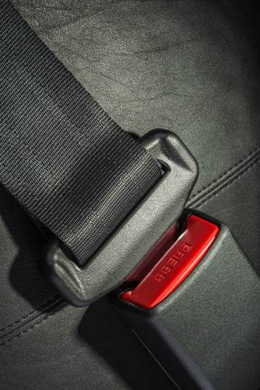
Prevention of traffic accidents
Don’t drink & drive.
Don’t speed.
Wear your seatbelt.
Keep your eyes on the road.
Stay aware of your surroundings.
Keep safe following distances.
Stop every two hours to stretch your legs.

Slide 21
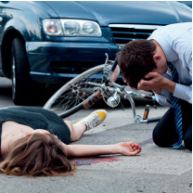
Prevention of traffic accidents
Don’t drive tired.
Don’t use your phone while driving.
All legislation needs to be enforced.
Roads need to be maintained.
Road users need to be responsible.
Figure 10.10: Wearing a cycle or motorcycle helmet in the correct way can reduce the risk of severe injury by more than 70% and the risk of death by almost 40%

Slide 22
Learning activity 10.5
Module 10
Test your knowledge of this section by completing Learning activity 10.5 in your Student’s Book.

Slide 23
Traffic safety measures, including no drunk driving
Unit 10.2

Slide 24
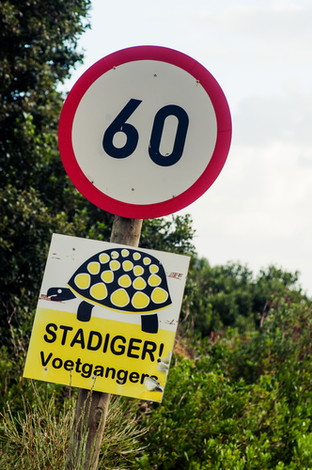
What is a measure?
Measure = action to prevent something bad from happening.
Traffic safety measures can be:
Part of a vehicle (e.g. a seatbelt)
Road infrastructure (e.g. speed bump)
Law (e.g. speed limit).

Slide 25
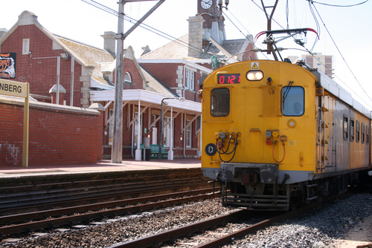
Measures for road safety management
Road safety policy includes:
Government-funded agencies (e.g. Arrive Alive)
Public transport systems
Laws & law enforcement.

Slide 26
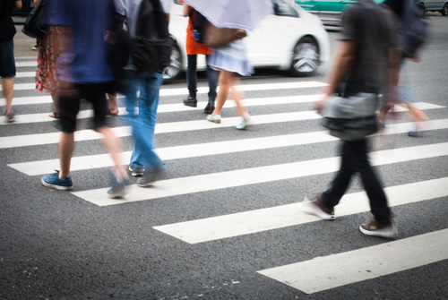
Measures for safer roads & mobility
Maintaining old roads
Building safe new roads
Special lanes (e.g. for buses or bicycles)
Pavements & pedestrian crossings.

Slide 27
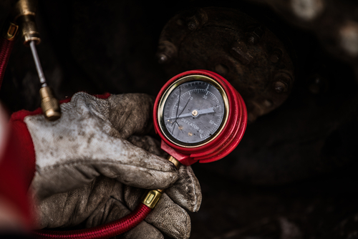
Measures for safer vehicles
Safety features (e.g. airbags, seatbelts & headrests)
Roadworthy tests (including functioning lights, brakes & tyres).

Slide 28
Measures for safer road users
Know & obey road signs.
Break up long journeys.
Use car seats for children.
Ensure that any loose items (e.g. bags & shopping) are securely stored.

Slide 29
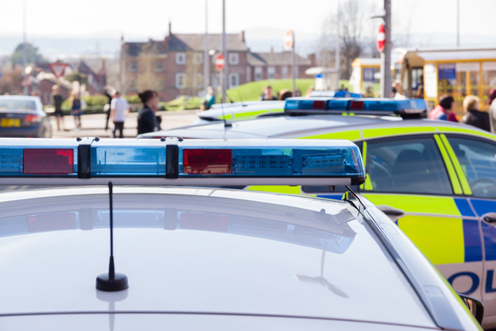
Measures for safer post-crash response
Know the numbers for emergency services.
Emergency services include:
Traffic police
Ambulance & fire trucks
Tow trucks & private roadside assistance.

Slide 30
Learning activity 10.6
Module 10
Test your knowledge of this section by completing Learning activity 10.6 in your Student’s Book.

Slide 31
Dangers of drunk driving
Alcohol = main cause of road accidents & deaths.
Alcohol (& some medication) causes:
Drowsiness & blurred vision
Poor concentration
Bad judgement & decision-making
Slow reaction time
Overconfidence and/or aggression.

Slide 32
Dangers to the drunken driver
Impaired abilities.
Drivers found over the limit:
Arrested & charged
Held by police
Criminal record, large fine and/or prison
May lose their licence
Charged with murder if the accident results in someone’s death
No insurance payment.

Slide 33
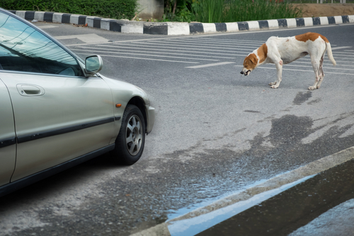
Dangers to others, property & the environment
Injury or death of:
Passengers
Drivers/passengers in other vehicles
Motorcyclists, cyclists & pedestrians
Animals.
Damage to:
Other vehicles
Property (e.g. walls & buildings).

Slide 34
Learning activity 10.7
Module 10
Test your knowledge of this section – and research data on road deaths in South Africa – by completing Learning activity 10.7 in your Student’s Book.

Slide 35
Basic first aid for traffic accident victims
Unit 10.3

Slide 36
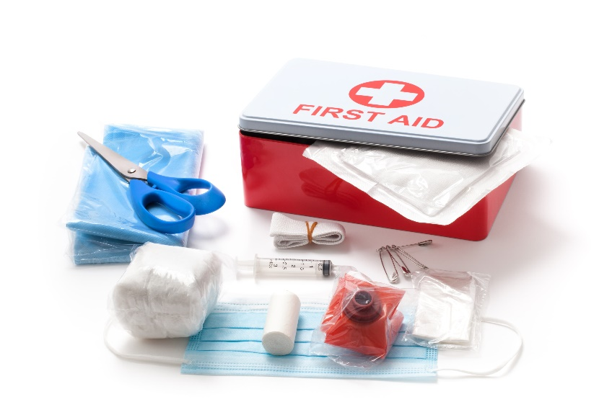
What is first aid?
First aid = first assistance/care for an injured person until professional medical treatment is available.
Aim of first aid = to stabilise victims.
Focus on breathing, heartbeat & blood before other injuries.

Slide 37
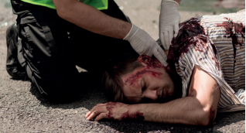
Basic first aid for accident victims
Secure situation & call for help.
Ask bystanders to assist (especially anyone with medical training).
Ensure the victim is breathing & that there is a pulse.
Figure 10.20: Checking for a pulse – note that the
person is wearing gloves for protection against possibly
infected blood; use a plastic bag if you don’t have gloves

Slide 38
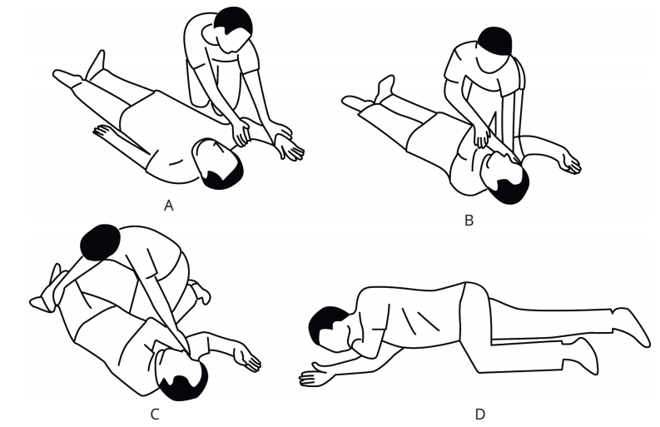
Basic first aid for accident victims
You may need to do CPR.
Stop excessive bleeding.
Place the person in recovery position (note: don’t move them if they have a back/neck injury).
Figure 10.23: In the recovery position, the person should appear to be sleeping on their side, with the arm under them stretched out.
The other arm should be across the chest & the hand
under the cheek

Slide 39
Basic first aid for accident victims
Guard against the person going into shock.
Cooperate with emergency staff.
Figure 10.24: A protective blanket helps to keep the victim warm and out of deep shock; you could use a jacket, towel or regular blanket

Slide 40
Learning activity 10.8
Module 10
Test your knowledge of this unit – and practise some basic first aid – by completing Learning activity 10.8 in your Student’s Book.

Slide 41
Donating blood
Unit 10.4

Slide 42
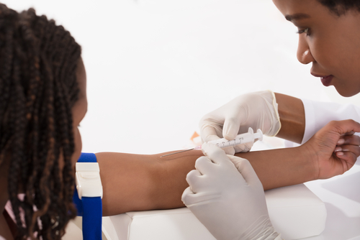
What is blood donation?
Trained people remove blood from your body.
This blood is stored to be given to someone to save their life.
Transfusion = transfer of blood into the bloodstream of someone else.

Slide 43
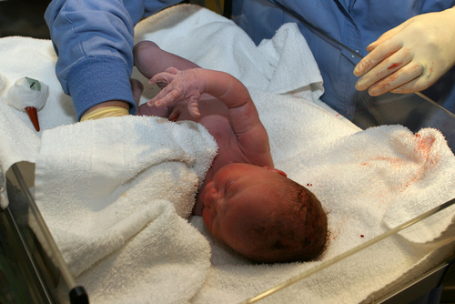
Why give blood?
Used for loss of blood in:
Accident victims
People having surgery
Patients with blood disorders
Mothers & babies during or after birth.

Slide 44
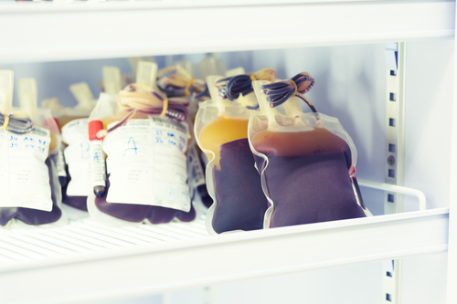
Why give blood?
There is a need for different blood products:
Whole blood or red cells, platelets & plasma
Different blood types:
A, B, AB & O
Rhesus (Rh) negative or positive
Needs to be restocked regularly.

Slide 45
Characteristics of a blood donor
Refer to Table 10.5 in your Student’s Book for the main requirements for donors of low-risk, safe blood.

Slide 46
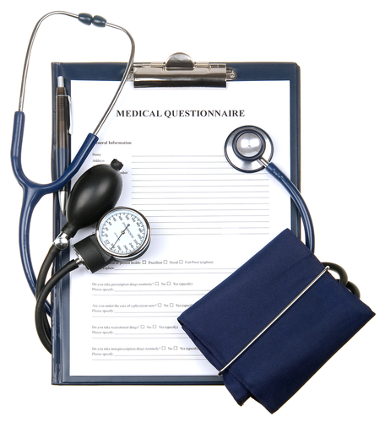
The process of donating blood
Identify a South African National Blood Services (SANBS) clinic.
Eat a healthy meal a few hours before donation.
Take your ID & the names of medications you use.
Complete the questionnaire & interview.

Slide 47
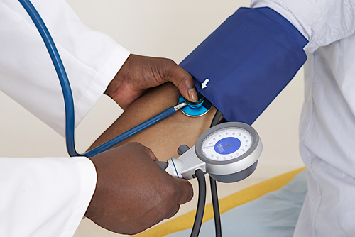
The process of donating blood
Blood pressure, heart rate & iron levels are checked.
A needle is gently inserted into a vein in the arm & blood is drawn.
Increase fluid intake for six hours.
Avoid exertion for a few hours.

Slide 48
Learning activity 10.9
Module 10
Test your knowledge of this unit – and start planning a blood donation drive – by completing Learning activity 10.9 in your Student’s Book.

Slide 49
Module 10
Test your knowledge of this module by completing the Summative assessment of Module 10 in your Student’s Book.

Slide 50
Portfolio task 3
Complete Portfolio task 3B in your Student’s Book, or Portfolio task 3A or 3C. This is a formal assessment.

