Slide 1
Life Orientation: Life Skills
NQF 4

Slide 2
Revise & refine your personal development plan (PDP) in terms of your chosen career path
Module 1

Slide 3
Think about it…
Is it possible to plan ahead to enhance your skills & your employability?
How can you turn weak areas in your personal life around?
When do you stop learning in life?

Slide 4
Your personal profile
Unit 1.1

Slide 5
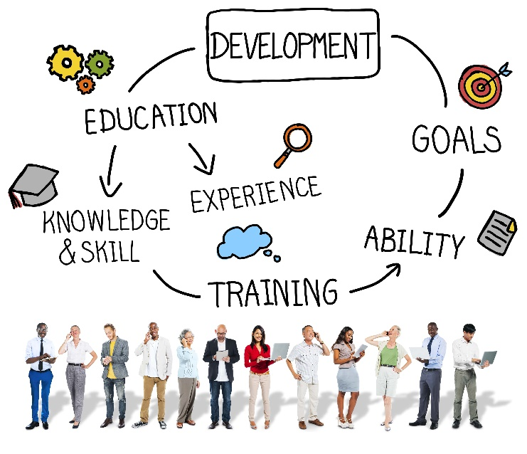
What is a profile?
Short summary of the most important facts about something
Personal profile includes strengths, weaknesses, skills, abilities, education & experience.

Slide 6
What is a profile?
Personality profile = your attitude, values, emotional maturity & life skills.
Personal development plan (PDP) = plan to get to where you want to be.
Figure 1.1: Your skills are perhaps the most important aspect of your job-related profile

Slide 7
Reviewing your personal profile
Helps you to achieve your goals by:
Gaining knowledge & experience
Learning new skills
Building up strengths
Taking steps to promote your career path.

Slide 8
Reviewing your personal profile
To review your personal profile:
Complete a skills audit
Research job requirements
Investigate job functions
Read about job market trends
Identify scarce skills
Examine career opportunities.

Slide 9
Reviewing your personal profile
Refer to Tables 1.1 & 1.2 in your Student’s Book for a PDP template, as well as an example of a PDP.

Slide 10
Areas to strengthen in future
You need to work with your:
Strengths & weaknesses
Education & learnt skills
Work & life experience
Expertise & abilities
Career aspirations.

Slide 11
Areas to strengthen in future
Write down SMART (specific, measurable, attainable, realistic & time-bound) goals.
Write down steps to achieve your goals.
Refer to Case studies 1.1 & 1.2 in your Student’s Book.

Slide 12
Learning activities 1.1 & 1.2
Module 1
Test your knowledge of this unit – and your personal profile – by completing
Learning activities 1.1 & 1.2 in your Student’s Book.

Slide 13
Goals for lifelong learning
Unit 1.2

Slide 14
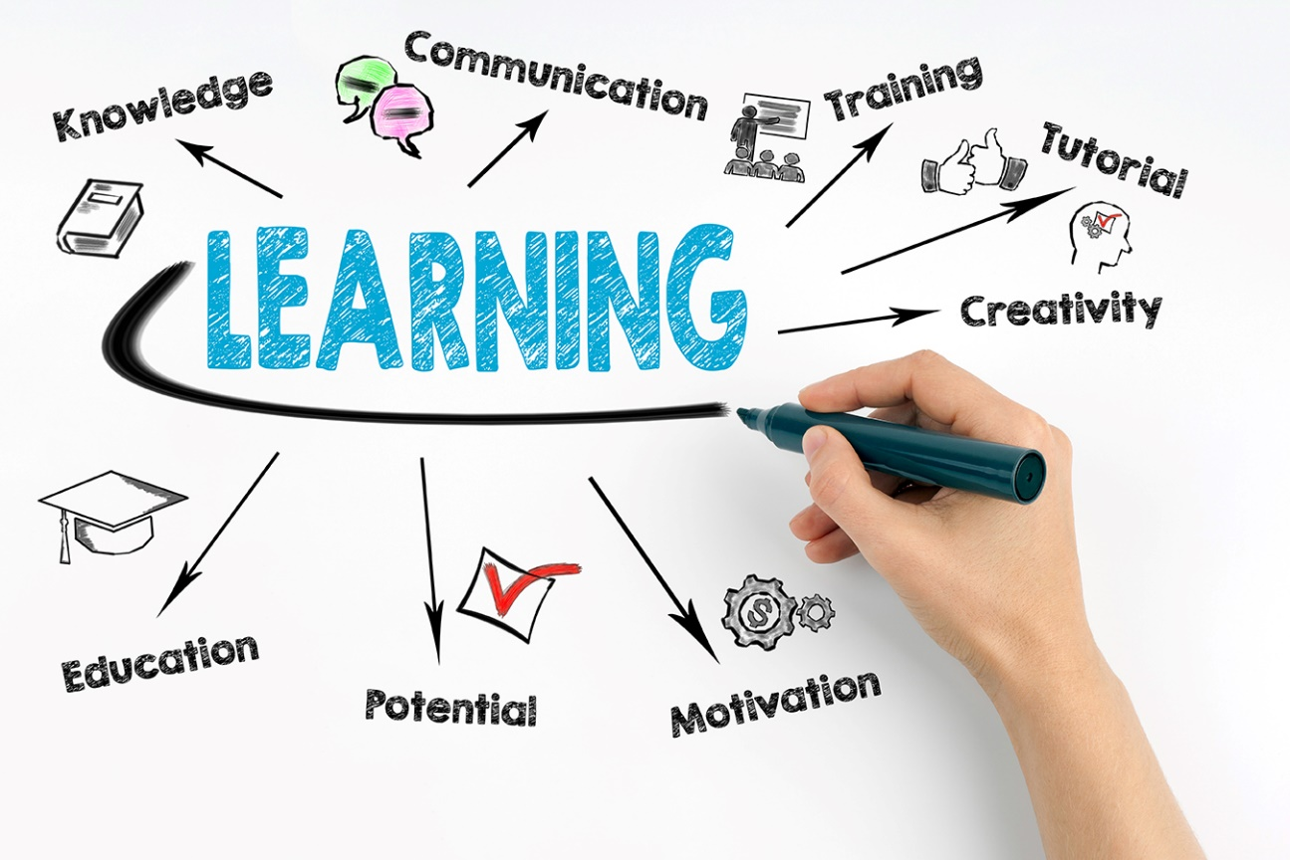
What is lifelong learning?
Gaining new knowledge, skills & abilities in all areas of life & throughout your life.

Slide 15
Setting goals for lifelong learning
Table 1.3: Different kinds of lifelong learning
Types of learning | Description
Formal | A formal degree, diploma or professional training offered by an institution (e.g. a part-time evening class held for obtaining a certificate in sports nutrition or web design).
Non-formal | Learning provided by an employer (e.g. a workshop, printed manual, in-house training or mentoring) or a body (e.g. a community centre that offers informal courses in crafts, small space gardening, basic repairs or writing for social media).
Informal | Spontaneous occasions for informal learning, which may pop up anywhere and at any time.

Slide 16
Setting goals for lifelong learning
You need to be self-motivated & find ways to learn more:
Identify a few large skills, tasks or areas of knowledge
Write down goals, sub-goals & timelines
Plan to meet goals
Plan to find support
Keep track of your progress.

Slide 17
The value of lifelong learning
Many benefits, such as:
Puts you in control
Builds on prior knowledge
Keeps skills up to date
Allows you to adapt
Helps you to make connections
Enhances personal growth.

Slide 18
Learning activity 1.3
Module 1
Test your knowledge of this unit – and set goals for your lifelong learning – by completing Learning activity 1.3 in your Student’s Book.

Slide 19
Employability & job market-related skills sets
Unit 1.3

Slide 20
What is employability?
Having skills, qualities, attitude & understanding to make you successful in a job
Having potential for growth in a role
Needs to be developed throughout working life.

Slide 21
Methods to develop employability
Refer to Table 1.4 in your Student’s Book for more information on ways to develop your employability.

Slide 22
Job market-related skills sets
Skill = what you do with what you know or have.
Thinking skills:
Creative thinking
Critical thinking
Problem-solving.

Slide 23
Job market-related skills sets
Human relations skills = interacting well with others:
Verbal & written communication
Non-verbal communication
Listening skills
Conflict resolution.

Slide 24
Job market-related skills sets
Flexibility, adaptability & skills transfer:
Flexible = easy-going; adapt to changed plans & new methods
Adaptable = can change according to different situations or demands
Skills transfer = applying existing skills to new situations.

Slide 25
Job market-related skills sets
Computer literacy:
Working knowledge of programs like Word, Excel, Outlook, Access & online skills.
Other skills, e.g. managing files & folders, printing, using shortcut keys, video calling.

Slide 26
Job market-related skills sets
Money management skills:
Budget
Do calculations
Pay bills & submit income tax on time
Save, & manage debt
Understand insurance & investments.

Slide 27
Job market-related skills sets
African & English language proficiency means that you are skilled in:
Correct forms of greeting
Correct spelling & grammar
Good sentence construction
Suitable word choice
Awareness of cultural sensitivities.

Slide 28
Job market-related skills sets
Team skills:
Consistent yet flexible
Motivating
Responsible
Truthful yet tactful.
Self-management skills:
Have energy & a positive attitude
Work without constant supervision.

Slide 29
Methods to develop job market-related skills sets
Refer to Table 1.6 in your Student’s Book for examples & methods to develop market-related skills.

Slide 30
Click above to play this video.

Slide 31
Learning activities 1.4 & 1.5
Module 1
Test your knowledge of this unit – and complete a skills audit – by completing
Learning activities 1.4 & 1.5 in your Student’s Book.

Slide 32
Module 1
Test your knowledge of this module by completing the Summative assessment of Module 1 in your Student’s Book.

