Slide 1
Life Orientation: Life Skills
NQF 3

Slide 2
Know & understand HIV & Aids, STIs & opportunistic infections
Module 9

Slide 3
Think about it…
What are ordinary, commonsense ways of preventing an infection?
Do people die from Aids, or from related infections & diseases?
What kinds of support services are available to prevent, or deal with, infection?

Slide 4
The immune system & infection control
Unit 9.1

Slide 5
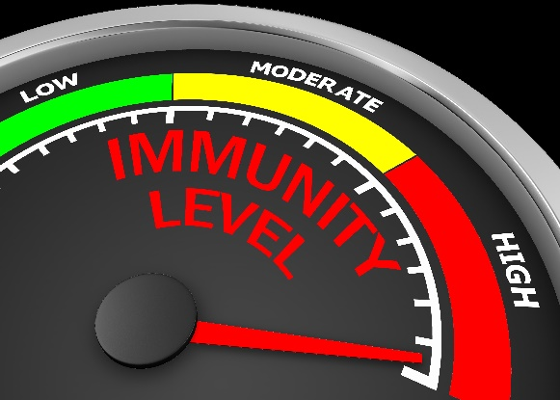
What is immunity?
Immunity = body strong enough to fight infection or disease & not get sick.
Disease = condition that stops the body or mind from functioning normally.
The immune system is the body’s defence against infections & illnesses.

Slide 6
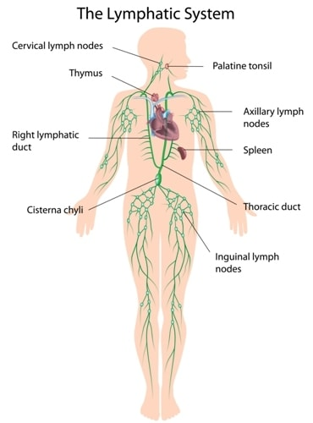
What is immunity?
The immune system is made up of:
The lymphatic system, thymus, tonsils & spleen
Lymph, white blood cells & bone marrow
Antibodies & other special cells
Mucous membranes.
Figure 9.1: The nodes and ducts of the lymphatic system are seen in green in this diagram

Slide 7
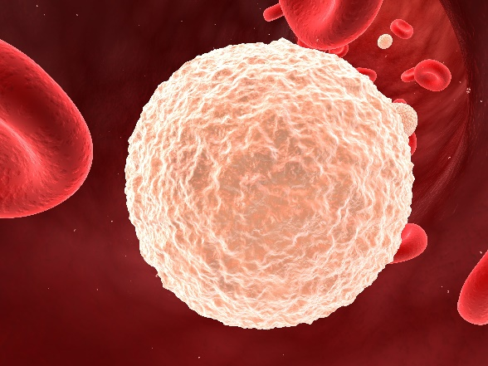
How do white blood cells work?
Protect against infections & invasions
Different kinds perform different functions, such as:
Dissolving bacteria
“Eating” bacteria
Killing parasites
Defending against viruses & tumours.
Figure 9.2: A white blood cell

Slide 8
How do lymphocytes work?
Type of white blood cell
Thymus cells or T-cells make up 75%:
Made in bone marrow
Then move to the thymus
B-cells:
Made in bone marrow
Produce antibodies when needed.

Slide 9
How do lymphocytes work?
Table 9.1: Types of T-cells
Types | Description
Helper T-cells | They start and coordinate the immune response by producing signalling cells called cytokines, which stimulate B-cells and macrophages into action.
Cytotoxic T-cells | They produce toxic granules with powerful enzymes to break open and kill invaders.
Memory T-cells | They form a memory of invaders they have encountered, so that the immune system will recognise them if they attack again.
Suppressor T-cells | They control immune response so that it doesn’t kill healthy cells after a threat has been dealt with.

Slide 10
How is the immune system compromised?
Viruses (e.g. HIV,
Ebola, flu virus)
Parasites
(e.g. tapeworm,
bilharzia, malaria)
Harmful bacteria (e.g. syphilis, chlamydia, E. coli)
Immune system
Fungi
(e.g. moulds that
produce spores)
Substances such as pollen grains or foreign proteins
Cancer cells
Figure 9.3: A mind map showing the organisms that compromise the immune system

Slide 11
How is the immune system compromised?
Your immune system will usually fight threats.
If you are immunodeficient (have a weakened immune system), your body struggles to fight illness & infections.
A compromised immune system leads to opportunistic infections.

Slide 12
How is the immune system compromised?
Refer to Example 9.1 in your Student’s Book for more information.

Slide 13
Click here to play this video.

Slide 14
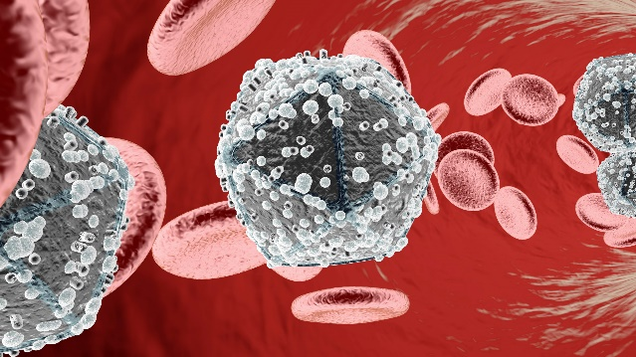
How does HIV attack cells?
Enters body & binds to CD4 glycoprotein on T-helper cells
Duplicates itself
HIV ‘reprogrammes’ T-helper cells to make them useless.
Figure 9.4: HI viruses in the bloodstream, seen here
with red blood cells

Slide 15
How does HIV attack cells?
Remember Aids = Acquired Immune Deficiency Syndrome.
Aids occurs when an HIV-positive person’s CD4 count drops from 500–1 200 to less than 200.
Someone with Aids cannot fight ordinary infections (has a compromised immune system) and is at risk of contracting opportunistic infections.

Slide 16
Learning activity 9.1
Module 9
Test your knowledge of this unit by completing Learning activity 9.1 in your Student’s Book.

Slide 17
Infection control measures
These are ways to prevent spread of disease-causing organisms.
Examples include:
Wash hands regularly.
Avoid contact with body fluids.
Don’t touch dead wild animals & birds.
Wash fruit & vegetables before eating.
Don’t eat any diseased food.
Refrigerate leftovers.

Slide 18
Infection control measures
Examples include:
Boil drinking water.
Don’t pollute water sources.
Sneeze & cough into your elbow.
Use a condom.
See a healthcare professional if you are worried about your body.
Refer to Section 9.1.3.1 in the Student’s Book for a full list of do’s & don’ts.

Slide 19
Medication for HIV infection control
People with HIV need to take antiretrovirals (ARVs).
Must be taken as prescribed – if not taken regularly, the virus builds up resistance.
Different drugs do different things.
Take ARVs at the same time every day.
Take ARVs with food or on empty stomach (as prescribed).
Be aware of side-effects.
Find out how ARVs react with other meds.

Slide 20
Click here to play this video.

Slide 21
Learning activity 9.2
Module 9
Test your knowledge of this unit by completing Learning activity 9.2 in your Student’s Book.

Slide 22
Infections, their modes of transmission & prevention
Unit 9.2

Slide 23
How HIV is transmitted
Mode = way something is done, or the way in which it happens
Only way HI virus can enter body is through body fluids or open wounds
HI virus transmitted through:
Blood
Equipment or procedures
Sexual activity
Mother-to-child transmission.

Slide 24
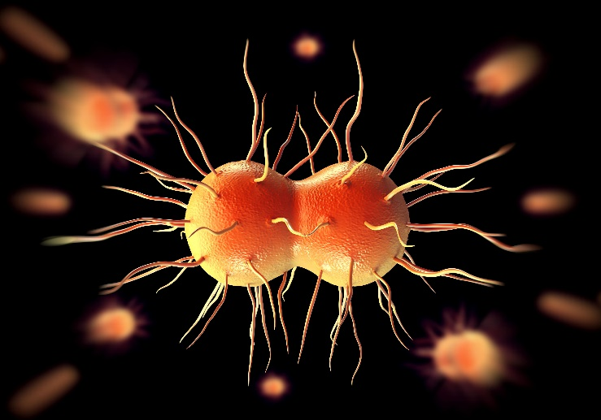
How STIs are transmitted
Remember, STI = sexually transmitted infection.
STIs can be caused by micro-organisms such as:
Bacteria
Viruses
Parasites
Protozoans
Fungi.

Slide 25
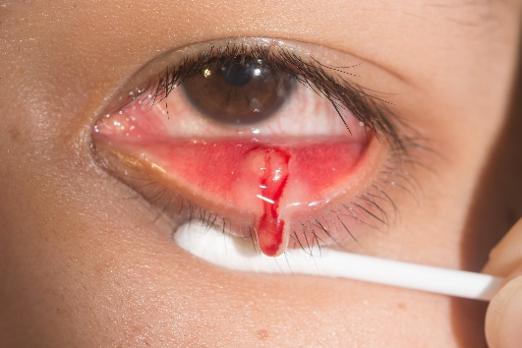
How STIs are transmitted
STIs are transmitted through sexual activity (oral, vaginal or anal).
STIs transmitted through contact with:
Body cavities
Body fluids
Mucous membranes
Sores, wounds, broken skin & whole skin.

Slide 26
How STIs are transmitted
Remember, an infected person may not look sick.
STIs need to be treated by a doctor.
Refer to Box 9.1 in your Student’s Book for an example of identifying an STI (gonorrhoea).

Slide 27
Click here to play this video.

Slide 28
Learning activity 9.3
Module 9
Test your knowledge of this unit by completing Learning activity 9.3 in your Student’s Book.

Slide 29
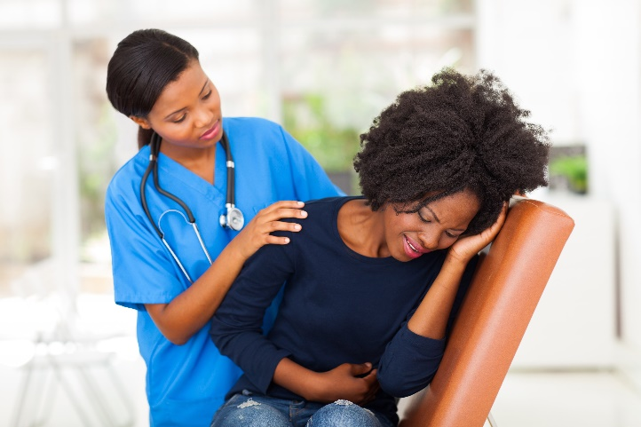
Opportunistic infections
These take advantage of weakened immune systems
Caused by pathogens that a strong immune system could fight
Need to be treated or can result in death!

Slide 30
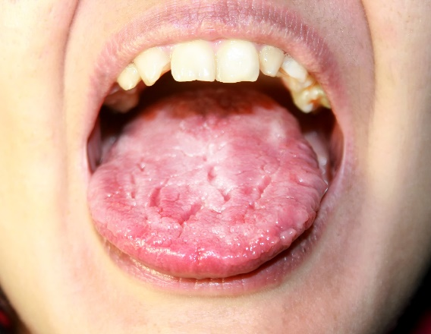
Opportunistic infections
Examples of opportunistic infections include:
Aspergillosis
Candidiasis
Pneumocystosis
Tuberculosis.
See Table 9.2 in your Student’s Book for more examples.
Candidiasis (oral thrush)

Slide 31
Click here to play this video.

Slide 32
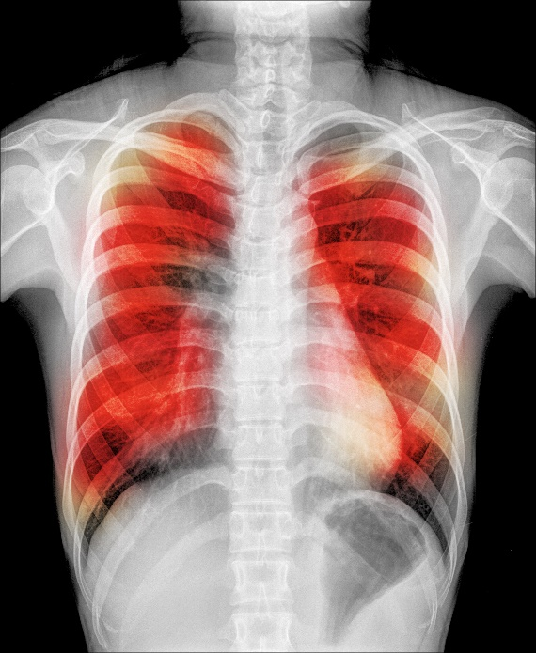
Tuberculosis (TB)
Example of an opportunistic disease
Caused by bacteria that attack the lungs
Types of TB:
Latent infection
Cavitary tuberculosis
Miliary tuberculosis.

Slide 33
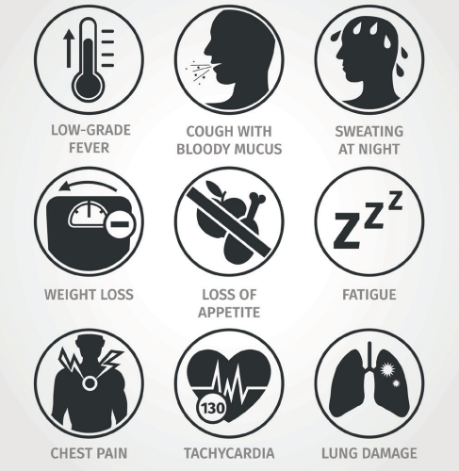
Tuberculosis (TB)
Symptoms of TB:
Figure 9.18: Symptoms of TB

Slide 34
Tuberculosis (TB)
TB spreads through droplets when someone coughs, sneezes, spits, sings or speaks.
Drug-resistant TB (MDR TB):
Doesn’t respond to normal TB medication
Caused by patients not finishing course of meds
Spreads to others.

Slide 35
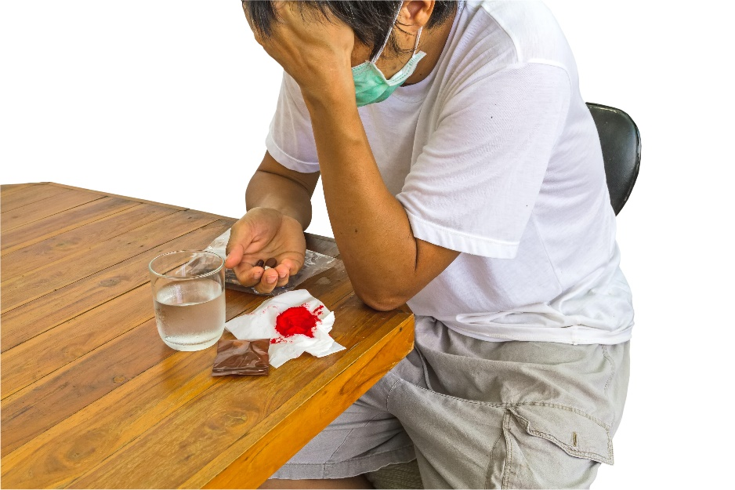
Tuberculosis (TB)
To prevent MDR TB:
Patients must take medication regularly.
Patients must complete treatment (approx. two years).

Slide 36
Preventing TB
Turn away when someone coughs or sneezes.
Wear a surgical mask around TB patients.
Ventilate rooms.
Wash your hands regularly.
Follow a healthy diet.
See a healthcare professional if you have symptoms.
See a healthcare professional if you’ve been in close contact with someone with TB.
Cough into a tissue & throw it away.
Complete your treatment.

Slide 37
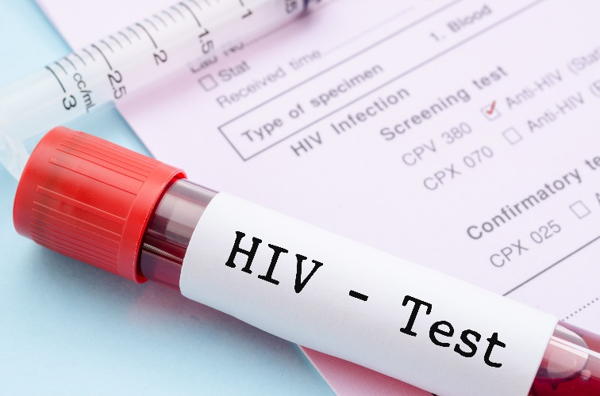
Preventing HIV, Aids & STIs
See a healthcare professional if you have symptoms.
Get tested for HIV every year.
Avoid blood & body fluids.
Wear protective clothing around others’ blood & body fluids.

Slide 38
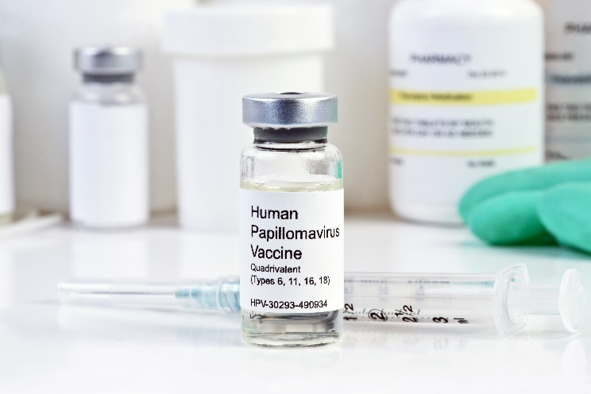
Preventing HIV, Aids & STIs
Don’t share razors or needles.
Use a condom.
Commit to safe sex.
Follow treatment carefully.
Vaccinate against STIs such as HPV or hepatitis A & B.
Educate others.

Slide 39
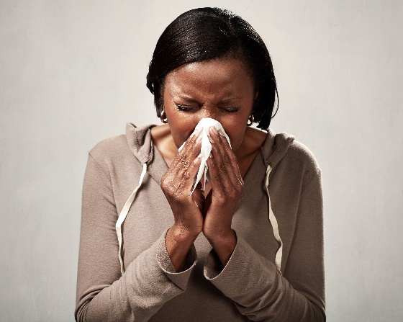
Preventing opportunistic infections
Measure & monitor CD4 count.
Take ARVs & other meds regularly.
Take medication as prescribed.
Tell doctor if taking other medication.
Avoid blood & body fluids.
Don’t smoke, drink, do drugs or have unsafe sex.
Be aware of hygiene.
Cook food thoroughly.
Eat healthily & rest well.

Slide 40
Click here to play this video.

Slide 41
Learning activity 9.4
Module 9
Test your knowledge of this unit by completing Learning activity 9.4 in your Student’s Book.

Slide 42
Health-related support services
Unit 9.3

Slide 43
Support services in South Africa
Aim: to promote, improve, maintain & restore wellbeing.
Government:
Hospitals & clinics
Schools
Social services
Helplines & counselling
Legal services.

Slide 44
Support services in South Africa
Umbrella organisations & networks:
Based locally or overseas
May work with government
Try to create awareness, educate & assist with healthcare.
NGOs & NPOs:
Independently run
Don’t make a profit, but address a social or political issue.

Slide 45
Support services in South Africa
Local community initiatives & religious organisations
Helplines, such as:
LifeLine Crisis Hotline (also for rape, HIV & Aids counselling) | 0861 322 322
National Aids Helpline in South Africa | 0800 012 322
loveLife Youth Line | 0800 121 900
loveLife Parent Line | 0800 121 100
National HIV & TB Health Care Worker Hotline | 0800 212 506

Slide 46
Click here to play this video.

Slide 47
Learning activity 9.5
Module 9
Test your knowledge of this unit by completing Learning activity 9.5 in your Student’s Book.

Slide 48
Module 9
Test your knowledge of this module by completing the Summative assessment of Module 9 in your Student’s Book.

