Slide 1
Life Orientation: Life Skills
NQF 3

Slide 2
Indicate strategies & lifestyle changes to avoid risky behaviour
Module 8

Slide 3
Think about it…
How do you refuse something harmful or bad when the pressure is on?
Can you grow stronger in refusal skills?
How will you know when you are being abused?

Slide 4
Peer pressure
Unit 8.1

Slide 5
Who are your peers?
People of similar age
Same background, status and/or interests
Peer pressure = being influenced by your peers
Peer pressure can be spoken or unspoken.

Slide 6
When is peer pressure positive?
When it:
Raises your standards
Improves your behaviour
Boosts your self-esteem healthily
Influences you in the right way.

Slide 7
When is peer pressure negative?
When it:
Criticises you or makes you feel small
Encourages you to do wrong
Makes unfair or unlawful demands on you
Lowers your standards, values & goals
Can destroy your future.

Slide 8
Peer pressure & risky behaviour
Leads you to behave differently
You try to make people like you by doing what they want
Especially dangerous in a risky situation
Refer to Example 8.1 in your Student’s Book to see examples of harmful peer pressure.

Slide 9
Assertiveness & refusal skills
Remember, being assertive means having self-confidence to stand up for yourself & your values.
Refusal skills include:
Asking questions
Pointing out the negative behaviour
Pointing out the consequences.

Slide 10
Assertiveness & refusal skills
Refusal skills include:
Delaying the issue
Suggesting other options
Standing firm
Leaving the scene
Being dramatic
Reversing the pressure by challenging the peer(s)
Ignoring the issue or comment, & trying to change the subject

Slide 11
Assertiveness & refusal skills
Refer to Table 8.1 in your Student’s Book for examples of responses.

Slide 12
Improving your assertiveness
Table 8.2: Strategies for improving assertiveness
Interests | Confidence | Self-esteem | Connection | Goals & principles | Being yourself
Develop interests outside of your peer group. Learn or do something that you really like to do, & you will soon get to know other people. | Practise having confidence. For instance, when you are among people you don’t know, make a nice comment about something to the person next to you. | If you have low self-esteem or are depressed, think about why this is so & speak to a trusted person, a counsellor, a faith practitioner or a clinic nurse. | Connect with people who care about you or have the same values as you, such as your family, your parents’ friends & your faith community. | Find out what your main goal & direction in life are. Embrace a set of values & moral principles that will help to steer you there. Follow positive role models. | Remind yourself that when you resist peer pressure, you free up your life, time & space to pursue your own identity, style & ideals.

Slide 13
Click here to play this video.

Slide 14
Learning activity 8.1
Module 8
Test your knowledge of this unit – and assess your assertiveness and refusal skills – by completing Learning activity 8.1 in your Student’s Book.

Slide 15
Situations that encourage abuse
Unit 8.2

Slide 16
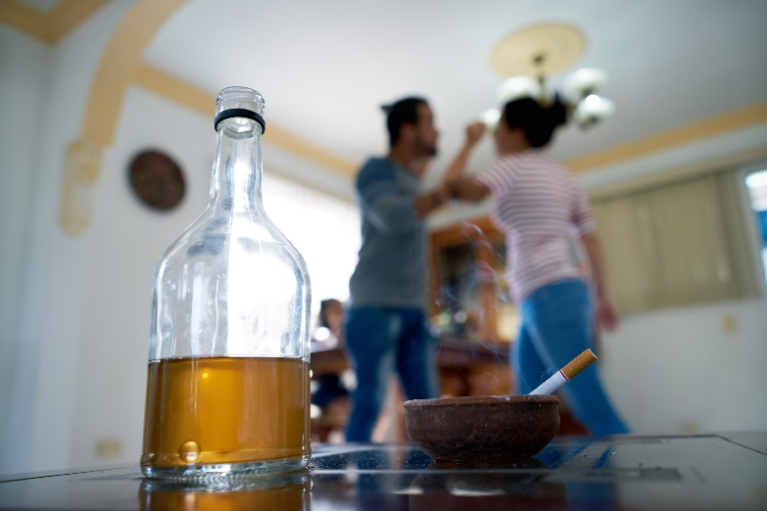
What is abuse?
Abuse = when someone or something is treated in a wrong, hurtful, violent way.
Usually refers to repeated incidents.
Different types, e.g. verbal, physical, social, emotional, psychological, sexual & economic.

Slide 17
Various abusive situations
Table 8.4: Examples of types of abuse
Types of abuse | Definition | Examples
Verbal | Hurtful words | Dirty, rude or offensive language; insults; constant criticism; racist comments; mean or belittling jokes
Physical | Hurtful actions | Hitting; kicking; tripping
Social | Hurtful behaviour | Exclusion; constantly ignoring someone or being cold towards them
Emotional & psychological | Hurtful influence or effect | Repeated vandalism or crime; mocking; cyberbullying; stalking
Sexual | Hurtful intimate relations | Rape; adultery; any form of forced or degrading sex
Economic | Withholding resources in a hurtful way | Not contributing to rent, a home loan, child support or household expenses; selling things belonging to members of the family; using up their savings

Slide 18
Abuse is more likely when:
The victim is vulnerable
The abuser takes advantage of a situation
The victim lacks self-esteem & assertiveness
The abuser lacks coping mechanisms, self-control & self-esteem.

Slide 19
Ways to avoid abusive situations
Be aware of warning signs
Choose your friends wisely
Communicate clearly
Discourage abusive behaviour
Seek support

Slide 20
Ways to avoid abusive situations
Ensure your safety
Seek professional help
Form other relationships
Resist becoming bitter
Boost your confidence.

Slide 21
Click here to play this video.

Slide 22
Learning activity 8.2
Module 8
Test your knowledge of this unit by completing Learning activity 8.2 in your Student’s Book.

Slide 23
Date rape drugs
Unit 8.3

Slide 24
What is rape?
Rape = forced sexual intercourse/penetrative acts
Can happen anywhere at any time
Rapist(s) can be male or female, or a group
Date rape is committed by rapist(s) who go on a date with the victim
Rapist(s) may use physical force or drugs.

Slide 25
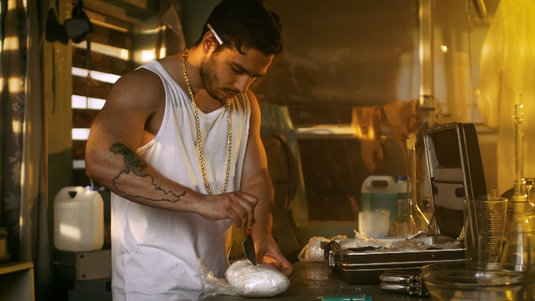
Different date rape drugs
Tranquilisers snuck into someone’s drink or food
Meant to make someone lose control or pass out
Some are legal drugs (misused by rapists)
Some are made in illegal drug labs.

Slide 26
Different date rape drugs
Examples include Rohypnol, GHB & Ketamine
Effects depend on quantity consumed and whether it is mixed with alcohol
Refer to Table 8.6 in your Student’s Book for more on the effects of date rape drugs.

Slide 27
Avoiding date rape drugs
Guard your drinks (& food)
Choose your dates wisely
Choose a safe location
Be aware of unusual sensations
Refer to Case studies 8.1 & 8.2 in your Student’s Book for more information.

Slide 28
Learning activity 8.3
Module 8
Test your knowledge of this unit – and think about your own safety – by completing Learning activity 8.3 in your Student’s Book.

Slide 29
Module 8
Test your knowledge of this module by completing the Summative assessment of Module 8 in your Student’s Book.

