Slide 1
Life Orientation: Life Skills
NQF 3

Slide 2
Explore the principles of a balanced lifestyle in a workplace context
Module 7

Slide 3
Think about it…
What is a company or organisation’s most important resource or asset?
Why are programmes aimed at employees’ wellbeing important?
How does physical & mental wellbeing impact on your work productivity?

Slide 4
Wellbeing & work productivity
Unit 7.1

Slide 5
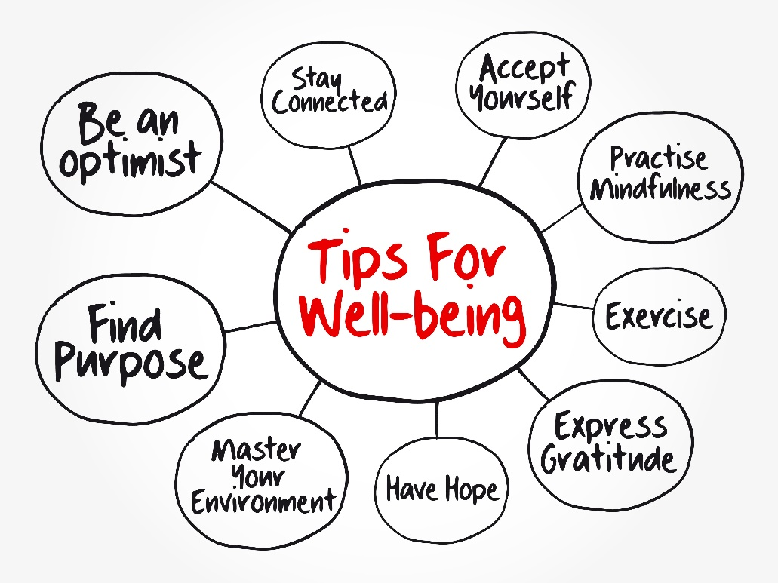
What is physical wellbeing?
Wellbeing = good health of body & mind
Not only about not being sick, but improving your quality of life
Physical wellbeing is made up of different aspects.

Slide 6
Aspects of physical wellbeing
Energy levels
Senses
Skin, hair & nails
Mouth, teeth & breath
Circulation
Respiration
Immune system
Figure 7.1: You have had a good night’s sleep if you wake up feeling fully rested

Slide 7
Aspects of physical wellbeing
Mass (weight)
Pain
Digestion & elimination
Bones, joints & muscles
Hormones, glands & genitals
Refer to Table 7.1 in your Student’s Book for descriptions of these aspects of physical wellbeing.

Slide 8
Aspects of mental wellbeing
Mentally sharp
Strong perception
Good memory
Teachable
Discernment
Able to control emotions
Mental strength
Respectful

Slide 9
Aspects of mental wellbeing
Stable state of mind
Good behaviour
Positive attitude
Good sense of humour
Refer to Table 7.2 in your Student’s Book for descriptions of these aspects of mental wellbeing.

Slide 10
Effects of wellbeing on work productivity
Physical health gives employees:
More energy
Healthy appearance
Fewer aches & pains
Less need for sick leave
Fewer accidents due to tiredness.

Slide 11
Effects of wellbeing on work productivity
Physical & mental wellbeing gives employees:
Lower stress levels
Physical & mental strength
High job performance
Job satisfaction.
Figure 7.6: Your physical health affects your mental health, and the other way around

Slide 12
Learning activity 7.1
Module 7
Test your knowledge of this unit – and assess your physical and mental wellbeing – by completing Learning activity 7.1 in your Student’s Book.

Slide 13
Wellness programmes
Unit 7.2

Slide 14
An employee wellness programme
Special programme at work to promote physical & mental health
Aims to:
Improve overall health
Reduce sick leave
Reduce loss of work time & medical costs.

Slide 15
Criteria of a wellness programme
Coordinator/committee to run programme
Programme designed for employees’ health needs
Support from management
Needs goals, budget & timeline

Slide 16
Criteria of a wellness programme
Clear incentives
Approachable & informed task leaders
Employees with health risks need to see a health professional
Implemented, reviewed, sustained
Progress monitored.

Slide 17
Components of a wellness programme
Wellness events
Screening
Workshops
Information pieces
Policy development.
Figure 7.10: Informed and motivated employees will share their knowledge with their families

Slide 18
Learning activity 7.2
Module 7
Test your knowledge of this unit by completing Learning activity 7.2 in your Student’s Book.

Slide 19
Module 7
Test your knowledge of this module by completing Summative assessment of Module 7 in your Student’s Book.

