Slide 1
Life Orientation: Life Skills
NQF 3

Slide 2
Apply learning & thinking skills & strategies in various contexts
Module 6

Slide 3
Think about it…
Can we exercise our mind & memory, or are we stuck with what we have?
Are there different methods for making decisions, or are we led by our emotions & circumstances?
What are creative ways of looking at problems that need to be solved?

Slide 4
Mnemonic techniques
Unit 6.1

Slide 5
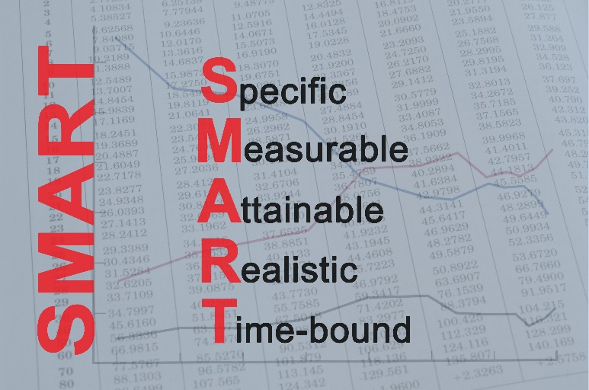
What are mnemonic techniques?
Say: nee-mónick
A system to help you to remember a list or sequence
Example: making a special word, sentence, pattern of letters, or rhyme.

Slide 6
Mnemonic techniques for memory skills
Words:
Write down the first letter of each word in the list.
Use the letters to form a word.
Use the new word to create a mental picture of the concept.
Figure 6.2: The well-known mnemonic “Roy G. Biv” is a useful way to remember the order of the colours of a rainbow

Slide 7
Mnemonic techniques for memory skills
Sentences:
Form a sentence with the first letter/parts of words
Associations:
Link a fact or number to something else
Rhymes & tunes:
Use music & actions
Stories.

Slide 8
Learning activity 6.1
Module 6
Test your knowledge of this unit – and use mnemonic techniques –
by completing Learning activity 6.1 in your Student’s Book.

Slide 9
Decision-making methods
Unit 6.2

Slide 10
Decision-making methods
Every day, you need to make decisions.
You need to think through your choices.
Use different methods to avoid bad decisions.

Slide 11
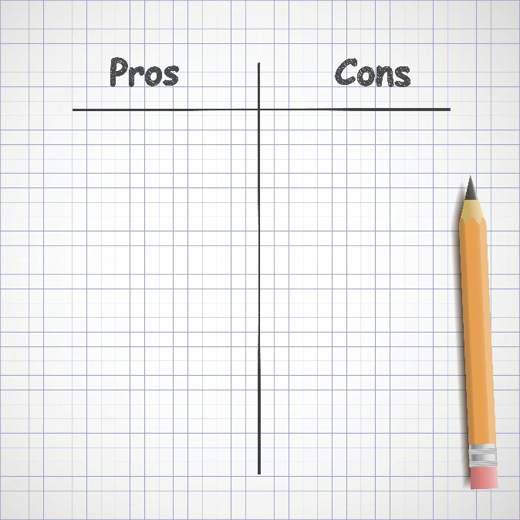
Decision-making methods
Compare the pros & cons:
List advantages & disadvantages
Think long-term
Do what will be best for you in future, and not just now.
Figure 6.6: Making a list of pros and cons can help you to weigh up the positives and negatives about your decision

Slide 12
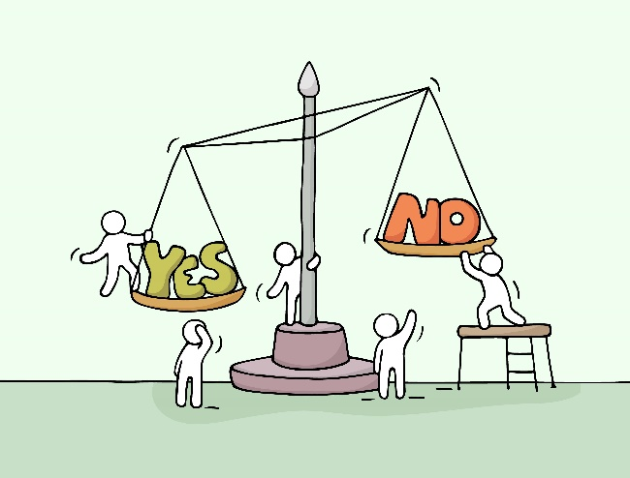
Decision-making methods
Weigh up alternatives:
Write down all options
Work out pros & cons.
Ask questions:
Write them down or talk them over
Answer the questions honestly
Think logically.

Slide 13
Decision-making methods
Find group consensus:
If the outcome affects others, talk through the options with them.
Seek outside advice from people:
Who you know & respect
Who aren’t affected by your decision (neutral)
Individually to get an unbiased response.

Slide 14
Click here to play this video.

Slide 15
Learning activity 6.2
Module 6
Test your knowledge of this unit – and practise decision-making methods – by completing Learning activity 6.2 in your Student’s Book.

Slide 16
Problem-solving methods & creative thinking skills
Unit 6.3

Slide 17
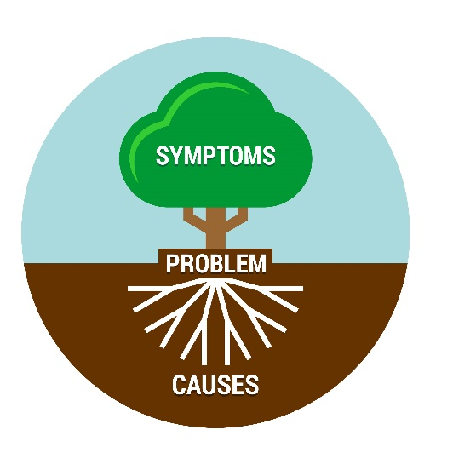
Conventional thinking methods
Identify the cause & effect.
Find the root cause (it may be deeper than you think).
Use reasoning.
Figure 6.12: Unfortunately, many “solutions” are only aimed at lessening the distress or pain of the symptoms, and don’t attend to or reach the root causes

Slide 18
Conventional thinking methods
Table 6.4: Types of reasoning
Types | Descriptions
Inductive reasoning | Observe statements or things that happen and then make generalisations (draw conclusions) based on your observations. In other words, go from the specific to the general.
Deductive reasoning | Make a generalised assumption (or theory or hypothesis) that you believe to be true and then set out to find observations to prove it. In other words, go from the general to the specific.
Critical thinking | Analyse and examine a problem in detail – all its components, pros and cons, and all arguments and claims around it. Establish the facts and weigh up all evidence before reaching a judgement.
Conditional thinking | Explore your options in a given or anticipated problem situation. The leading phrase in each case can be: “If I do this, or choose this option (or if this happens), then ...”, as well as the words “but (however) ...” and “therefore ...”.

Slide 19
Learning activity 6.3
Module 6
Test your knowledge of this section by completing Learning activity 6.3 in your Student’s Book.

Slide 20
Unconventional thinking methods
Creative thinking = thinking beyond the obvious
Doesn’t follow established patterns of thought
Generates new ideas
Allows for innovation.

Slide 21
Unconventional thinking methods
Think creatively:
Look through other lenses
Brainstorm.
Think laterally (from another angle)
Generate innovative ideas:
Combine facts to form a new concept
Find new uses for familiar objects
Make random associations
Use whole brain thinking.

Slide 22
Unconventional thinking methods
Table 6.5: Herrmann’s styles of thinking
Thinking style | Description | Examples
Analytical | Logical, technical, critical | Collecting data; analysing it; reasoning logically; evaluating facts
Sequential | Structured, planned, detailed | Organising; solving problems step by step; following directions
Interpersonal | Emotional, spiritual, feelings | Sensory input; group interaction; expressing ideas; listening
Imaginative | Intuitive, visual, conceptual | Problem-solving; taking the initiative; enjoying visuals; looking at the big picture of things

Slide 23
Learning activity 6.4
Module 6
Test your knowledge of this section – and practise unconventional thinking skills – by completing Learning activity 6.4 in your Student’s Book.

Slide 24
Portfolio task 1
Complete Portfolio task 1 in your Student’s Book. This is a formal test.

