Slide 1
Life Orientation: Life Skills
NQF 3

Slide 2
Develop a study method
Module 5

Slide 3
Think about it…
Do people have different ways in which they prefer to learn?
Will some study techniques work better for certain people than for others?
Can you draw up a plan to improve your academic performance?

Slide 4
Brain dominance & learning styles
Unit 5.1

Slide 5
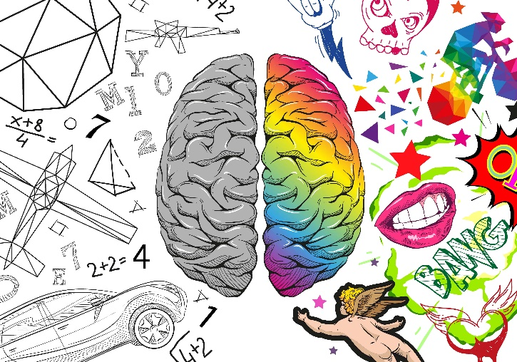
The brain hemispheres
The brain is a large organ in the head that controls the nervous system.
Each part of the brain is responsible for different functions.

Slide 6
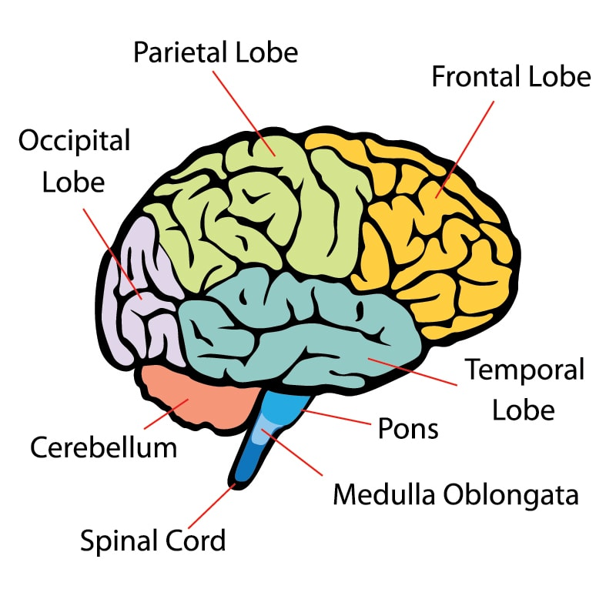
The brain is made up of:
Cerebral cortex (largest part) = parietal, frontal, occipital & temporal lobes – has two halves/hemispheres.
Cerebellum (at base).
Brainstem (also forms spinal cord).
Figure 5.1: An illustration of the brain as seen from the side, using colours to show the different parts

Slide 7
Left & right hemispheres
Some scientists say each side of the brain controls different functions.
Brain dominance = idea that the left or right hemisphere is more important in individuals and/or situations.
In psychology, the terms ‘left-brain dominant’ or ‘right-brain dominant’ are often used.

Slide 8
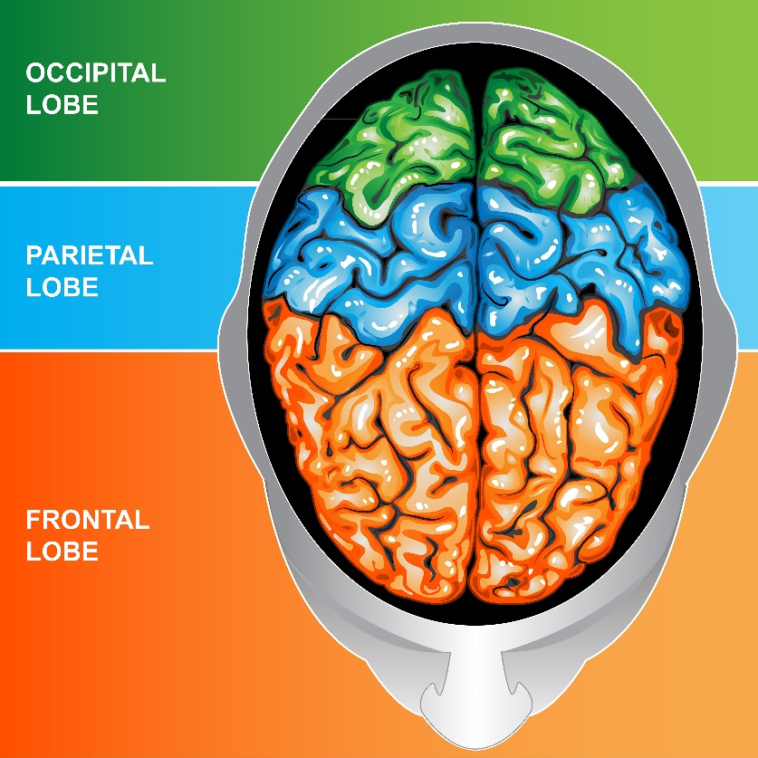
Left & right hemispheres
Figure 5.2: Illustration of the brain showing the cerebral cortex from above (the left and right hemispheres of the brain are joined on the inside by the corpus callosum, which is a bundle of neural fibres that enables communication between the two hemispheres)

Slide 9
Left & right hemispheres
Table 5.1: Broad functions given to the left and right sides of the brain
Left hemisphere (logical, chronological, detailed) | Right hemisphere (intuitive, unsystematic, holistic)
• Strong verbal skills | • Good at non-verbal expressions
• Good at language | • Not strong in grammar or vocabulary
• Thinks in words | • Has a strong imagination; daydreams
• Thinks analytically, systematically & realistically | • Thinks more in terms of feelings & impressions
• Thinks rationally (logically) | • Thinks intuitively (instinctively)
• Very aware of detail when looking at things | • Not so concerned with details, but good at forming mental images & more aware of the bigger picture

Slide 10
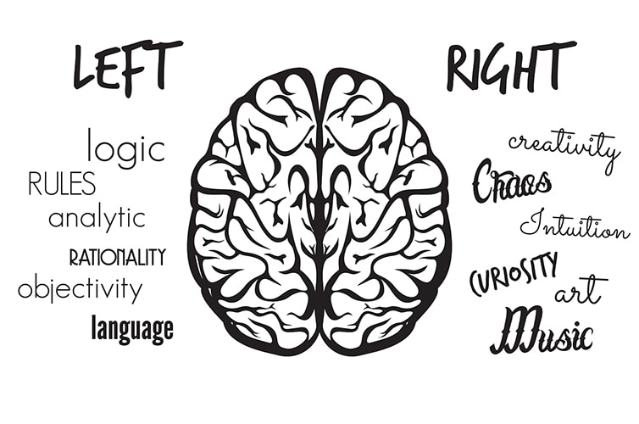
Left & right hemispheres
Table 5.1: Broad functions given to the left and right sides of the brain (continued)
Left hemisphere (logical, chronological, detailed) | Right hemisphere (intuitive, unsystematic, holistic)
• Likes to plan logically & in detail | • Tends to be impulsive
• Finds it easy to arrange things in a certain order | • Tends to link things together randomly
• Good with numbers (maths), facts & science | • Good at art, colours, music & writing
• Tends to be more careful | • Inclined to be adventurous

Slide 11
Click above to play this video.

Slide 12
Learning activity 5.1
Module 5
Test your knowledge of this section by completing Learning activity 5.1 in your Student’s Book.

Slide 13
Learning styles & preferences
The way you approach & best understand information
May use many styles, but some are easier for you
Depends on your personality, strengths, weaknesses & the situation.

Slide 14
Types of learning styles
Visual (seeing)
Auditory (hearing)
Tactile (feeling)
Kinaesthetic (moving)
Gustatory (tasting)
Olfactory (smelling).
Figure 5.6: Auditory learners are able to repeat accurately information they have heard

Slide 15
Types of learning styles
Table 5.2: Preferred learning styles
Learning styles | Activities that enhance learning the most | Type of tasks and tests that are easiest
Visual | Seeing; reading; drawing diagrams & pictures; underlining or highlighting words; writing outlines and lists; watching a demonstration or video; taking notes; studying in a quiet environment | Written answers; charts; posters; comparisons; spelling; memorisation; written reports; written comprehension tests
Auditory | Listening; speaking; reading aloud; telling a story; talking to yourself; holding discussions; joining a study group | Verbal instructions; oral answers, summaries and explanations; debates; dictation; vocabulary; oral reports

Slide 16
Types of learning styles
Table 5.2: Preferred learning styles (continued)
Learning styles | Activities that enhance learning the most | Type of tasks and tests that are easiest
Tactile-kinaesthetic | Feeling; touching; handling; writing; doing; exploring; doing fieldwork; moving about | Physical activities; role-plays; experiments; demonstrations; building models; multiple-choice questions
Gustatory | Tasting | Identifying and describing tastes
Olfactory | Smelling | Identifying and describing smells

Slide 17
Your own learning styles & preferences
Affect how you learn
Depend on the situation
Practise different styles in risk-free contexts
Use best style for the specific task.

Slide 18
Click above to play this video.

Slide 19
Learning activity 5.2
Module 5
Test your knowledge of this section – and assess your own learning styles and preferences – by completing Learning activity 5.2 in your Student’s Book.

Slide 20
Personal study techniques
Unit 5.2

Slide 21
Different study techniques
Study technique = way to approach content in order to understand & remember it
Can be structured or simple things you do while learning.

Slide 22
SQ3R method
Survey = skim read for overview.
Question = form questions from the chapter title & headings.
Read = read full text in sections.
Recite = after each section recall main points.
Review = quick read of text and underline keywords.

Slide 23
Click above to play this video.

Slide 24
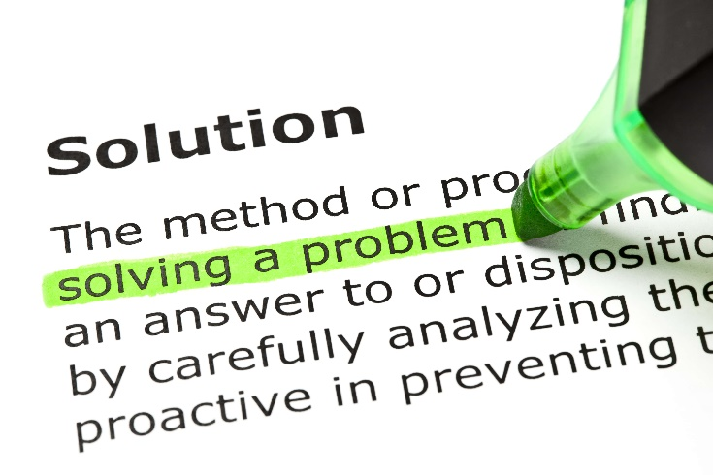
Summarise
Summary = most important facts
No examples, stories or long sentences
Short outline
Underline keywords to use in your own full sentences
Use your own words.

Slide 25
Mind maps
Diagrams that outline the topic
Keyword/phrase in the middle
Other words/phrases radiate from the central point.

Slide 26
Mind maps
Represent ideas
visually to recall
them easily
Show links,
associations and
connections
Aim of
mind maps
Break down
and arrange information
to make more sense to you
See the overall
structure of the way details fit together
Figure 5.11: A mind map showing the aim of mind maps

Slide 27
Comparative tables
Compare similarities & differences at a glance.
First column/row lists items being compared.
Other headings indicate different features.
Refer to Example 5.3 in your Student’s Book.

Slide 28
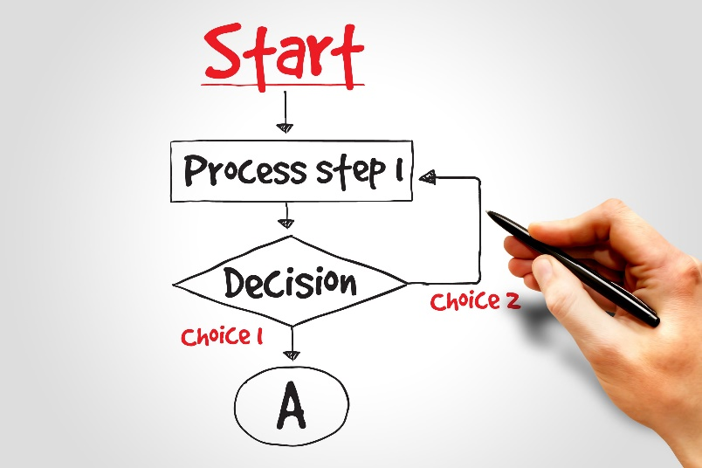
Flowcharts
A diagram to show one or more of the following:
Functions
Sequence
Hierarchy
Causes & effects
Questions & answers
Stages of a process.

Slide 29
Learning activity 5.3
Module 5
Test your knowledge of this section by completing Learning activity 5.3 in your Student’s Book.

Slide 30
Study techniques involving movement and/or sound
Move around while learning
Recite information aloud
Work in silence
Work while listening to music.
Figure 5.17: Most people work and study best when the light is good, the temperature is not too cool or too warm, and there are few distractions

Slide 31
Click above to play this video.

Slide 32
Learning activity 5.4
Module 5
Test your knowledge of this section – and practise different study techniques – by completing Learning activity 5.4 in your Student’s Book.

Slide 33
Academic progress & performance
Unit 5.3

Slide 34
Tracking academic progress
Record all marks & symbols in a table or spreadsheet
You can compare future results
You can convert all ratings to percentages:
You can do more with spreadsheets.

Slide 35
An action plan for your academic performance
Identify steps to reach your goal
Include final date, as well as steps & dates for each goal
See Table 5.5 in your Student’s Book.

Slide 36
Learning activity 5.5
Module 5
Test your knowledge of this unit – and start tracking your academic performance – by completing Learning activity 5.5 in your Student’s Book.

Slide 37
Module 5
Test your knowledge of this module by completing the Summative assessment of Module 5 in your Student’s Book.

