Slide 1
Life Orientation: Life Skills
NQF 3

Slide 2
Explain measures to report corruption in the workplace
Module 12

Slide 3
Think about it…
Are all institutions & organisations vulnerable to corruption? Why?
Why are some people open to corruption, while others resist it?
Does crime ever pay?

Slide 4
Morally acceptable behaviour at work
Unit 12.1

Slide 5
What is moral behaviour?
Based on moral principles
Morals are standards of good & bad behaviour
Not always law, but followed by employers & employees for acceptable business practices.

Slide 6
Morally acceptable & unacceptable behaviour in the workplace
Usually, all involved agree on what is ethical
Moral principles apply to all.
Figure 12.1: Morally acceptable or unacceptable behaviour in a situation rests on a choice guided by your conscience, morals and values, and always has consequences

Slide 7
Morally acceptable & unacceptable behaviour in the workplace
Refer to Table 12.1 in your Student’s Book to see examples of moral principles & morally unacceptable behaviours, as well as work-related examples.

Slide 8
Dealing with negative emotions
Make a decision not to do anything unethical
Take a deep breath, count to 10 &, if necessary, give yourself a day to respond
Practise positive choices & behaviour
Use your actions to show that you are moral.

Slide 9
Learning activity 12.1
Module 12
Test your knowledge of this unit – and assess your moral principles – by completing Learning activity 12.1 in your Student’s Book.

Slide 10
Corruption & economic crimes
Unit 12.2

Slide 11
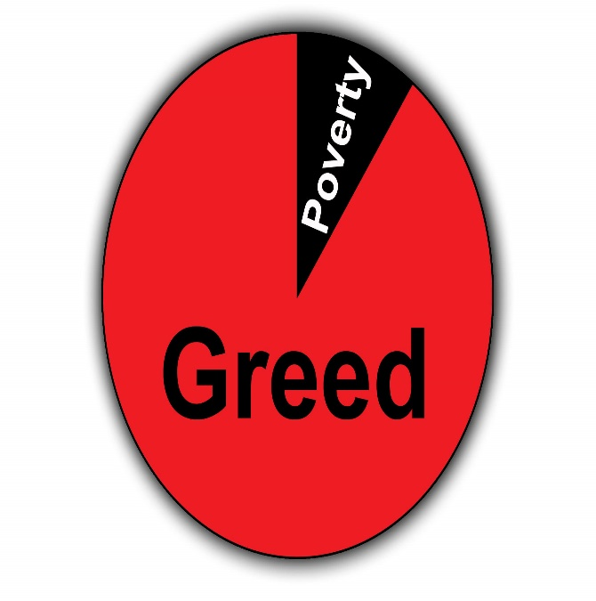
What is corruption?
Dishonest, lawbreaking behaviour
Morally unacceptable
Usually for personal gain.
Figure 12.4: The underlying motive for the majority of corrupt activities is greed – for more money, power or recognition

Slide 12
What is corruption?
Examples of corruption include:
Offering or accepting a bribe
Using your position to influence people to behave immorally
Using work supplies for personal needs
Charging more than an item or service is actually worth
Claiming more overtime than you worked
Pretending to be someone else (identity theft/fraud).

Slide 13
Learning activity 12.2
Module 12
Test your knowledge of this section – and assess your experience of corruption – by completing Learning activity 12.2 in your Student’s Book.

Slide 14
Economic crimes
Type of corruption
All about stealing money in different ways, such as through scams, fraud & rip-offs.

Slide 15
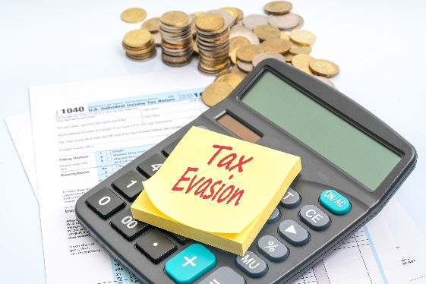
Economic crimes
Examples of economic crimes include:
Using someone else’s ID, credit card or banking details
Not paying back debt
Claiming expenses that you didn’t have
Making false insurance claims
Passing on other people’s personal info
Not paying tax.

Slide 16
Learning activity 12.3
Module 12
Test your knowledge of this section – and assess your experience of economic crimes – by completing Learning activity 12.3 in your Student’s Book.

Slide 17
Corruption & economic crimes in South Africa & the world
Controlling prices of a product
Insider trading (sharing confidential information about stock markets)
Giving loans to people who can’t repay them
Misspending clients’ invested money
Nepotism: favouring friends & family for jobs.

Slide 18
Corruption exists at all levels
At governmental level
At company level
All types of officials can be involved
Refer to Table 12.2 in your Student’s Book for more information.

Slide 19
Learning activity 12.4
Module 12
Test your knowledge of this section – and think of ways to deal with corruption – by completing Learning activity 12.4 in your Student’s Book.

Slide 20
Effects of corruption & economic crimes
Effects on the individual include:
Loss of savings
Higher prices, premiums & taxes
Loss of income & time
Greater danger
Emotional suffering.

Slide 21
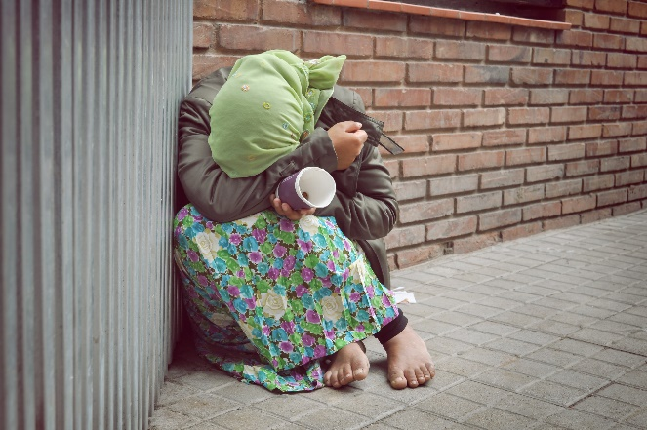
Effects of corruption & economic crimes
Effects on society include:
Resources going to criminals
Damage to reputation
Loss of income & jobs
Loss of morals
Increase in crime & violence
Social development & progress being blocked.

Slide 22
Effects of corruption & economic crimes
Effects on the country include:
Reduced economic, industrial & democratic development
Government less effective
Affects provision of services
Loss of tax income for government means less funding for national budget
More crime, which means more money is needed trying to stop crime.

Slide 23
Click here to play this video.

Slide 24
Learning activity 12.5
Module 12
Test your knowledge of this section – and think of ways to fight corruption – by completing Learning activity 12.5 in your Student’s Book.

Slide 25
Reporting corruption & economic crimes
Unit 12.3

Slide 26
Process of reporting corruption
Anti-Corruption Task Team (ACTT) = interdepartmental team working on big corruption cases with the:
National Prosecuting Authority (NPA)
Special Investigating Unit (SIU)
Hawks (Directorate for Priority Crime Investigation).

Slide 27
Process of reporting corruption
Special Anti-Corruption Unit investigates cases against senior public servants
Public Protector handles cases (not criminal) against government departments or officials
South African Police Service (SAPS) handles criminal cases of corruption.

Slide 28
Process of reporting corruption
Independent Police Investigations Directorate: report misconduct by police
Government department hotlines: report corrupt officials
South African Revenue Service (SARS): report tax evasion & ID theft
Corruption Watch: report any corruption.

Slide 29
Pros & cons of reporting corruption
Pros:
Exposes information
Gets results
Promotes a united attempt
Allows money to be used effectively
Sets a good example
Improves rules & legislation.

Slide 30
Pros & cons of reporting corruption
Cons:
Some people fear losing their jobs
Some don’t feel brave enough or think they won’t be believed
Some fear revenge
Some people think they don’t have enough evidence.

Slide 31
Click here to play this video.

Slide 32
Learning activity 12.6
Module 12
Test your knowledge of this section by completing Learning activity 12.6 in your Student’s Book.

Slide 33
Module 12
Test your knowledge of this module by completing the Summative assessment of Module 12 in your Student’s Book.

