Slide 1
Life Orientation: Life Skills
NQF 3

Slide 2
Identify ways to oppose human rights violations & abuse in terms of the Constitution & Bill of Rights
Module 11

Slide 3
Think about it…
Where do children first learn tolerance & respect for other cultures?
What are the dangers of persistent negativity to people’s human rights?
What can be done against human rights violations?

Slide 4
Diversity, culture & the workplace
Unit 11.1

Slide 5
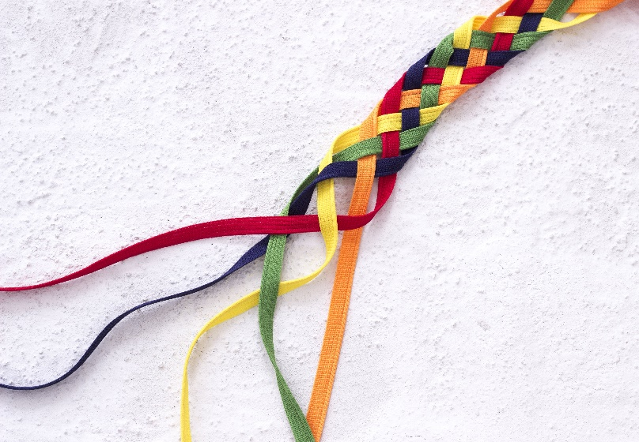
Diversity & culture
Diversity = variety; difference.
Culture = way of life of a particular group, including values, customs, beliefs, practices.
Figure 11.1: A society that embraces its diverse elements is stronger

Slide 6
National coat of arms
Several symbols represent South Africa and its people:
The protea = national flower represents SA as a flowering nation
The motto = Khoisan for “diverse people unite”.
Figure 11.2: The South African
national coat of arms,
with the king protea
under the secretary bird

Slide 7
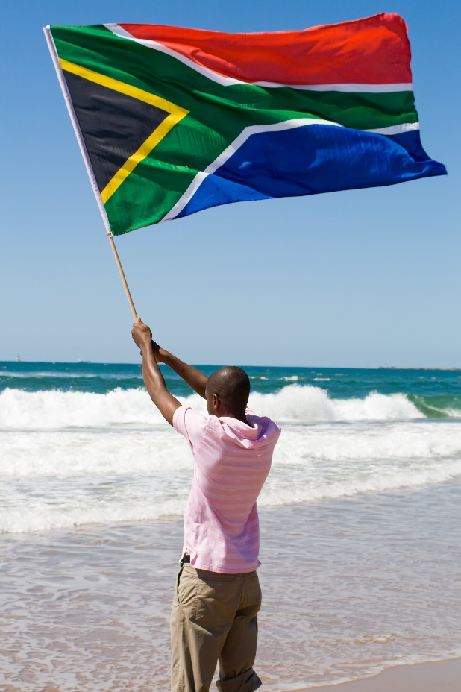
National flag
Six colours
V-shape said to represent diverse elements uniting.
Figure 11.3: The new South African flag was first flown on 27 April 1994, the day of
South Africa’s first democratic elections

Slide 8
Constitution
Highest law in the land
Drawn up in 1996
Made law on 4 February 1997
Constitution = set of written principles & laws
Bill of Rights = Chapter 2 of Constitution, protects human rights.

Slide 9
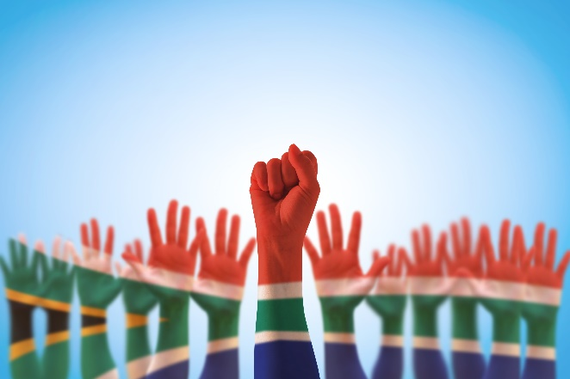
National charters
Charter = a written statement of the rights of a specified group of people
Examples include:
Freedom Charter, 26 June 1955
South African Charter of Religious Rights and Freedoms, 14 February 2008.

Slide 10
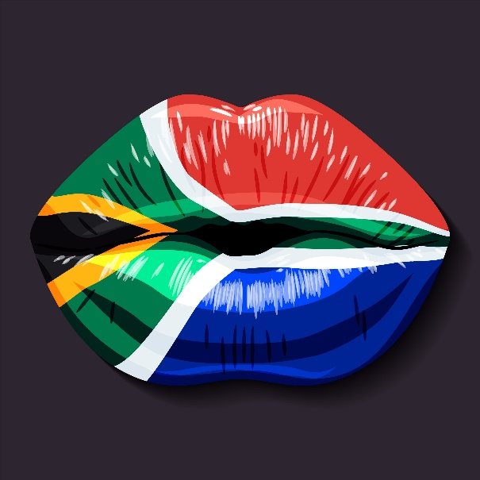
Examples of diversity & culture
Section 9 of Constitution deals with equality & forbids unfair discrimination.
An example of diversity includes linguistic diversity (11 official languages).

Slide 11
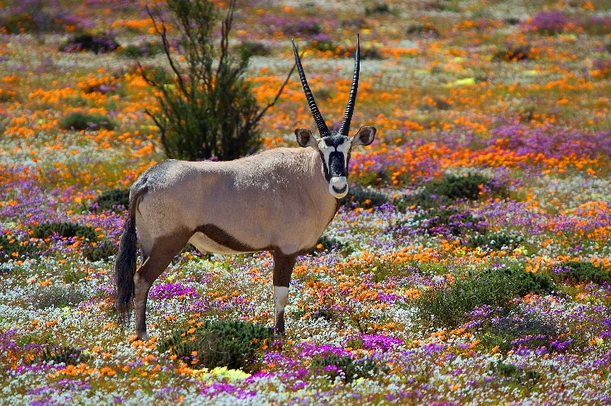
Examples of diversity & culture
Other examples of diversity include:
Occupational diversity (free to choose career)
Political diversity (free to choose political party & vote in secret)
Religious & cultural diversity
Natural diversity (Constitution protects the environment).

Slide 12
Learning activity 11.1
Module 11
Test your knowledge of this unit by completing Learning activity 11.1 in your Student’s Book.

Slide 13
Diversity in the workplace
Workplace made up of people from different backgrounds
People bring different experiences & approaches.

Slide 14
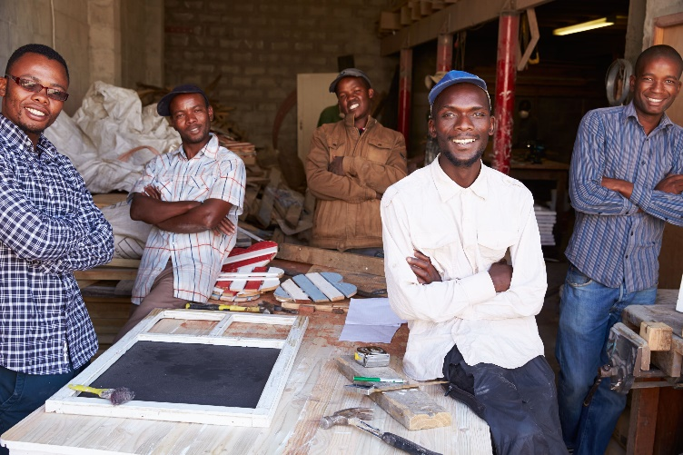
Benefits of respecting diversity at work
Each person brings different qualities
Different personalities & outlooks make teams more balanced
Different opinions allow for careful decision-making
Policies allow for differences.

Slide 15
Benefits of respecting diversity at work
Different problem-solving methods
Awareness of different values
Need to accept different cultures in global environment
Language skills increased by diverse staff.

Slide 16
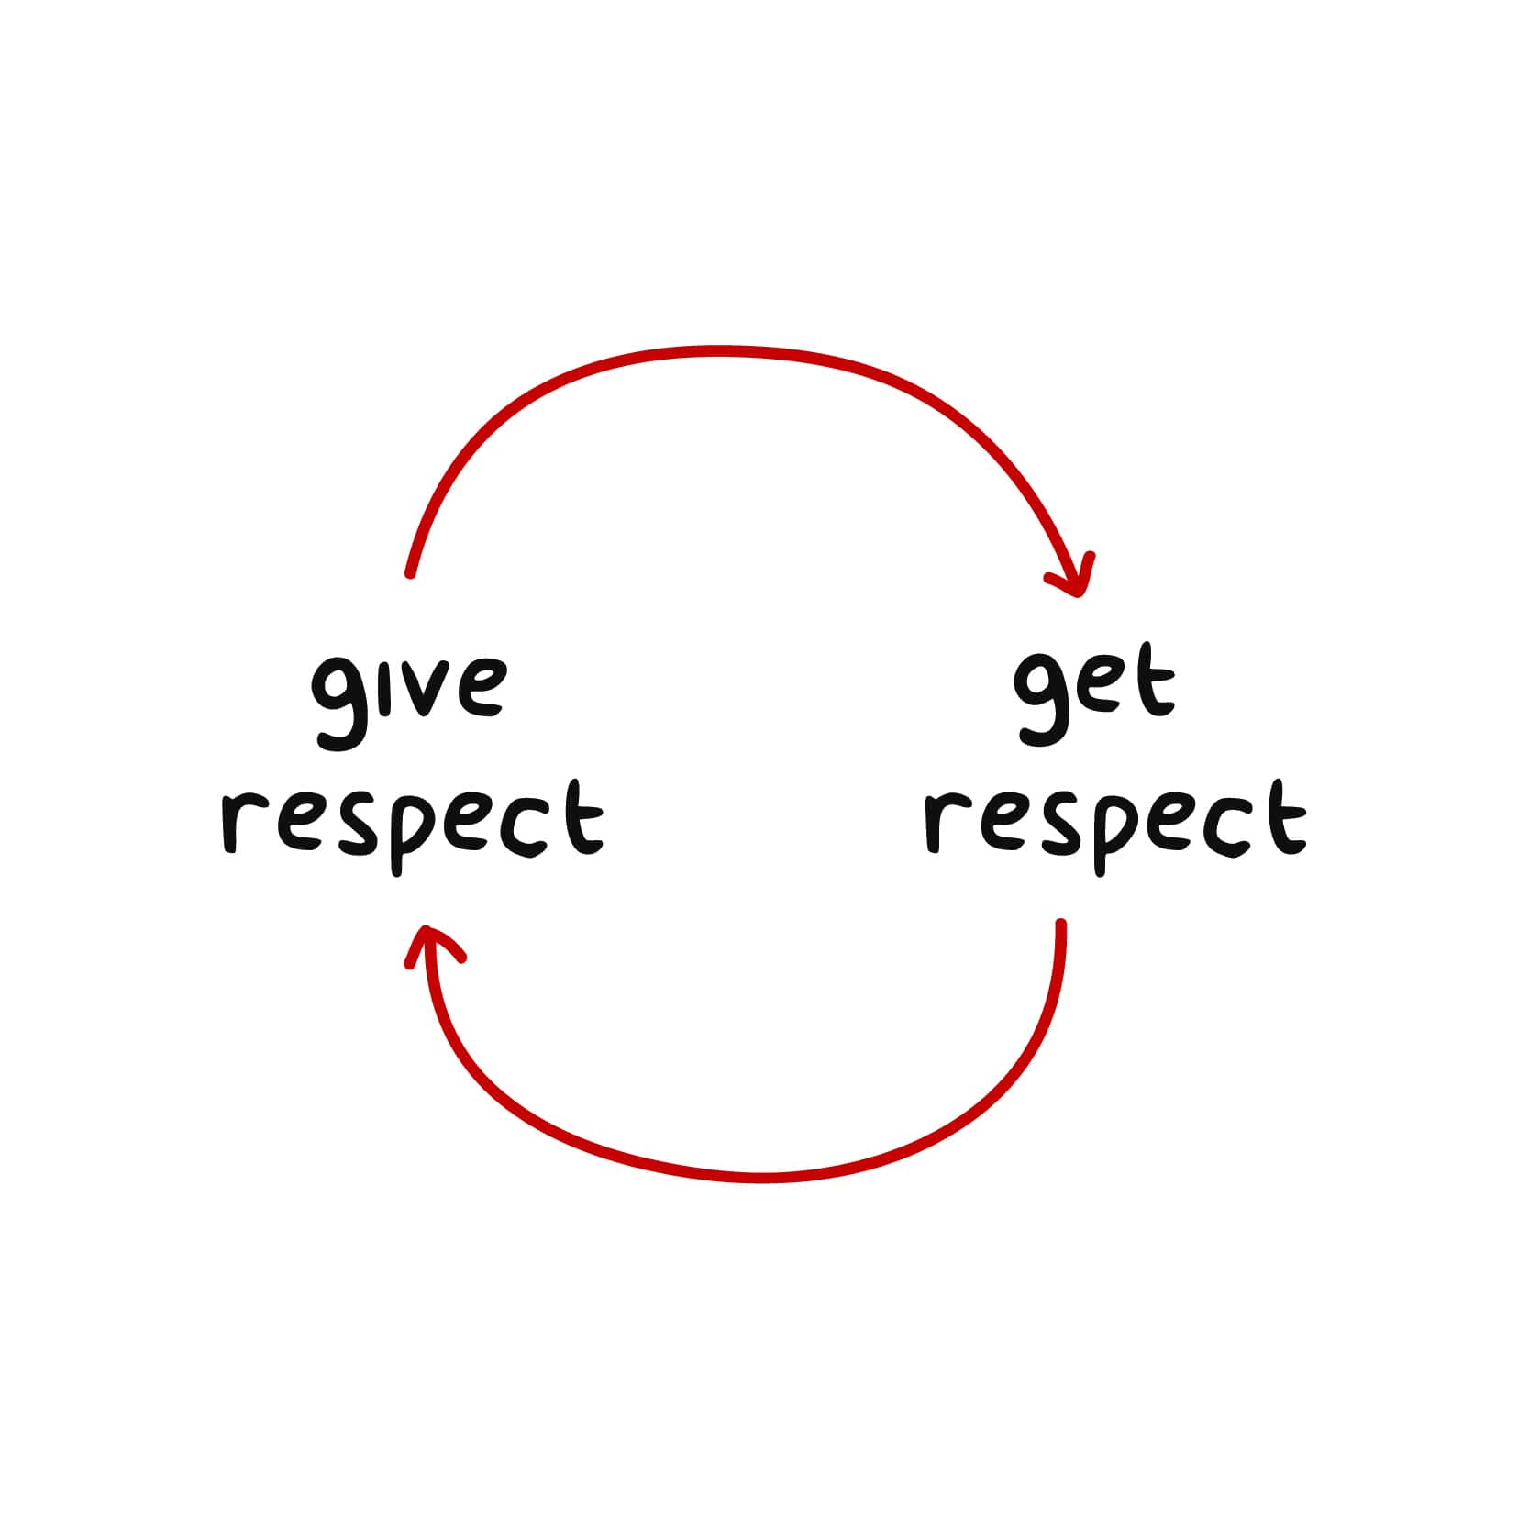
Showing respect in the workplace
Show respect for others’:
Health & wellbeing
Way of life
Possessions
Reputation
Personal style
Values
Time
Family life & personal relationships

Slide 17
Showing respect in the workplace
Refer to Table 11.1 in your Student’s Book for more on showing respect in the workplace.

Slide 18
Click above to play this video.

Slide 19
Learning activity 11.2
Module 11
Test your knowledge of this section – and relook at your code of work ethics and productivity – by completing Learning activity 11.2 in your Student’s Book.

Slide 20
Negative cultural concepts
Unit 11.2

Slide 21
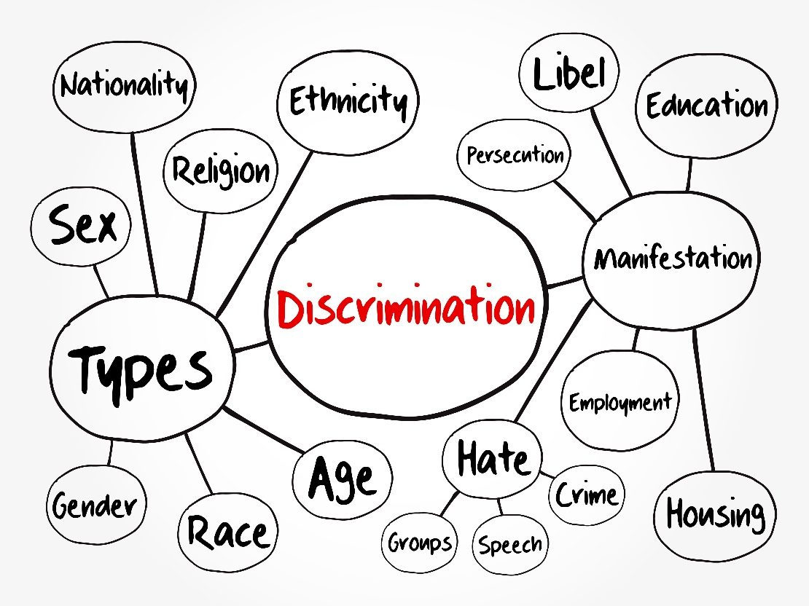
Discrimination
Discrimination = treating different groups of people differently (usually badly)
Section 9 of the Constitution forbids unfair discrimination.

Slide 22
Racism
Racism = discrimination based on race or ethnicity
Shows disrespect for others’ looks, traditions, practices, beliefs, etc.

Slide 23
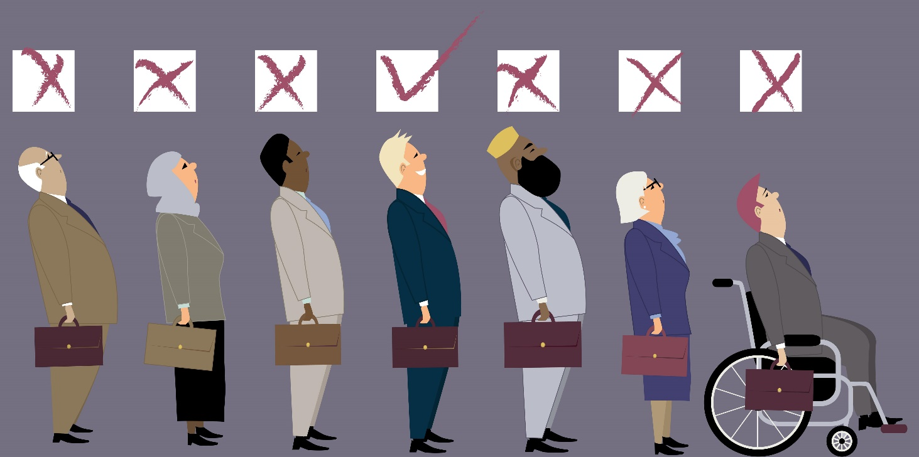
Prejudice
Prejudice = preconceived opinion not based on fact or actual experience.

Slide 24
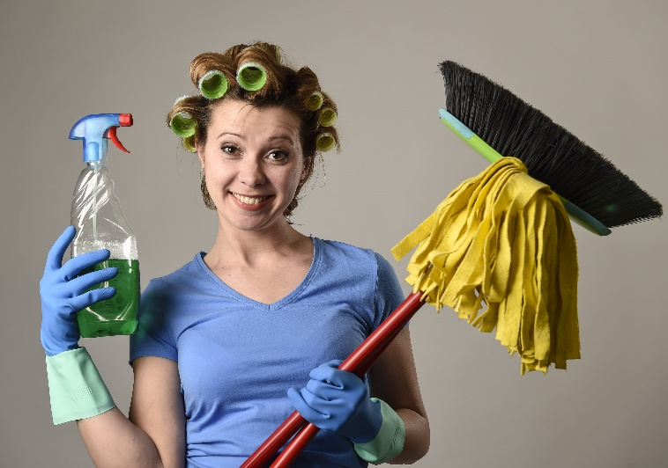
Stereotyping
Stereotyping = negative preconception about a group
Can cause xenophobia (fear or hatred of foreigners)
Need to challenge & dismiss stereotypes.

Slide 25
Click here to play this video.

Slide 26
Learning activity 11.3
Module 11
Test your knowledge of this unit – and think about how you can avoid negative cultural concepts – by completing Learning activity 11.3 in your Student’s Book.

Slide 27
Human rights violations
Unit 11.3

Slide 28
What are human rights violations?
Violate = break or harm
Usually involves disrespect, disobedience and/or force
Can happen when:
People are prevented from doing what they are legally entitled to
Breaking agreements to protect rights
Abusing rights (abuse = cruel treatment).

Slide 29
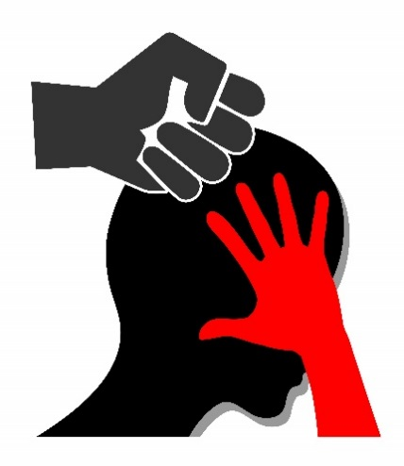
Violation: Gender abuse
Mistreatment or violence against someone who:
Is male or female
Identifies as being male or female
Prohibited by section 9 of Constitution
Gender-based violence = physical, sexual and/or psychological harm
See Table 11.2 in your Student’s Book for more information.

Slide 30
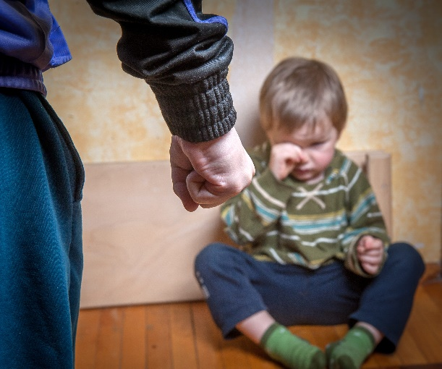
Violation: Child abuse
Child abuse is against the law.
Section 28 of the Constitution prohibits:
Neglect
Bad treatment
Humiliation
Child labour
Physical & sexual abuse
Denial of food, shelter & family care.
See Table 11.3 in your Student’s Book for more information.

Slide 31
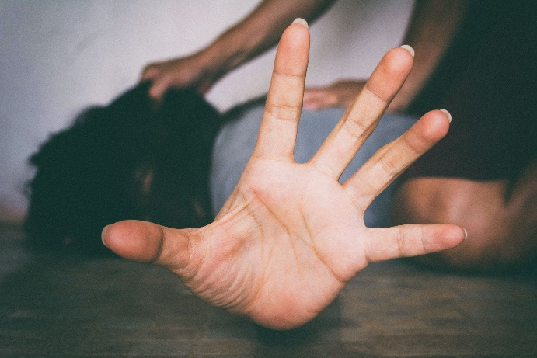
Violation: Human trafficking
Human trafficking = victims captured & taken to a place where they are kept
Victims forced into slavery, prostitution or hard labour
Section 13 of the Constitution outlaws slavery, servitude & forced labour.

Slide 32
Violation: Genocide
Genocide = deliberate, cruel killing of a group of people (e.g. ethnic or political)
Aim is to destroy the group
Motive is intense hatred
Fuelled by propaganda & accusations.

Slide 33
Violation: Genocide
Global examples:
Rwandan genocide of 1994
Holocaust in Nazi Germany & Europe (1933–1945)
Khmer Rouge in Cambodia (1975–1979)
Forbidden by section 16 of the Constitution.

Slide 34
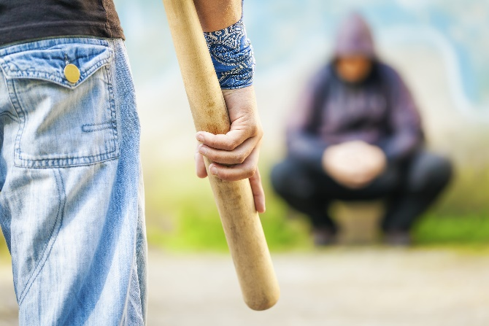
Violation: Xenophobia
Xenophobia = dislike, fear or hatred of foreigners
Foreigners falsely accused by those who are xenophobic
People & their property harmed & even killed in attacks.

Slide 35
Learning activity 11.4
Module 11
Test your knowledge of this section – and think of ways you can prevent human rights violations – by completing Learning activity 11.4 in your Student’s Book.

Slide 36
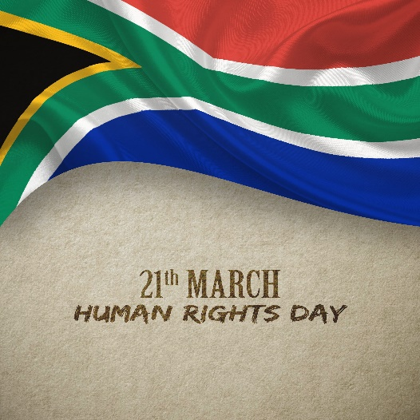
Dealing with human rights violations
Oppose human rights violations by:
Observing national & international days (21 March = SA Human Rights Day)
Participating in campaigns
Reporting violations
Volunteering.
Report human rights violations:
To social workers & police
To organisations & departments.

Slide 37
Finding help & support against human rights violations
International bodies & courts include:
UNICEF (United Nations Children’s Fund)
UNHCR (United Nations High Commissioner for Refugees)
ICC (International Criminal Court)
ACHPR (African Commission on Human & People’s Rights).

Slide 38
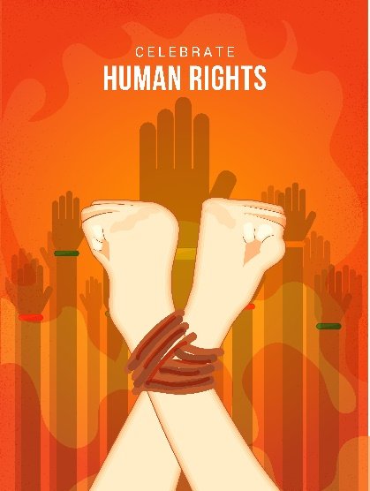
Finding help & support against human rights violations
International organisations include:
Amnesty International, which campaigns to end human rights abuses
Human Rights Watch – an independent organisation that aims to protect human rights.

Slide 39
Finding help & support against human rights violations
National courts & commissions include:
Constitutional Court – highest court in SA
South African Human Rights Commission (SAHRC) supports democracy & protection of human rights
Commission for Gender Equality (CGE) deals with gender-related issues.

Slide 40
Finding help & support against human rights violations
National & regional organisations:
There are many examples throughout SA
Sonke Gender Justice Network & People Opposing Women Abuse (POWA) promote gender equality & oppose gender-based violence
Helplines & helpdesks (refer to Table 11.5 in your Student’s Book).

Slide 41
Click here to play this video.

Slide 42
Learning activity 11.5
Module 11
Test your knowledge of this unit by completing Learning activity 11.5 in your Student’s Book.

Slide 43
Module 11
Test your knowledge of this module by completing the Summative assessment of Module 11 in your Student’s Book.

