Slide 1
Life Orientation: Life Skills
NQF 3

Slide 2
Explain water safety measures
Module 10

Slide 3
Think about it…
Can alcohol abuse also lead to water accidents?
What are the dangers of near-drowning?
With regard to water, are there new accidents or only new victims?

Slide 4
Water – risk situations & safety measures
Unit 10.1

Slide 5
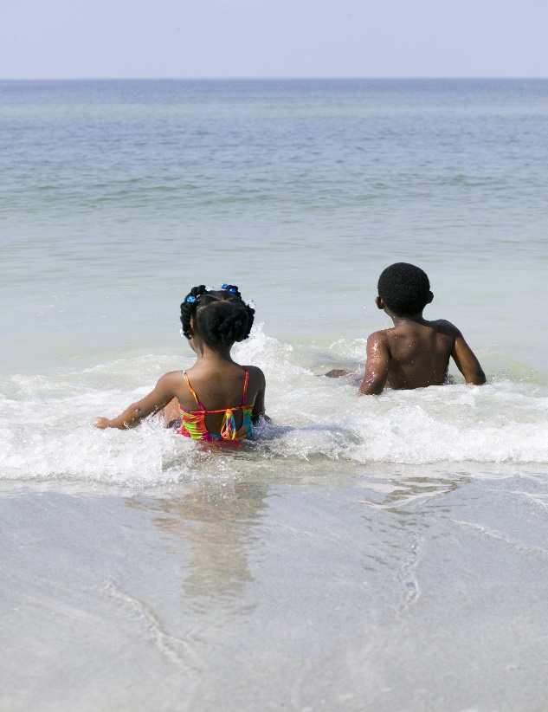
What is a water risk?
Risk = danger of being harmed or injured
Being in or near water always has risks.
Figure 10.1: Not only children, but also hundreds of adults are injured or die every year in water-related incidents

Slide 6
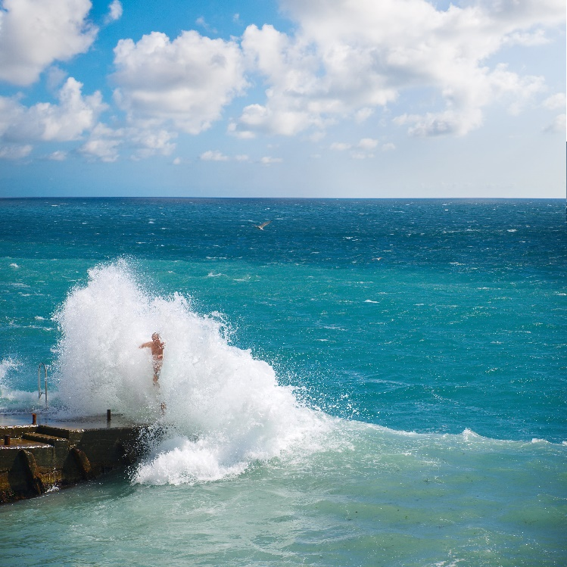
Potential risk situations near or in water
You could be at risk:
On your own, in a group or near others
Near water
In water
In a vessel
Moving across water.
Figure 10.2: Freak waves can sweep people off piers and rocks

Slide 7
Example of water risk: Contaminated water
Unsafe to drink, wash or swim in
Can cause disease (e.g. bilharzia) or death
Chemicals (e.g. pool acid or industrial waste) cause chemical contamination, & can burn skin & poison water.

Slide 8
Example of water risk: Drowning
Drowning = death from breathing in water & not being able to absorb oxygen.
Near-drowning = surviving drowning, but may have lasting damage.
Secondary drowning = water in lungs causes complications & death (even days after the incident).
Refer to Table 10.1 in your Student’s Book for more information.

Slide 9
Example of water risk: Drowning
People most at risk of drowning:
Can’t swim or are unfit
Under influence of alcohol
Have a medical condition
Lose consciousness after knocking their head/neck
Have an accident in or near water.

Slide 10
Example of water risk: Health factors
People who are unfit, weak or tired
People with medical conditions (e.g. asthma, heart disease, epilepsy)
People who get cramps (making them unable to swim).

Slide 11
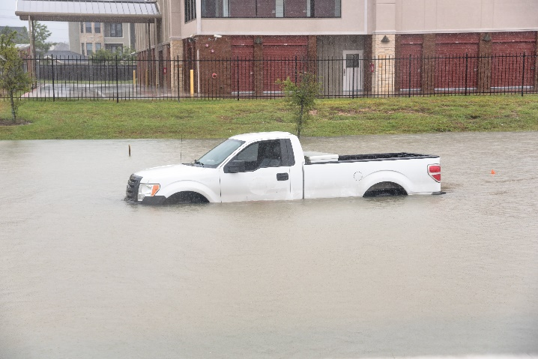
Example of water risk: Carelessness or misfortune
People may ignore safety regulations.
People may behave carelessly.
An unexpected disaster may occur.

Slide 12
Learning activity 10.1
Module 10
Test your knowledge of this section by completing Learning activity 10.1 in your Student’s Book.

Slide 13
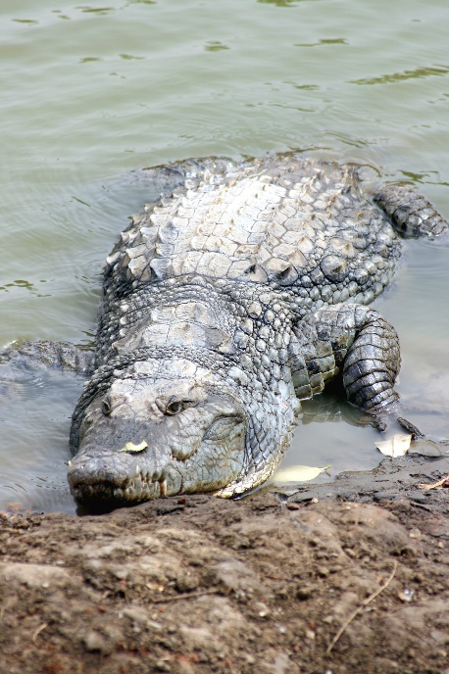
Example of water risk: Natural environment
Dangerous animals:
In fresh water, e.g. crocodiles & hippos
In sea water, e.g. jellyfish & stingrays
Near water, e.g. lions or leopards.
Inhaling water
Corals & rocks.
Figure 10.6: Crocodiles in rivers and dams may also cause drowning as they drag their live victims under the water

Slide 14
Example of water risk: Hypothermia
People may get too cold in water or in wind after getting out of the water.
Body’s core temperature drops.
Causes shivering & restricted blood flow which can lead to passing out & even death.

Slide 15
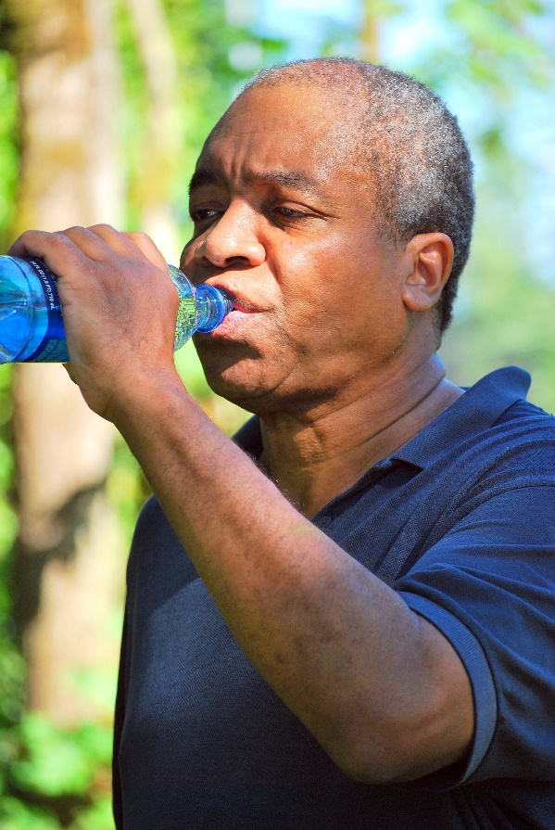
Example of water risk: Dehydration
People stranded in water may not have fresh water to drink & may be exposed to the sun for a long time.
People may over-hydrate by swallowing too much water when trying to stay afloat or get out of the water.

Slide 16
Click here to play this video.

Slide 17
Learning activity 10.2
Module 10
Test your knowledge of this section by completing Learning activity 10.2 in your Student’s Book.

Slide 18
What are safety measures?
Safety measures = rules, regulations & common sense to prevent injury or death
Refer to Example 10.1 in your Student’s Book for more information.

Slide 19
Learning activity 10.3
Module 10
Test your knowledge of this section by completing Learning activity 10.3 in your Student’s Book.

Slide 20
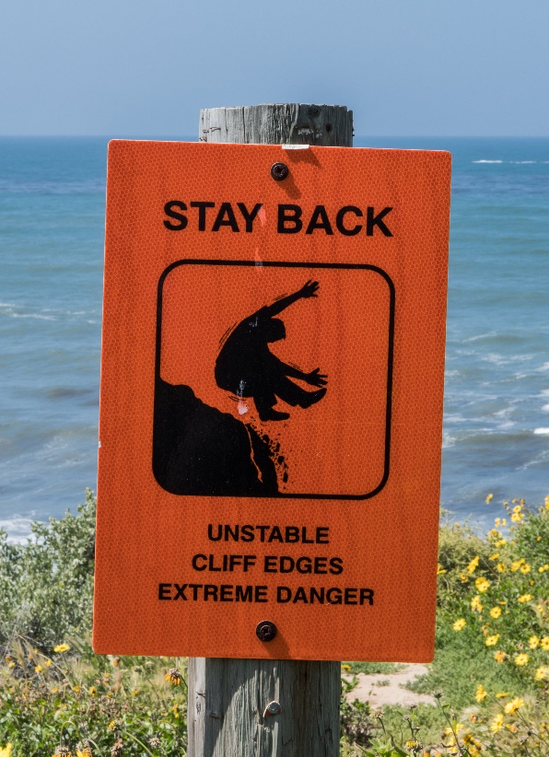
Safety measures to avoid accidents in or near water
Take along clothing & gear
Keep safe company
Observe rules & warnings
Use watercraft correctly
Respect nature
Use pools safely.

Slide 21
Click here to play this video.

Slide 22
Learning activity 10.4
Module 10
Test your knowledge of this unit by completing Learning activity 10.4 in your Student’s Book.

Slide 23
Basic first-aid skills
Unit 10.2

Slide 24
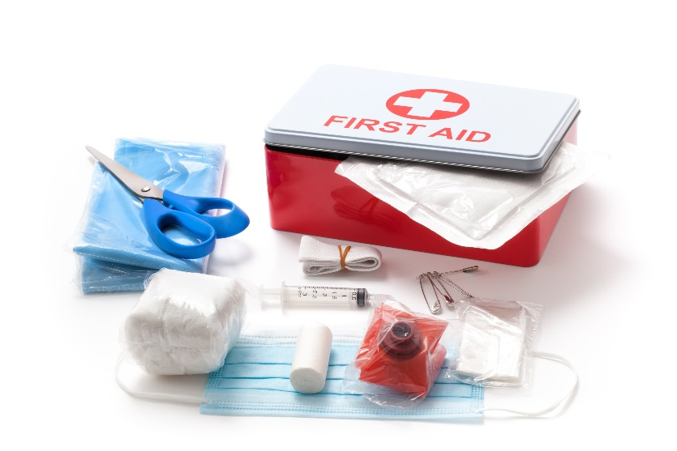
What is first aid?
First aid = first assistance/care for an ill/injured person until professional medical treatment is given
Aim of first aid = to stabilise victims
Focus on breathing, heartbeat & blood before other injuries.

Slide 25
First aid for water accidents
Focus on ABC of first aid:
Airway
Breathing
Circulation
Need oxygen for body to function & to prevent permanent brain damage.
May need to do different parts of first aid at once.

Slide 26
A = clear the Airway
Airway = nose, mouth, throat & lungs
Clear:
Object stuck in throat
Water, vomit or chemicals inhaled.
Note: Choking occurs when something (food, water or a small item) is inhaled accidentally.
See Box 10.1 in your Student’s Book for more information about dealing with choking.

Slide 27
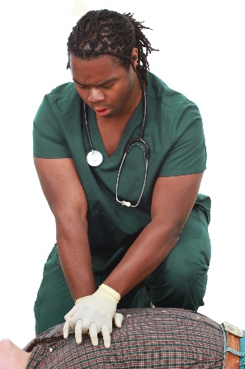
B = get the Breathing going
Unconscious = no response to talking, pain or the situation
If there is no pulse or heartbeat, need to start CPR
CPR = cardiopulmonary resuscitation; getting oxygen to the heart (“cardio”) & lungs (“pulmonary”).

Slide 28
How to give CPR
Turn patient onto their back
Check that the airway is clear
Place heel of your hand on top of your other hand
Adults & older children: 30 compressions (presses) on chest (between nipples)
Young children: press to a depth of 4 cm only
Babies: press with two fingers only

Slide 29
How to give CPR
Gently tilt victim’s head back & pinch nose shut
Completely cover the victim’s mouth with yours (or with a special inflatable device)
Blow hard enough for their chest to rise (only a small breath for a baby)
Give another two blows.

Slide 30
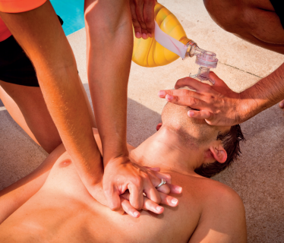
How to give CPR
Continue to give 30 compressions & two deep breaths until help arrives
Don’t give up! If necessary, swap with someone or ask them to help.
Figure 10.17: The rescuer on the left is performing chest compressions, while the one on the right is holding the victim’s head back and administering air

Slide 31
C = restore the Circulation
Cover the patient with a blanket, dry towel or jacket to warm them
Don’t give the patient anything to eat or drink
Try to stop any bleeding, but don’t touch blood.

Slide 32
Recovery position
Note: don’t move the patient if they have a back/neck injury
Once the patient is breathing & has a pulse, they need to be in recovery position
Recovery position prevents choking & makes breathing easier
Refer to Box 10.4 in your Student’s Book for guidelines on the recovery position.

Slide 33
Click here to play this video.

Slide 34
Learning activity 10.5
Module 10
Test your knowledge of this unit – and think about your own safety – by completing Learning activity 10.5 in your Student’s Book.

Slide 35
Module 10
Test your knowledge of this module by completing the Summative assessment of Module 10 in your Student’s Book.

Slide 36
Portfolio task 3
Module 10
Complete Portfolio task 3 in your Student’s Book. This is a formal practical assignment.

