Slide 1
Life Orientation: Life Skills
NQF 2

Slide 2
Describe human sexuality within relationships
Module 9

Slide 3
Think about it…
In what ways do men & women differ biologically?
Do men & woman have different responsibilities?
Which kinds of situations can get me into trouble?

Slide 4
Biological differences between males & females
Unit 9.1

Slide 5
What is biology?
The study of living organisms
Physiology = study of the functions of living organisms, their body parts & organs
Males & females differ biologically.

Slide 6
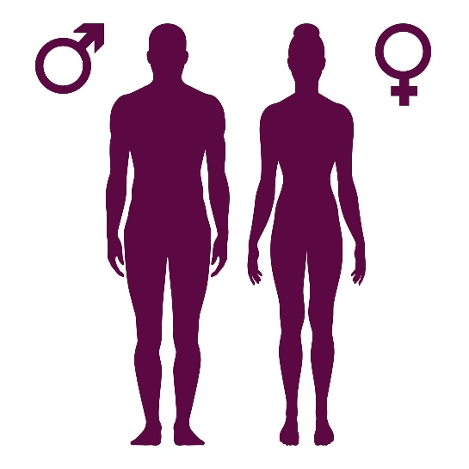
Differences between males & females
Males have the ability to inseminate.
Females can produce egg cells, bear offspring & produce breastmilk.
Males & females have other physiological differences.

Slide 7
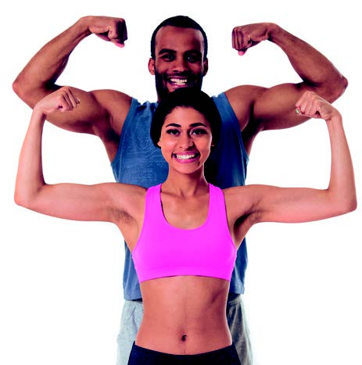
Locomotor differences
Locomotor system = parts of your body that make you move
On average, females have wider hips but smaller waists.
Figure 9.2: Men generally have stronger muscles, wrists, elbows and chests

Slide 8
Integumentary differences
Integumentary system = skin, hair & nails
Men have thicker facial hair & more hair on their bodies
Women are less likely to go bald
Male skin is thicker, and female skin more sensitive to pain.

Slide 9
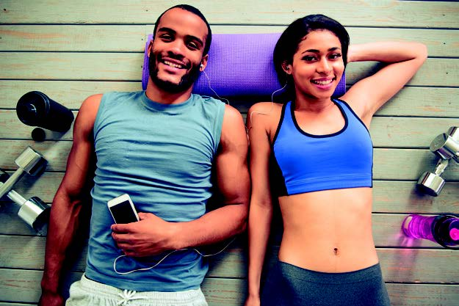
Respiratory & circulatory differences
Respiratory system = for breathing
Circulatory system = flow of blood through the body
Men have larger chests
Figure 9.3: Men’s larger chests give them a greater lung volume and therefore more oxygen in their blood

Slide 10
Respiratory & circulatory differences
Men have larger hearts = more oxygen.
Men heal faster (more red blood cells).
Women recover faster from illness (more white blood cells).
Women’s hearts beat faster.
Men have more serotonin (a good mood neurotransmitter).

Slide 11
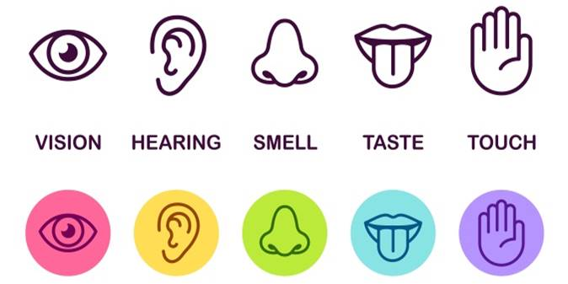
Brain & sensory differences
Sensory system = different senses.
On average, females have better hearing & sense of smell.
Females are more sensitive to touch.
Males usually have better eyesight.

Slide 12
Brain & sensory differences
Males have larger brains, but this doesn’t influence intelligence.
Females have more neurons in areas associated with language & speech.
Males have a larger amygdala (respond better to stress).
Females have a larger hippocampus (better memory).

Slide 13
Endocrine differences
Endocrine system = glands that produce different hormones
Table 9.1: Male and female hormonal development
Men | Women
Males have higher levels of testosterone & other androgens but small amounts of oestrogen. | Females have less androgens such as testosterone, but much more oestrogen & other female hormones.
Testosterone & other androgens are responsible for the development of an unborn male baby’s external sex organs. | Oestrogen & other female hormones are responsible for female characteristics.

Slide 14
Endocrine differences
Table 9.1: Male and female hormonal development
Men | Women
Later, these hormones cause secondary physical characteristics, such as: • Increased muscles & strength. • Deeper voice. • Heavier bones. • Facial hair & thicker skin. • Broadening of the shoulders & chest. • Larger hands & feet. • Taller stature. | Female characteristics include the following, which are all necessary for reproduction: • Development of breasts. • Increased body fat in the hips & thighs. • Increased body fat in the breasts & buttocks. • Wider hips (pelvis). • Menstrual cycle.

Slide 15
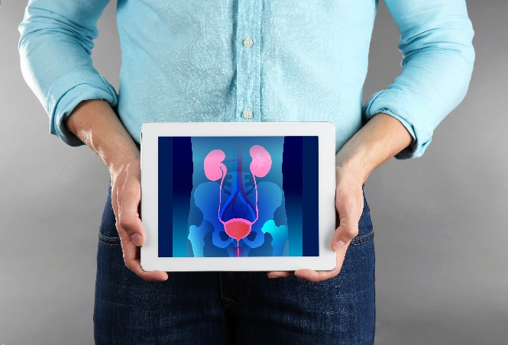
Reproductive & urinary differences
Reproductive system = ability to make a baby
Male sex organs external, female sex organs internal
Urinary system = part of waste elimination.

Slide 16
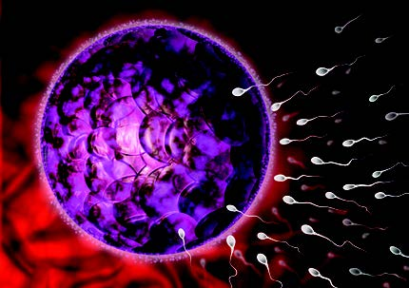
Reproductive & urinary differences
A male’s testes produce billions of sperm, while a female’s ovaries release one ovum (egg) per month.
The penis is also part of the urinary system.
Figure 9.6: Only one male sperm will be able to fuse with the female egg cell

Slide 17
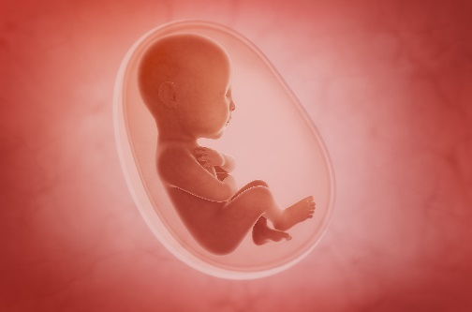
Reproductive & urinary differences
Females have a womb (uterus) to carry a child from conception to birth.
Females have monthly menstrual cycles.
Their fertility ends after menopause (menstrual cycle stops).
Male fertility continues into old age.

Slide 18
Learning activity 9.1
Module 9
Test your knowledge of this unit by completing Learning activity 9.1 in your Student’s Book.

Slide 19
Gender roles, responsibilities & behaviour
Unit 9.2

Slide 20
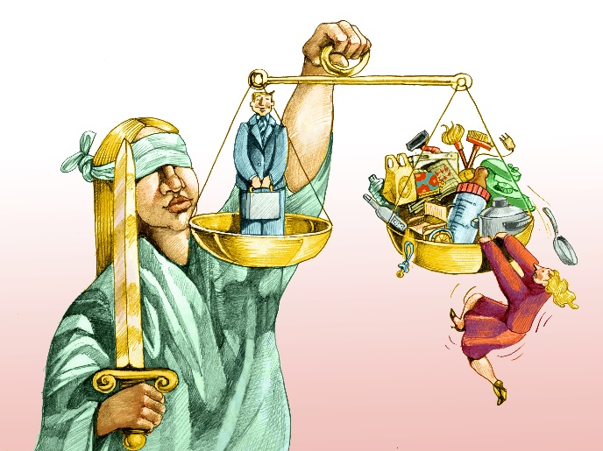
What is gender?
Masculine or feminine roles, behaviours or activities.
Societies dictate gender roles.
Gender roles vary across different cultures & places & over time.

Slide 21
Roles, responsibilities & behaviours
Biological & physical differences give males & females different strengths.
This influences different relationships.

Slide 22
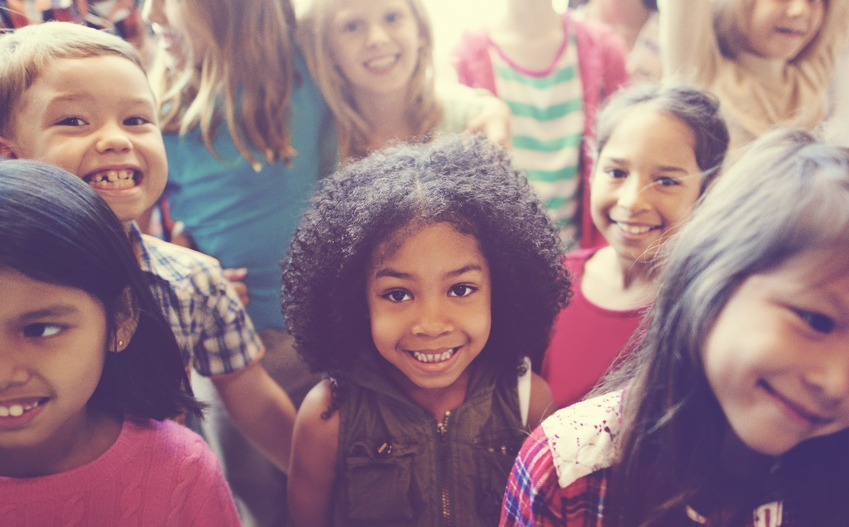
Personal relationships
Gender roles are learnt from parents, family units, friends, religion & education.
This influences different relationships.

Slide 23
Personal relationships
Females often take on the role of nurturing.
Males often take on protective roles.
Healthy & stable home life teaches children to socialise & be responsible.

Slide 24
Dominant needs in relationships
Table 9.3: General difference in dominant needs between men and women
Men | Women
Value being respected for their abilities & good judgement more | Value emotional security, affection, support & closeness in personal relationships more
Form bonds better by sharing goals & activities, rather than by talking about things | Use communication, responsiveness & expressiveness more openly
Are more competitive & driven not to appear weak | Are more sensitive to body language & people’s motives
Prefer to try something new, or to find their way, independently | Prefer asking for help or advice in a group context
Value their roles as providers & protectors | Value stability in the home & environment for their tasks of caring & nurturing

Slide 25
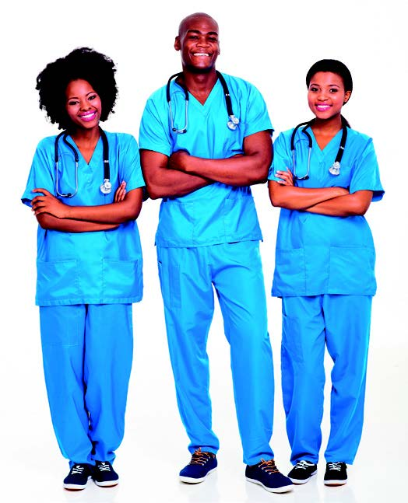
Work relationships
Stereotypes may dictate different roles for women & men.
However, changes in industrialisation, the World Wars, education & laws mean that men & women can pursue any career.
Figure 9.11: We live in an age where it is acceptable for men and women to follow the same career goals

Slide 26
Civil rights
Examples of women’s rights:
Equal education
Equal pay for jobs
Protection of the body.
Examples of men’s rights:
Rights which highlight that men are also harassed, abused & raped
Equal parental rights.

Slide 27
Learning activity 9.2
Module 9
Test your knowledge of this unit by completing Learning activity 9.2 in your Student’s Book.

Slide 28
Risky situations, encounters & behaviour
Unit 9.3

Slide 29
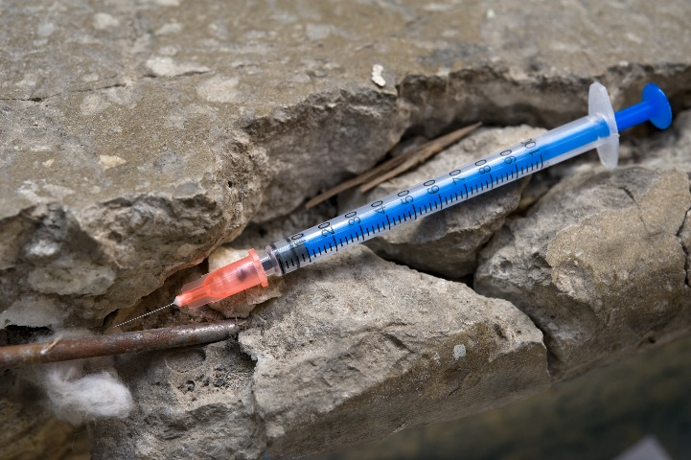
Situations leading to risky sexual behaviours
Encounter = experience unexpectedly
Males & females can be at risk in situations where they are exposed to:
Date rape
Unwanted pregnancy
STIs & HIV & Aids.

Slide 30
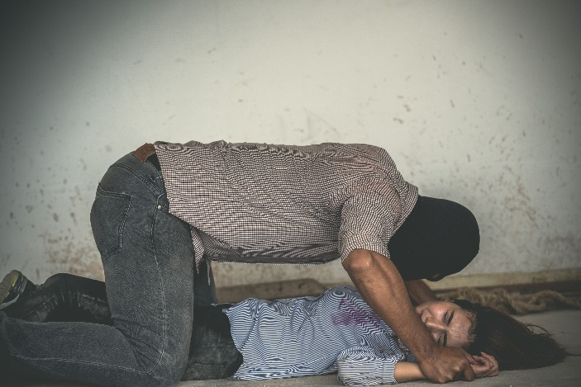
Date rape
Rape = forced sexual intercourse/ penetrative acts
Can happen anywhere, e.g. on a date, at a bar or at a party
The victim may or may not know the rapist(s).

Slide 31
Date rape
Rapist can be male or female, or a group
Rapist may use physical force or drugs
Date rape drugs make the victim weak, pass out or have no memory of the rape.
Figure 9.14: Never accept an open drink or leave your drink unattended, as you could end up having a spiked drink

Slide 32
Click above to play this video.

Slide 33
Unwanted pregnancy
One or both partners not ready to become parents
Can happen when:
No/incorrect contraceptive use
Failed contraceptives
Lack of sexual education
Ensure that you are in control of your body & plan your pregnancy.

Slide 34
STIs & HIV & Aids
STI = sexually transmitted infection
Need to be treated by a doctor
Can contract through:
Sexual intercourse
Contact with sore/infected area
Contact with infected bodily fluids.

Slide 35
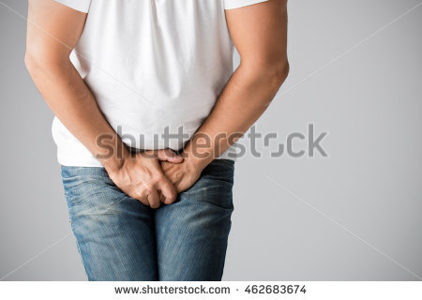
STIs & HIV & Aids can cause:
Sores & painful body parts
Damage to urinary system, throat & cervix
Problems in pregnancy
Certain cancers
Infertility
Or death.

Slide 36
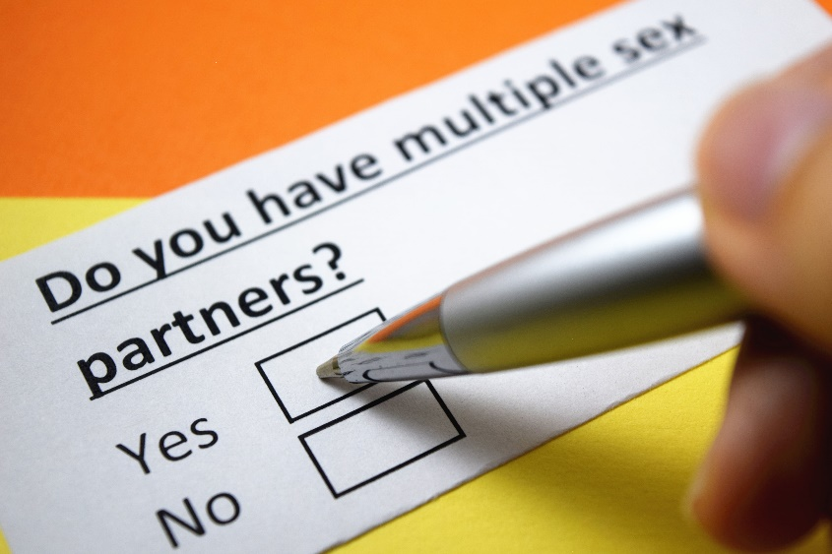
Risky situations include:
Intimate contact with infected person
Sex with infected person
More than one sexual partner
Sexual activity from a young age.

Slide 37
Avoiding risky situations
Don’t go out alone
Avoid alcohol & drugs
Communicate well & resist peer pressure
Prevent getting an STI or HIV
Learn self-defence methods.

Slide 38
Click above to play this video.

Slide 39
Sexuality & relationships
Respect others’ bodies
Respect your bodily systems
Respect family units
Keep your values
Keep your word
Respect your virginity
Respect your self-esteem.

Slide 40
Learning activity 9.3
Module 9
Test your knowledge of this unit – and assess your values – by completing Learning activity 9.3 in your Student’s Book.

Slide 41
Module 9
Test your knowledge of this module by completing the Summative assessment of Module 9 in your Student’s Book.

