Slide 1
Life Orientation: Life Skills
NQF 2

Slide 2
Describe a balanced lifestyle
Module 7

Slide 3
Think about it…
What is the single most important thing we need to get in our bodies?
Why do we often not make the time to exercise?
How can you change your nutritional habits for the better?

Slide 4
A balanced lifestyle
Unit 7.1

Slide 5
What is your lifestyle?
The way in which you live.
Your lifestyle changes over time as you change.
My interests
My activities
My habits & style of everyday living
What makes up my lifestyle?
My values & moral standards
My worldview and beliefs
My thoughts and words
Figure 7.1: Your lifestyle is made up of different components

Slide 6
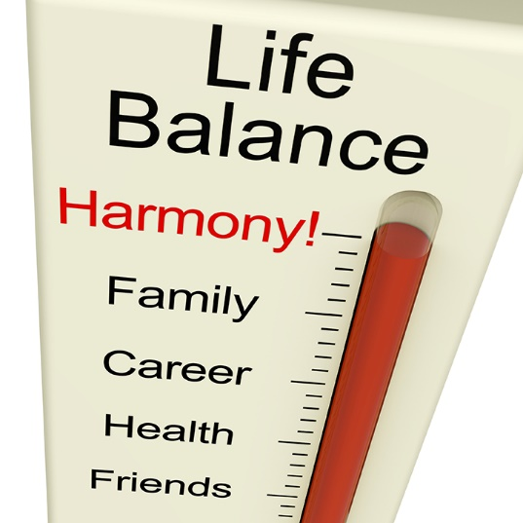
Habits for a balanced lifestyle
You need a balanced physical & emotional life.
Try not to focus too much on one aspect of your life so that other aspects suffer.

Slide 7
For a balanced life:
Follow a healthy diet.
Avoid stimulants (legal, prescribed & illegal chemicals that raise your physical activity temporarily)*.
*See Table 7.1 in your Student’s Book for more on why people take stimulants.
Figure 7.3: Caffeine in coffee & tea is not just a stimulant: it is also a diuretic, which means that it removes water from your body

Slide 8
For a balanced life:
Make healthy choices about:
Hydration
Detoxification
Pollution
Stress relief
Entertainment
Finances
Work.
Refer to Table 7.2 in your Student’s Book for more information.

Slide 9
For a balanced life:
Exercise regularly:
Regularly = every day, or at least four times a week.
Can be sports, gym, walking, running, cycling, housework, or gardening.
Exercise should speed up your heart rate.
Sessions should last about 20-40 mins.

Slide 10
Click above to play this video.

Slide 11
Learning activity 7.1
Module 7
Test your knowledge of this unit – and assess your lifestyle choices –
by completing Learning activity 7.1 in your Student’s Book.

Slide 12
Benefits of regular exercise
Table 7.3: Some of the benefits of exercising regularly
Systems | Descriptions
Mind & mood | Exercise sharpens the mind, senses, body systems & improves your mood.
Blood circulation | Exercise improves the blood circulation & eventually enlarges the arteries of the heart, which further increases blood flow. The heart then needs to beat fewer times (the heart rate slows down) & can take up more oxygen.
Lungs | Lung capacity is improved, which also means that more oxygen is available to the blood.
Bones & muscles | Exercise prevents the loss of bone & muscle mass, & strengthens the skeletal & muscular systems. Bone density is also actively improved.

Slide 13
Benefits of regular exercise
Table 7.3: Some of the benefits of exercising regularly
Systems | Descriptions
Immune system | The immune system is strengthened. The lymphatic system is kept in motion by muscle activity & is therefore better able to remove waste from the cells, & to kill bacteria & viruses in the lymph nodes.
Perspiration | You also sweat more when exercising, which helps remove waste products through the skin.
Elimination | Exercise helps prevent constipation, in that your body gets rid of waste matter sooner, & digestion is improved.
Anti-ageing | Antioxidants, which slow the ageing process, are released during exercise.

Slide 14
Benefits of regular exercise
Table 7.3: Some of the benefits of exercising regularly
Systems | Descriptions
Metabolic rate | Exercise also increases your energy levels & metabolic rate, so that you burn more calories & are less hungry.
Brain | The production of neurotransmitters is enhanced & the levels of the stress hormone cortisol are lowered. This improves memory retention & reaction time, because the brain is better able to take up glucose.
Sleep | Although you should preferably not exercise two to three hours before bedtime, exercise during the day will help you sleep better.
Depression | Aerobic exercise, in particular, reduces depression by stimulating the secretion of serotonin & dopamine levels.

Slide 15
Benefits of regular exercise
Table 7.3: Some of the benefits of exercising regularly
Systems | Descriptions
Pain | Aerobic exercise also lessens chronic pain because it causes the release of feel-good endorphins in your body.
Diseases | Regular physical activity slows down Alzheimer’s disease & may help to prevent Parkinson’s disease. It also prevents certain cancers linked to an inactive lifestyle & a poor diet.
Diabetes | Exercise may help to prevent diabetes & control blood sugar levels in diabetics, as it allows the muscles to take up more glucose from the blood.

Slide 16
Learning activity 7.2
Module 7
Test your knowledge of this section by completing Learning Activity 7.2 in your Student’s Book.

Slide 17
Fitness levels & a fitness programme
Unit 7.2

Slide 18
Note
Consult a doctor before attempting any exercise programme if you:
Are overweight
Are disabled
Are on medication or
Have a health condition.

Slide 19
Measure & record your fitness
Also called aerobic fitness.
Works your heart & blood vessels – makes your heart beat faster.
Cardiovascular endurance
Includes running, cycling, swimming, aerobic dancing, & rowing.
Figure 7.9: Jogging is a great way to get fit

Slide 20
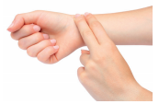
Pulse rate & heart rate
Aerobic exercise increases your heart rate.
Your pulse shows how physically fit you are.
Take your pulse as follows:
Turn one palm up.
Feel the artery in the wrist with two fingers.
Count number of beats in 30 seconds.
× 2 to get pulse rate (beats per minutes or bpm).

Slide 21
Heart rate
Maximum heart rate (MHR)
= 220 - your age
Target heart rate = 70 to 85% of MHR
Table 7.4: Target heart rate zones for certain age groups
Age | Maximum heart rate (MHR) (= 220 - your age) | Estimated target heart rate zone (= 70% to 85% of your MHR)
18 | 202 bpm | 141–172 bpm
21 | 199 bpm | 139–169 bpm
24 | 196 bpm | 137–167 bpm
27 | 193 bpm | 135–164 bpm
30 | 190 bpm | 133–162 bpm

Slide 22
Recording your cardiovascular fitness
Refer to Example 7.3 & Table 7.5 in your Student’s Book to see how to record your cardiovascular fitness.

Slide 23
Maximum volume of oxygen uptake
VO₂ max is the maximum volume of oxygen your body can absorb at maximum exercise.
Formula: VO₂ max = 0,0225 × distance - 11,3
Refer to Example 7.4 in your Student’s Book to calculate your VO₂ max.

Slide 24
Muscle strength
More anaerobic exercise = stronger muscles.
Anaerobic exercise needs glucose
(& not as much oxygen) as aerobic exercise.
Anaerobic exercise includes:
Strength training
Weight lifting
Combination anaerobic & aerobic (e.g. short sprints).

Slide 25
Measuring muscle strength
Refer to Example 7.5 & Table 7.6 in your Student’s Book to see how to measure your muscle strength.

Slide 26
Flexibility
How well you can use your muscles & joints in bending & stretching exercises (suppleness).
You need to warm up & stretch your muscles before exercise.
Measure flexibility by:
Touching your toes
Doing hand-leg slides
Doing feet slides.

Slide 27
Learning activity 7.3
Module 7
Test your knowledge of this section – and measure your own levels of fitness – by completing Learning activity 7.3 in your Student’s Book.

Slide 28
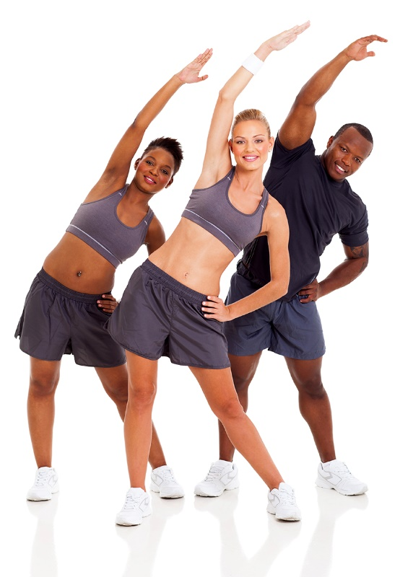
Plan a group fitness programme
A fitness programme improves your health, endurance, strength, flexibility & physical skills.
It is made up of regular sessions of exercise.
It forms part of your Level 2 Life Orientation course.
Figure 7.16: Exercising in a group is very motivating

Slide 29
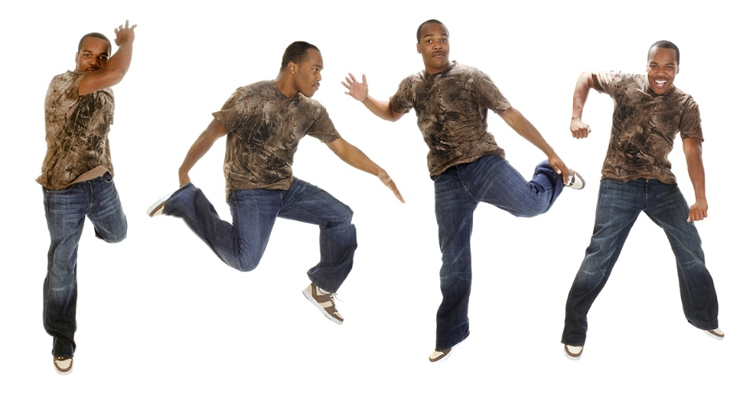
Suitable group exercise activities
Walking briskly
Jogging
Aerobic dancing
Step aerobics
Cardio-kickboxing
Cycling
Swimming
Can you think of others?

Slide 30
Set up an exercise group
Form a group of three to five students.
Plan a six-week programme.
Include an increase in intensity.
Start the programme.
Check progress each week.
Compare your own results.
After six weeks, formally compare initial & final measurements.

Slide 31
Click above to play this video.

Slide 32
Learning activity 7.4
Module 7
Test your knowledge of this section – and take part on your own exercise programme – by completing Learning activity 7.4 in your Student’s Book.

Slide 33
Nutrition for a healthy lifestyle
Unit 7.3

Slide 34
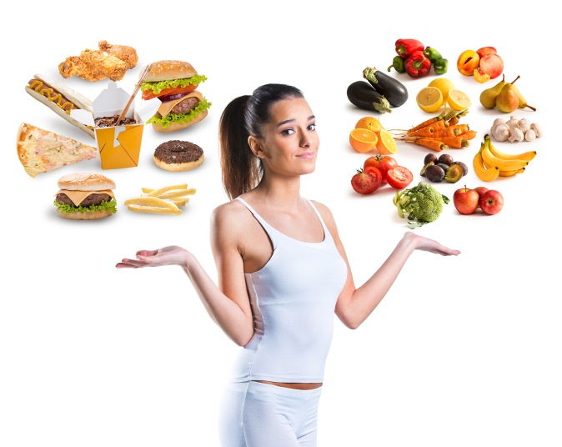
Identify your nutritional habits
Keep a diary of what you eat & drink.
Check that you have a balanced diet (refer to a food pyramid).
Try to eat healthily & avoid food that is bad for you.

Slide 35
A food pyramid
Figure 7.21: Average daily food requirements in a typical food pyramid

Slide 36
Learning activity 7.5
Module 7
Test your knowledge of your eating habits by completing Learning activity 7.5 in your Student’s Book.

Slide 37
An action plan for your nutrition
Record your mass.
Calculate your BMI ($\frac{weight in kg}{height in m²}$).
Find out how many kJ you need daily.
Obtain your needed kJ from a balanced diet.
Complete an action plan template.

Slide 38
An action plan for your nutrition
Refer to Tables 7.9 & 7.10 in your Student’s Book to see BMI value ranges & average kJ needs.

Slide 39
Learning activity 7.6
Module 7
Test your knowledge of this unit – and develop an action plan to maintain or improve your nutrition – by completing Learning activity 7.6 in your Student’s Book.

Slide 40
Module 7
Test your knowledge of this module by completing the Summative assessment of Module 7 in your Student’s Book.

