Slide 1
Life Orientation: Life Skills
NQF 2

Slide 2
Develop a study plan
Module 6

Slide 3
Think about it…
Does belonging to a study group help?
How can I draw up a timetable for study times?
Does it help to study very hard the night before an exam?

Slide 4
Study groups, timetables & plans
Unit 6.1

Slide 5
What is a study group?
Three or more students meeting regularly to study.
Beneficial for students, especially those who are:
Interpersonal.
Linguistic.
Figure 6.1: Some students learn better when discussing content with others

Slide 6
Table 6.1: Advantages and disadvantages of joining a study group
Study groups: pros & cons
Advantages | Disadvantages
You have academic support to talk about content until you understand & remember it. | The group may have the wrong approaches, explanations or answers, & lead you astray.
Discussing the work boosts your speaking, reasoning, debating & negotiating skills. | The group may talk too much, or chat about other things, & not get down to studying.
You can learn from one another’s strengths & acquire new or better study methods and habits. | The members’ weaknesses, poor habits or different learning styles may be distracting.
Being together in the same situation at the college offers emotional support & you can make new friends. | Group members who rely too much on the support of the group might not study independently.

Slide 7
Table 6.1: Advantages and disadvantages of joining a study group
Study groups: pros & cons
Advantages | Disadvantages
The group holds you accountable & you cannot postpone studying or not turn up. | Some members may be unreliable & not become a part of the team.
You can organise & complete group projects easily because you get to know each other better. | You may not learn best in a group setting & may need time to think things over quietly by yourself.
A study group expands your perspectives & you learn more about other cultures & individual differences. | You may become exposed to the bad habits or wrong views of some group members.
It saves time, as you can divide a long reading list or research work among you. | Some may do their share of the work wrong or do the minimum so that you have to redo it.

Slide 8
Table 6.1: Advantages and disadvantages of joining a study group
Study groups: pros & cons
Advantages | Disadvantages
A study group improves your teamwork & leadership skills, & builds self-confidence. | A group member with a strong personality may dominate the others, or criticise them too much.
If you form a new study group each term, you get to meet more people in class. | Being in the same study group for the whole year may cause you to not develop further.

Slide 9
Study timetables or study plans
Time management tool (plan) for managing your study time.
Usually in table form with days/dates, times of day, & what you’ll study when.

Slide 10
Guidelines for study timetables
Draw tables in a logical way.
Allocate time to subjects.
Include time for breaks, sleeping, eating & other activities.
Include activities from your calendar & to-do lists.

Slide 11
Guidelines for study timetables
Study: 45 min, rest: 15 min.
Divide subject content into available weeks.
Can use “rest” time to make copies, do research & complete homework.
Draw up short-term timetables for specific projects, tests or exams.

Slide 12
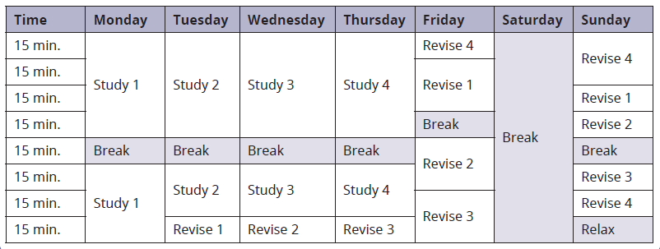
Guidelines for study timetables
Table 6.3: Example of a study plan for the week before a test

Slide 13
`
Click above to play this video.

Slide 14
Learning activity 6.1
Module 6
Test your knowledge of this unit – and draw up your own study timetable –
by completing Learning activity 6.1 in your Student’s Book.

Slide 15
Academic progress & performance
Unit 6.2

Slide 16
What is academic progress?
Moving forward in your formal studies.
Can be measured:
Per subject.
In all subjects.
In your qualification.

Slide 17
Tracking academic progress
Record your results.
Compare with previous results.
Use a table, spreadsheet or graph
(e.g. column or bar graph).

Slide 18
Creating a graph of your progress
Refer to Example 6.4 in your Student’s Book to see how to use Excel to create graphs to track your academic progress.

Slide 19
Action plan for academic performance
Set a clear, SMART goal.
Choose a method to reach the goal.
Break down the goal into subgoals.

Slide 20
Action plan for academic performance
Outline action steps for subgoals.
Set a deadline for each step.
Plan for obstacles.
Identify the resources needed.

Slide 21
Action plan for academic performance
Refer to Table 6.4: Template for an action plan in your Student’s Book for more information on how to plan for academic performance.

Slide 22
Learning activity 6.2
Module 6
Test your knowledge of this unit – and record your academic progress –
by completing Learning activity 6.2 in your Student’s Book.

Slide 23
Module 6
Test your knowledge of this module by completing the Summative assessment of Module 6 in your Student’s Book.

