Slide 1
Life Orientation: Life Skills
NQF 2

Slide 2
Explain how the brain works in terms of learning
Module 5

Slide 3

Think about it…
Is studying late into the night & getting too little sleep counterproductive?
Can we sabotage our brain health by eating unhealthily?
Are there different kinds of intelligence?

Slide 4
Your brain, learning
& sleep
Unit 5.1

Slide 5
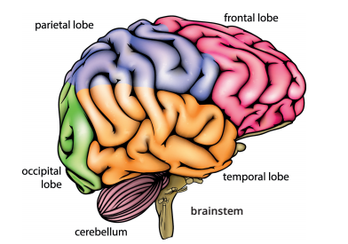
What is the brain?
A large organ that controls the nervous system.
Each part is responsible for different functions.
Figure 5.1: Parts of the brain

Slide 6
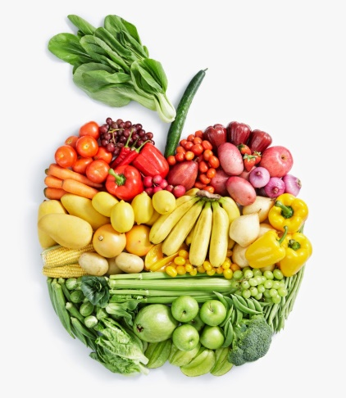
How does the brain work?
Nerve cells (neurons) pass messages to each other (through synapses).
Neurotransmitters (chemicals) send message signals from one neuron to the next.
Healthy food enables the brain to make neurotransmitters.

Slide 7
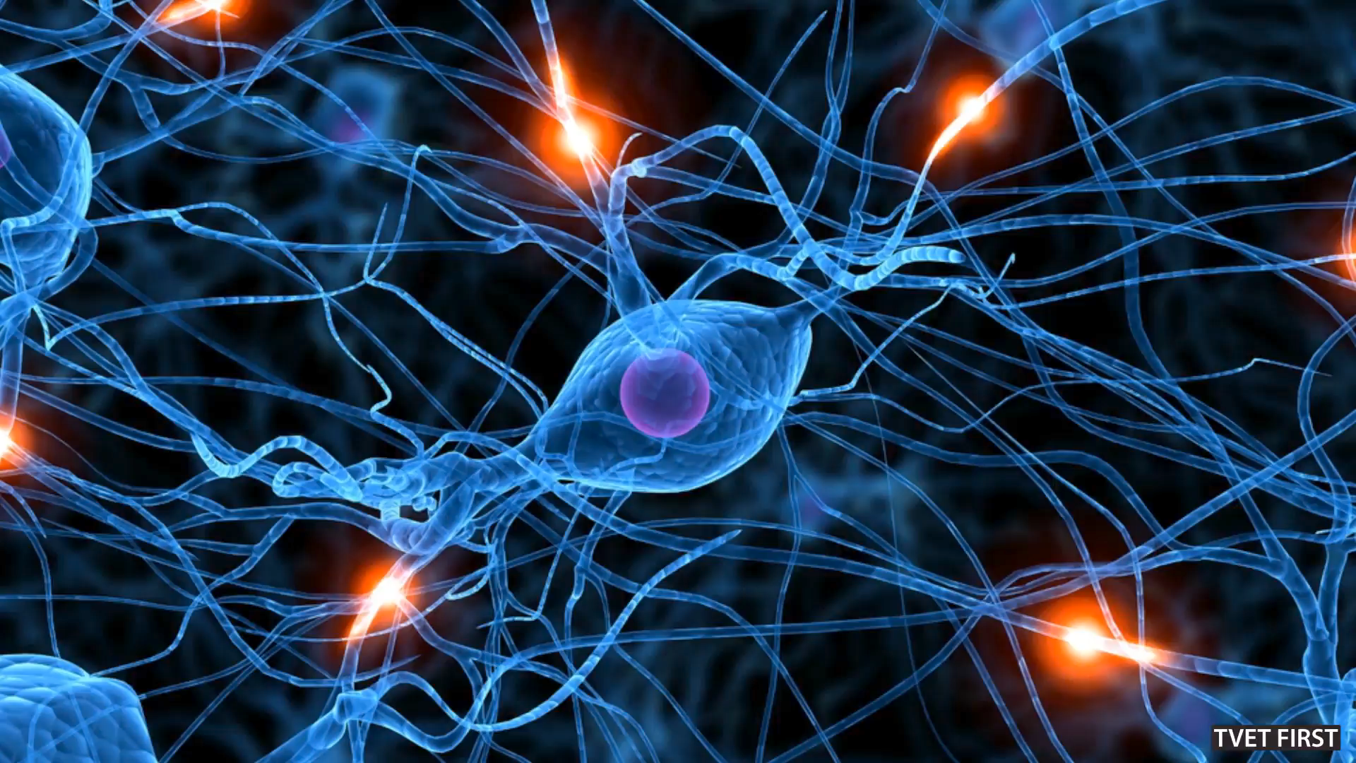
Click above to play this video.

Slide 8
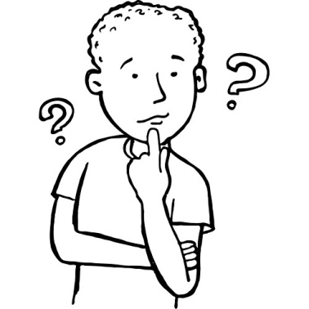
Thinking & learning
If you say, do or think something repeatedly,
neuron pathways strengthen & you remember things better.
When you do not recall specific information regularly, it is lost.

Slide 9

Your thoughts influence your mood
Certain thoughts trigger the release of neurochemicals that influence your mood:
Positive thoughts release good chemicals.
Negative thoughts release chemicals that increase your heart rate & blood pressure, & make you focus on negative things.

Slide 10
Learning activity 5.1
Module 5
Test your knowledge of this section by completing Learning activity 5.1 in your Student’s Book.

Slide 11
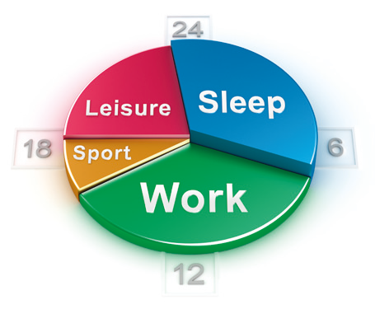
What your brain needs:
Fresh water.
Good nutrition.
Mental exercise.
An easy-going attitude.
Fresh air.
Good blood circulation (exercise).
Positive thoughts.
Sufficient sleep.
Figure 5.6: Our wellbeing & performance
are supported by a commonsense balance
in the different areas of our lives

Slide 12
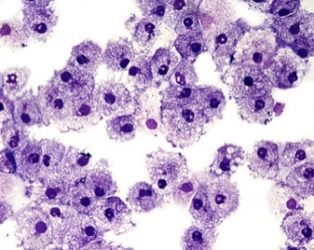
The importance of sleep
Table 5.1: Some benefits of a good night’s sleep
Benefits | Description
Rest and repair | When you sleep, the processes in your body slow down and are given rest. Your muscles relax and you breathe more deeply. Your body and cells repair themselves and important hormones are secreted. After sleeping, you will be healthier and able to perform better.

Slide 13

The importance of sleep
Table 5.1: Some benefits of a good night’s sleep
Benefits | Description
Better brain function | Good sleep increases brain function. Without sufficient sleep, your cognitive performance and alertness decrease. You may become clumsier, and battle to focus on your work or a lecture. You may also find it hard to make decisions, and forget things.

Slide 14
The importance of sleep
Table 5.1: Some benefits of a good night’s sleep
Benefits | Description
Better recall | While you sleep your mind organises information you received via your senses throughout the day. What you have learnt and your memories are combined. If you have slept well, you will recall better what you learnt the previous day.
Reduced stress hormones | The levels of the stress hormone, cortisol, are reduced during the night. High levels of cortisol can upset brain function and cause anxiety, irritability and sleeplessness. These make you feel worse and affect your emotions and performance.

Slide 15
The importance of sleep
Table 5.1: Some benefits of a good night’s sleep
Benefits | Description
Stronger immune system | Your immune system builds up as you sleep. This makes you stronger against colds, flu and other diseases that could prevent you from learning and working well.
Refreshed when awakening | You awake refreshed after a good night’s sleep, but without enough sleep you will be sleepy during the day. Sleep deprivation will affect your enthusiasm for your work and your ability to concentrate and learn. It may even lead to costly mistakes or accidents.

Slide 16

The importance of sleep
Table 5.1: Some benefits of a good night’s sleep
Benefits | Description
Better appetite control | Leptin is one of the important hormones that are released while you sleep. It regulates your appetite by telling your body when you have eaten enough. If you don’t sleep well, your level of leptin will be too low and you will have an appetite that is difficult to control. If you then snack on unhealthy brain foods (see Unit 5.2), your performance will be hampered.

Slide 17
Learning activity 5.2
Module 5
Test your knowledge of this section by completing Learning activity 5.2 in your Student’s Book.

Slide 18
Nutrition of the brain
Unit 5.2

Slide 19

How does food affect your brain?
Good food keeps the brain functioning at its best.
  Remember, the brain uses nutrients to produce neurotransmitters.
Bad food can dull, damage or shut down the brain.

Slide 20
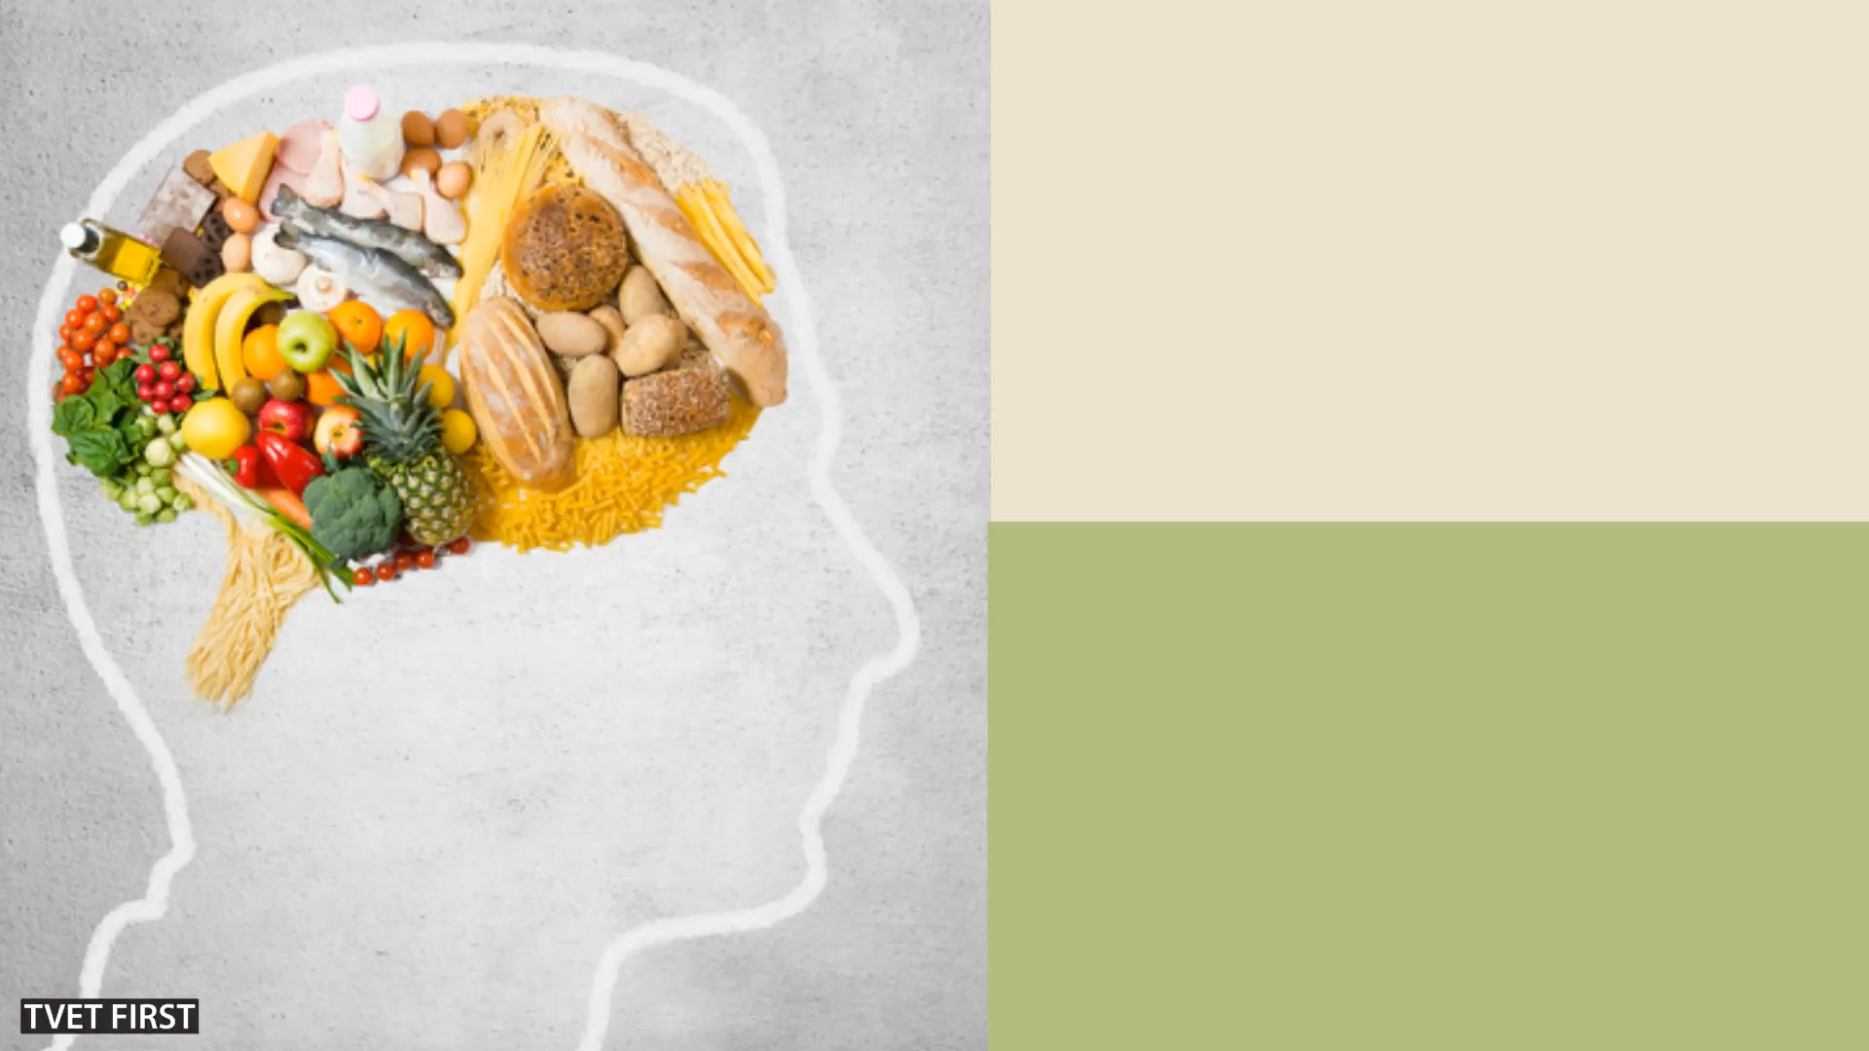
Click above to play this video.

Slide 21
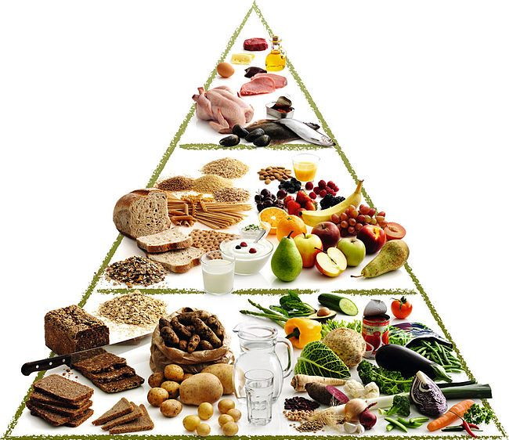
What are good foods?
Carbohydrates
(e.g. good high GI foods like wholewheat bread, beetroot, carrots & fruit)
Good fats
(e.g. oily fish & eggs)
Protein
(e.g. chicken, beans, fish, meat & dairy).

Slide 22
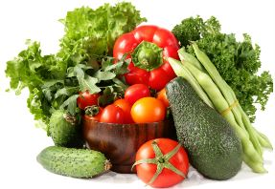
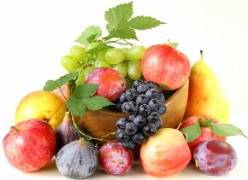
What are good foods?
Vitamins
(e.g. fruit & vegetables, wholegrains, beans, chicken, fish & meat)
Minerals
(e.g. fruit, vegetables & nuts)
Good liquids
(e.g. water, fruit juice & milk)

Slide 23
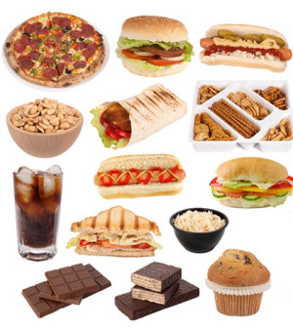
What are bad foods?
Bad high GI foods (including those made with white flour & sugary carbohydrates).
Fatty or fried foods.
Caffeine.
Alcohol.
Avoid bad foods when studying!
Figure 5.10: Junk food often contains flavour enhancers, such as MSG, which are addictive

Slide 24
Nutrients: functions & sources
Refer to Tables 5.2 & 5.3 in your Student’s Book to see the functions of important brain nutrients & more examples of foods that contain them.

Slide 25
Learning activity 5.3
Module 5
Test your knowledge of this section by completing Learning activity 5.3 in your Student’s Book.

Slide 26
Multiple intelligences
Unit 5.3

Slide 27
Gardner’s multiple intelligences
Eight different intelligences (ways of thinking & learning):
    Visual-spatial (pictures)
    Bodily-kinaesthetic (body)
    Musical (music)
    Interpersonal (others)
    Intrapersonal (self)
    Linguistic (words)
    Logical-mathematical (numbers)
    Naturalist (nature)

Slide 28
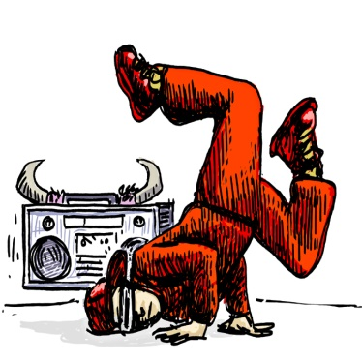
Preferred learning styles
If you are visual-spatial, you prefer to:
  Observe & see things.
  Do hands-on work.
  Visualise, use graphics & draw.
If you are bodily-kinaesthetic, you prefer to:
  Touch things.
  Experience things physically.
  Move.

Slide 29
Preferred learning styles
If you are musical, you prefer to:
  Hear things.
  Experience rhythm.
  Listen to music.
If you are interpersonal, you prefer to:
  Talk.
  Work in groups.
  Interact with others.
If you are intrapersonal, you prefer to:
  Reflect.
  Discover things yourself.
  Work at your own pace.

Slide 30

Preferred learning styles
If you are linguistic, you prefer to:
  Use words.
  Read & write.
  Discuss & debate.
If you are logical-mathematical, you prefer to:
  Use numbers & data.
  Organise.
  Use reasoning & logic.
  Solve problems.
If you are a naturalist, you prefer to:
  Be outdoors.
  Touch & observe things.

Slide 31
Activities for the 8 intelligences
Table 5.5: Activities preferred by the various intelligences
Intelligences | Games and hobbies
1. Visual-spatial | Jigsaw puzzles, 3D-model building, photographs, drawings, doodling, mind maps
2. Bodily-kinaesthetic | Dancing, craft making, mime, physical games, athletics, sewing, woodworking, role-play
3. Musical | Multimedia, musical instruments, singing, music, whistling, listening to music
4. Interpersonal | Text chats, team sports, group activities, socialising with friends

Slide 32
Activities for the 8 intelligences
Table 5.5: Activities preferred by the various intelligences
Intelligences | Games and hobbies
5. Intrapersonal | Books, diaries, creative materials, thinking activities
6. Linguistic | Crossword puzzles, poetry, reading, humour, word games, storytelling, writing
7. Logical-mathematical | Puzzles, logic games, number games, quizzes, strategy games
8. Naturalist | Gardening, pets, hikes, parks, tours, telescopes, binoculars, microscopes

Slide 33
Learning activity 5.4
Module 5
Test your knowledge of this section by completing Learning activity 5.4 in your Student’s Book.

Slide 34
Module 5
Test your knowledge of this module by completing the Summative assessment of Module 5 in your Student’s Book.

